Slide 1
Career Resources for CISE Grad Students
Welcome to the University of Florida!!

Slide 2
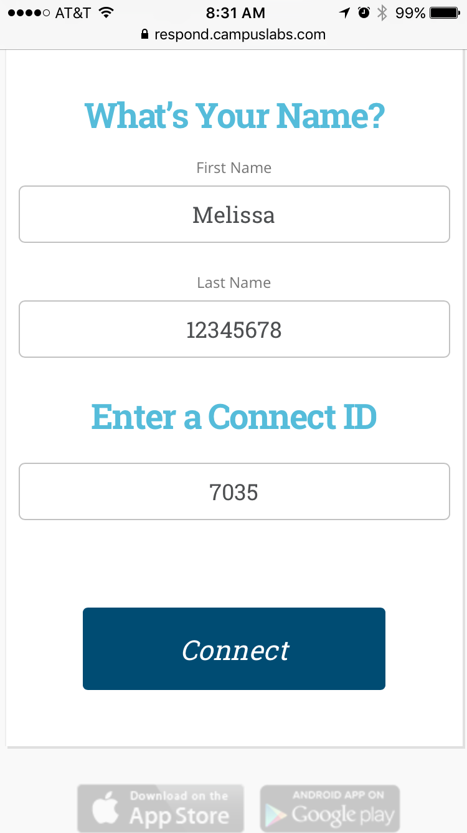
Let’s Hear From You!
On your smart phone/tablet:
Go to srs.campuslabs.com on your browser
Enter your FIRST NAME and for last name enter your UFID
Enter 7035 for your Connect ID, then click Connect
Select your response to the question: “What topic do you want to learn the most about today?”

Slide 3
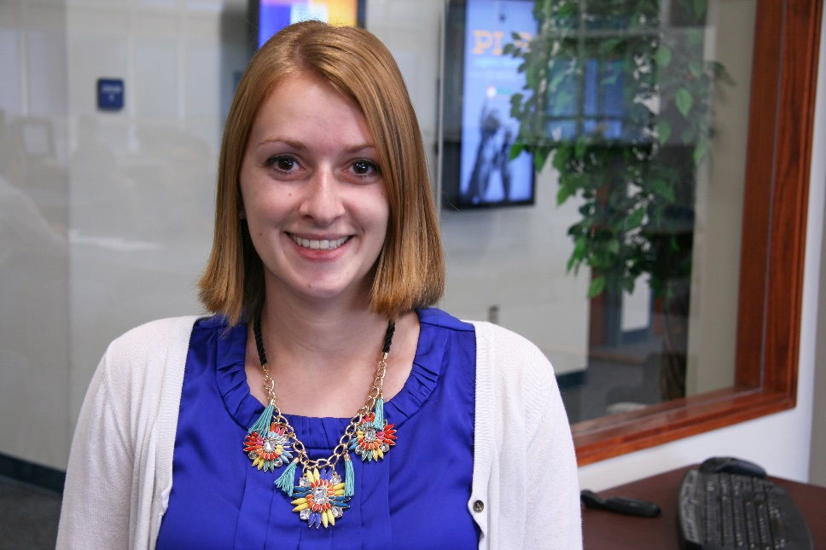
Melissa Lyon
Assistant Director for Career and Professional Development
Master of Education focus in College Student Personnel Administration
Bachelor of Arts in Political Science
Hometown: Sicklerville, NJ
Strengths: Intellection, Input, Learner, Deliberative, Analytical
@MelissaLyon28
Notes:
Will be updated depending on who is presenting
Name
Title
Education
Hometown
Six word story
Strengths
Twitter handle (optional)

Slide 4
The ability to enter one's chosen career with a clear understanding of self and the ability to demonstrate a combination of industry knowledge and core competencies in the workplace
Career Readiness

Slide 5
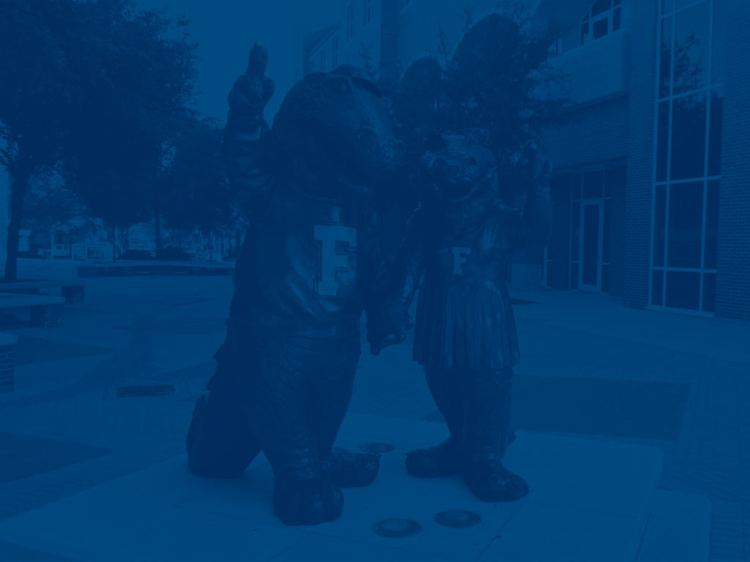
Gaining Experience:
Graduate Assistantships
Academic Research
Internships and Co-ops
Published Research
Volunteering
Part-Time Work
Fellowships
Professional Organizations
Graduate Organizations
Job Shadowing
Study/Work Abroad
Presentations
Notes:
Before you get started on your resume, think about all the experiences you’ve had. Experience can look different for everyone, and can fall into different categories. Before we get started, I want you to know that there is no “right” or “wrong” way to write your resume. There are suggestions and guidelines to follow, but there is flexibility in how you organize your content. You might have all of these, or just a few. Either way, its OK!

Slide 6
Skills Gained @ UF
Communication Skills
Critical Thinking
Teamwork
Sense of Self
Social Responsibility
Notes:
Critical Thinking
Definition
The ability to process and interpret information objectively in order to make decisions
The ability to reflect upon the outcomes of decisions made in order to inform future actions
Communication Skills
Definition
The ability to effectively exchange thoughts and ideas with others through listening, speaking, writing, and non-verbal interactions
Sense of Self
Definition
The ability to understand one’s personal identity, values, and ethics, and how they impact the way you interact with others
The ability to use reflection in order to maintain an awareness of self
The ability to behave in a respectful and professional manner
Ethics, Self- Management , Identity and values awareness , Motivation and Initiative, Emotional Intelligence
Teamwork
Definition
The ability to navigate interactions with a variety of individuals to contribute to a common goal
Conflict Management, Appreciation and engagement with Diversity, Understanding of Group Dynamics, Collaboration
Social Responsibility
Definition
The willingness and ability to be an active participant in the management and betterment of communities to which you belong

Slide 7
Career Readiness
Connecting YOU and Employers
Gator CareerLink
Job Search Workshops
Professional Development Workshops
Notes:
The goal of this series of presentations is to bring awareness to the concept of career readiness.
(Read the definitions)
Career Readiness -the ability to enter one's chosen career with a clear understanding of self and the ability to demonstrate a combination of industry knowledge and core competencies in the workplace.
Professional Development - is the continuous process of acquiring new knowledge and skills that relate to one’s profession, job responsibilities, or work environment through a variety of facilitated learning opportunities.
Experiential Education- learning activities that engage the learner directly what they are studying
Keep this in mind throughout the presentation as we develop your brand. How will you demonstrate to employers you are career ready in your mission or brand?

Slide 8
Agenda:
How to get started with the CRC
How to get connected with employers
How to develop professionally and prepare for your job/internship search or next steps

Slide 9
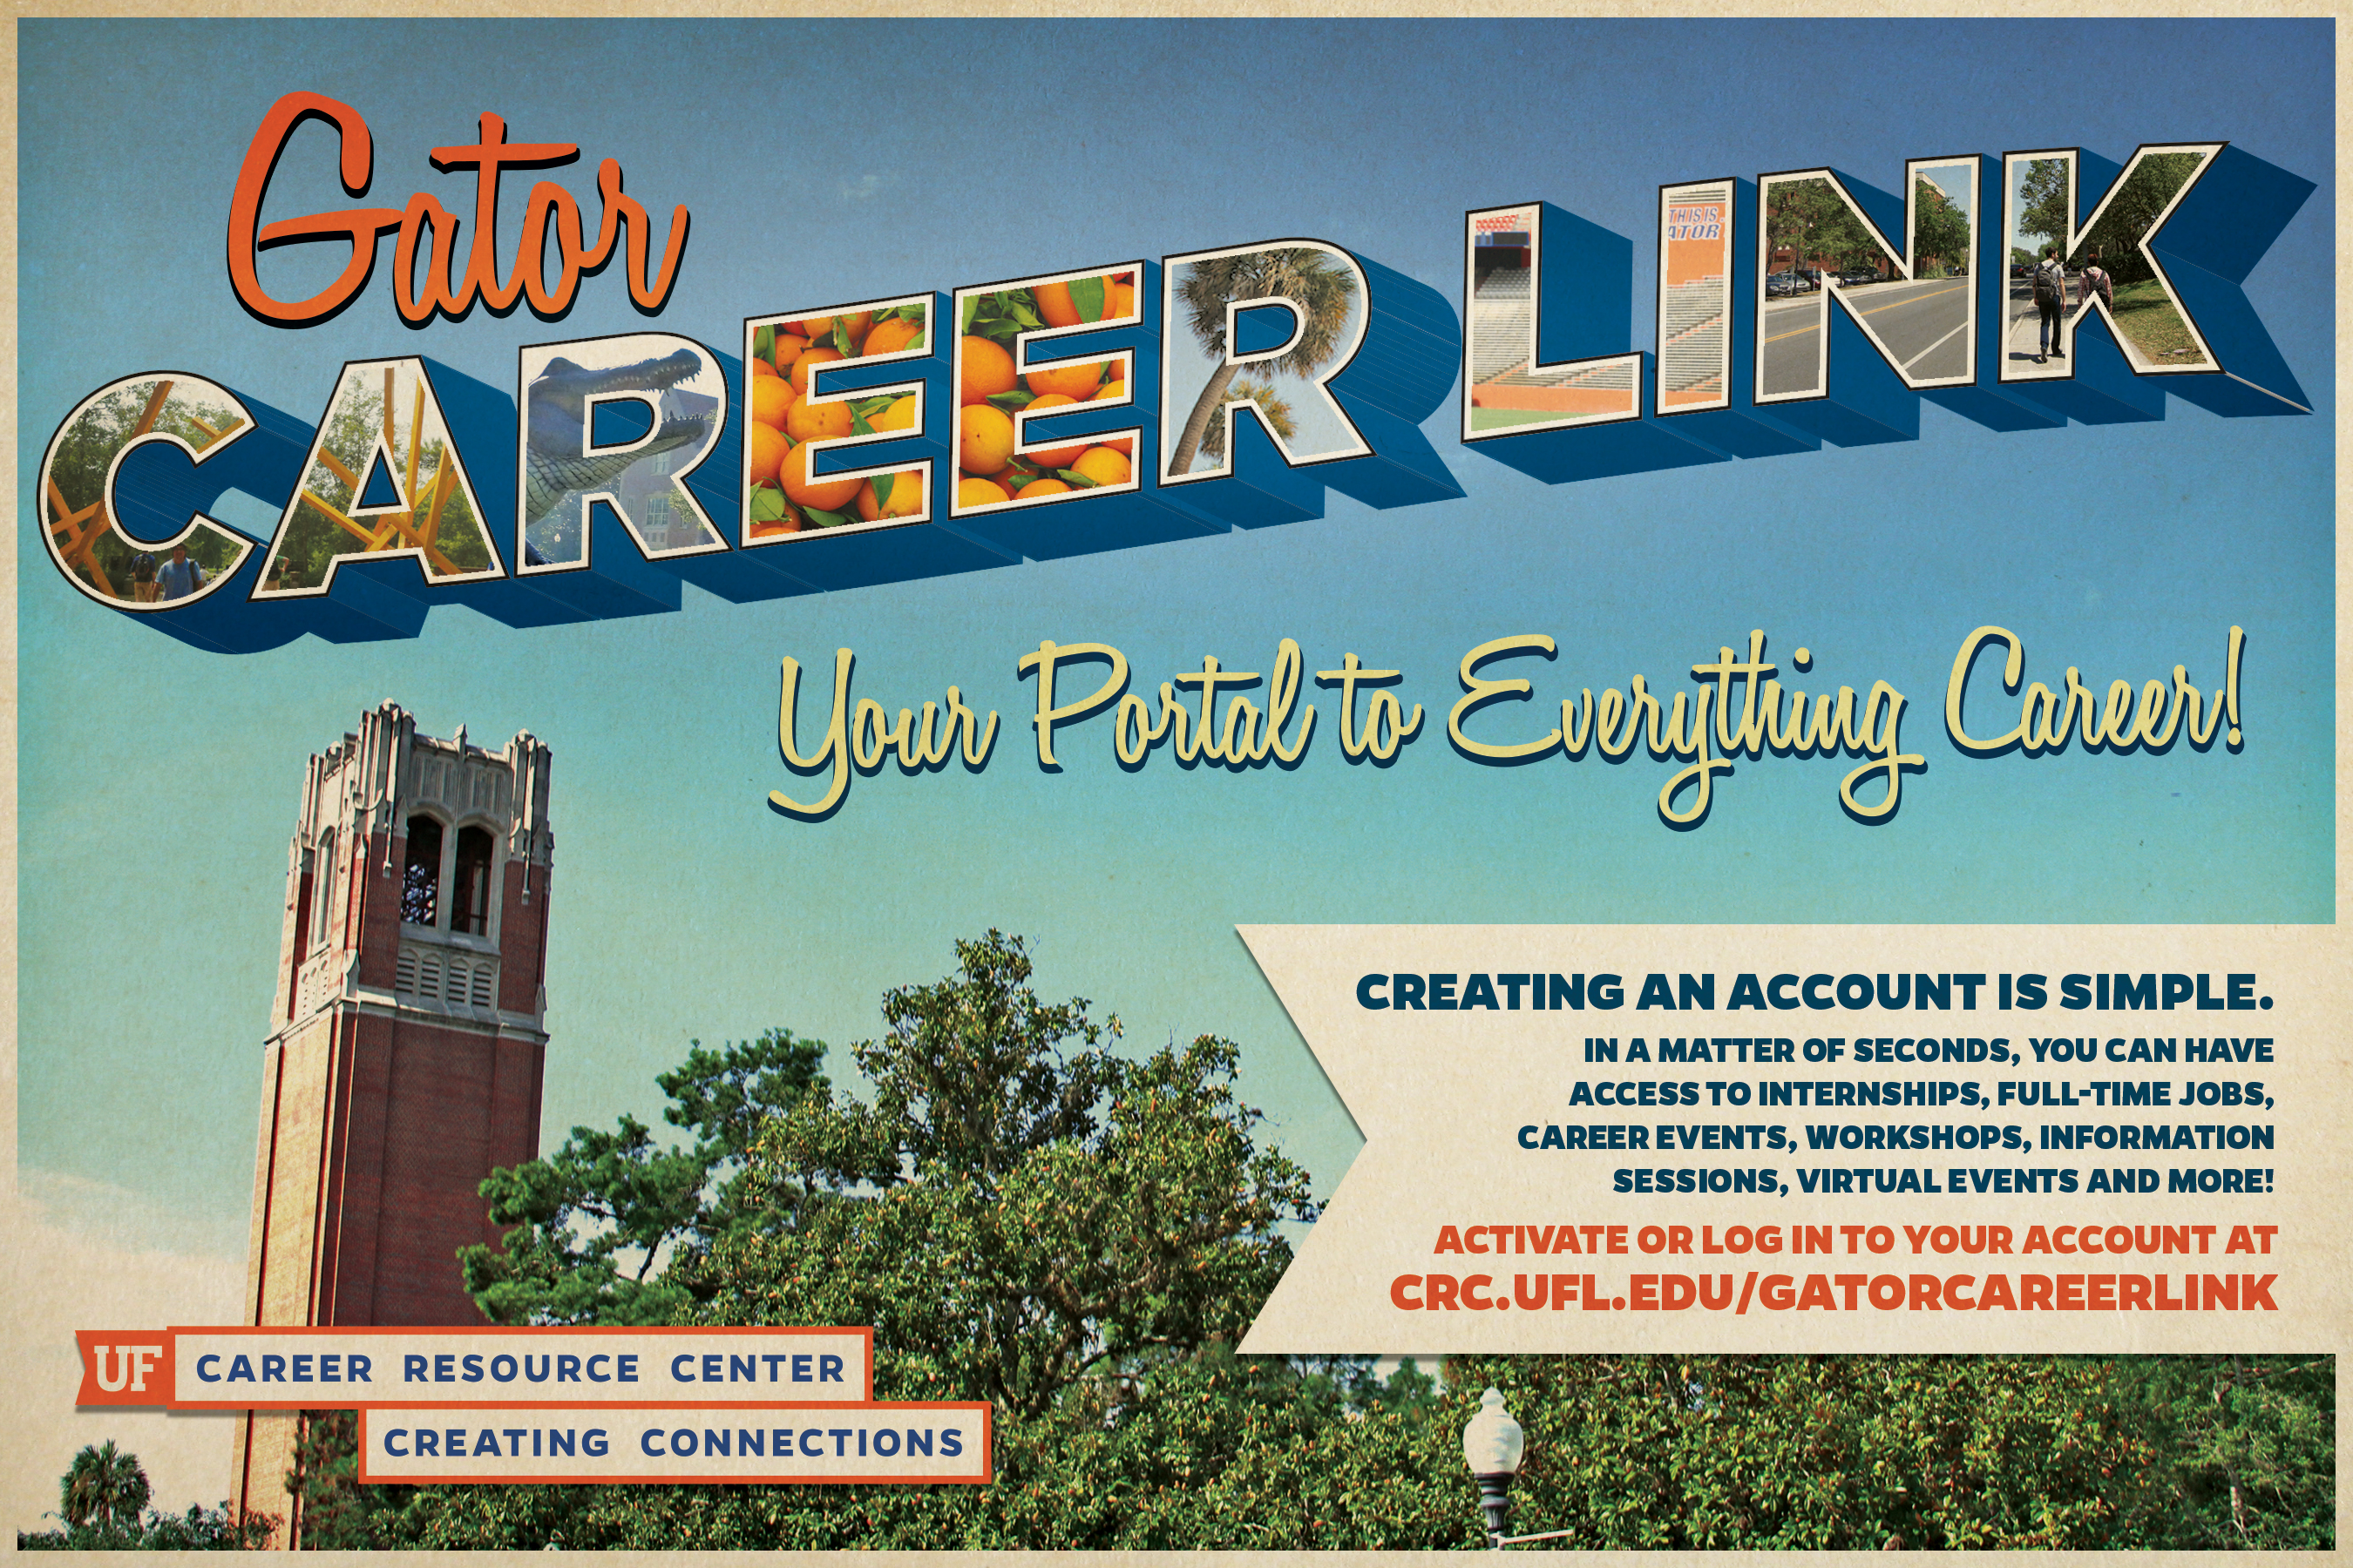
Notes:
The log in for GCL can be on the main CRC webpage crc.ufl.edu
GCL is your one stop shop for all things career. From the most updated listing events and workshops to job/internship postings or scheduling a career planning appointment. It has everything you need for whatever stage you are in the career planning process right at your fingertips.

Slide 10
Gator CareerLink
Schedule career planning appointment
See upcoming workshops and events
View employers coming to career fairs, networking events, and information sessions
Find available jobs and internships off campus
Watch workshops (livestreamed or recorded!)
Looking for a job on campus? Try jobs.ufl.edu!

Slide 11
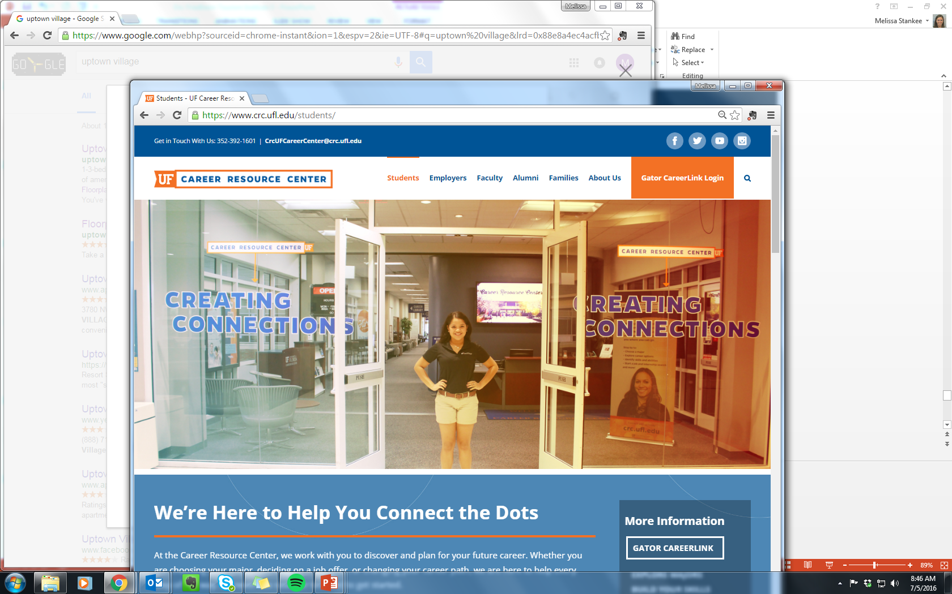
To Login to Gator CareerLink:
Log-in to schedule an appointment in-person, via phone or Skype!

Slide 12
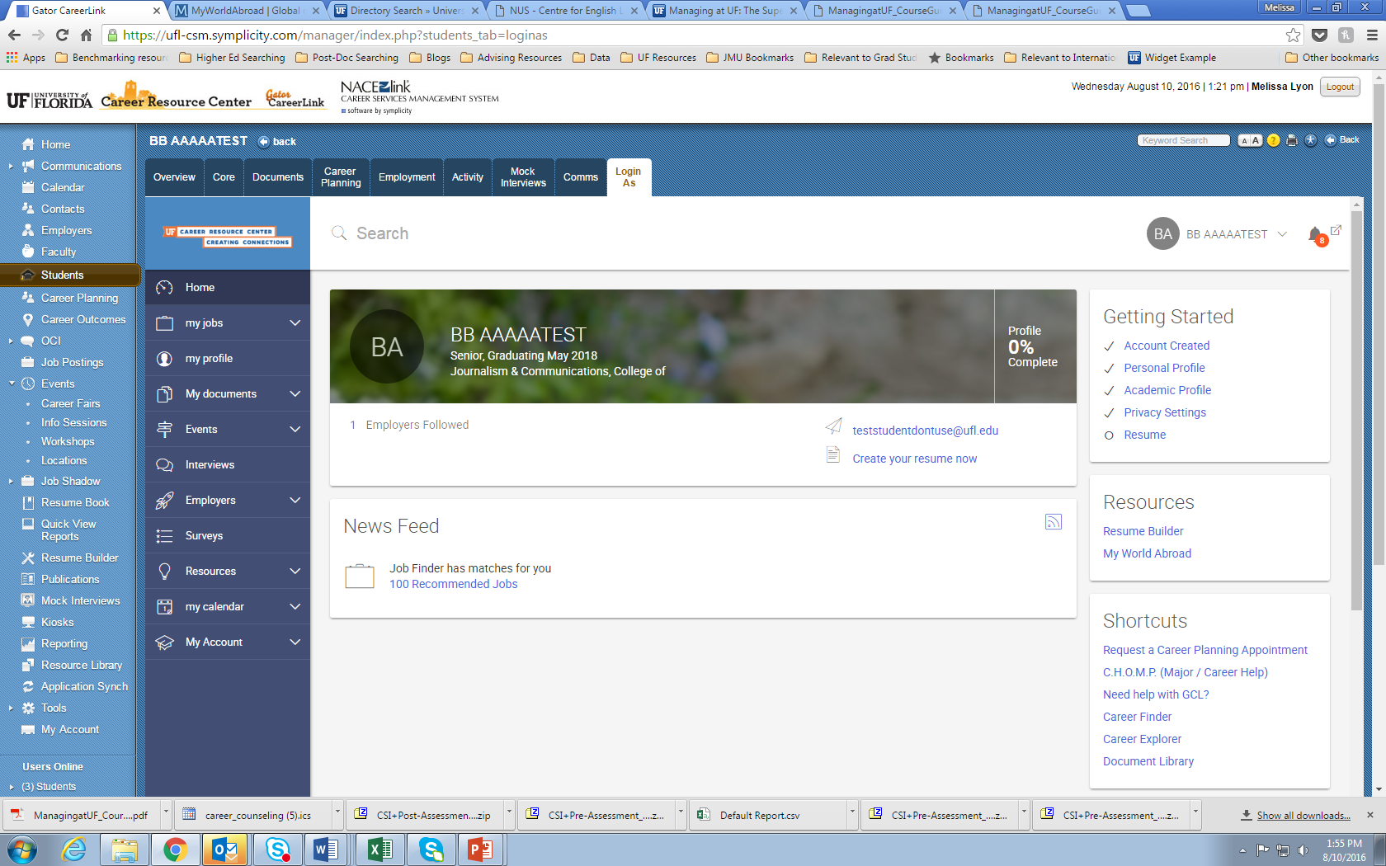
Getting Started

Slide 13
Career Development
Helping YOU to be the best candidate!

Slide 14
Career Planning
Individual and customized meeting to talk about:
Finding an internship/co-op, part-time job, etc.
Finding a Full time job
Developing Your Resume, CV, Cover Letter, Personal Statement, etc.
Preparing for Interviews
Preparing for Graduate School
Choosing or Changing Your Career Path

Slide 15
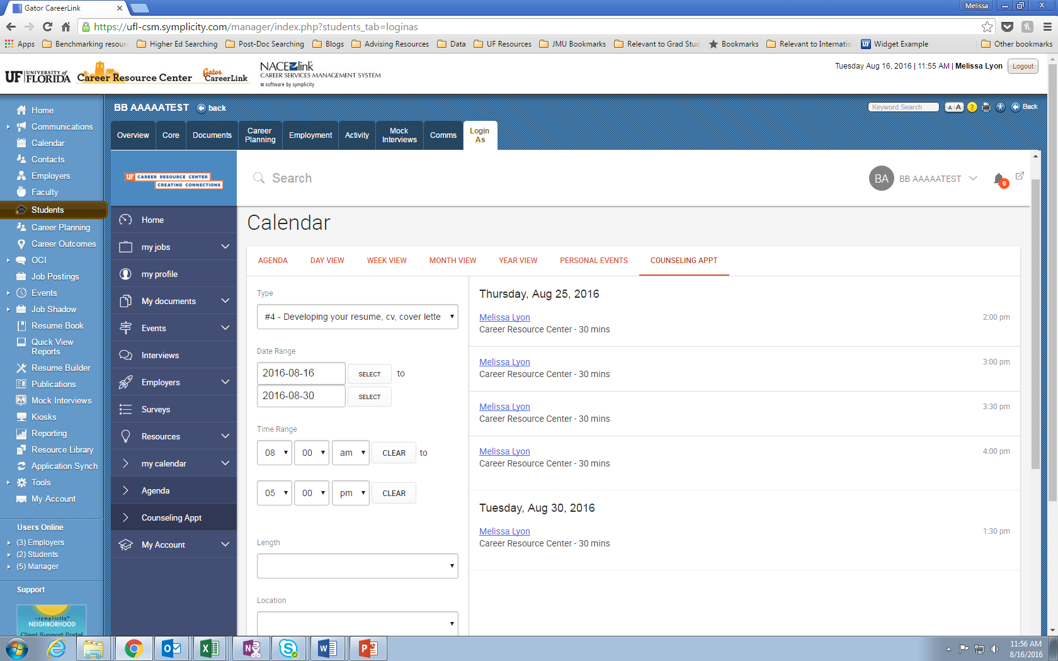
Getting Started

Slide 16

Express Drop-In
Resumes & Cover Letters
Bring a hard copy of your resume or cover letter to the CRC library for a critique.
Monday –Friday
9:00am-4:00pm
Sit down with a Career Ambassador who will review it on the spot!
No appointments needed!

Slide 17
Workshops
50 minute sessions focused on a given topic
Several different “series” of workshops for different types of students
No registration necessary to attend*
See calendar of events in Gator Career Link, social media, or CRC Website
*If you want to attend virtually, there is a quick registration to complete in Gator Career Link.*

Slide 18
CRC Graduate Student Series: Job Search Prep
Developing Your Resume, CV, or Cover Letter (Sept. 15th)
Interviewing Skills (Sept. 22nd)
Job Searching and Networking in Academia (Oct. 6th)
Job Searching Outside of Academia (Oct. 12th)
Networking and Using LinkedIn (Oct. 19th)
All workshops begin at 4:05pm and are held in the
Career Resource Center, Level 1 of the Reitz Union

Slide 19
CRC Graduate Student Series: Professional Development
Creating Your Career Action Plan (Nov. 2nd)
Negotiating in Academia (Nov. 9th)
Stretch Your Stipend and Build Financial Foundations (Oct. 5th)
Opportunities for International Engagement (Oct. 11th)
Careers in Industry Panel (Oct. 20th)
Careers in Academia Panel (Oct. 27th)
All workshops begin at 4:05pm and are held in the
Career Resource Center, Level 1 of the Reitz Union

Slide 20
CRC International Student Series
International Students and the Job Search (Sept. 13th)
Communicating With Employers at Career Showcase
(Sept. 21st)
OPT/CPT/OPT-Stem Information Sessions
(Sept. 16th and 20th at 10:40 and 3:00pm)
Transitioning to an Employment Based Visa: Featuring Immigration Attorney Aaron Blumberg
(November 3rd)

Slide 21
Gator Professional Series
Core
Navigating Roadblocks
Using Your Professional Compass
Navigating Your Search
Dropping Your Pin
People & Points of Interest
Discovering Professional You
Entering Your Coordinates
Mapping Professional You
Take the Highlighted Route
Navigating Offer to Office
Notes:
This workshop is a part of the GPS other presentations are ….
(Read full title)
Mapping Professional You: Creating an effective Resume, Cover Letters and Interview
Using Your Professional Compass: Using emotional intelligence to be an effective team member
Navigating Roadblocks: Using effective communication skills and critical thinking
Dropping your pin: Translating your UF experience and impact
A complete listing of dates and times can be found on Gator CareerLink. Competition of the series will result in a certificate.

Slide 22
Life After The Swamp
How To Survive Your First 30 Days
The Art Of Negotiation
Show Me The Money!
Figuring Out What’s Next
Oh The Places You’ll Go!
Notes:
The excitement of life after college comes with many unknowns, these unknowns can cause for a stressful last semester. The Life After the Swamp series can assist in alleviating some of this fear and stress. Students who participate in the Life After the Swamp five- week series will attend a variety of presentations that will focus on topics addressing what to expect after graduation. These presentations will be delivered by a variety of campus partners and employers

Slide 23
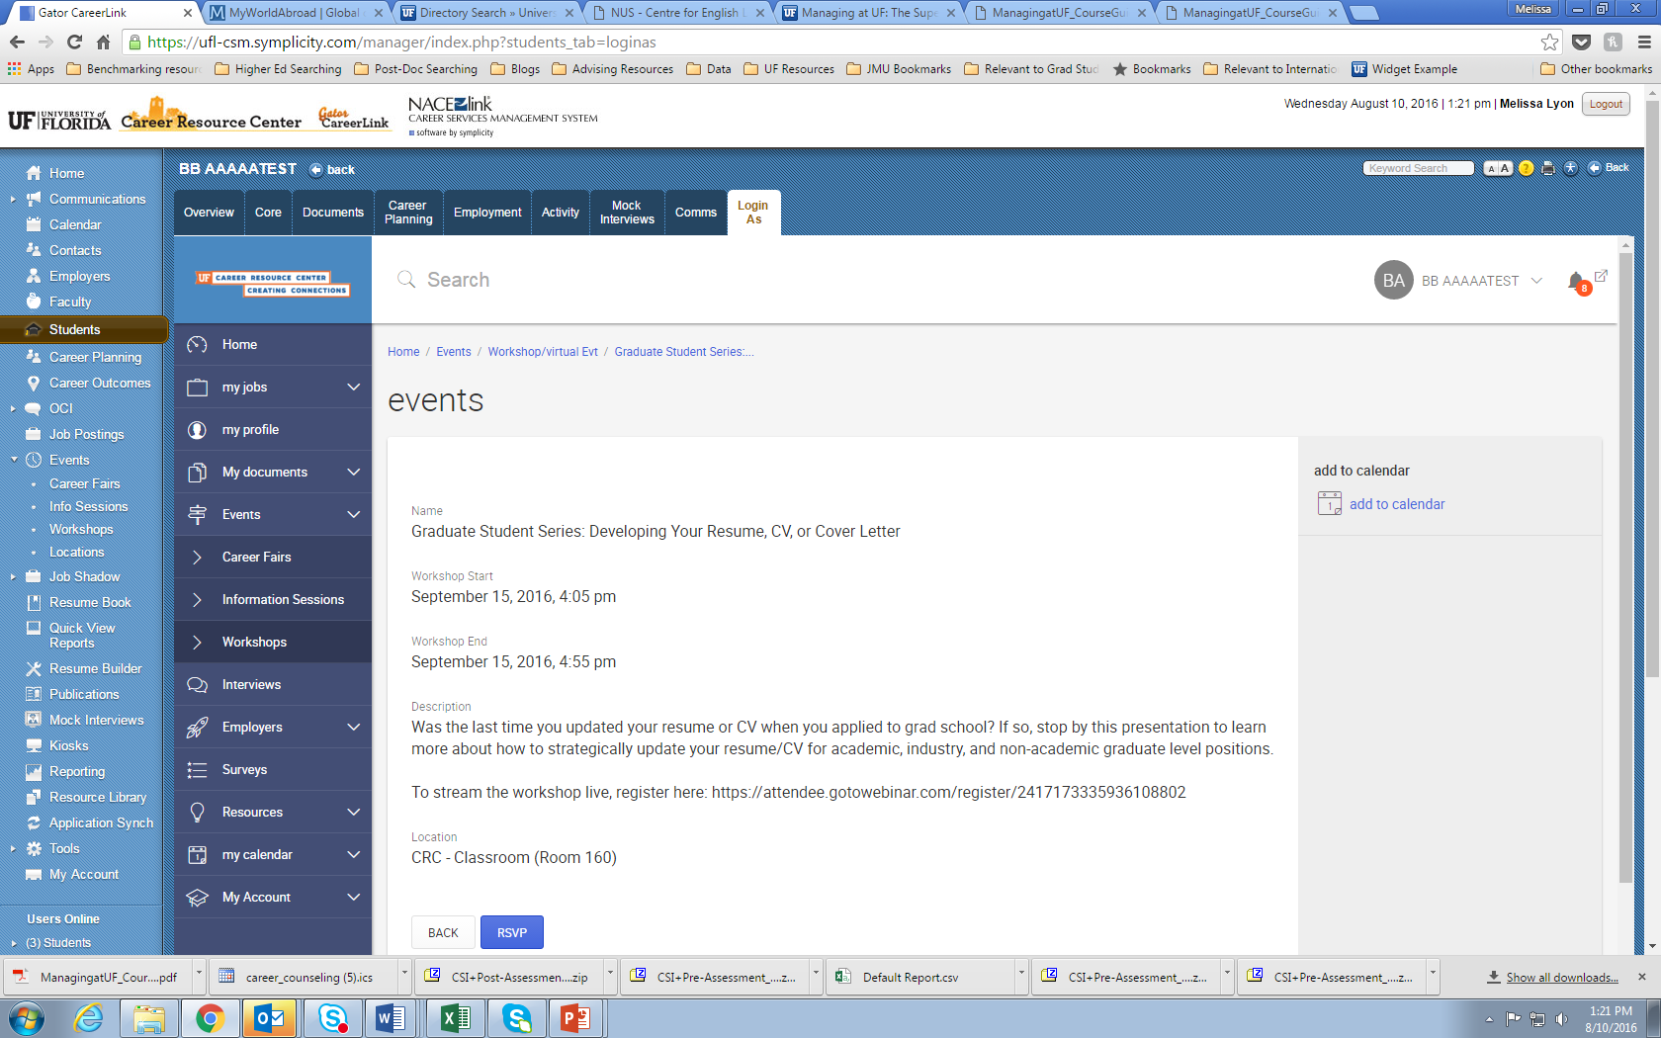
Livestreaming Workshops

Slide 24
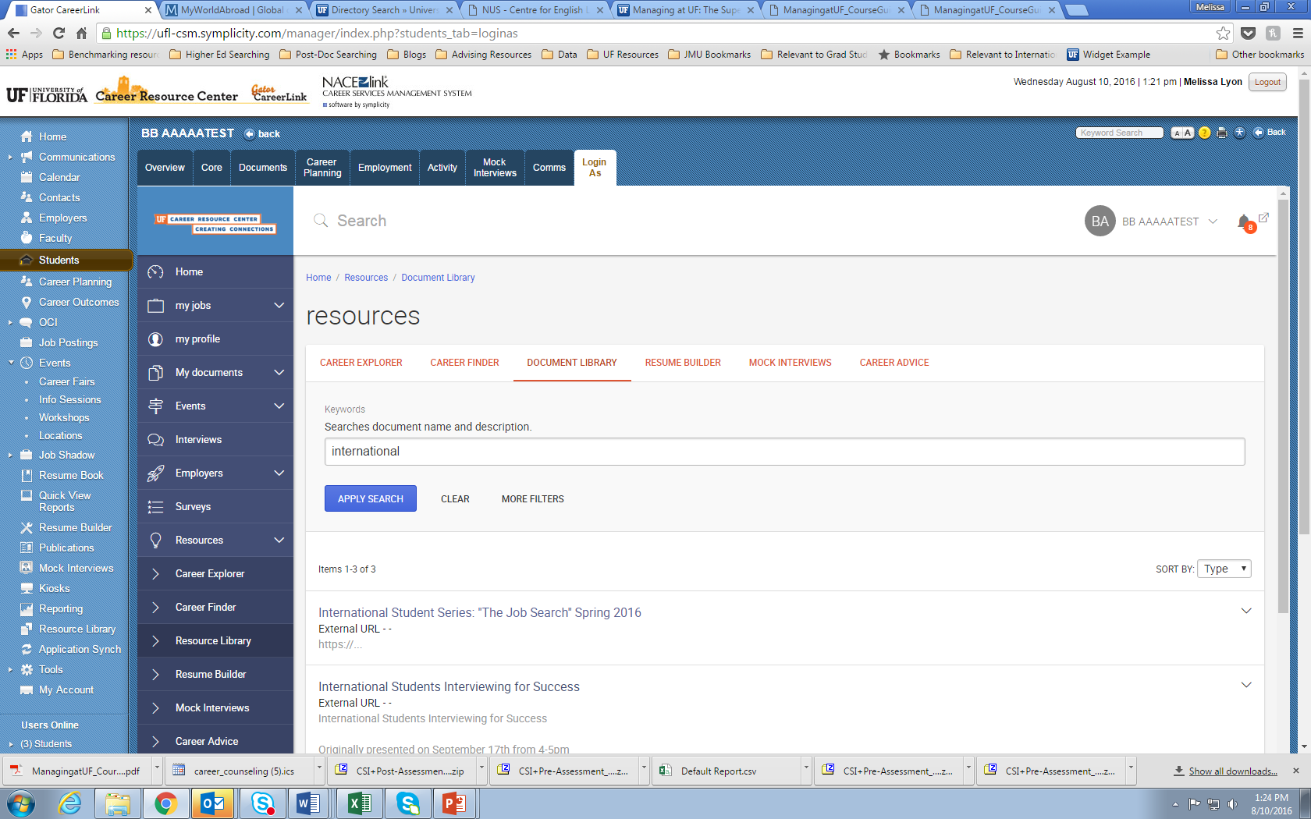
Recorded Workshops

Slide 25
Employer Networking
Connecting you and employment opportunities

Slide 26
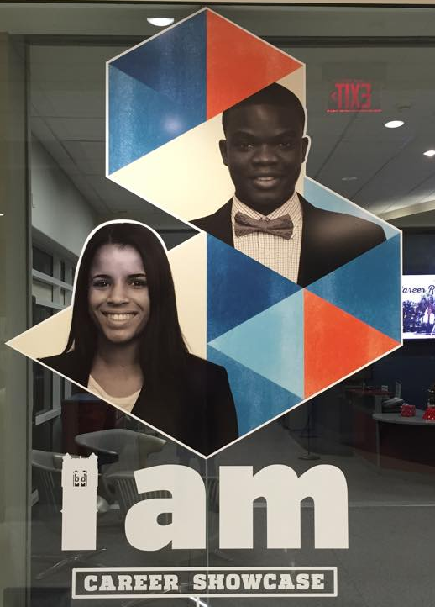
Career Showcase
September 27th (Non-Technical)
September 29th (Technical)
Location: Southwest Recreation Center
Time: 9am-3pm
View a list of employers attending in Gator CareerLink!

Slide 27
Diversity Meet-up:
Pre-Showcase Connections
September 26th from 5-8pm
Learn how to network from employers
Meet employers in a less formal setting
Get a head start for Career Showcase!

Slide 28


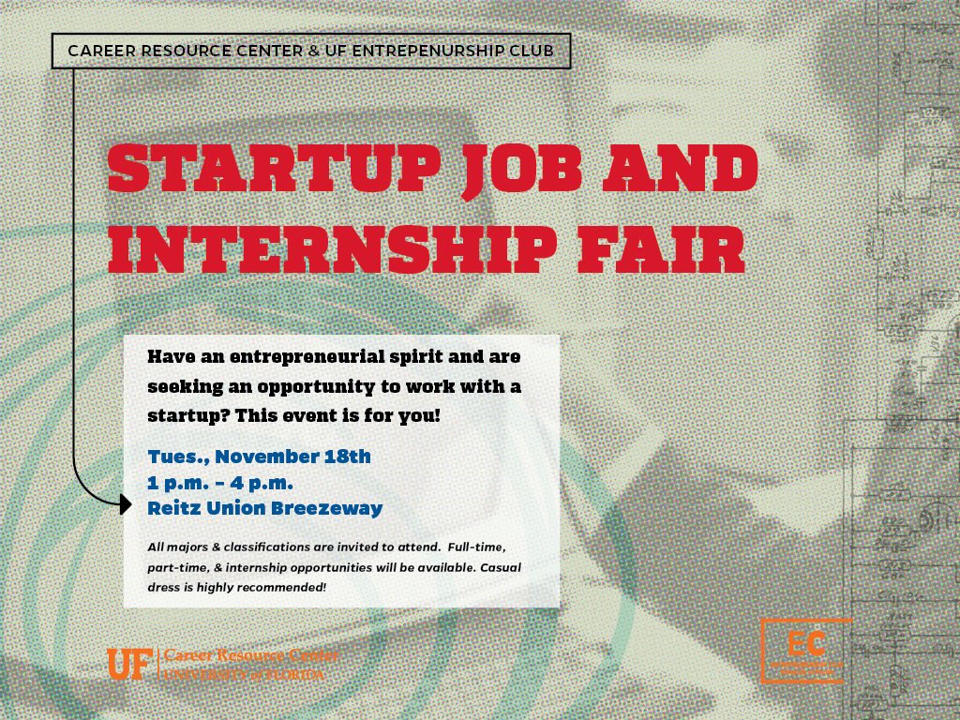
Industry Focused Fairs
Notes:
The date for the 2015 Startup Job and Internship Fair is Wednesday, Oct. 21 from 1-4 p.m. in the Reitz Union Breezeway.

Slide 29
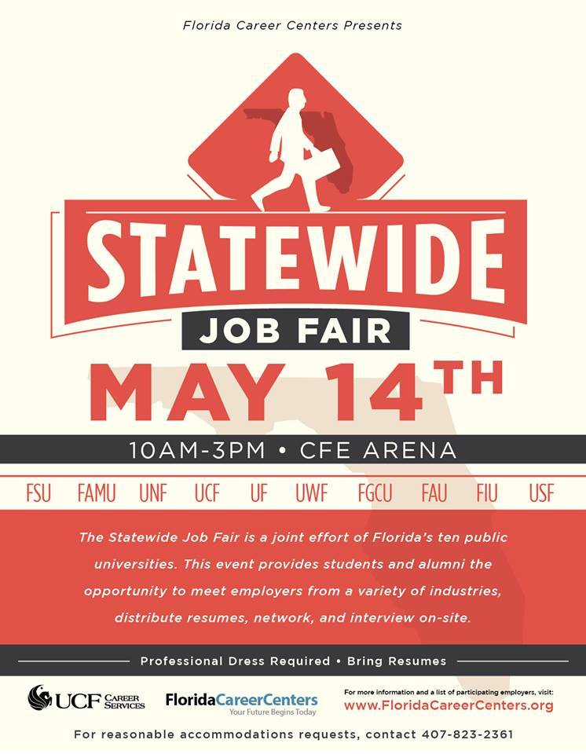

Other Fairs

Slide 30
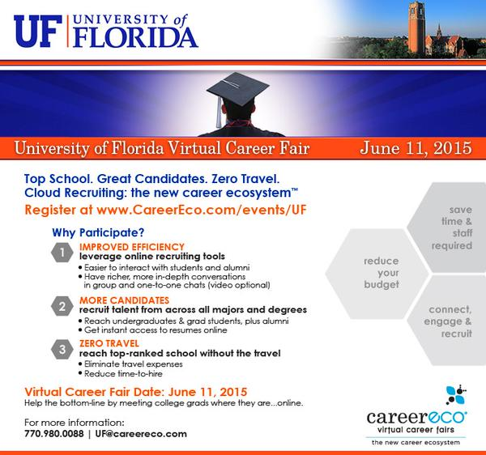
Virtual Fairs

Slide 31
Other Employer Connections
Employer Information Sessions
Employers visit campus during the semester
Learn about the employer, company culture, and network for open opportunities
Network with representatives, share your resume, and begin building a relationship
On Campus Interviews
Make a connection at Career Showcase or at an Info Session to be invited to interview!
View employers doing on campus interviews on Gator CareerLink

Slide 32
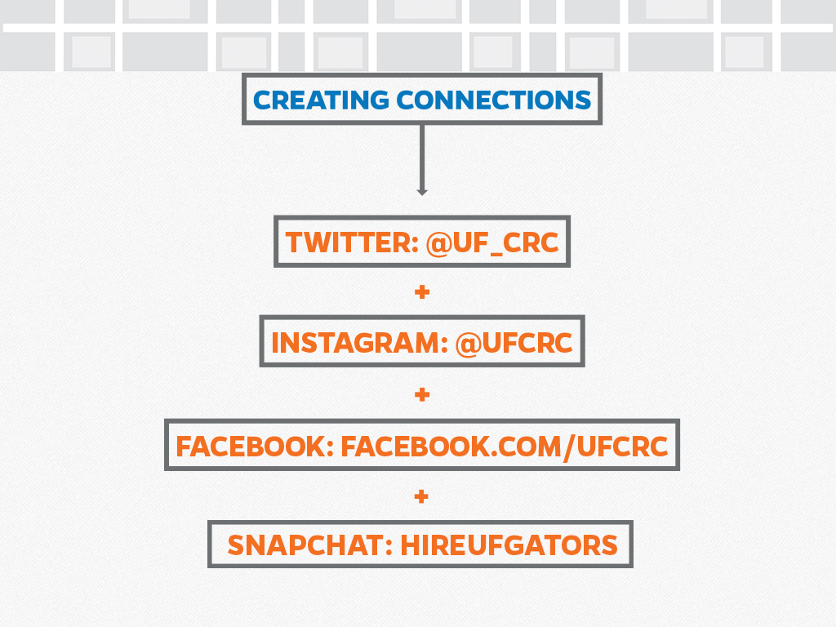

Slide 33
Questions?
www.crc.ufl.edu
Melissa Lyon; melissaly@crc.ufl.edu

