Slide 2
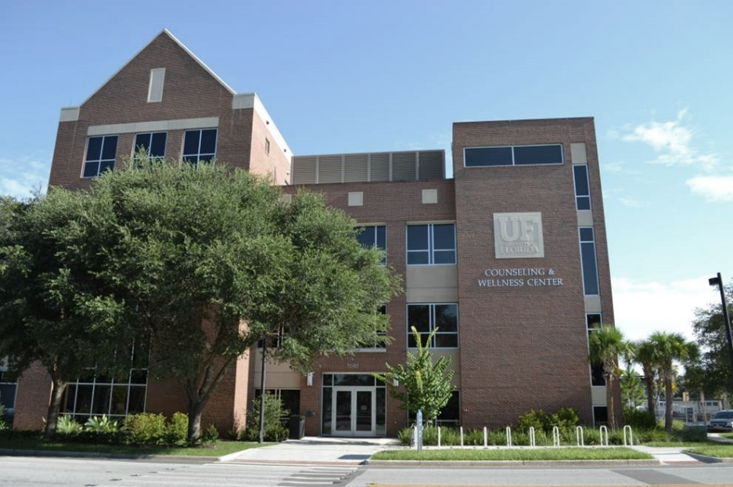

CWC IS HERE FOR YOU!
There is a counseling center on campus that is for you:
www.counseling.ufl.edu
counseling.ufl.edu

Slide 3

ON YOUR PATH TO SUCCESS, ACCEPT THE CHALLENGE & INVEST IN YOUR WELLNESS
A rewarding graduate school experience includes being challenged.
It is normal to be overwhelmed at times, or to question yourself or your path.
Tips & Suggestions
Accept the challenge as part of your experience.
Have a concrete reminder for harder times that you have what it takes to succeed at grad school.
Invest in your wellness: To keep yourself mentally strong, take daily action!
Check out CWC wellness tools (next slide)
www.counseling.ufl.edu
counseling.ufl.edu

Slide 4
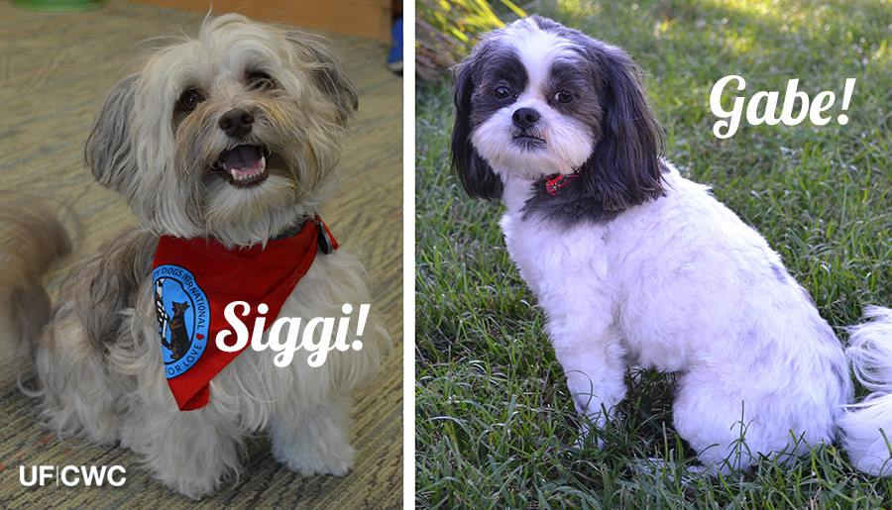
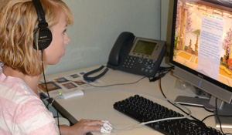
CWC SERVICES TO KEEP YOU STRONG no appointment needed
Online trainings & relaxation videos
Yappy Hour with our
certified therapy dogs
Mind & Body Center featuring Biofeedback
Learn how to improve your attention, manage stress, and enhance your mental effectiveness through play
On-site psychoeducational
workshops
A stress-relief opportunity is available every day at a CWC location. Check the schedule online.
counseling.ufl.edu

Slide 5
OTHER CWC SERVICES INCLUDE:
Crisis
Consultation
Call or walk-in if having an emergency
20-min Triage Appointment
To assess your needs and identify service options
Group Therapy
with specific groups for graduate students!
Short-term & limited Individual Therapy
Psychological
Testing
Referral to SHCC Psychiatry
Referral to
Other Resources
www.counseling.ufl.edu
counseling.ufl.edu

Slide 6

WHATEVER YOUR NEED MIGHT BE
Our team has generalist providers working with wide range of needs and concerns.
Most common presenting concerns at CWC tend to be
Stress and anxiety
Depressed mood
Difficulty concentrating
Relationship concerns
www.counseling.ufl.edu
counseling.ufl.edu

Slide 7
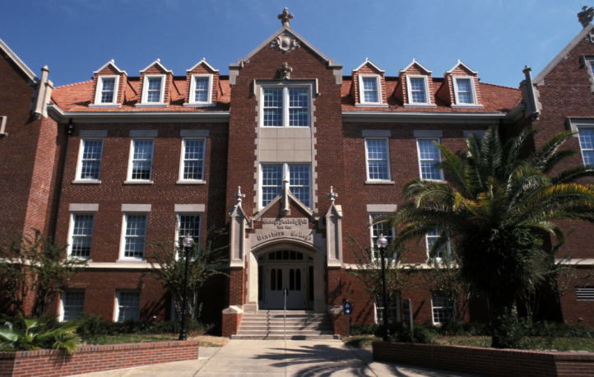
MOST SERVICES ARE PROVIDED AT OUR TWO LOCATIONS
CWC Main Building
3190 Radio Road
Crisis & Emergency Resource Center
at the heart of the campus
Peabody Hall, 4th Fl.
www.counseling.ufl.edu
counseling.ufl.edu

Slide 8

IMPORTANT HIGHLIGHTS
All CWC services are confidential
Available to all registered UF Students
Paid by your health fee; no additional cost to you
CWC office hours
Monday - Friday | 8 am – 5 pm
Emergency walk-in hours
Monday - Friday | 9 am – 4 pm at either CWC locations: Radio Rd or Peabody Hall 4th fl
24/7
Emergency phone consultation available for students in distress as well as students who would like to consult about a friend in distress at 352-392-1575.
www.counseling.ufl.edu
counseling.ufl.edu

Slide 9
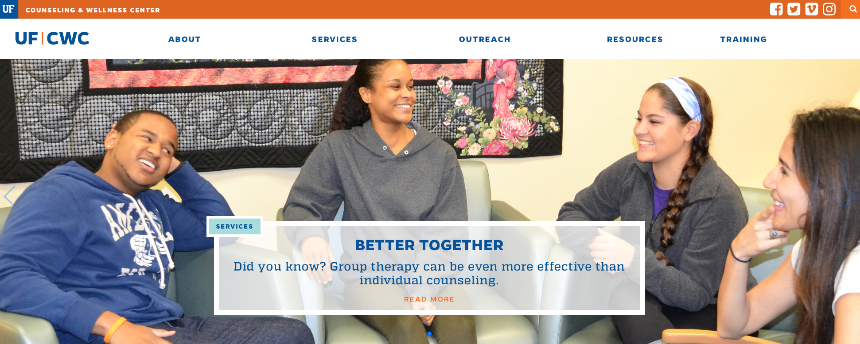
TO LEARN MORE, VISIT OUR WEBSITE
counseling.ufl.edu
Learn more about CWC services including group and workshop schedules
Request a presentation for your student group
Access CWC Referral Database for a list of mental health providers in community
Tap onto online resources: Relaxation exercises, CWC self-help blog, and trainings!
Launching a brand new website Fall 2017!
counseling.ufl.edu

Slide 10
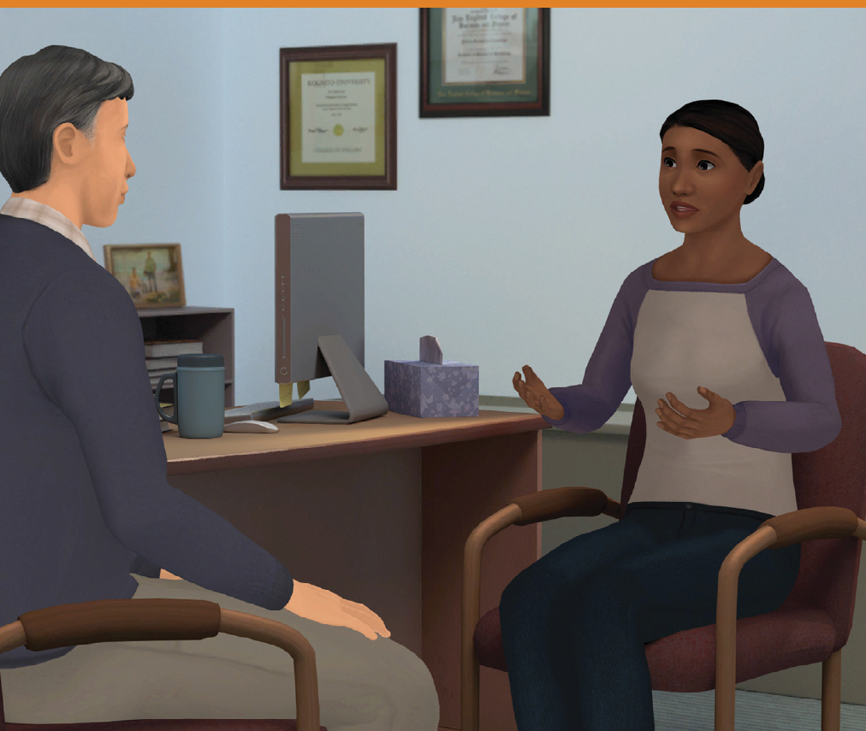
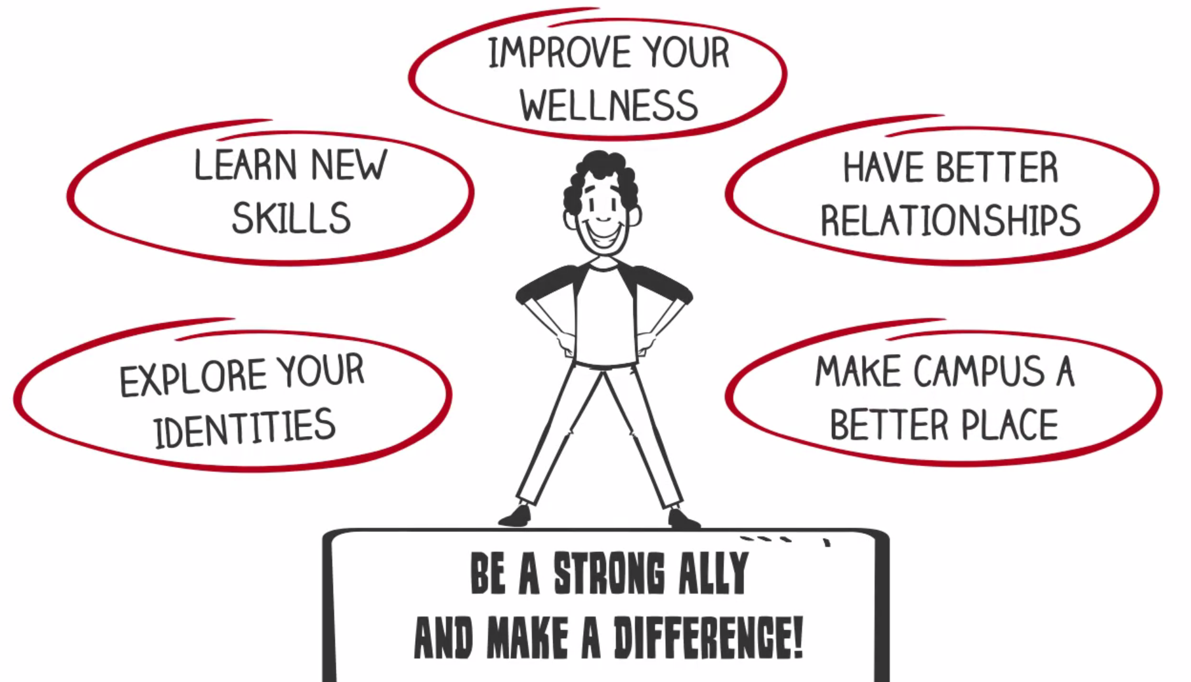
TWO FREE ONLINE TRAININGS FOR PERSONAL AND CAMPUS WELLNESS
At-risk Kognito – A simulation training
BAM: Best Allyship Movement!
Practice how to lead real-life conversations with students in distress and how to refer to services.
Faculty version is strongly recommended for graduate students with teaching responsibilities.
30-45 minutes
4 modules, each ~20 minutes
Visit counseling.ufl.edu to get started today!
counseling.ufl.edu

Slide 11

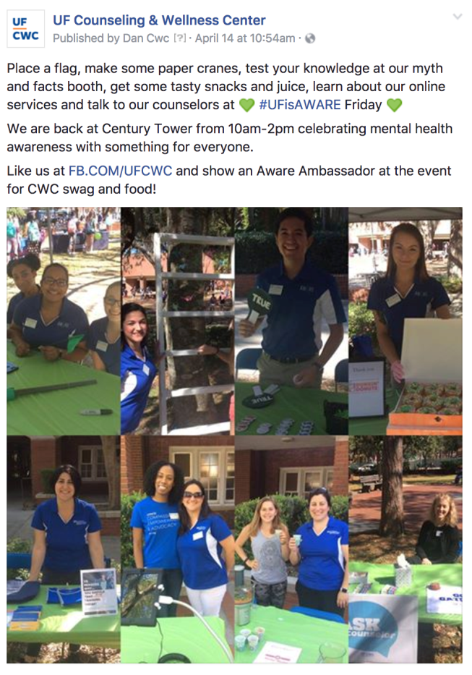


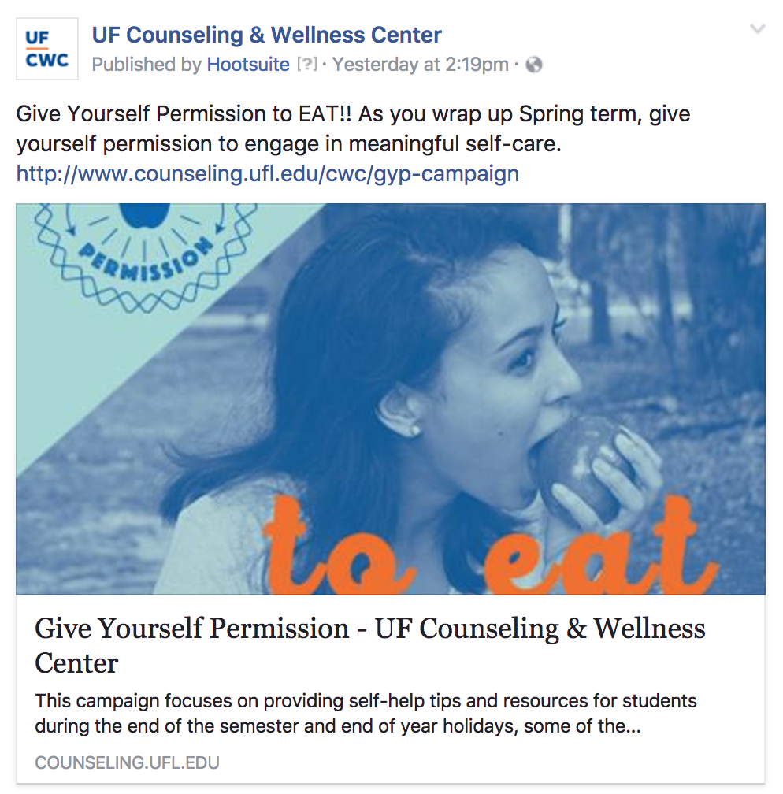
TO STAY IN TOUCH, FOLLOW US ON FACEBOOK FB.COM/UFCWC
Learn more about mental health
Access links to online wellness tools
Hear about specific CWC services
counseling.ufl.edu

Slide 12
UF Counseling and Wellness Center
3190 RADIO ROAD
---------------------------------------------------------------
Crisis and Emergency Resource Center (CERC)
Mind & Body Center PEABODY HALL 4th FLOOR
(352) 392-1575

