Slide 1

CRC Overview
Helping You Create Connections

Slide 2

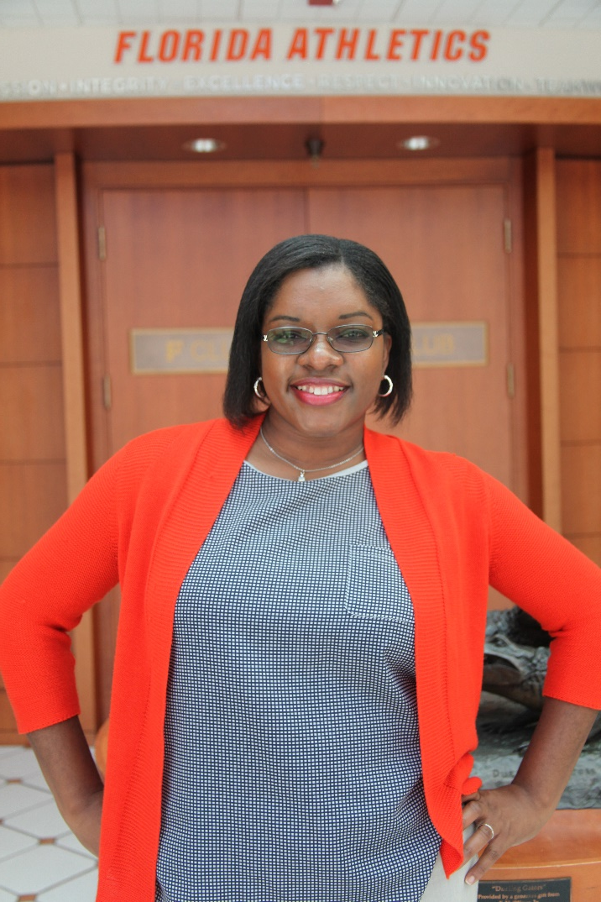

Keira Simmonds
Assistant Director for Career & Industry Engagement
Master of Arts in Management & Leadership
Bachelor of Arts in Psychology
Hometown: Jamaica, WI
Staff Photo
Office Hours & Location
312 Weil Hall
Monday, Tuesday, Wednesday 2-4pm
Thursday and Friday 9-12pm
/gatorengineercareers
Email: keiras@crc.ufl.edu

Slide 3
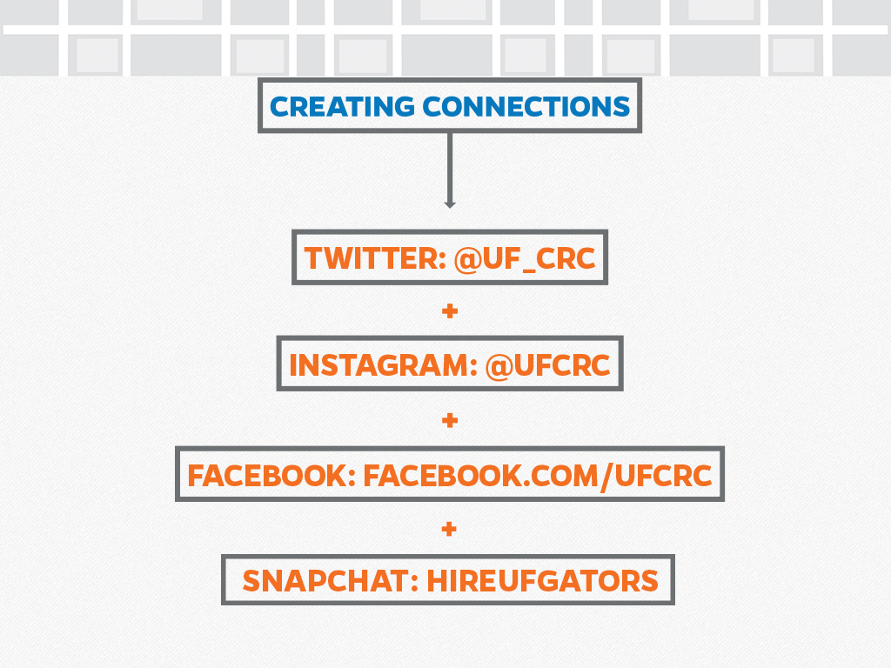

Slide 4

Today’s Objectives
Recognize the various components of career readiness.
Communicate plan of action to engage in activities for career readiness.
Identify CRC resources that can enhance career readiness.

Slide 5

Career Readiness
Classroom Knowledge
Skill Development
Experiential Education
Professional Development

Slide 6
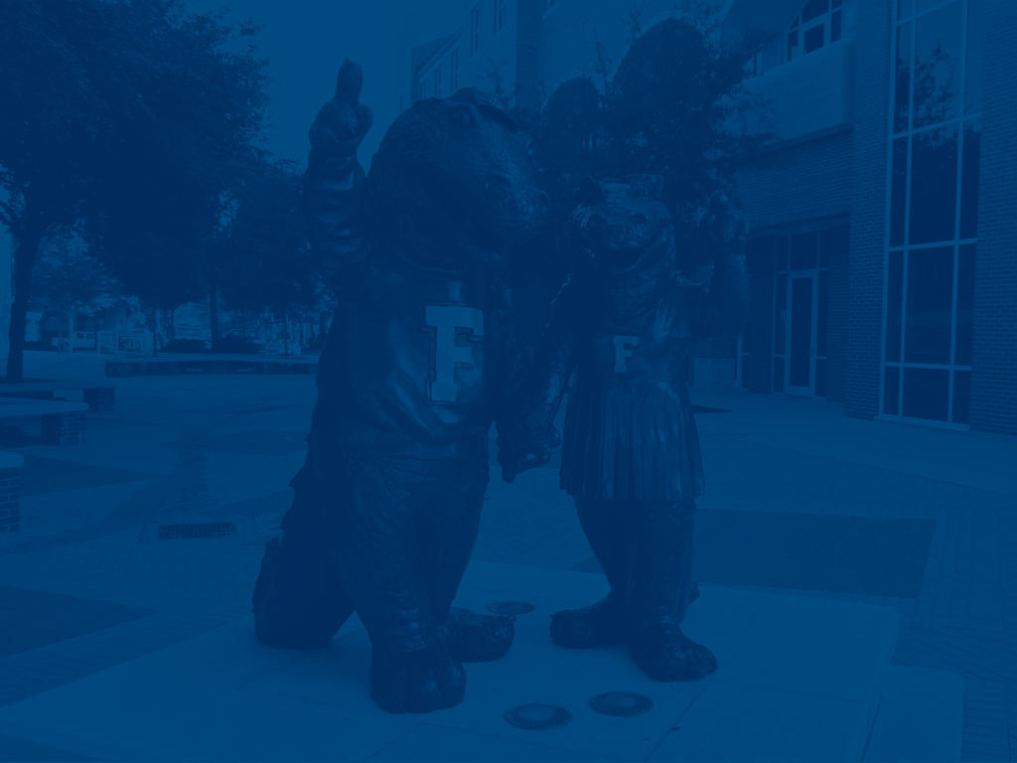
Gaining Experience
Graduate Assistantships
Academic Research
Study/Work Abroad
Internships and Practicums
Publishing or Presenting
Volunteering
Part-Time Work
Fellowships
Professional Organizations
Graduate Organizations
Job Shadowing

Slide 7

Skills Gained @ UF
Communication Skills
Critical Thinking
Teamwork
Sense of Self
Social Responsibility

Slide 8

How To Get Started With Us
Gator CareerLink
Notes:
We offer opportunities to build your skills online, in person, and in different workshops and events. In order to take advantage of all of our services, you will need to make an account on GatorCareerLink.

Slide 9
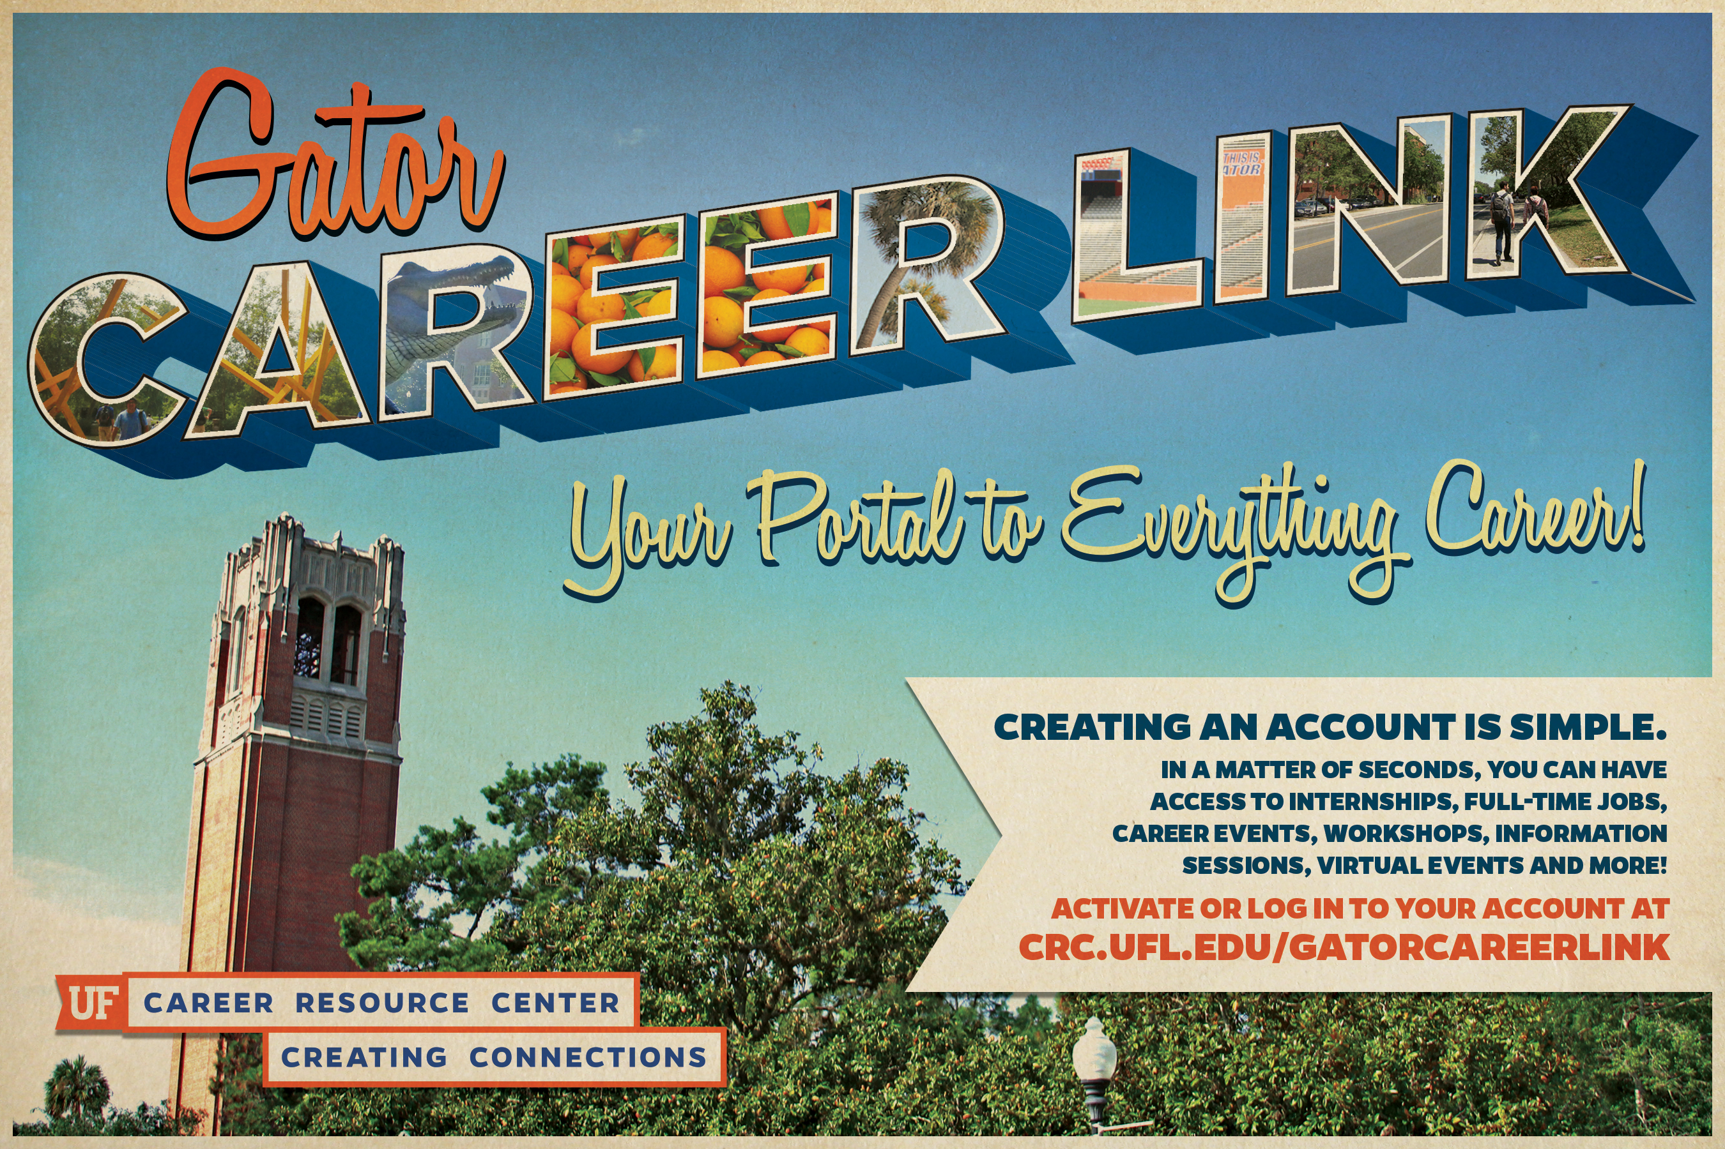

Slide 10
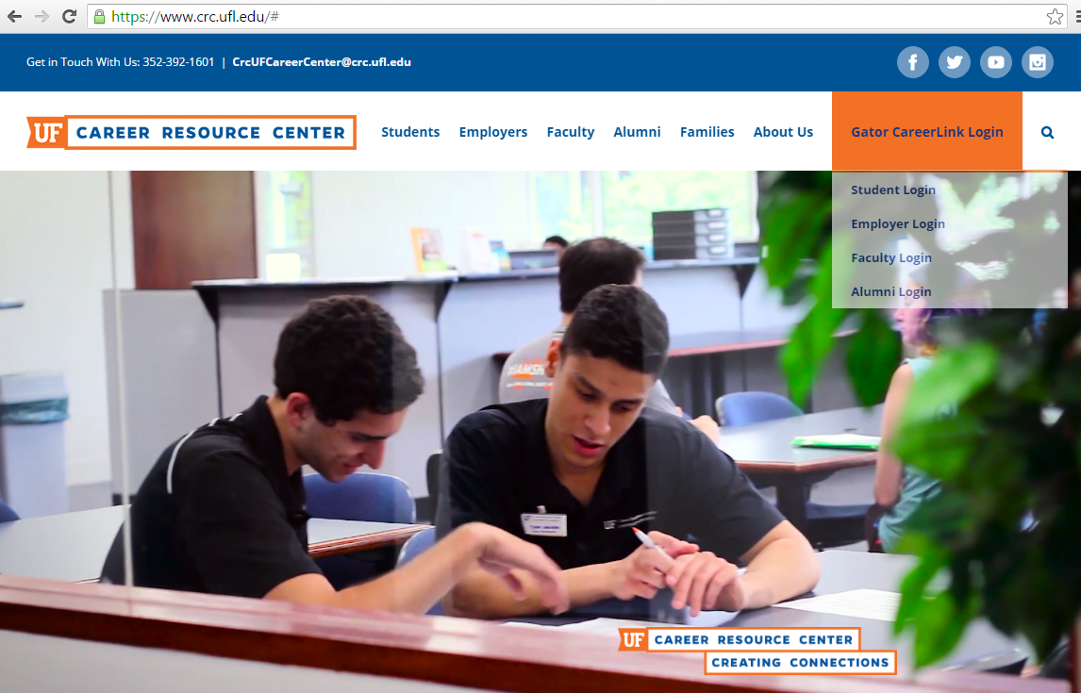
How to Access Gator Career Link
Log-in to Gator Career Link to schedule an appointment in-person, via phone or Skype!

Slide 11
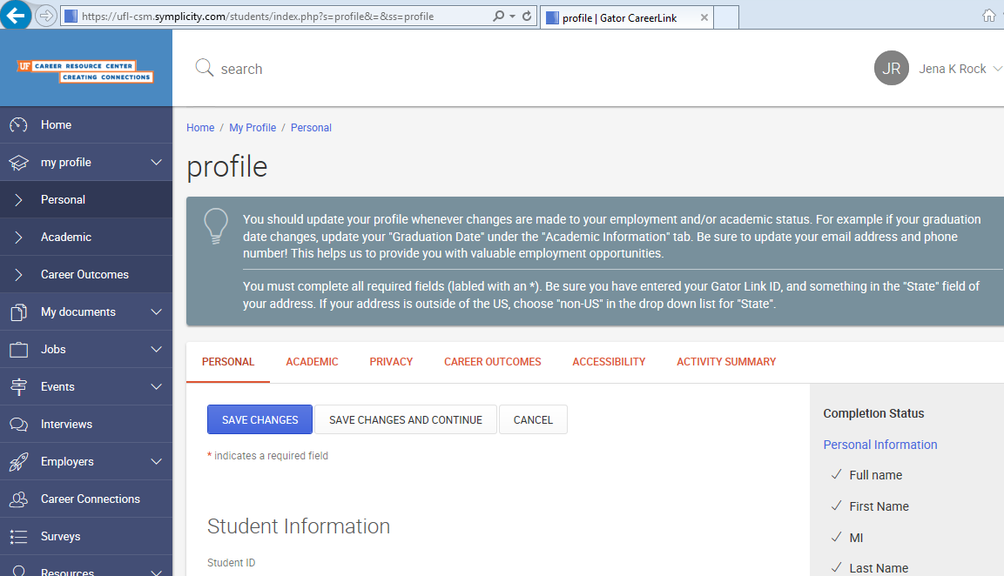
Getting Started:
Creating a Profile

Slide 12
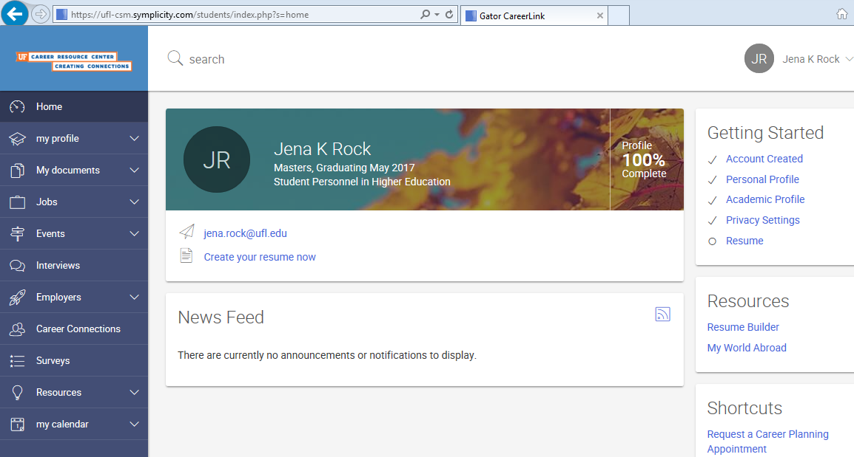
Home Page
Navigation and Announcements
#CreatingConnections

Slide 13
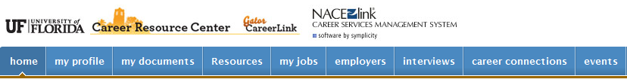

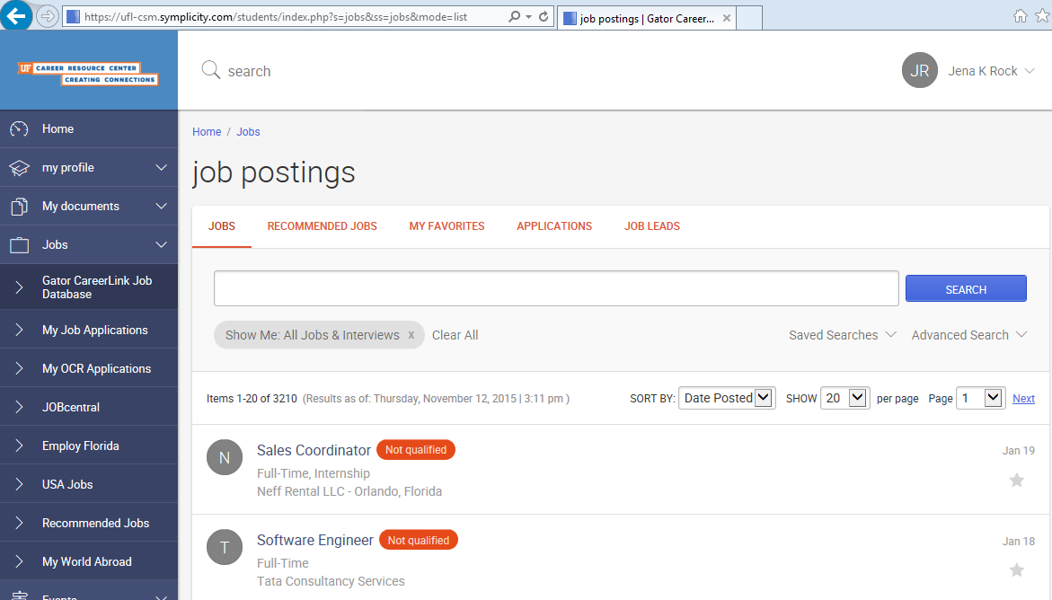


Build a resume and upload documents for a potential employer
Learn about popular careers, leading industries and potential career opportunities

Slide 14
Career Planning
Create Your Personalized Action Plan

Slide 15
Career Planning Topics
Exploring Career Opportunities
Resume, Cover Letter, Personal Statement, LinkedIn Critique (Including Teaching and Research Statements)
Interviewing Strategies
Finding an Internship or part-time job
Finding a Full-time Job
Graduate School Exploration and Preparation

Slide 16
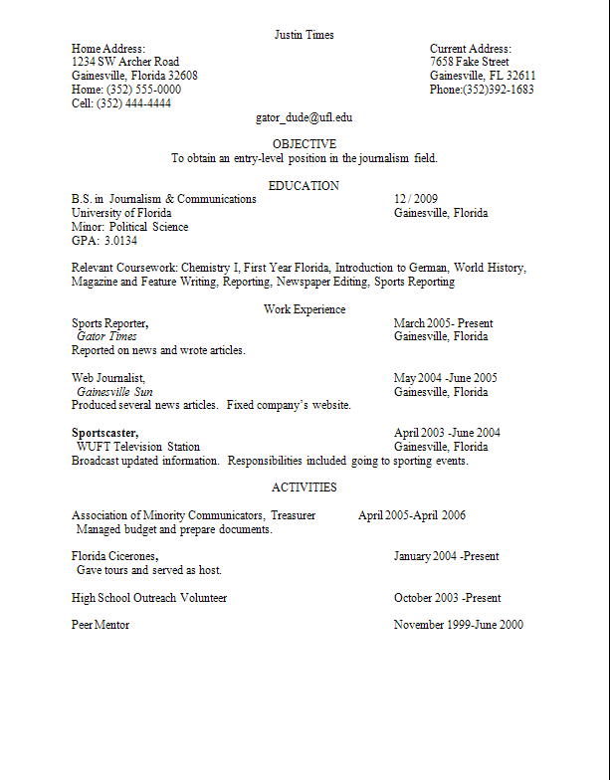
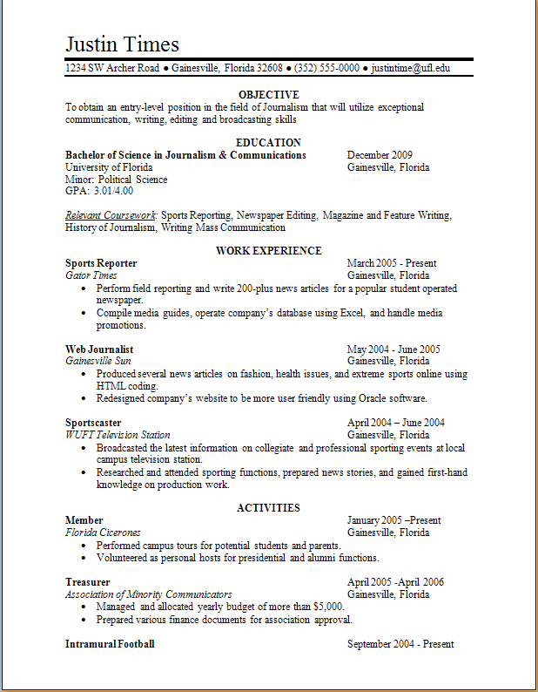
Express Drop-In
Monday-Friday
9:00am-4:00pm
Resume & Cover Letter Critiques
Job and Internship Search Assistance
Mock Interviews
Handouts

Slide 17
Workshops
Explore, Enhance, Engage, Excel

Slide 18
Graduate Student Programs
International Students and the Job Search*
September 14 | 4:05-4:55pm
Communicating With Employers at Career Showcase
September 19 | 4:05-4:55
OPT/CPT/OPT-Stem Information Sessions*
September 21 | 10:40-12:10 & 3:00-4:30
September 22 | 10:40-12:10 & 3:00-4:30
Transitioning to an Employment Based Visa:
Featuring Immigration Attorney Aaron Blumberg*
November 8 | 4:05-6:05

Slide 19
Gator Professional Series
Core
Navigating Roadblocks
Using Your Professional Compass
Navigating Your Search
Dropping Your Pin
People & Points of Interest
Discovering Professional You
Entering Your Coordinates
Mapping Professional You
Take the Highlighted Route
Navigating Offer to Office

Slide 20
Employer2Student Programming
Go for the Goal: Goal Setting
Ace the Interview
Taking the Lead: The Value of Leadership Skills
Work It: Networking as a Student
Navigating the Job/Internship Search
Personal Branding
Getting Experience as a Student
Ready for Work: Preparing to Be a New Professional
Building Great Resumes
#CareerLoveMonth
Pre-Showcase Events
Employer Resume Review

Slide 21
Life After The Swamp
How To Survive Your First 30 Days
The Art Of Negotiation
Show Me The Money!
Figuring Out What’s Next
Oh The Places You’ll Go!

Slide 22
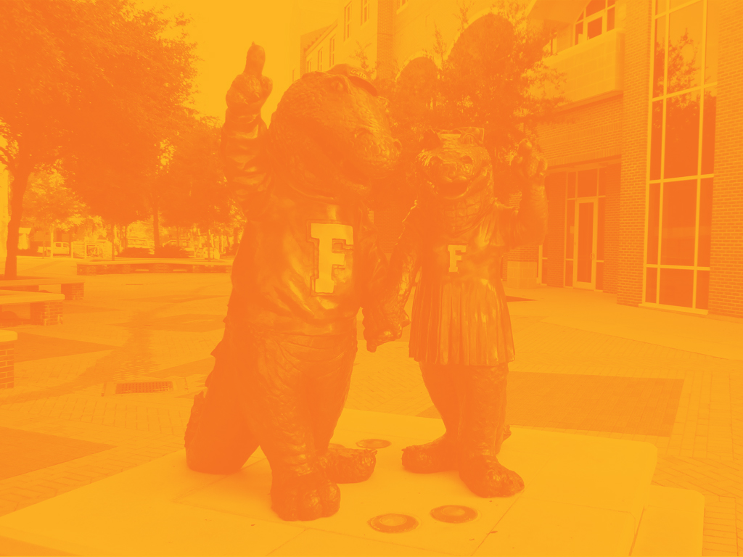
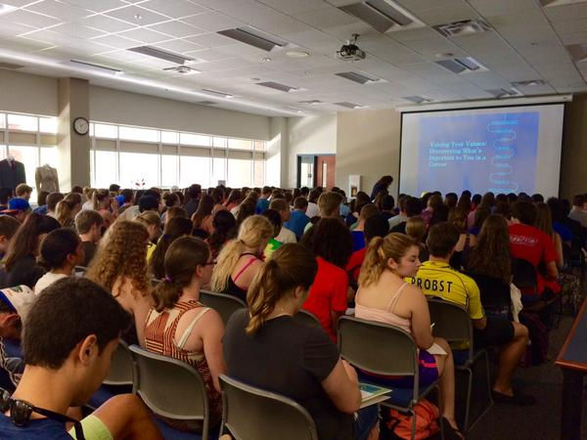
Outreach Requests

Slide 23

Employer Networking
Creating Connections

Slide 24
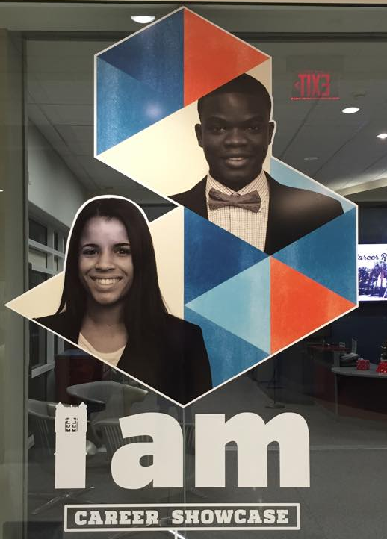
Career Showcase
September 26: Non-Technical
September 27: Technical

Slide 25

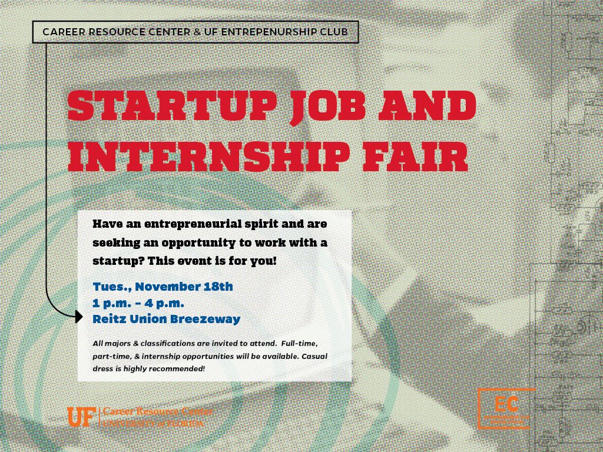

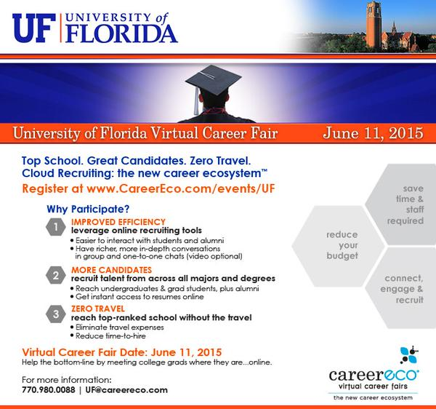
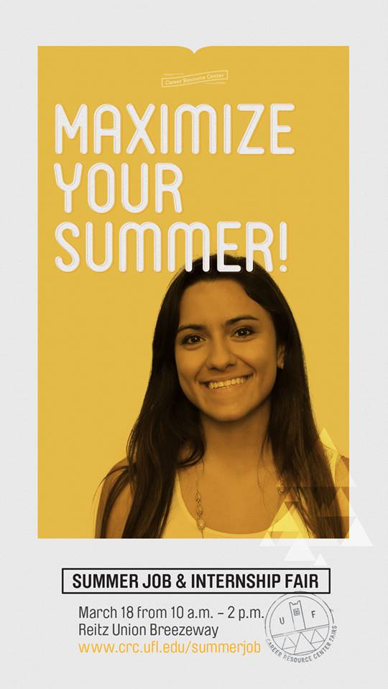
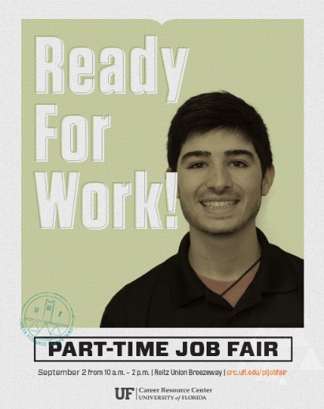
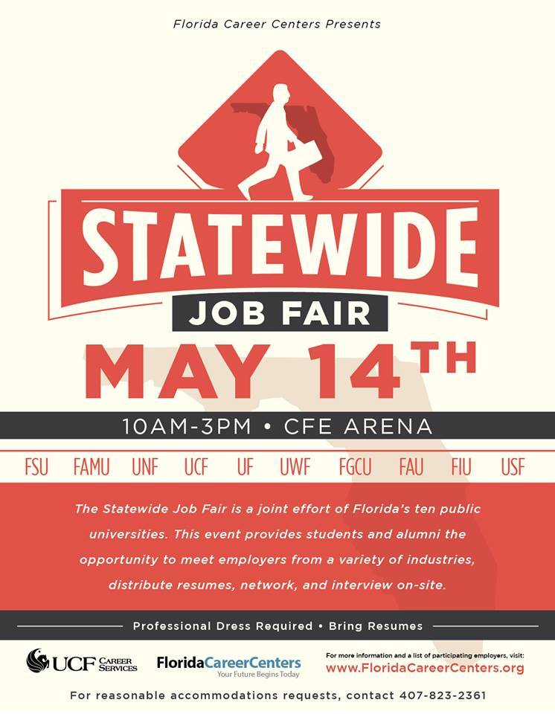
Other Fairs

Slide 26

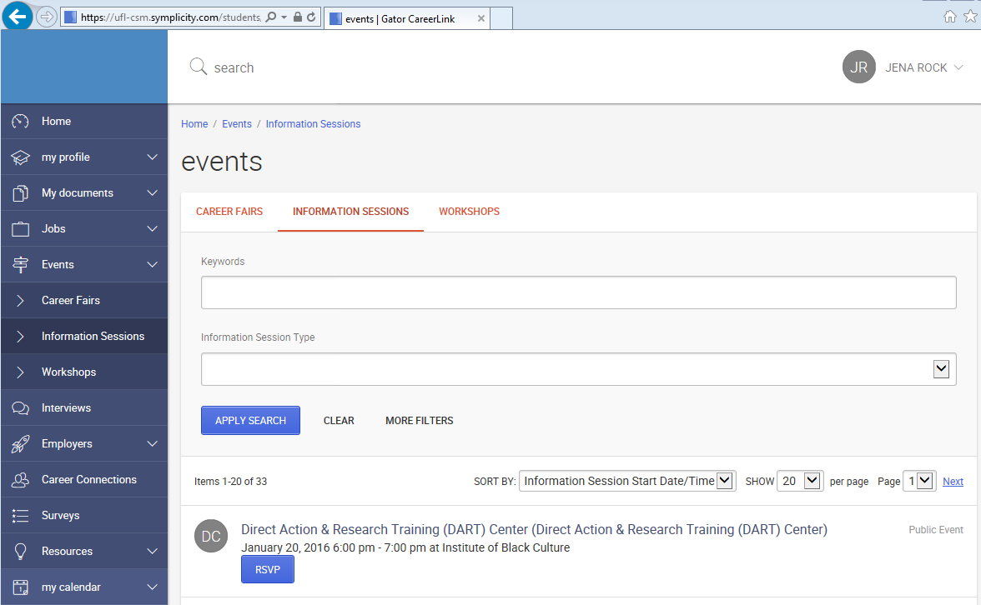

Information Sessions

Slide 27
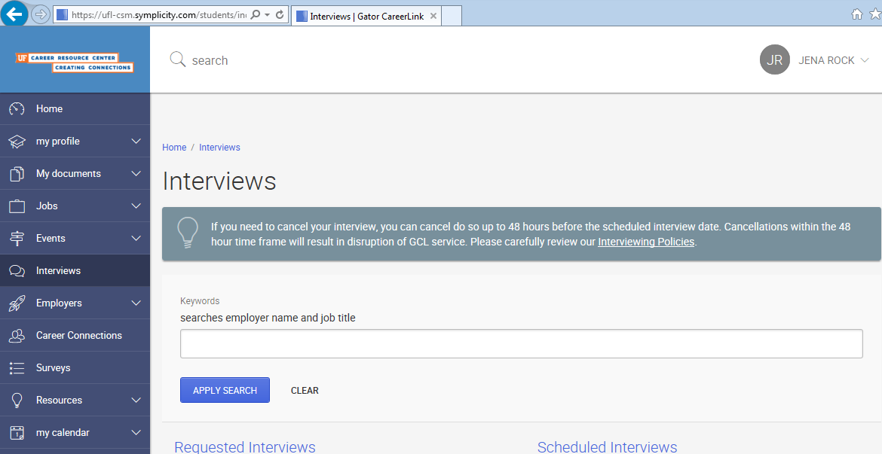
On-Campus Interviews

Slide 28
Summary
Career Planning
Gator CareerLink
Workshops
Employer Networking

Slide 30

Questions?
www.crc.ufl.edu
Email: keiras@crc.ufl.edu

