Slide 1
Jamming-Aware Traffic Allocation for Multiple-Path Routing Using Portfolio Selection
Authors: P. Tague et al.
IEEE/ACM transactions on Networking
Presented by: Ying Xuan

Slide 2
Jamming Behaviors
disturb wireless communications
proactive / reactive
constant, random, repeat, deceive
single bit/packet
outsider / insider
static / mobile
nondeterministic and dynamic
http://khongtenmien.com/forum/showthread.php?p=8462

Slide 3
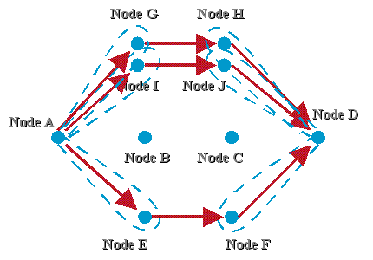
Multiple-Path routing
Anti-jamming techniques = diversity
Multiple frequency bands
Different MAC channels
Multiple Routing paths
Multi-Path Routing
Each source node chooses multiple paths
Each path is allocated with different traffic amount (how to avoid congestion?)
Each path has different probabilities to be jammed (how to measure this?)
http://w3.antd.nist.gov/adhoc/Project_drouting.shtml
Goal: Efficiently allocate the traffic to maximize the overall throughput.

Slide 4
Roadmap
Use PDR to approximate the overall throughput
What is PDR? How to get PDR?
Use a quadratic program based on Portfolio Selection Theory to give the optimal solution
Objective Function? Constraints?
Use Lagrangian dual decomposition to get a distributed solution
Efficiency: accuracy, convergence, scalability.

Slide 5
Represent the throughput - I Estimate local packet success rates (LPSR)
Each node updates (LPSR), Update period T << Ts update relay period
Estimated value by Packet Delivery Rate (PDR)
Variance by the variance of PDR

Slide 6
Represent the throughput - II End-to-End Packet Success Rate
Mean
Variance/covariance
Given that there are Ls paths at source node s, what does these two above mean?

Slide 7
Represent the throughput – III
Given that the traffic allocation vector at node s is
Expected throughput:
Variance:

Slide 8
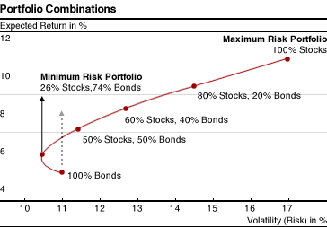
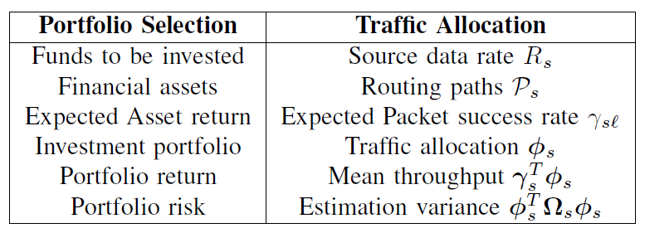
Formulate Optimal Solution – I Portfolio Selection
Analogy of concepts
http://proteger.com.my/articles/investment/modernportfolio.html

Slide 9
Formulate Optimal Solution – I Portfolio Selection (cont’)
risk-aversion factor ks
ks = 0 means the throughput is maximized regardless of any risks
Ks>0 (0.005 in the simulation)

Slide 10
Formulate Optimal Solution – II Congestion Avoidance
Delivery rate from s to node i is
The aggregate traffic going through link (i,j) is

Slide 11
Formulate Optimal Solution - III

Slide 12
Iterative and Distributed Solution
Many allocation quadratic program on large-scale networks can be solved efficiently through decomposition techniques
Daniel P. Palomar and Mung Chiang, A Tutorial on Decomposition Methods for Network Utility Maximization.
Lagrangian dual decomposition

Slide 13
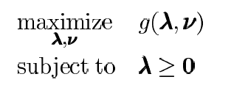
Lagrangian Duality

Slide 14
Decomposition Topology

Slide 15
Decomposition Flow
lagrangian
decouple(c)
dual function
the dual function could be solved using a gradient method

Slide 16
Apply to this formulation
Local update at step 3 requires mutual information exchanges at all the sources……

Slide 17
What can we learn
Way to formulate throughput
Way to solve quadratic program distributedly for large-scale networks

Slide 18
Q&A
Thanks!

