Slide 1
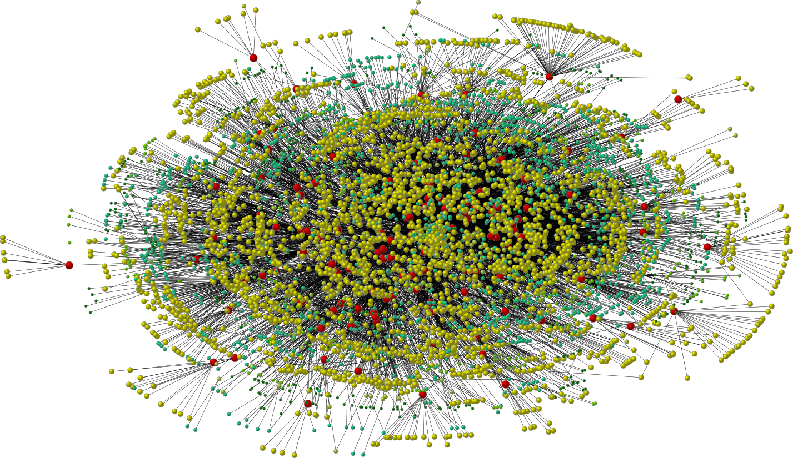
Positive Influence Dominating Set and Beyond
My T. Thai @ UF

Slide 2
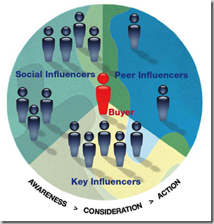
Spread of Influence
Online Social Networks (OSNs) have been exploited as a platform for spreading INFLUENCE
Opinions
Information
Viral marketing
Innovation
Political campaigns…

Slide 3
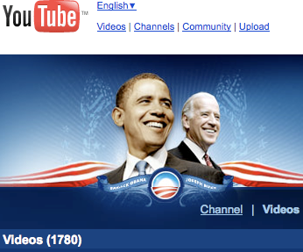
Spread of Influence (Examples)
Major movie studios place trailers for their movies on Facebook;
US presidential candidates ran online political campaigns on YouTube;
Individuals and amateur artists promote their songs, artwork, and blogs through these sites

Slide 4
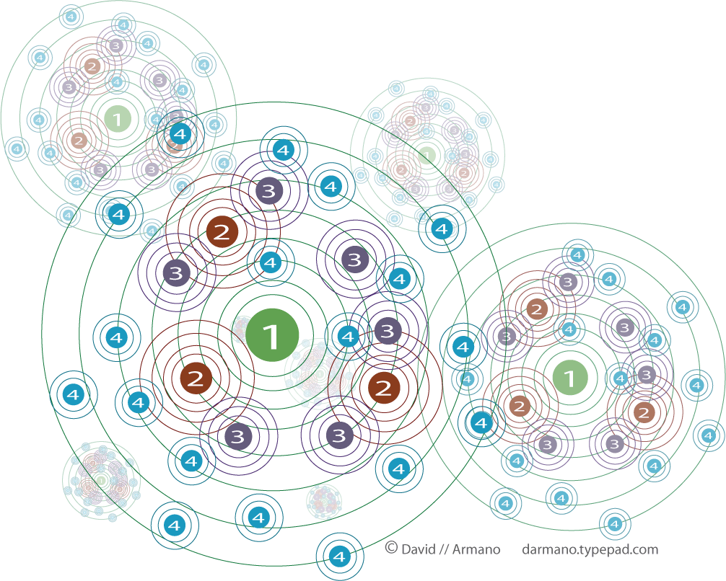
Information Propagation & Myths
It is widely believed that through the “word of mouth” effects, influence will spread widely and quickly throughout the network.
Notes:
Source: http://www.informing-arts.biz/blog/social-influence-marketing/

Slide 5
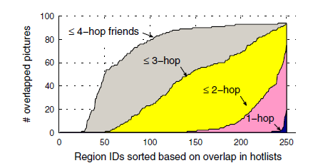
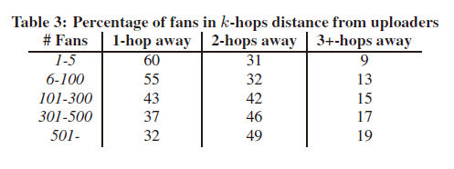
Information Propagation - The Truth
M. Cha et al. WWW’09, Propagation in Flickr.
How widely does information propagate in the social network?
Not widely – within two yards
How quickly does information propagate?
Not quickly, it takes a long time.
The average delay in information propagation across social links is about 140 days!!!
Notes:
Widely: Distance from fans to picture owners.
Quickly: After the first few (10-20) days, most pictures, in aggregate, enter a period of steady linear growth

Slide 6
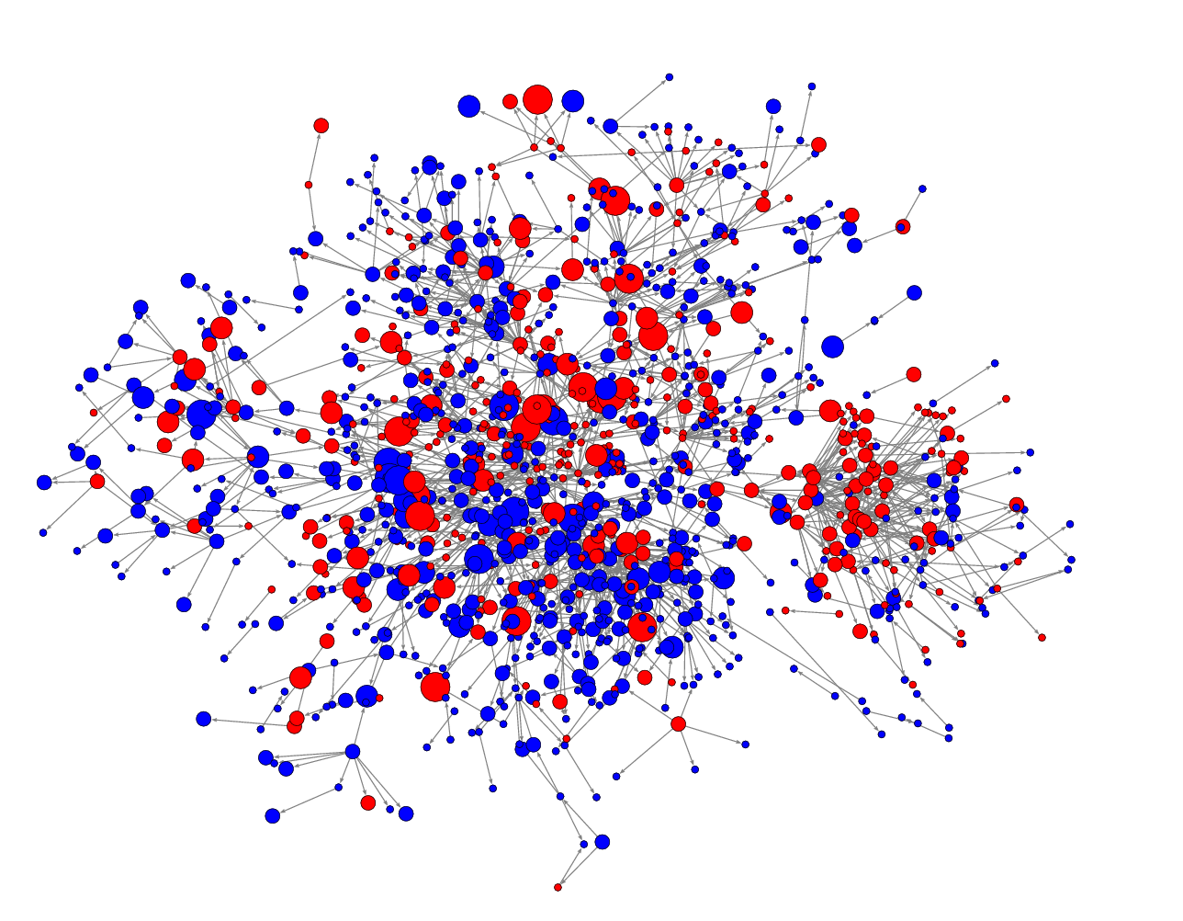
Fast Influence Spreading Problem
Given
Network G=(V, E).
The maximum number of propagation hops d.
Goal
Spread the influence into the whole network within d hops (e.g. dominate a particular market)
Question
What is the minimum set of individuals to target at?
Notes:
Source: Inferring Networks of Diffusion and Influence, Manuel Gomez Rodriguez^{1,2} Jure Leskovec¹ Andreas Krause³

Slide 7
What’s next?
Influence Propagation Model
Direct Influence: number of hop d=1
Generalized Dominating Set
Tractability & Approximation Algorithms on
General Graphs
Bounded Degree Graphs
Power-law Graphs
Trees
Multiple-hop Propagation
Hardness of approximation
Selection Algorithm

Slide 8
I. Models of Influence
1
General operational view:
A social network is represented as a graph, with each person (customer) as a node
Nodes start either active or inactive
An active node may trigger activation of neighboring nodes
Monotonicity assumption: active nodes never deactivate
First mathematical models
[Schelling '70/'78, Granovetter '78]
0
1
1
1
0
1
2
2
Notes:
Schelling introduced a multi-agent model to describe the segregation dynamics that may occur with individuals having only weak preferences for “similar” neighbors.
Granovetter '78: His theory on the spread of information in social networks known as "The Strength of Weak Ties" (1973).
Assumption: node can switch to active from inactive, but does not switch in the other direction
Exp: Influence propagation within d=2 hops.

Slide 9
I. Model of Influence
Major models: Linear Threshold and Independent Cascade
Linear threshold: Each node v has a threshold w_{v} v is activated if there are ≥ t_{v} active neighbors.
Independent Cascade: An active node u activates its neighbor v independently with probability p_{uv}.
Our models: Linear Threshold
v is activated if there are ≥ ρ_{v} d(v) active neighbors.
d(v): degree of v; 0< ρ_{v} < 1.
Notes:
Node thresholds are highly correlated with their degree. Higher degree, more influencers to be influenced.
We represent threshold in fraction of a node’s degree.

Slide 10
II. Direct Influence in Networks (d=1)

Slide 11
Positive Influence Dominating Set(PIDS)
Given: A graph G=(V, E) and a single constant 0< ρ < 1 . A node v ∈ V has threshold ρ d(v).
Problem: Find minimum set P ⊆V, so that after d=1 hop, all nodes are activated.
Intuition: Half of my friends use Iphone, why shouldn’t I?
1
0
1
1
1
0
0
1
1
Notes:
ρ = 1/3.

Slide 12
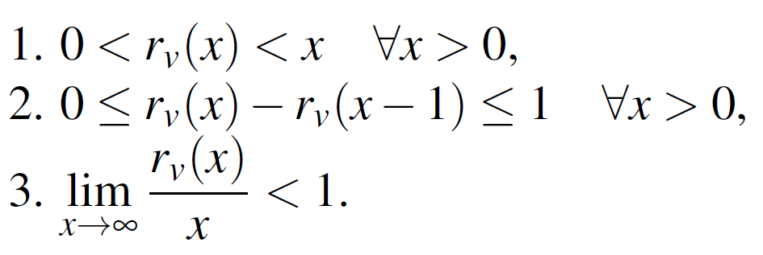
Generalized Dominating Set (GDS)
The threshold function might not be linear
log d(v), √ d(v), etc.
Characteristics of a threshold function:
A node v is activated if ≥ r_{v} (d(v)) active neighbors.
Monotone increasing function
⇒ dominating function.

Slide 13
Problems in GDS
Dominating set: r_{v} (x) = 1.
k-tuple dominating set: r_{v} (x) = k.
Positive influence dominating set: r_{v} (x) = ρ x.
Fixed threshold model: r_{v} (x) = t_{v} .
…
GDS capture the dynamic aspect of networks.
More neighbors ⇒ Threshold Increase and vice versa.
Notes:
Fixed threshold = Linear Threshold

Slide 14
Properties of Dominating Set
Total: Even nodes in the dominating set have to dominate themselves
Connected: The induced subgraph is connected
k-connected: The induced subgraph is k-vertex connected (cannot disconnect the graph by deleting k-1 vertices.)
and combinations
Total connected
k-connected total

Slide 15
Generalized DS and MORE…
TOTAL GDS (T-GDS)
CONNECTED GDS ( C-GDS)
k-CONNECTED GDS (kC-GDS)
TOTAL CONNECTED GDS (TC-GDS)
k-CONNECTED TOTAL GDS (kCT-GDS)

Slide 16
Bad News
All domination problems in all mentioned classes
Cannot be approximated within ln Δ - O(ln ln Δ), unless P = NP.
Cannot be approximated within (1/2 - ε) ln |V|, unless NP ⊂ DTIME(n^{o(log log n)} )
where Δ is the maximum degree of G=(V,E).
Cannot be approximated within ln B - O(ln ln B), unless P = NP,
in graphs with degrees bounded by B
APX-hard even in Power-law networks

Slide 17
Good News
Problems in GDS: approximated within H(2Δ).
Problems in T-GDS: approximated within H(Δ).
Problems in C-GDS: approximated within H(3Δ).
Problems in TC-GDS: approximated within H(2Δ).
In power-law networks: PIDS-like problems (r(x) >αx for some constant α) problems are approximated within a constant factor
In trees: Optimal solution in linear time.
H(n)=1+1/2+…+1/n is the harmonic function.

Slide 18
Inapproximability
Typical road map: Reduction from Set Cover
But, involve many tweaking of Feige’s (1-o(1)) ln n threshold proof.
e₁
x'₁
x₁
S₁
e₂
. . . . . . . .
S₂
x'_{i}
x_{i}
e₃
S₃
e₄
. . . . . . . .
. . . .
e₅
x'_{t}
x_{t}
S_{|S|}
. . . .
e_{|U|}
D’
D
S
U

Slide 19
Feige’s reduction
Reduction from MAX 3SAT-5 to k-provers proof system.
k provers : k binary code words of length l, weight l/2 and Hamming distance at least l/3.
The provers select randomly l/2 clauses and l/2 variables.
Acceptance predicate:
Weak: at least one pair of provers is consistent.
Strong: every pair of provers is consistent.

Slide 20
Feige’s Reduction: Construction
A partition system B(m,L,k,d) has the following properties.
There exists a ground set B of m distinct points.
There is a collection of L distinct partitions p₁,…,p_{L}.
For 1≤i≤L, partition p_{i} is a collection of k disjoint subsets of B whose union is B.
Any cover of the m points by subsets that appear in pairwise different partitions requires at least d subsets.
R=(5n)^{l} : Number of random strings.
r↔B_{r}(m,L,k,d): m=n^{Θ(l)}, L=2^{l}, d=(1-2/k)k∙ln(m), Q=n^{l/2}(5n/3)^{l/2} (questions to P_{i}).
Universal U = Unions of all B_{r}
Collection S = Subsets S(q,a,i): question q, answer a, prover i.
Q=n^{l/2}(5n/3)^{l/2} (questions to prover i).

Slide 21
Feige’s Hidden Parameters
Number of subsets in S?
|S| ≤ Q 2^{2l}
Maximum size of a subsets?
Δ ≤ m 3^{l/2} : For each i and q, there are at most 3^{l/2} random strings such that the verifier makes query q to the prover i.
Maximum frequency of a point/element?
F ≤ k 2^{l} l: Each partition contains k copies of a point, and a subsets contains at most 2^{l} subsets from a same partition.

Slide 22
Hardness Ratio and Suf. cond.
The hardness ratio
(1-4/k) ln m [ ln m vs. ln (mR +Q 2^{2l} ) ]
Sufficient conditions:
l >1/c (5 log k+2log ln m)
To get (1- ε) ln n: Feiget set m = (5n)^{2l/ε} → very large Δ
Number of vertices

Slide 23
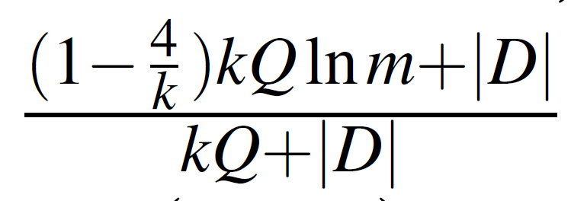
Set Cover to GDS
Hardness ratio from our reduction:
where |D| ~ Δ
Feige settings give hardness ratio ~ 1 ☹
e₁
x'₁
x₁
S₁
e₂
S₂
x'₂
x₂
e₃
S₃
e₄
. . . . . . .
. . . .
e₅
x'_{t}
x_{t}
S_{|S|}
. . . .
e_{|U|}
D’
D
S
U

Slide 24
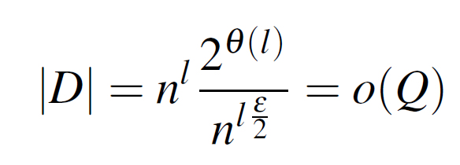
Hardness of GDS, T-GDS,…
Optimal setting for our reduction
m = (5n)^{l(1-ε)}
Hardness ratio > (1/2 - ε) ln |V|
We make D a clique → total, k-connected.

Slide 25
Hardness of GDS, T-GDS in Bounded Graphs
In graph with degrees bounded by B. We use Trevisan [STOC’01] settings for bounded set cover.
m = B/poly log B.
New issue: Keep degree of vertices in D bounded.
Possible by choosing |D| = mR/B ln²B.
Hardness: ln B - O(ln ln B), unless P = NP
→hardness ln Δ - O(ln ln Δ)
e₁
x'₁
x₁
S₁
e₂
S₂
x'₂
x₂
e₃
S₃
e₄
. . . . . . .
. . . .
e₅
x'_{t}
x_{t}
S_{|S|}
. . . .
e_{|U|}
D’
D
S
U
Notes:
If there exists ln Δ - O(ln ln Δ) approx algo -> for fixed B there exists ln B - O(ln ln B) approx algo. (contrad)

Slide 26
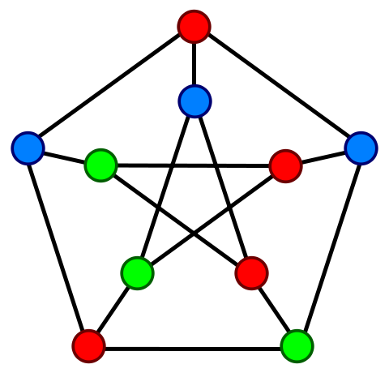
Bounded degree: kC-GDS
Issue: Cannot make |D| a clique (bounded degree)
Solution: Connect |D| using a 2k-Ramanujan graph → |D| has vertex expansion at least k.

Slide 27
Approximation Algorithms
GDS, T-GDS reduction to
C-GDS, TC-GDS: Greedy algorithm using analysis technique for non-supmodular potential function. [ Du et al., SODA 2008]

Slide 28
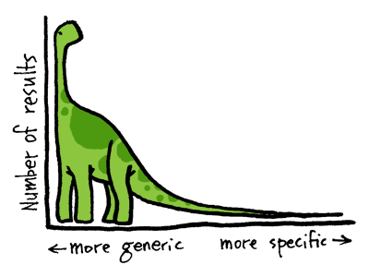
PIDS-like DS in Power-law Graphs
PIDS-like: r_{v}(x) > α x
Long tails make it “easier” to approximate the optimal solution
Primal-Dual fitting to give Lower bound on size of PIDS-like DS.

Slide 29
PIDS-like DS in Power-law Graphs
Objective of Dual feasible solution → lower bound for Primal
Strategy: Force all y_{u} dual variables to have a same value χ. Optimize χ using degree distribution to give the best lower bound.

Slide 30
PIDS-like DS in Power-law Graphs
Power-law distribution:
y vertices have degree x:
β is log-log growth rate → network characteristics
Size of networks:

Slide 31
PIDS-like DS in power-law Graphs
Results:
All DS have size at least Ω(|V|)!!!
Trivial constant approximation algorithm.
Agree with the NOT WIDELY propagation observation
Require a large number of initial target to propagate to the whole networks.

Slide 32
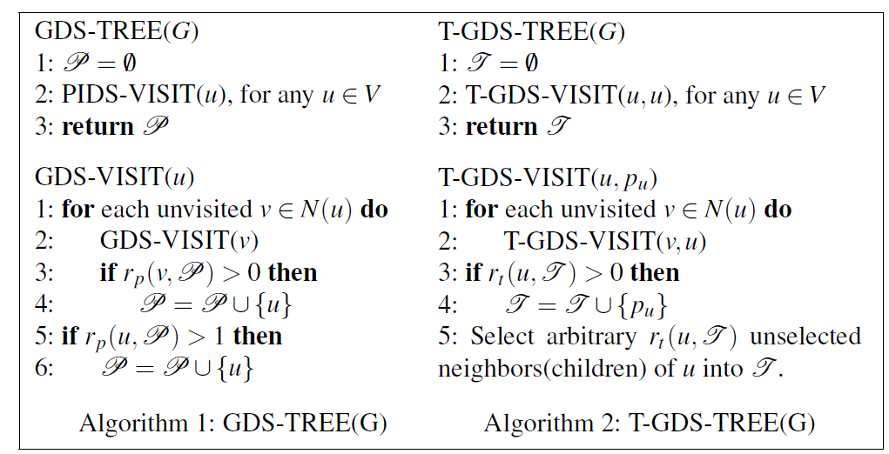
Optimal Solutions in Trees
kC-GDS: Optimal solutions are on non-leaf nodes! Trees are really easy !!!☺

Slide 33
III. Multiple-hop Propagation

Slide 34
Approximability
Hardness of Approximation
(1-o(1)) ln n for d < 4
for d ≥ 4
Approximation:
Constant factor approximation algorithm in power-law networks
Initial set is again Ω(|V|)!!!

Slide 35
Efficient Heuristics for Large Scale Networks
VirAds-Fast-Spreading Algorithm
A priority queue of nodes: priority = # affected vertices + #affected edges.
Pickup vertex with highest priority
Recalculate priority, and select the vertex if the new priority is still the highest, repeat otherwise
Update the number of activated vertices with the selected node
Lazy update: Update priority for only vertices that are “affected” by the selected vertex. Repeat!
Notes:
Affected = change the domination requirements.

Slide 36
Heuristics for Large Scale Networks
Datasets: Facebook
New Orleans City: 90 K vertices, ~4M edges.
Orkut social network: 3 M vertices, 220 M edges
Competitors:
Max degree selector
Virads: One-hop greedy selector
Virads-Full-Spreading:
Expensive multi-hop greedy
Cannot run for large networks (e.g. Orkut)

Slide 37
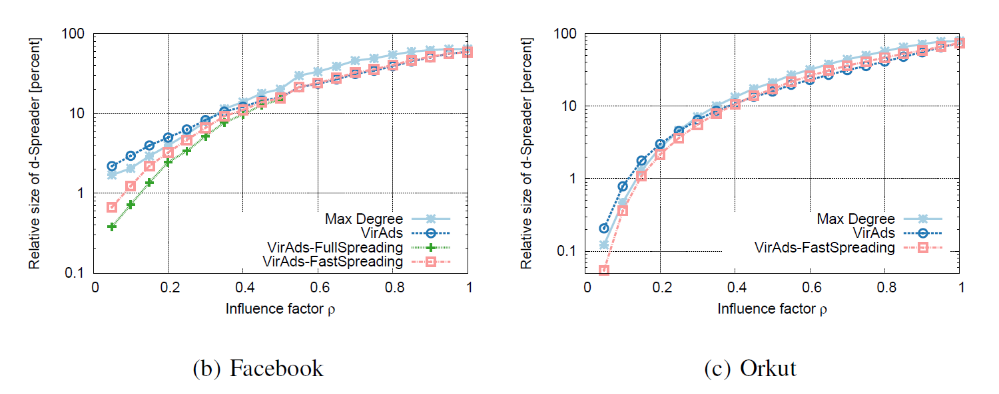
Experiments Results
Running time on Orkut (220 M edges):
Virads-Fast-Spreading: Few minutes
Virads-Full-Spreading: >> weeks.
Quality is on par with the expensive multihop-greedy.
Notes:
Virads-Fast-Spreading is on par with the expensive multihop-greedy algorithm

Slide 38
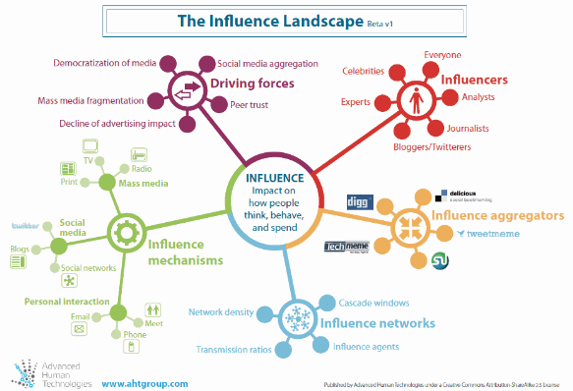
Thank you for listening!
Spheres of influence are now the measure of power in human relationships.
Notes:
Source: http://www.relationship-economy.com/?p=12308

