Slide 1
Multilevel compression of random walks on networks reveals hierarchical organization in large integrated systems
M. Rosvall and C. T. Bergstrom
Presented by Thang N. Dinh CISE Department, University of Florida

Slide 2
Introduction
Community structure gives 2-level map of the network
Real-world networks, the organization rarely is limited to two levels
Flows of commuters in UK
Notes:
Figures from: Finding statistically significant communities in networks, Andrea Lancichinetti,Filippo Radicchi, Jose J. Ramasco, and Santo Fortunato

Slide 3
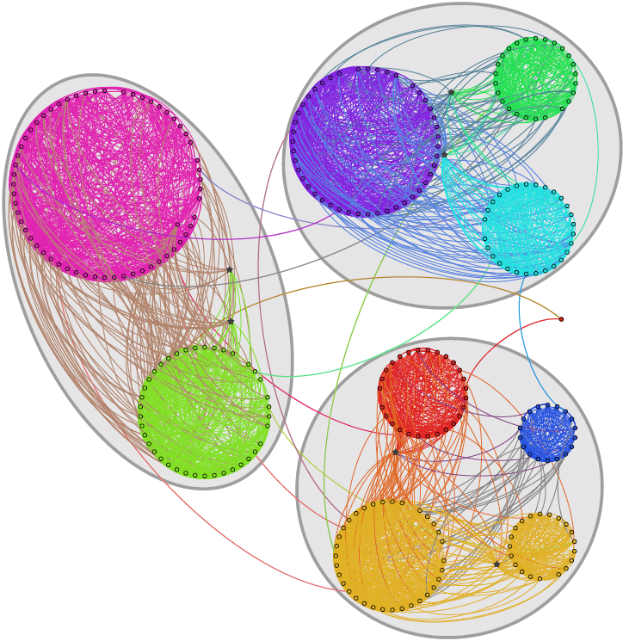
Hierarchical Community structure
How many hierarchical levels?
How many modules at each level?
What are members of each module?
Notes:
Figures from: Finding statistically significant communities in networks, Andrea Lancichinetti,Filippo Radicchi, Jose J. Ramasco, and Santo Fortunato

Slide 4
Hierarchical Community structure
Hierarchical clustering:
Agglomerative algorithms
Divisive algorithms
Sales-Pardo, 2007: Deriving hierarchical from node similarities.
Clauset et al. 2007, 2008: Divide the dendogram using Maximum Likelihood
Lancichinetti et al. 2009: Local optimization of a fitness function
Notes:
Detecting communities by compressing the description of information flows on networks. (A) We want to describe the trajectory of a random walk on the network such that important structures have unique names. The orange line shows one sample trajectory. (B) A basic approach is to give a unique name to every node in the network. The Huffman code illustrated here is an efficient way to do so. The 314 bits shown under the network describe the sample trajectory in A, starting with 1111100 for the first node on the walk in the upper left corner, 1100 for the second node, etc., and ending with 00011 for the last node on the walk in the lower right corner. (C) A two-level description of the random walk, in which major clusters receive unique names, but the names of nodes within clusters are reused, yields on average a 32% shorter description for this network. The codes naming the modules and the codes used to indicate an exit from each module are shown to the left and the right of the arrows under the network, respectively. Using this code, we can describe the walk in A by the 243 bits shown under the network in C. The first three bits 111 indicate that the walk begins in the red module, the code 0000 specifies the first node on the walk, etc. (D) Reporting only the module names, and not the locations within the modules, provides an efficient coarse graining of the network.
Source: PNAS

Slide 5
Encoding Network Flows
Optimal compression of network flows → Network structure (M. Rosvall, C. T. Bergstrom, PNAS 2008)
Top three performers (LFR benchmark, Fortunato et al. 2009)
Can be extended to reveal hierarchical structure of network

Slide 6
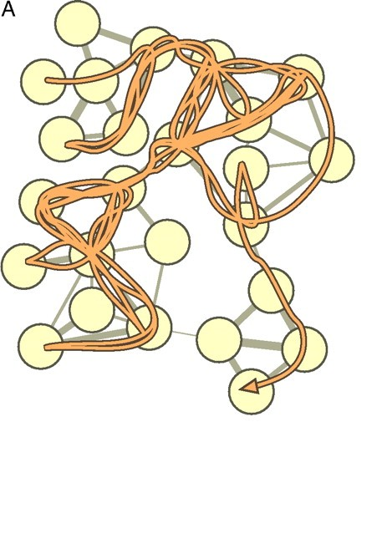
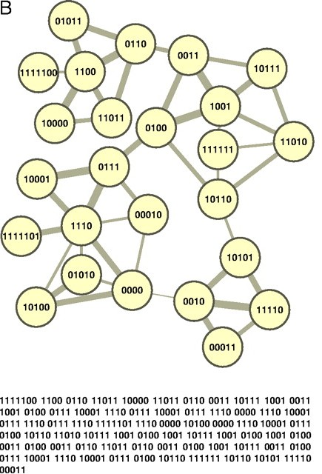
Encoding network flows

Slide 7
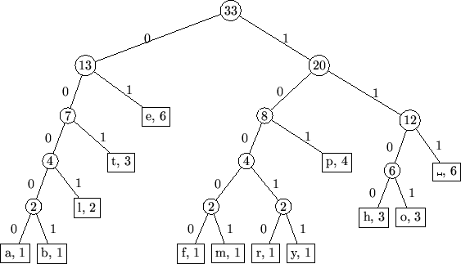
Encoding Network Flows
Compressing an infinite flow (random walk)
Minimize the expected code length
Shannon’s source coding theorem:
Notes:
Figure from: http://myyn.org/static/assets/mathbrowser/article/3203/images/img2.png

Slide 8
Two-level map encoding
Each module has a code
Within module:
Each node has a code
Special exit code

Slide 9
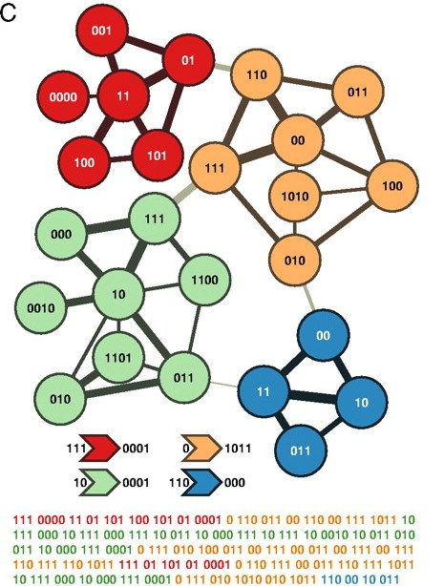
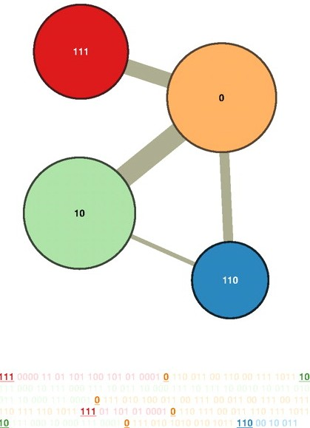
Two-level map encoding
http://www.mapequation.org/mapdemo/index.html

Slide 10
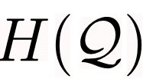
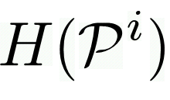
Two-level map encoding
Community structure M, with modules P^{i}
The rate in which code for modules used
Probability of entering modules i
Entropy of code for modules
The entropy of code for nodes in module i

Slide 11
Two-level encoding

Slide 12
Hierarchical map encoding

Slide 13
Hierarchical map encoding

Slide 14
Algorithm
Fast stochastic and recursive search algorithm
Join neighboring nodes -> modules -> super-modules (Brondel. 2008)
Recursive operate on modules at any levels
Local improvement
Submodules movement
Single-node movement

Slide 15
Experiments

Slide 16
Experiments

Slide 17
Experiments

Slide 18
Experiments

