Slide 1
STEALING REALITY
-Yaniv Altshuler, Nadav Aharony, Yuval Elovici Alex Pentland and Manuel Cebrian
Presented by:
Sindhura Tokala

Slide 2
b1
a5
a1
b2
b8
A
a2
B
b3
a4
b7
a3
b4
b6
b5

Slide 3
b1
a5
a1
b2
b8
A
a2
B
b3
a4
b7
a3
b4
b6
b5
Is A more valuable? or B?
Technical topology of the network vs Topology of the human network that communicates on top of it.

Slide 4
Relationship and Context
Patterns of communication
Information like age, occupation, role, etc.

Slide 5
N. Eagle, A. Pentland, D. Lazer, “Inferring social network structure using mobile phone data”
Behavioral variables:
Phone communication
Proximity on a Saturday night
Number of unique locations
Proximity outside work
Proximity with no reception
Proximity at home
Proximity at work
Detected friendships based on the behavioral variables

Slide 6
Why are Stealing Reality attacks dangerous?
Easy to replace data network topologies.
Difficult to replace real world network.
Behavioral pattern attacks can be stealth attacks. Hence, difficult to detect.

Slide 7
Network Model
P_{v}(u,t): Probability that vertex u was “learned” at time t.
P_{E}(u,t): Probability that edge e(u,v) was learned at time t.
I_{u}(t)=1 iff u is infected at time t
I_{e}(t)=1 iff either u or v or both are infected at time t.
Percentage of vertices related information learned:
Percentage of edge related information learned:

Slide 8
How easy is it to figure out the logic behind a network?
Sample 1: For every two users, the users are connected if they joined the network in the same month.
Sample 2: For every two users, the users are connected in probability p.
This is quantified using the “Kolmogorov complexity”

Slide 9
Kolmogorov complexity
The minimal number of bits required to code a network such that it could later be completely restored.
eg: “abababababababababababababababababababababababababababababababab” is ”ab 32 times”
Therefore, has a Kolmogorov complexity of 11 bits.

Slide 10
Quantifying the essence of the network
Benefit of the learning process is proportional to the number of combinations that can be composed from the information learned.
Attacker is interested in maximizing Λ_{E}, Λ_{v}, Λ_{s}

Slide 11
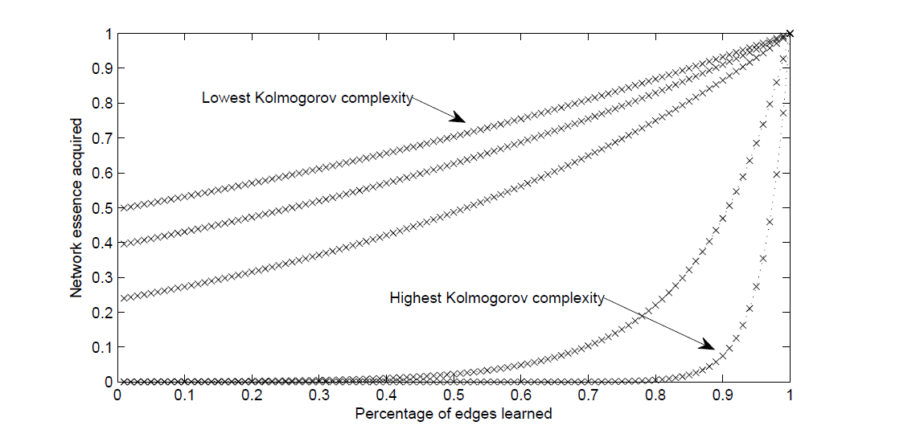

Slide 12
Attack Analysis
r_{i} : Learning rate of each edge vertex, determined by the activity level level.

Slide 13
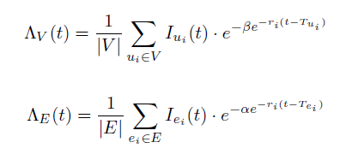
Attack success rate

Slide 14
Aggressive attack or Slow attack?
Aggressive attack is more likely to be detected
Slow attacks evade detection for a long time.
Detection probability of attacking agents at time t:
ρ: probability that an agent would copy itself to a neighboring vertex at each time step.

Slide 15
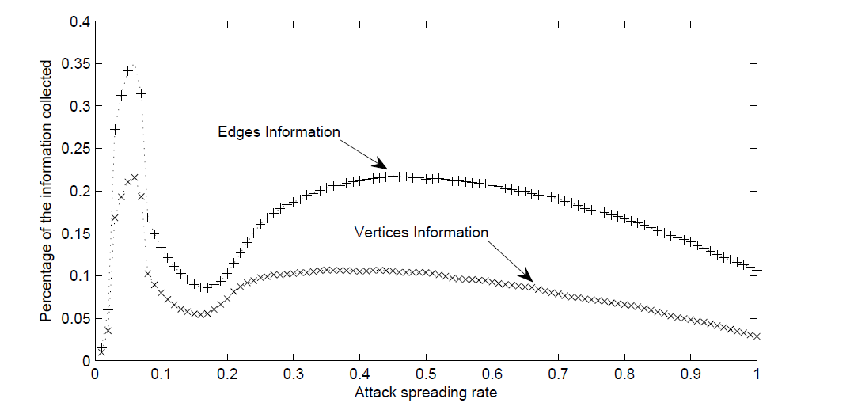

Slide 16
What is a safe network against such attacks?
Initially, learning each edge contributes: O(1) information
As the logic behind the network unveils, contribution from each edge increases.
Critical learning threshold:

Slide 17
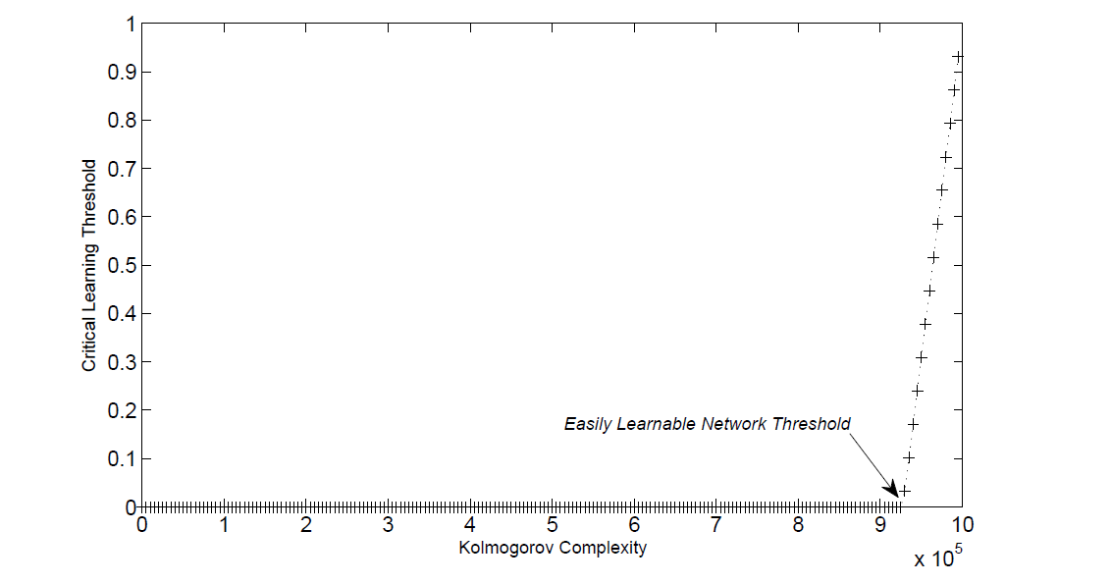
Easily learnable network
Critical learning threshold = O(1)

