Slide 1
Parallel Community Detection on Large Networks with Propinquity Dynamics
Yuzhou Zhang﹡, Jianyong Wang ＃, Yi Wang§, Lizhu Zhou¶
^{Presented by Nam Nguyen}
﹡ ＃ ¶ Department of Computer Science and Technology
Tsinghua University
Beijing 100084, China
§ Google Beijing Research
Beijing 100084, China

Slide 2
Introduction to Community Detection Problem
Graph(Network) can model many real life data.
Community structure:
Highly intra connected subgraphs with relatively sparse connections to the leaving parts.
Coherent.
Ubiquitous, distinguishing property of real-life graph.
Applications include:
Online Social network
Web linkage graph
Biological network
Wikipedia graph

Slide 3
How to Define the Community Structure
Clique(complete connected graph): too strict to be realistic.
Quasi-Clique: a relaxed version.
Edge density: inner community edges exceed the inter community edges.
Implicit definition:
Optimize a quality function.
Modularity: a popular one.
Even no quality function: depends on the heuristic.

Slide 4
Related Works
Graph partitioning: several parameters must be specified.
Edge cutting: the key is defining edge centrality.
Betweenness:
edge betweenness;
current-flow betweenness;
Random-walk betweenness;
Information centrality.
Edge clustering coefficient.
Modularity optimization:
greedy algorithm;
simulated annealing;
extremal optimization;
spectral optimization;
Spectral(laplacian matrix, normal matrix).
Other…

Slide 5
Motivation
Many algorithms exist, why we propose another??
We need a more efficient one for web scale data.
Existing algorithm ≥ O(|V|²) on sparse graph.
Ours ≈ O(k·|V|).
We emphasize the scalability aspect.
Parallelized.
Incremental.

Slide 6
Brainstorm
The community structures are right there, why mine?
Can the communities claim themselves by increase the graph contrast?
How…?
Observation: In social network, communities are progressively and spontaneously formed by the collaborative local decision of each individual.
Our solution: Continue with more aggressive criterion.
Community structures can emerge naturally.
Simulation of this process: Propinquity Dynamics.

Slide 7
Overview
Input Network
(Graph with low contrast)
Propinquity dynamics
Parallelization
Refined Network
(Graph with higher contrast)
Finding connected components
Network communities

Slide 8
Example
Propinquity dynamics
Finding networks communities: Via connected components

Slide 9
Propinquity Dynamics
Propinquity: evaluate the probability that a pair of vertices are involved in a coherent community. Denoted by
In global view:
Contradict propinquity and topology.
Update the topology to keep consistent with propinquity.
In local view: Edge deletion and insertion.
Local topology update criteria:
α: cutting threshold
β: emerging threshold

Slide 10
Propinquity Dynamics (high level description)
Init:
Term condition:
The incremental version:
Not yet proven
Init:
Converge condition:

Slide 11
Overlapping Community Extraction
Connected components are simply the communities we want.
We have a chance to extract the community overlap:
Micro clustering the neighbors at each vertex.
Breadth-first-search.

Slide 12
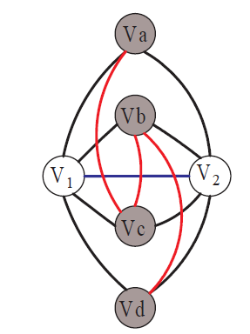
Coherent Neighborhood Propinquity
A concrete propinquity definition.
Three parts:
Direct connection;
Common neighbors;
Conjugates;
It reflects the connectivity of the maximum coherent sub graph involving a vertex pair;
Locality;

Slide 13
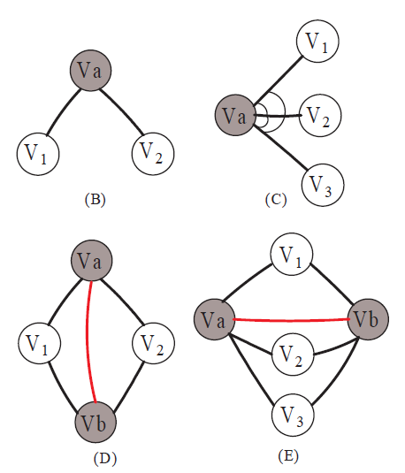
Propinquity Calculation
Complexity by definition:
Efficient way:
Angle propinquity: for-each-vertex;
Conjugate propinquity: for-each-edge;
The overall complexity can be reduced to
Can the propinquity be updated via an adaptive algorithm?

Slide 14
Incremental Propinquity Update
Single edge delete and insert is easy to handle.
What if overall topology update is considered?
Let N_{n}(v) be the neighboring vertex set of v in topology T_{n}.
All the following formulations will be mapped to operations on the three set.
Given two disjoint vertex sets, S₁, S₂(S₁⊓S₂=∅),
: for each v_{i}∈ S₁ and each v_{j}∈ S₂, increase P(v_{i}, v_{j}) by a unit propinquity;
: for each v_{i}, v_{j} ∈ S(v_{i}≠v_{j} ), add a unit propinquity to P(v₁, v₂)

Slide 15
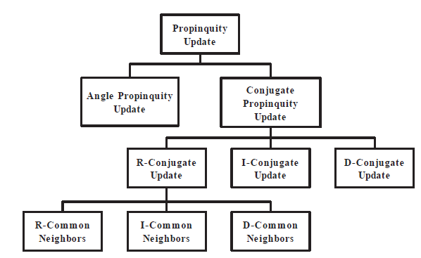
Update overview

Slide 16
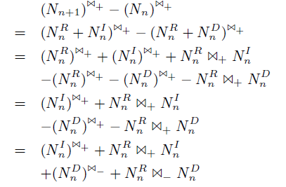
Angle Propinquity Update
Angle propinquity w.r.t a specific vertex v(omitted):

Slide 17
Conjugate Propinquity Update(D,I)
Conjugate propinquity update brought by a…
Deleted edge:
Inserted edge:
It seems that, we have covered all the cases… Really?

Slide 18
Conjugate Propinquity Update(R)
The answer is NO!!
The conjugate propinquity contributed by a remained edge may partly change by updated local neighborhood…
Let : be the remained common neighbor set between v₁ and v₂
and can be similarly defined.
This part of propinquity update can be calculated by:
Which can be further calculated by………

Slide 19
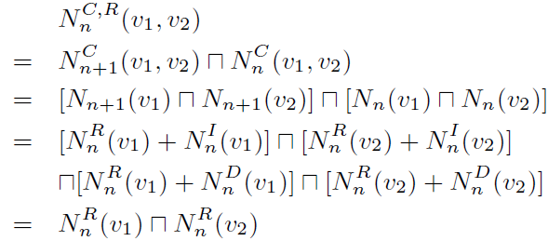
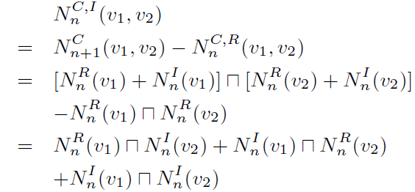
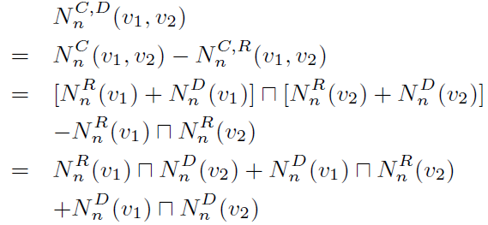
Conjugate Propinquity Update(R)

Slide 20
Incremental propinquity update(all)

Slide 21
Parallelization
Time complexity without sparse graph assumption:
Real datasets are large and dense;
Degree distribution is highly skewed;
So we need HPC’s help…

Slide 22
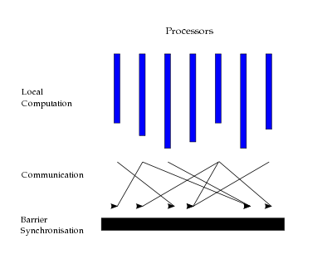
Parallel Model (Vertex oriented BSP)
Virtual processor(vertex);
Physical machine execute virtual processor;
Message passing;
Bulk synchronous parallel (BSP) model:
Computation proceeds in consecutive supersteps
(1)Accessing the messages sent to it in the previous superstep;
(2)Carrying out local computation and accessing local memory;
(3)Send other processors messages, which will be available to the destination processor later in the next superstep.
Barrier: Dump both memory and messages for fault recovery;

Slide 23
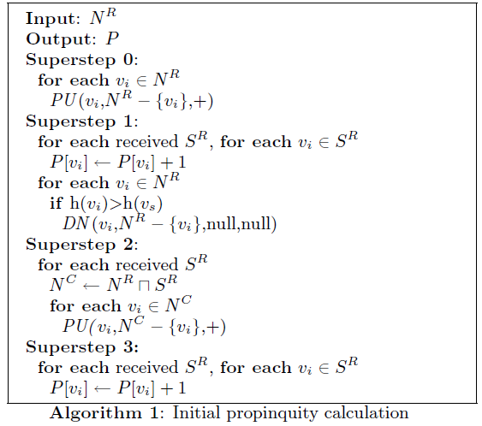
Parallel Implementation
Message type:
: propinquity update;
: donate neighbors;

Slide 24
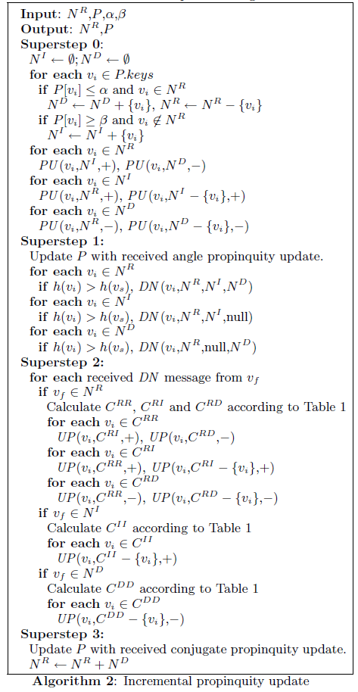
Parallel Implementation
We use C^{XY} to refer the resulting set calculated from operation at X column and Y row:

Slide 25
Performance issues
Message flow control:
Divide the macro superstep into micro superstep;
Message size estimate & flow control strategy;
Propinquity map buffering;

Slide 26
Experiments
Dataset statistics:
Different α and β for each network
Wikipedia: α=400, β= 1000
eatRS: α= 5, β= 180
Erdos02: α=2, β= 20
Hep-th-new: α=20, β= 300

Slide 27
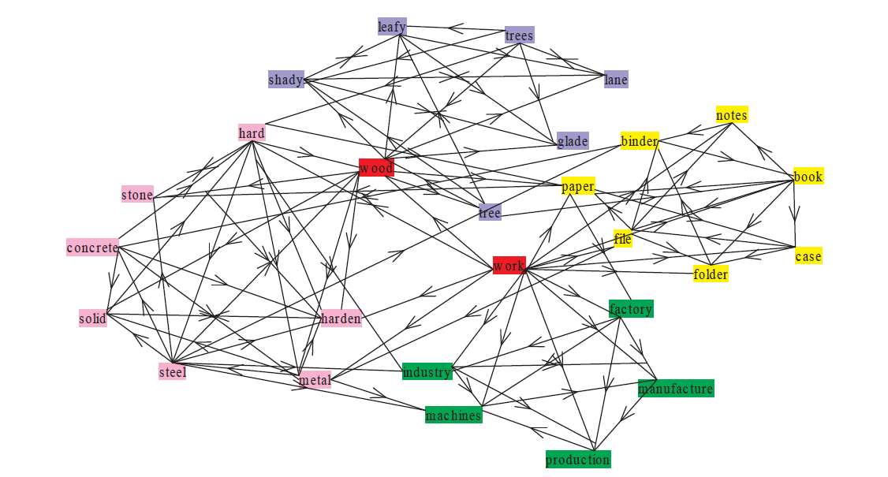
Experiments
Overlapping community structures mined from word association network eatRS.

Slide 28
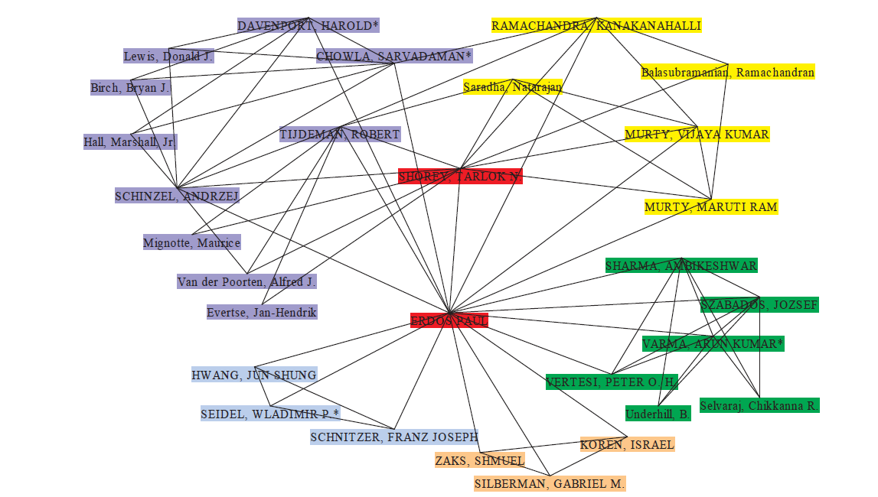
Experiments
Overlapping community structures mined from the Erdos02 co-authorship network.

Slide 29
Experiments
Selected community structures mined from Wikipedia linkage graph.

Slide 30
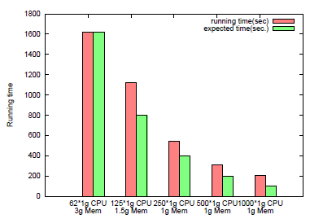
Experiments
Speedups while running on neural-sized hep-thnew
paper citation network.
Speedups while running on large scale Wikipedia
linkage graph.

Slide 31
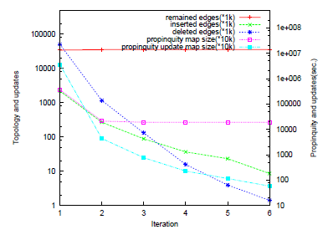
Experiments
The effectiveness of the incremental propinquity
update(Wikipedia linkage graph).
Topology and propinquity evolves with iteration.

Slide 32
Thank you for your attention☺

