Slide 1
Wireless Array Based Sensor Relocation in Mobile Sensor Networks
W. Li, Y. I. Kamil and A. Manikas
Department of Electrical and Electronic Engineering
Imperial College London, UK
Presented by: Dung T. Nguyen

Slide 2
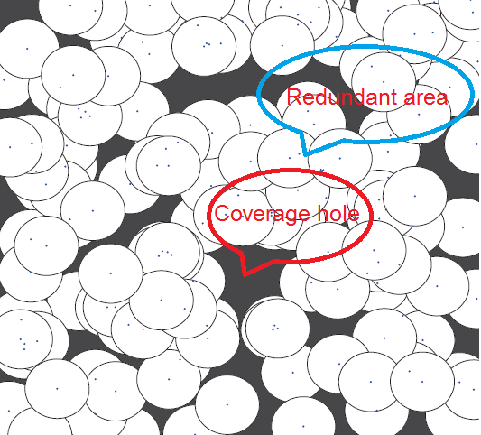
Randomly scattered mobile sensors
Redundant sensors in some area
Coverage holes appear
Move redundant sensors to heal coverage holes

Slide 3
Outline
Model and Problem statement
Redundant sensor detection
Sensor relocation algorithm
Performance evaluation
Conclusion

Slide 4
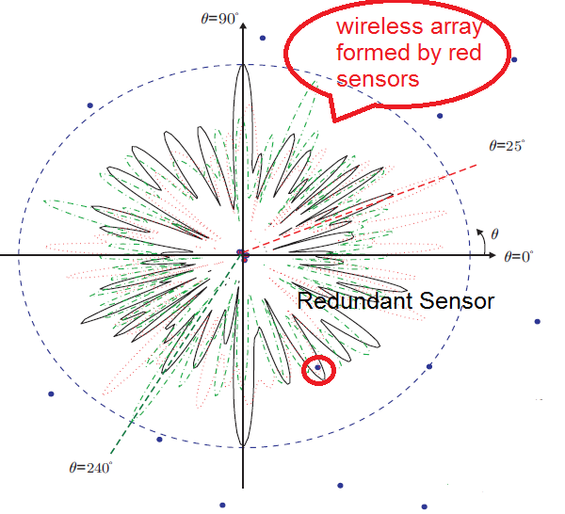
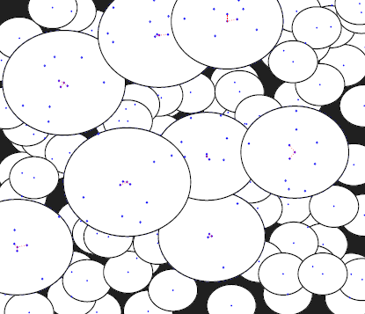
Cooperative sensing model
Each sensor knows its location
Near sensors corporate to form wireless array (WA)
Consider a WA as a big sensor
A redundant sensors lies “inside” another sensor

Slide 5
Problem statement
Max distance a sensor can move is Lmax
Schedule to move sensors to maximize the coverage area
Approach:
Detect coverage holes
Move redundant sensors to heal holes

Slide 6
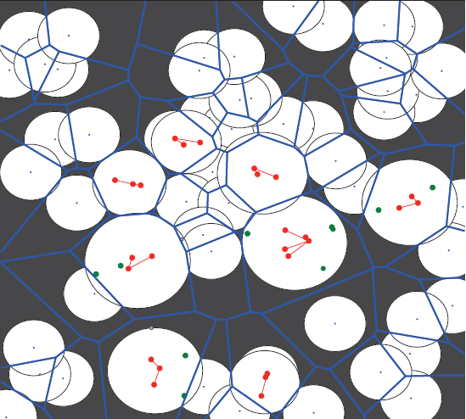
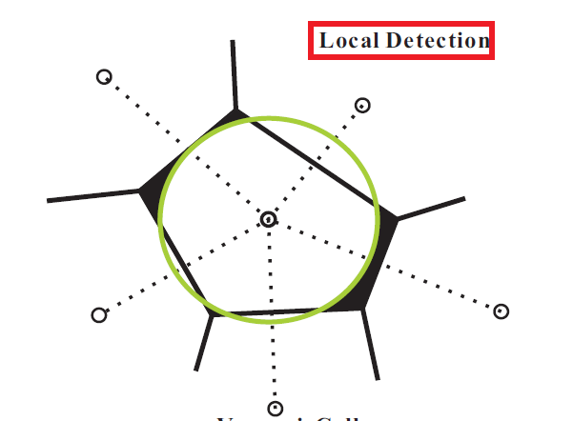
Local Detection Diagram
Partition space into areas (cell):
Each area include 1 sensor
If a point is cover in an area, it must be covered by the corresponding sensor
Check coverage hole in each cell

Slide 7
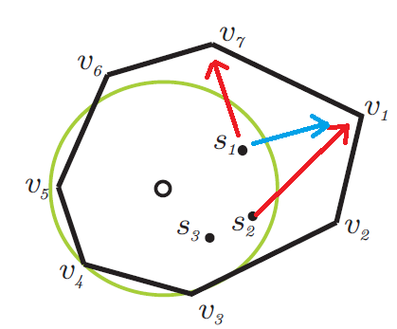
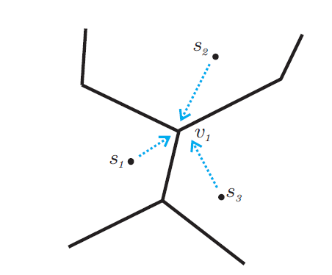
Relocate redundant sensors
Move redundant sensors to cell vertices as many as possible
Broadcast information to neighbor cells to avoid duplication

Slide 8
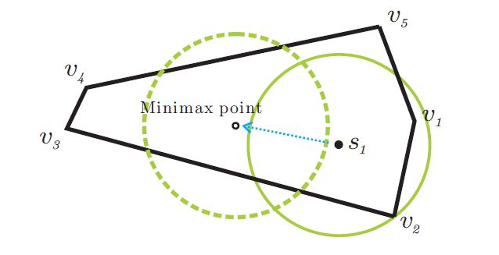
Strategies to move sensors
After relocations of redundant sensors, iterative move sensors:
Rebuild local detection diagram
Move a sensor to the center of mass of its cell
Only move sensors if coverage gain is greater than the given threshold
Stop is there is no movement

Slide 9
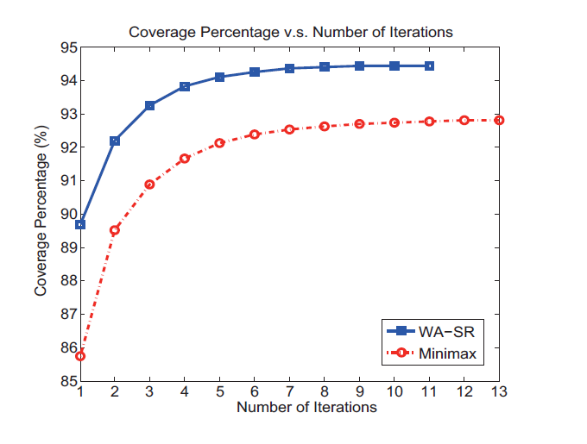
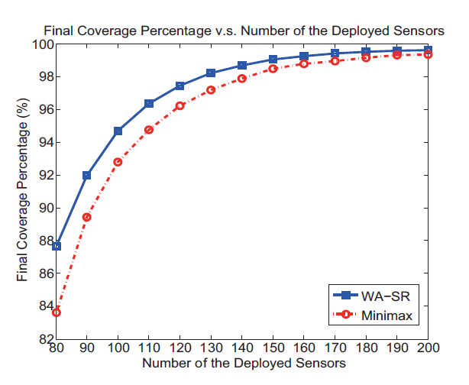
Performance evaluation
Provide better coverage percentage and run in less iteration compared to minimax movement

Slide 10
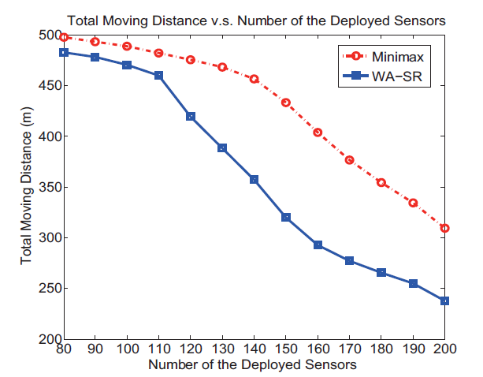
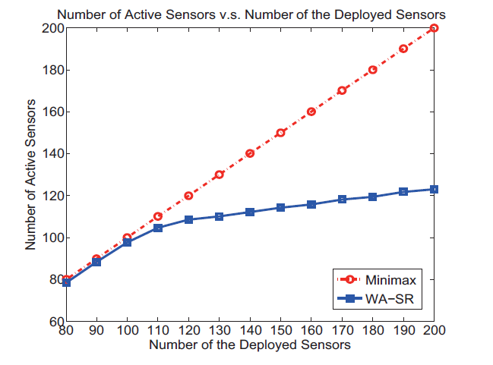
Performance evaluation

Slide 11
Conclusions
Advantages:
Add redundant sensor detection phase
Move sensor to the center of mass
Distributed algorithms
Disadvantages:
Need to know location information
Assume wireless array as a big sensor
When a sensor stops working, many other sensors move to cover its hole

Slide 12
ZONER: A ZONE-based Sensor Relocation Protocol for Mobile Sensor Networks
Xu Li and Nicola Santoro
School of Computer Science
Carleton University, Canada
Presented by: Dung T. Nguyen

Slide 13
Problem statement
All sensors are mobile sensor
Each sensor only knows its local topology
When a sensor is failure, find a redundant mobile sensor to replace it

Slide 14
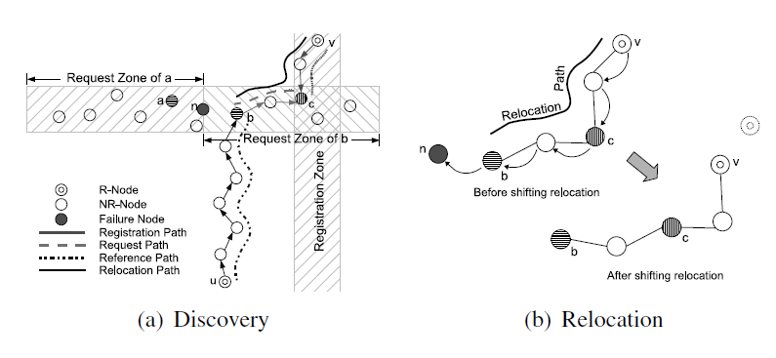
Coverage hole healing
Each redundant sensor broadcast its locations to all other sensors in a vertical strip
When a sensor fails, its neighbor broadcast the information in a horizontal line
Move a redundant sensor to replace the failed sensor

Slide 15
Conclusions
Advantages:
Save energy due to broadcast in a restricted area
Available set of redundant nodes
Can work on hybrid sensor networks
Disadvantages:
No cost optimization
Simple collision solution
Each sensor in vertical strips stores too much information

Slide 16
Conclusions
Improvement (may include in the paper)
Create set of available mobile sensors in each head node in grid quourum model
Each head node only stores 4 best mobile sensors in four quad laterals
Set up the subgraph of head nodes to reduce the number of communication messages.

