Slide 1
CAP5510 – Bioinformatics Fall 2025
Tamer Kahveci
CISE Department
University of Florida

Slide 2
Vital Information
Instructor: Tamer Kahveci
Email: tkahveci @ ufl
Office: MH 5400C
Time: M/W/F (10:40-11:30AM)
Office hours: M/F 11:50-12:40 AM
Course page:
http://www.cise.ufl.edu/~tamer/teaching/fall2025

Slide 3
Goals
Understand the major components of bioinformatics data and how computer technology is used to understand this data better.
Learn main potential research problems in bioinformatics and gain background information.

Slide 4
This Course will not
Teach you biology.
Teach you programming
Teach you how to be an expert user of off-the-shelf molecular biology computer packages.

Slide 5
Course Outline
Introduction to terminology
Biological sequences
Sequence comparison
Lossless alignment (DP)
Lossy alignments (BLAST, etc)
Sequence assembly
Substitution matrices, statistics
Multiple sequence alignment
Phylogeny
Protein structures and their prediction
Biological networks

Slide 6

Grading
Project (50 %)
Contribution (2.5 % bonus)
Other (50 %)
Homeworks + quizzes
How can I get an A ?

Slide 7
Expectations
Background needed
Data structures and algorithms.
Coding (C, Java, etc)
Encourage
read bioinformatics literature in general

Slide 8

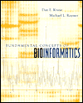
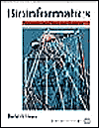
Text Book
No text book.
Class notes + papers.

Slide 9
Where to Look ?
Journals
Bioinformatics
Genome Research
PLOS Computational Biology
Journal of Computational Biology
IEEE Transaction on Computational Biology and Bioinformatics
Conferences
RECOMB
ISMB
ECCB
PSB
BCB

Slide 10
What is Bioinformatics?
Bioinformatics is the field of science in which biology, computer science, and information technology merge into a single discipline. The ultimate goal of the field is to enable the discovery of new biological insights as well as to create a global perspective from which unifying principles in biology can be discerned. There are three important sub-disciplines within bioinformatics:
the development and implementation of tools that enable efficient access and management of different types of information.
the analysis and interpretation of various types of data including nucleotide and amino acid sequences, protein domains, and protein structures
the development of new algorithms and statistics with which to assess relationships among members of large data sets
From NCBI (National Center for Biotechnology Information)
http://www.ncbi.nlm.nih.gov/Education/BLASTinfo/milestones.html

Slide 11
Does biology have anything to do with computer science?

Slide 12
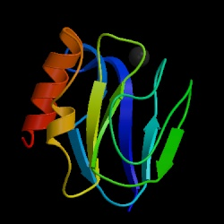
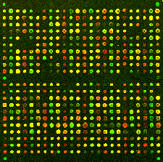

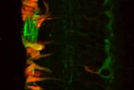
Challenges 1/4
Data diversity
DNA (ATCCAGAGCAG)
Protein sequences (MHPKVDALLSR)
Protein structures
Microarrays
Biological networks
Bio-images
Time series

Slide 13
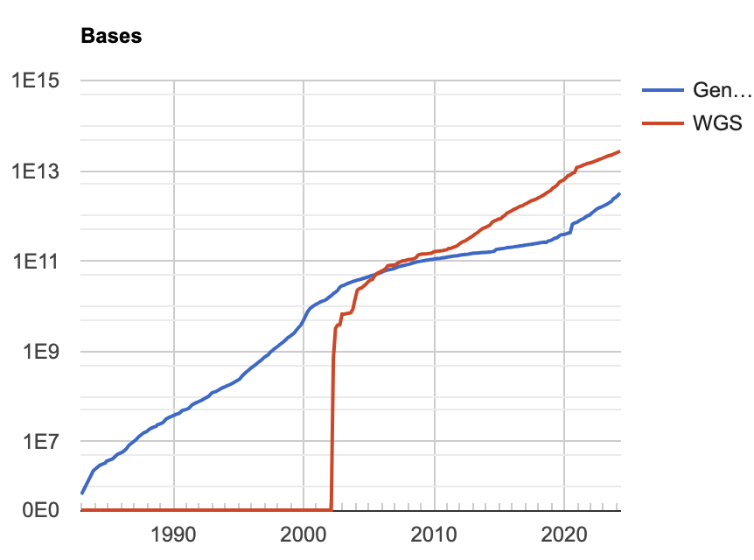
Challenges 2/4
Database size as of April 2024,
GeneBank : More than 30x10¹³ bases.
More than 500K protein sequences,
More than 214K protein structures in PDB
Genome sequence now accumulate so quickly that, in less than a week, a single laboratory can produce more bits of data than Shakespeare managed in a lifetime, although the latter make better reading.
-- G A Pekso, Nature 401: 115-116 (1999)

Slide 14
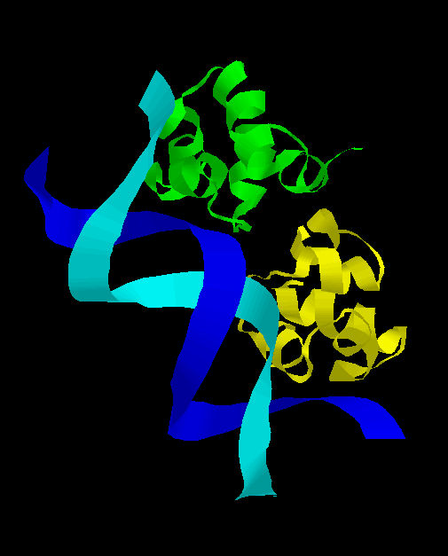
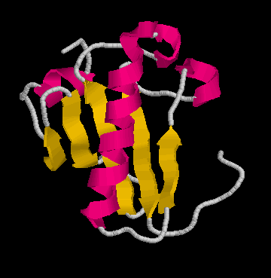
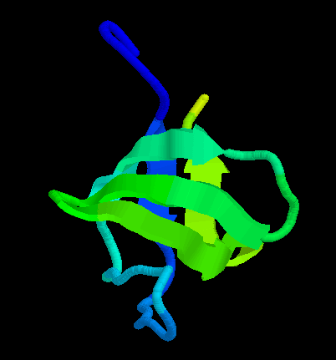
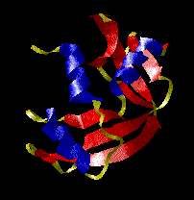
Challenges 3/4
Deciphering the code
Within same data type: hard
Across data types: harder
caacaagccaaaactcgtacaaatatgaccgcacttcgctataaagaacacggcttgtgg
cgagatatctcttggaaaaactttcaagagcaactcaatcaactttctcgagcattgctt
gctcacaatattgacgtacaagataaaatcgccatttttgcccataatatggaacgttgg
gttgttcatgaaactttcggtatcaaagatggtttaatgaccactgttcacgcaacgact
acaatcgttgacattgcgaccttacaaattcgagcaatcacagtgcctatttacgcaacc
aatacagcccagcaagcagaatttatcctaaatcacgccgatgtaaaaattctcttcgtc
ggcgatcaagagcaatacgatcaaacattggaaattgctcatcattgtccaaaattacaa
aaaattgtagcaatgaaatccaccattcaattacaacaagatcctctttcttgcacttgg
atggcaattaaaattggtatcaatggttttggtcgtatcggccgtatcgtattccgtgca
gcacaacaccgtgatgacattgaagttgtaggtattaacgacttaatcgacgttgaatac
atggcttatatgttgaaatatgattcaactcacggtcgtttcgacggcactgttgaagtg
aaagatggtaacttagtggttaatggtaaaactatccgtgtaactgcagaacgtgatcca
gcaaacttaaactggggtgcaatcggtgttgatatcgctgttgaagcgactggtttattc
ttaactgatgaaactgctcgtaaacatatcactgcaggcgcaaaaaaagttgtattaact
ggcccatctaaagatgcaacccctatgttcgttcgtggtgtaaacttcaacgcatacgca
ggtcaagatatcgtttctaacgcatcttgtacaacaaactgtttagctcctttagcacgt
gttgttcatgaaactttcggtatcaaagatggtttaatgaccactgttcacgcaacgact

Slide 15
Challenges 4/4
Inaccuracy
Redundancy

Slide 16
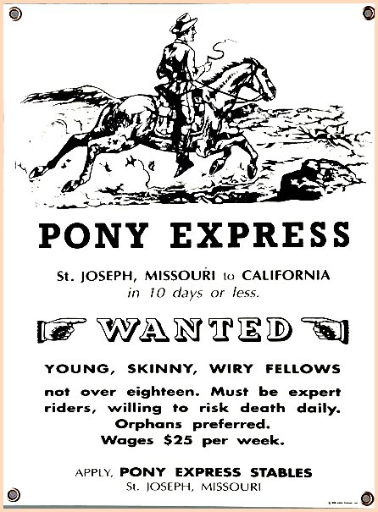
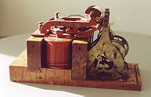
What is the Real Solution?
We need better computational methods
Compact summarization
Fast and accurate analysis of data
Efficient indexing

Slide 17
A Gentle Introduction to Molecular Biology

Slide 18
Goals
Understand major components of biological data
DNA, protein sequences, expression arrays, protein structures
Get familiar with basic terminology
Learn commonly used data formats

Slide 19
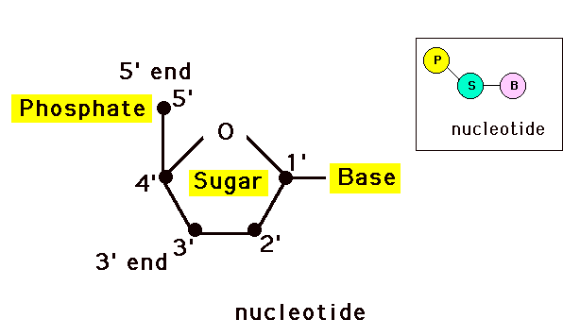
Genetic Material: DNA
Deoxyribonucleic Acid, 1950s
Basis of inheritance
Eye color, hair color, …
4 nucleotides
A, C, G, T

Slide 20
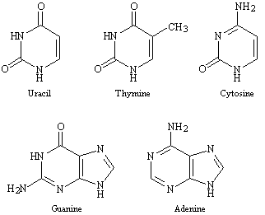
Chemical Structure of Nucleotides
Pyrmidines
Purines

Slide 21
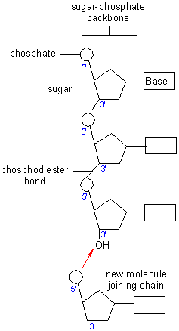
Making of Long Chains
5’ -> 3’

Slide 22
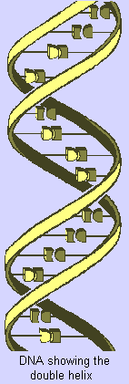
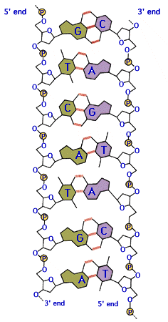
DNA structure
Double stranded, helix (Watson & Crick)
Complementary
A-T
G-C
Antiparallel
3’ -> 5’ (downstream)
5’ -> 3’ (upstream)

Slide 23
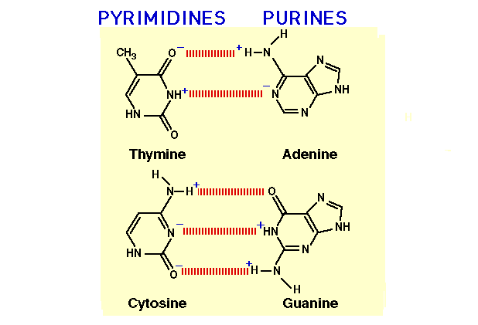
Base Pairs

Slide 24
Question
5’ - GTTACA – 3’
5’ – XXXXXX – 3’ ?
5’ – TGTAAC – 3’
Reverse complements.

Slide 25
Repetitive DNA
Tandem repeats: highly repetitive
Satellites (100 k – 1 Gbp) / (a few hundred bp)
Mini satellites (1 k – 20 kbp) / (9 – 80 bp)
Micro satellites (< 150 bp) / (1 – 6 bp)
DNA fingerprinting
Interspersed repeats: moderately repetitive
LINE
SINE
Proteins contain repetitive patterns too

Slide 26
Genetic Material: an Analogy
Nucleotide => letter
Gene => sentence
Contig => chapter
Chromosome => book
Traits: Gender, hair/eye color, …
Disorders: down syndrome, turner syndrome, …
Chromosome number varies for species
We have 46 (23 + 23) chromosomes
Complete genome => volumes of encyclopedia
Hershey & Chase experiment show that DNA is the genetic material. (ch14)

Slide 27
Functions of Genes 1/2
Signal transduction: sensing a physical signal and turning into a chemical signal
Enzymatic catalysis: accelerating chemical transformations otherwise too slow.
Transport: getting things into and out of separated compartments

Slide 28
Functions of Genes 2/2
Movement: contracting in order to pull things together or push things apart.
Transcription control: deciding when other genes should be turned ON/OFF
Animation (ch7)
Structural support: creating the shape and pliability of a cell or set of cells

Slide 29
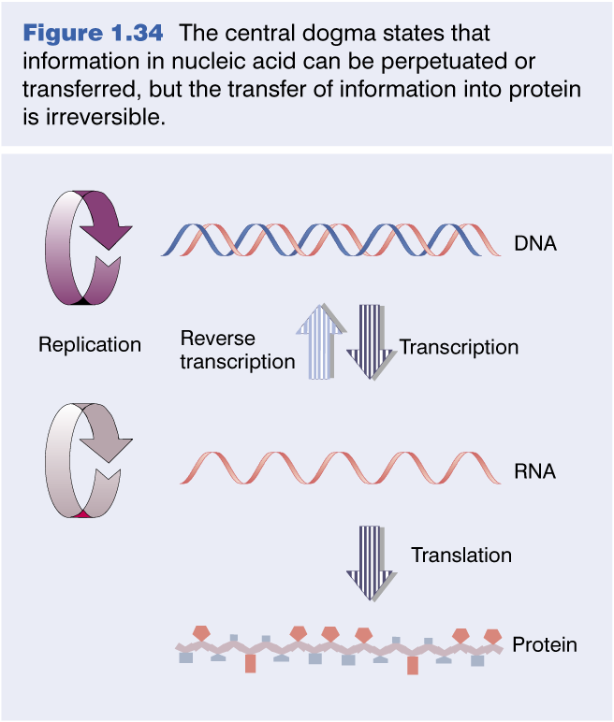
Central Dogma

Slide 30
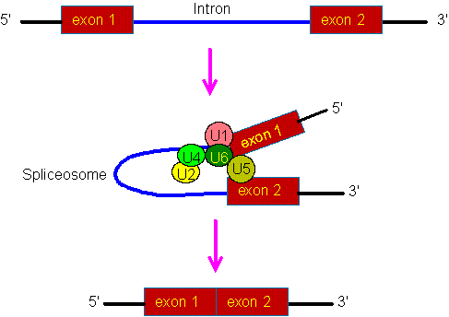
Introns and Exons 1/2

Slide 31
Introns and Exons 2/2
Humans have about 20,000 genes < 3% of total DNA in genome.
Remaining 97% for control information. (e.g. when, where, how long, etc...)

Slide 32
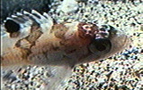


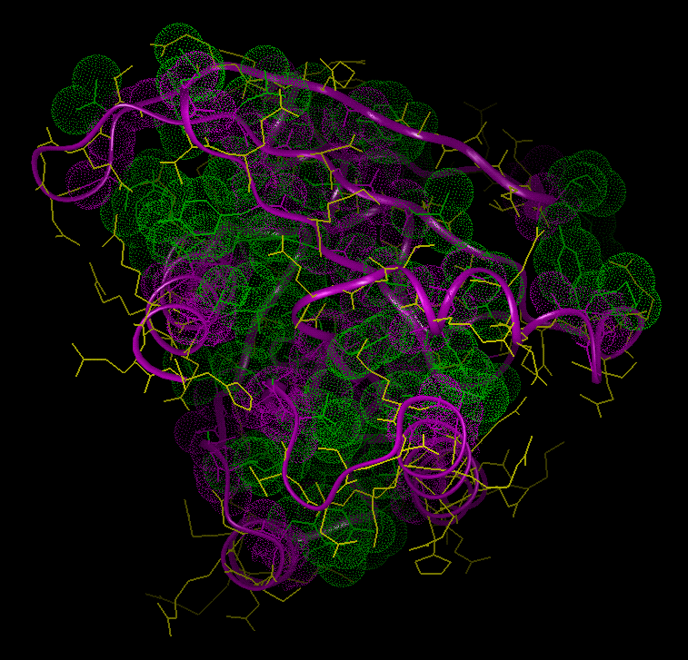
DNA
(Genotype)
Protein
Phenotype
Gene expression

Slide 33
Gene Expression
Building proteins from DNA
Promoter sequence: start of a gene
≥ 13 nucleotides.
Positive regulation: proteins that bind to DNA near promoter sequences increases transcription.
Negative regulation

Slide 34
Microarray
Animation on creating microarrays

Slide 35
Amino Acids
20 different amino acids
ACDEFGHIKLMNPQRSTVWY but not BJOUXZ
~300 amino acids in an average protein, hundreds of thousands known protein sequences
How many nucleotides can encode one amino acid ?
4² < 20 < 4³
E.g., Q (glutamine) = CAG
degeneracy
Triplet code (codon)

Slide 36
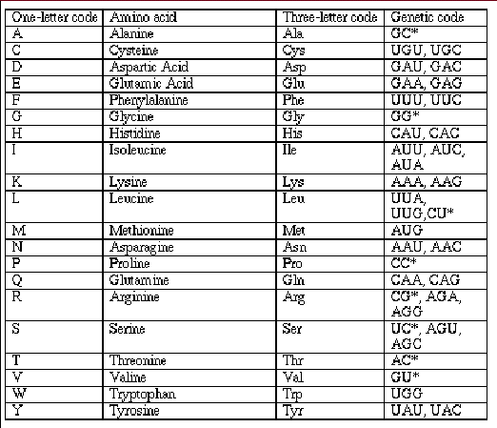
Triplet Code

Slide 37
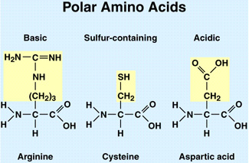
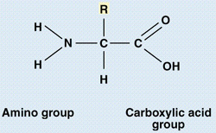
Molecular Structure of Amino Acid
C∝
Side Chain
Non-polar, Hydrophobic (G, A, V, L, I, M, F, W, P)
Polar, Hydrophilic (S, T, C, Y, N, Q)
Electrically charged (D, E, K, R, H)

Slide 38
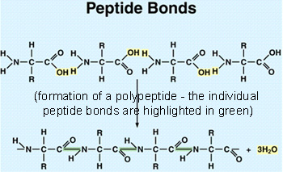
Peptide Bonds

Slide 39
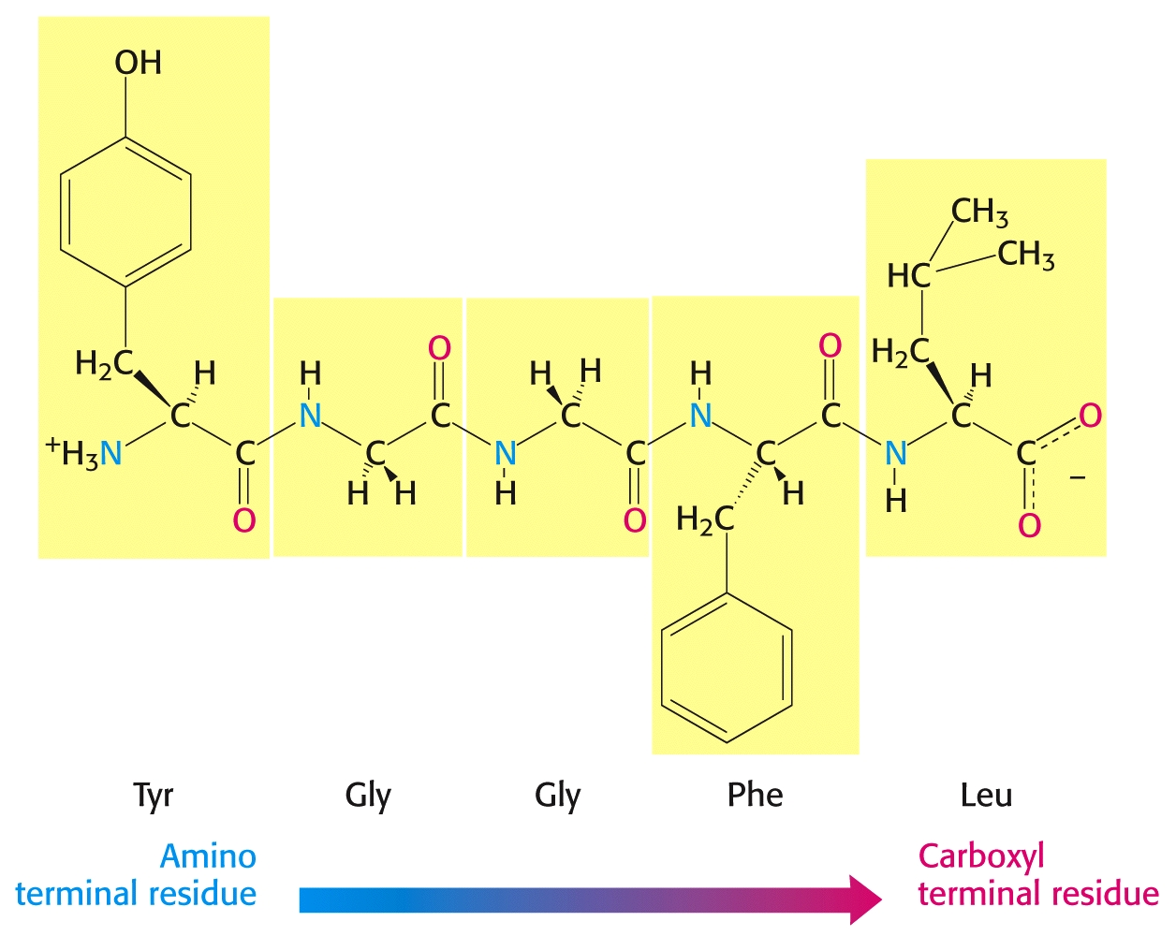
Direction of Protein Sequence
Animation on protein synthesis (ch15)

Slide 40
Data Format
GenBank
EMBL (European Mol. Biol. Lab.)
SwissProt
FASTA
NBRF (Nat. Biomedical Res. Foundation)
Others
IG, GCG, Codata, ASN, GDE, Plain ASCII

Slide 41
Primary Structure of Proteins
>2IC8:A|PDBID|CHAIN|SEQUENCE
ERAGPVTWVMMIACVVVFIAMQILGDQEVMLWLAWPFDPTLKFEFWRYFTHALMHFSLMHILFNLLWWWYLGGAVEKRLGSGKLIVITLISALLSGYVQQKFSGPWFGGLSGVVYALMGYVWLRGERDPQSGIYLQRGLIIFALIWIVAGWFDLFGMSMANGAHIAGLAVGLAMAFVDSLNA

Slide 42
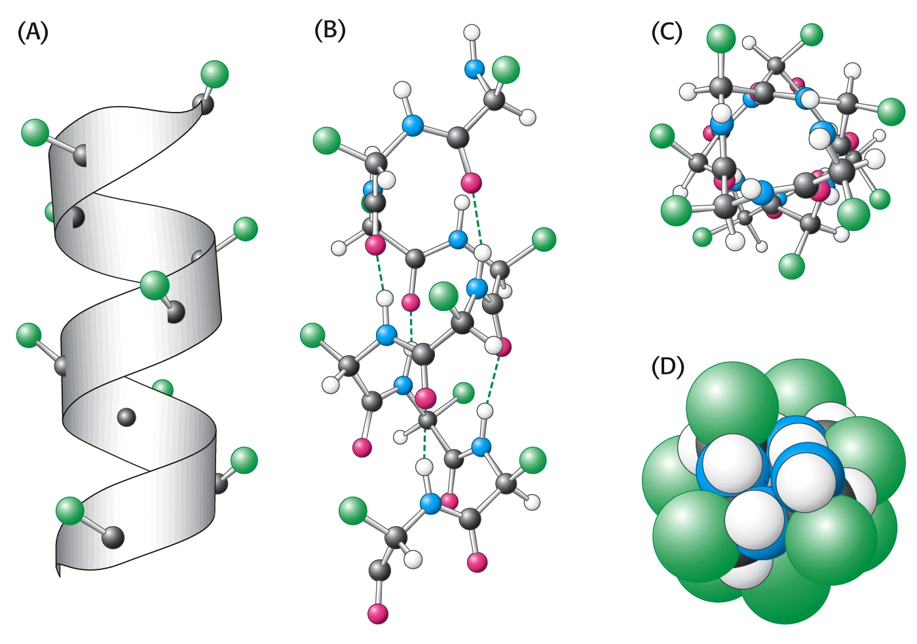
Secondary Structure: Alpha Helix
1.5 A translation
100 degree rotation
Phi = -60
Psi = -60

Slide 43
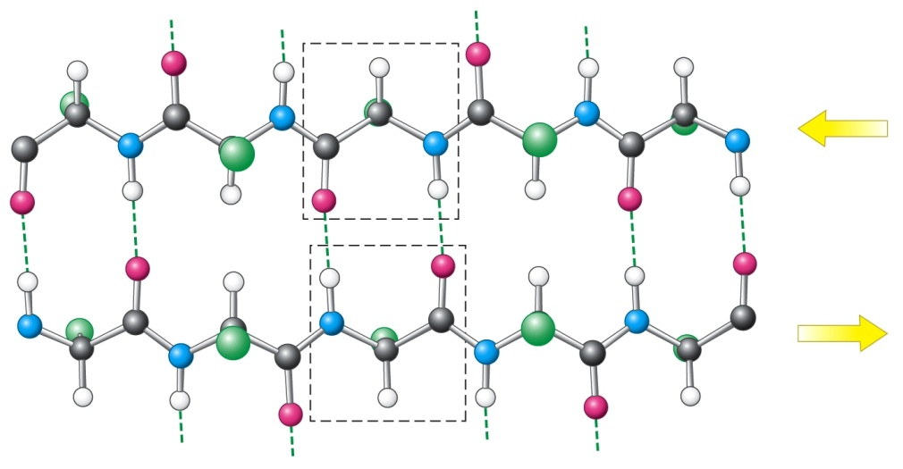
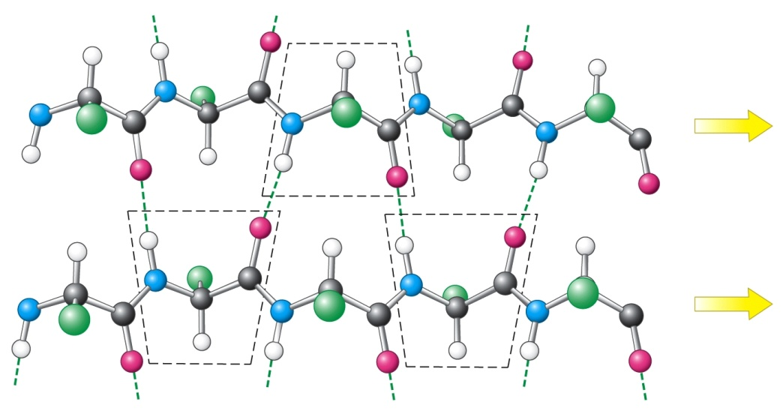
Secondary Structure: Beta sheet
anti-parallel
parallel
Phi = -135
Psi = 135

Slide 44
Tertiary Structure
phi₁
phi₂
psi₁
2N angles

Slide 45
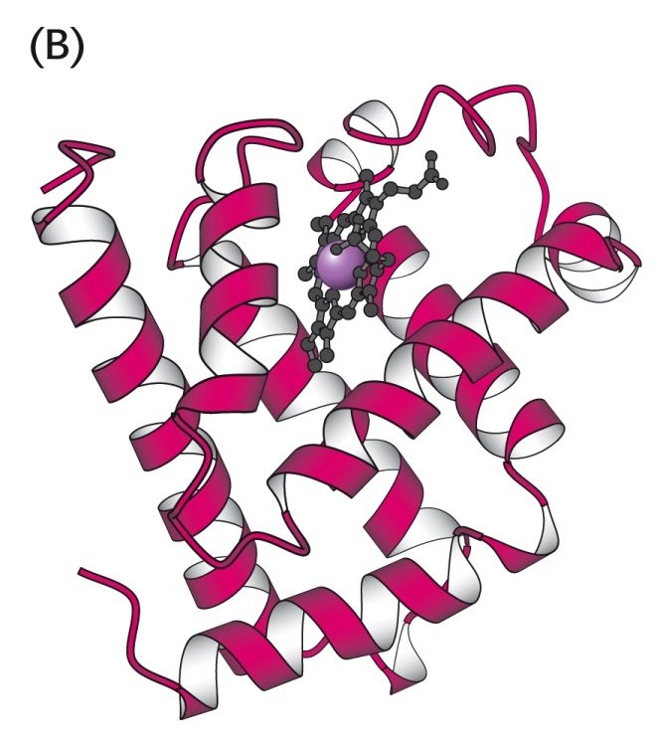
Tertiary Structure
3-d structure of a polypeptide sequence
interactions between non-local atoms
tertiary structure of
myoglobin

Slide 46
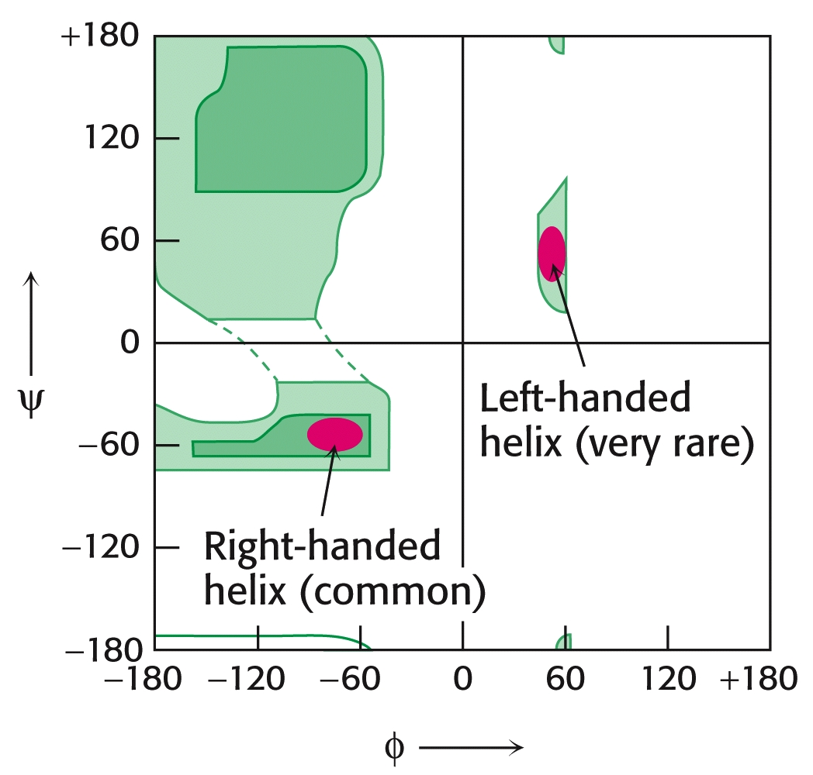
Ramachandran Plot
Sample pdb entry ( http://www.rcsb.org/pdb/ )

Slide 47
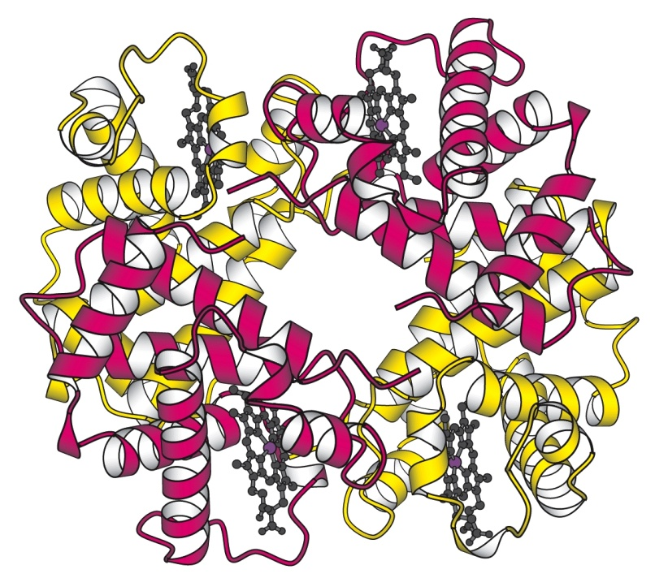
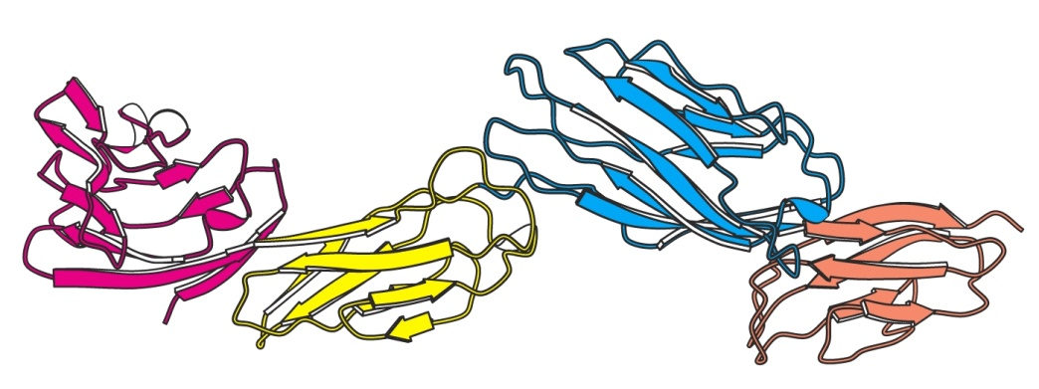
Quaternary Structure
Arrangement of protein subunits
quaternary structure of Cro
human hemoglobin tetramer

Slide 48
Structure Summary
3-d structure determined by protein sequence
Prediction remains a challenge
Diseases caused by misfolded proteins
Mad cow disease
Classification of protein structure

Slide 49
Biological networks
Signal transduction network
Transcription control network
Post-transcriptional regulation network
PPI (protein-protein interaction) network
Metabolic network

Slide 50
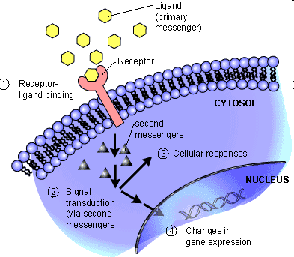
Signal transduction
Extracellular molecule
activate
Memberane receptor
alter
Intrecellular molecule

Slide 51
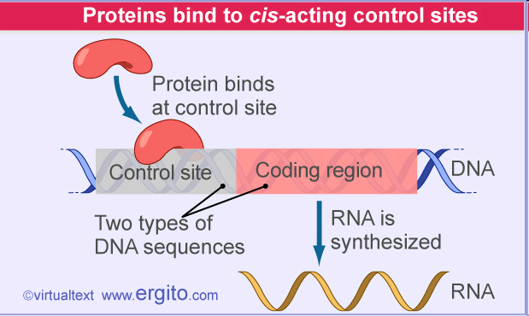
Transcription control network
Transcription Factor (TF) – some protein
bind
Promoter region of a gene
Up/down regulates
TFs are potential drug targets

Slide 52
Post transcriptional regulation
RNA-binding protein
bind
RNA
Slow down or accelerate protein translation from RNA

Slide 53
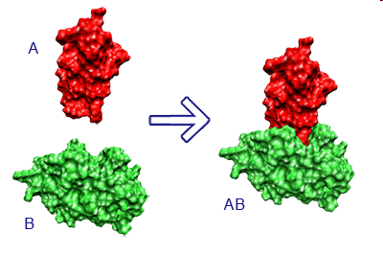
PPI (protein-protein interaction)
Creates a protein complex

Slide 54
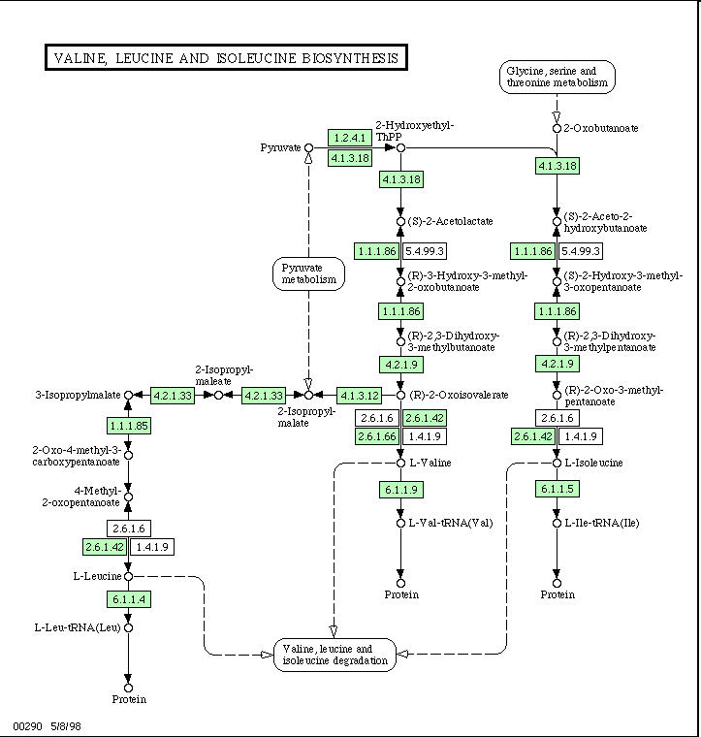
Metabolic interactions
Compound A1
…
Compound Am
consume
Enzyme(s)
produce
Compound B1
…
Compound Bn

Slide 55
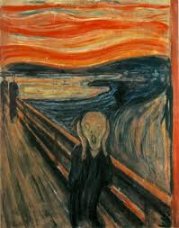
Quiz Next Lecture
পরীক্ষা
考試
QUIZ

Slide 56
STOP
Next:
Basic sequence comparison
Dynamic programming methods
Global/local alignment
Gaps

