Slide 1
Security Measures in Mobile Ad hoc Networks
Radhika Apte
CIS6930 Advanced Cryptography

Slide 2
Motivation
Cellular Networks
802.11
MANETs
  Key characteristics:
    Every node is a router
    Every node moves
    No special node
  Advantage of MANETs:
    Quick formation of network
    No pre-established infrastructure
    Little human configuration required
    Self- heal capability

Slide 3
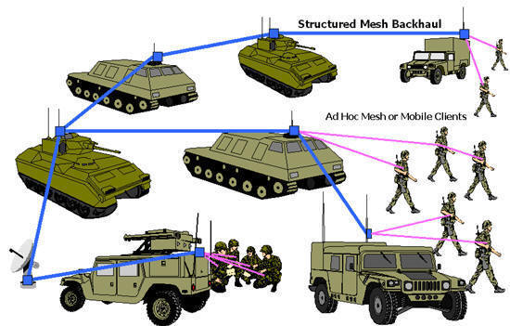

Continued…
Application of MANETs
  Battlefield environments
  Emergency response
  Vehicular Networks
  Sensor Deployment

Slide 4
Ad hoc Network Vulnerabilities
Absence of Infrastructure
Wireless Links between the nodes
Limited Physical Protection
Lack of a Centralized Monitoring or Management Unit
Resource constraints

Slide 5
Attacks in Ad hoc Network
Passive Attacks
  Passive link intrusion
  Passive node intrusion
Active Attacks
  Impersonation
  Masquerade
  Replay
  Modification
  DOS
Jamming
Energy Exhaustion Attack

Slide 6
Current state of security in ad hoc networks
Focus mainly on secured routing protocols
Secured key distribution and management is neglected
Pre-existence and pre-sharing of secret and public key is assumed
Ad hoc network key management is an open problem
Distribution of key in ad hoc networks mirrors TRUST relations
A scheme efficient and feasible for resource constrained devices is needed

Slide 7
Security Measures
Proactive Approach
  Prevent an attacker from launching an attack initially
Reactive Approach
  Detect security threat and react accordingly
Other Measures
  Threshold Cryptography
  Certificate Authorities
  Reputation Schemes
  Authentication

Slide 8
Threshold Cryptography
(k , n) threshold cryptography scheme by Shamir
Secret split into shares such that for certain threshold k < n , any k components combine to form a valid signature
Value of the threshold k is very important
Tradeoff between security and QoS requirement
Threshold level selection is influenced by :
  Network density
  Node speed
  Node transmission range
  Security level
  Link BW and power loss

Slide 9
Combined ID-Based and threshold Cryptogaphy Scheme
Flexible and Efficient key distribution mechanism
ID-based Encryption Algorithm
  Setup
  Extract
  Encrypt
  Decrypt
Threshold Cryptography
  t –out –of –n threshold scheme
Combined Approach
  Keying material and trust is established during network formation
  Master Public key PK
  Master Secret key SK

Slide 10
Continued…
Algorithm:
  Master public key is given to all when they join the network
  PKG issues secret keys to nodes based on identities
  A node presents the identity to t nodes and receives their private key share
  With correct t shares the node computes its own private key
Advantages:
  Prevents single point of failure
  Resist compromise up to the threshold(k)
  Resilient solution
  Reduction in the computation in joining the network
  Saving in Bandwidth
  Robustness

Slide 11
Certification Authorities
Definition of Trust
Certificate Authorities(CA) in ad hoc networks
Functions of CA:
  Issuing the certificates to authentic nodes
  Storing the certificates
  Validating and revoking the certificates
  Maintains its own private key
  Disseminate the public keys to inquiring clients
  Remain available (on-line)
Certification types :
  Cluster based
  Non- cluster based

Slide 12
Cluster based certification scheme
Clustering:
  Ad hoc network is partitioned into number of clusters
  Cluster head is responsible for organizing the cluster
  Gateways manage communication with other clusters
Building blocks
  Network-Wide Certiﬁcation Infrastructure
  Intra-Cluster Security
  Node Status and Authorization
Protocol
  Key Distribution and Key Refreshment
  Log-On Procedure
  Gateways
  Delegation of Cluster Heads
  Adaptable complexity

Slide 13
Reputation Scheme
Use of reputation schemes
Goals of reputation schemes:
  Distinguish between trusty principal and untrustworthy principal
  Encourage principals to act in a trustworthy way
  Discourage untrustworthy principals from participating in the reputation service
Several ways are:
  Assigning trust values and updating them dynamically
  Differentiating selfish peers from co-operative ones
  Dealing with liars
  Detecting malicious nodes

Slide 14
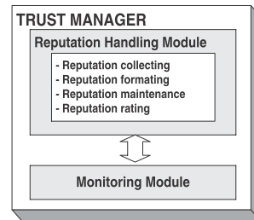
Reputation based trust mechanism
Necessary to monitor the reputation of each node in the network and broadcast it regularly
Trust through an entity : Trust Manager
Two main components of Trust Manager are:
  Monitoring Module
  Trust Handling Module

Slide 15
Continued….
Monitoring Module
  Monitoring related to the proportion of correctly forwarded packets with respect to the total number of packets to be forwarded during a ﬁxed time window.
  Anomaly detected is informed to the Reputation Manager
Reputation Handling Module
  Reputation Information Collection
    Sensing or Direct monitoring
    Recommendations and accusations
  Reputation Information Template
    Use of Reputation Header
  Reputation Information Maintenance
    Use of Reputation table
  Reputation Rating
    Use of a Reputation value
    Depends on previously calculated value

Slide 16
Authentication
Need for light weight and scalable authentication protocols
Use of standard e-signature and its effects
Authentication performance is based on two factors:
  Threshold level
  Authentication delay
Several ways are:
  Digital signatures
  Use of high speed hash function
  Interleaved message authentication
  Deniable electronic voting
  Use of efficient hash chains and one time hash tag commitments
  Based on trust and clustering

Slide 17
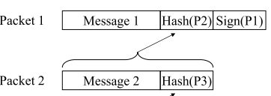


Message Authentication Scheme
Issues concerning Message authentication
  Efficiency
  Stability
Traditional authentication schemes
  Chain scheme : easy to break
  Star and tree scheme : more overhead
Use of Enhanced Chain scheme and Enhanced star and tree scheme

Slide 18
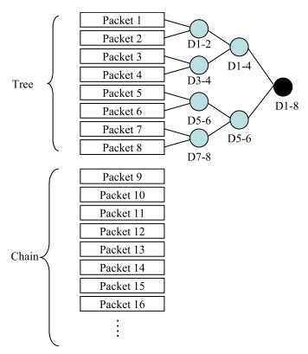
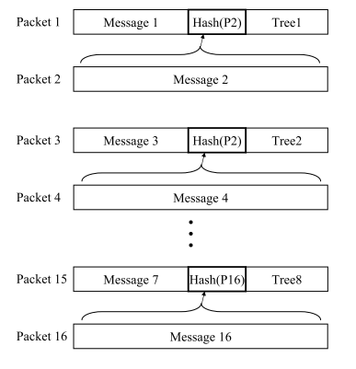
E-Chain and E-Tree scheme

Slide 19
Risk Management
Five step risk management method is as follows:
  Creation of an attacker Profile
  Creation of Attack Graph
  Labeling Attack Paths with Behavior Attributes
  Risk Computation
  Optimizing the risk level

Slide 20
Conclusion
Reasons of vulnerability of ad hoc networks to attacks
Different possible attacks
Security Approaches
  Threshold cryptography open questions:
    Bounds of threshold value
    Validity of partial key (time)
  CA
    Best criteria for CA selection
    Number of CAs
  Better performance with combination of reputation schemes and trust models

Slide 21
References
[1] Marianne A. Azer , Sherif M. El-Kassas , Magdy S. El-Soudani , “Security in Ad Hoc Networks From Vulnerability to Risk Management” , Third International Conference on Emerging Security Information, Systems and Technologies, 2009
[2] F. Sato, H. Takahira, and T. Mizuno. "Message Authentication Scheme for Mobile Ad hoc Networks," icpads, 11th International Conference on Parallel and Distributed Systems (ICPADS'05), pp.50-56, 2005.
[3] Y. Rebahi, V. Mujica, and D. Sisalem. "A Reputation-Based Trust Mechanism for Ad Hoc Networks," iscc, 10th IEEE Symposium on Computers and Communications (ISCC'05), pp. 37-42, 2005.
[4] A. Khalili, J. Katz, and W. Arbaugh, “Toward Secure Key Distribution in Truly Ad-Hoc Networks,” Proceedings of the 2003 Symposium on Applications and the Internet Workshops (SAINT-w’03).
[5] R. Dantu, K. Loper, and P. Kolan, “Risk Management using Behavior based Attack Graphs”, International Conference on Information Technology: Coding and Computing (ITCC'04) Volume 1
[6] Suhizaz Sudin, Alexei Tretiakov, Raja Haslinda Raja Mohd Ali, Mohd Ezane Rusli, “Attacks on Mobile Networks: An Overview of New Security Challenge” , 2008 International Conference on Electronic Design December 1-3, 2008, Penang, Malaysia
[7] http://www.atacwireless.com/adhoc.html
[8] http://www.youtube.com/watch?v=RY6nLhbOClQ
[9] http://www-nishio.ist.osaka-u.ac.jp/research/index.php?Ad-hoc%20network
[10] R. Dantu, K. Loper, and P. Kolan, “Risk Management using Behavior based Attack Graphs”, International Conference on Information Technology: Coding and Computing (ITCC'04) Volume 1

Slide 22
Thank You and Questions??

