Slide 1
Survey of steganography
With an emphasis on audio techniques.
By: Eric Hernandez

Slide 2
Discussion overview
What is steganography?
Definition
Do’s/Don’ts
Steganographic techniques
Images
Audio
Other applications
Steganalysis
Overview
Specific audio example
Examples of use in the real world

Slide 3
What is Steganography?
Literally, “covered writing”
Invisible inks
Character arrangement (non-cryptographic)
Wax coverings
Formal Definition:
“Steganography is the technique of concealing information within seemingly innocuous carriers. It is the art and science of writing hidden messages in such a way that no one, apart from the sender and intended recipient, suspects the existence of the message.”

Slide 4
“Rules of steganography”
Strength is not stealth
Stegonography =/= Cryptography
Not exclusive
Assume the hiding method is known
Known as Kerchkoff’s principle in crypto
Never divulge side information
Don’t add noise to a where it doesn’t belong
Cover images
Audio
Notes:
2. Statistics: if there are any tell-tale statistical changes, assume the adversary knows them. Difficult because you don’t know what statistics the adversary will focus on.
4. As quality of cameras, audio increases adding noises becomes more and more of a bad idea.

Slide 5
Steganographic Techniques

Slide 6
Steganographic techniques: Images
Common approaches:
LSB modification
Masking
Filtering
Transformations via algorithms
Not all approaches created equal
Size restrictions
Vulnerability to manipulation

Slide 7
Steganographic techniques: Images, LSB
Composed of hiding information inside of the LSB of an image
Leads to a few requirements:
Image must have suitable “noise”
Image must be of sufficient size
Must be able to “hide in plain sight”
Advantages/Disadvantages
Easy to implement
Does not stand up to compression
Scalability

Slide 8
Steganographic techniques: Images, Masking and Filtering
Most commonly seen as watermarks as a mean to protect copyright
Not traditional steganography in that information is being extended, not hidden
Accomplished not by hiding in noise, but by manipulating luminescence
Changes visible properties of an image, but can be still made to be undetectable to the human eye
Advantages/Disadvantages
More suitable for lossy compression than LSB
Not traditional stego

Slide 9
Steganographic techniques: Images, Algos and trans
Based on transformation via formula
Discrete Cosine Transformation (DCT)
Fast Fourier Transform
Advantages/Disadvantages
Can be visually undetectable
Can “scatter” secret information across image
Can be used together with encoding and similar watermarking (luminescence techniques)
Not as susceptible to cropping, compression, etc.
Complex

Slide 10
Steganographic techniques: Audio
Human Auditory System (HAS) has a large dynamic range that it can listen through
Perceives over a range of power > 1,000,000:1
Range of frequencies > 1,000:1
Makes it hard to add remove data from original sources
HAS has a weakness, though: sound differentiation
Loud vs. Soft
Several ways to exploit this weakness

Slide 11
Steganographic techniques: Audio
Low-bit encoding
Similar to previously discussed LSB stego
Easy to use, weak to any changes in audio
Phase encoding
Substitutes the phase of an initial audio segment with a reference phase that represents the hidden data
Inaudible in terms of signal-to-perceived noise ratio
Low data transmission rate
Best if used for watermarks or similar small data
Notes:
Audio changes: resampling, channel noise, compression, etc.
Low data transmission rate due to the fact that the secret message is encoded in the first signal segment only

Slide 12
Steganographic techniques: Audio
Spread spectrum
Spreads secret information across frequency spectrum
Two schemes
Direct Sequence
Frequency-hopping
High level of robustness against removal
Possibility of introducing noise
Echo Hiding
Blends information by introducing echo
Vary amplitude, decay rate, offset (delay time) of echo
High level of robustness
Echoes mimic environmental conditions (lossy compress.)

Slide 13
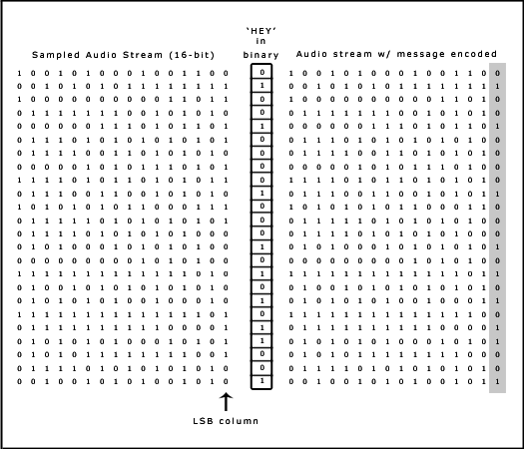
Steganographic techniques: Audio, LSB
Can be augmented with pseudorandom number generator to “scatter”
information over audio file.

Slide 14
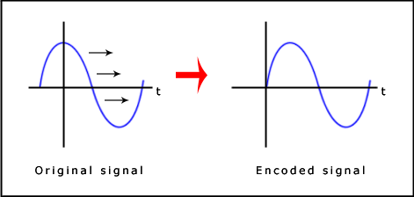
Steganographic techniques: Audio, Phase Encoding
Encodes message as phase shifts in the phase spectrum of a digital signal.
Relies on the fact that phase components of sound are not as perceptible as noise is
Steps:
Break signal into smaller segments
Discrete Fourier Transform (DFT)
Phase diff. between adjacent segments
Insert message into phase vector of first signal segment only
New phase matrix created from new phase of first segment and the original phase difference
Use inverse DFT and concatenate segments back together
Notes:
4. Phase shifts between phase segments easily detectable. Absolute can be changed, but relative cannot

Slide 15
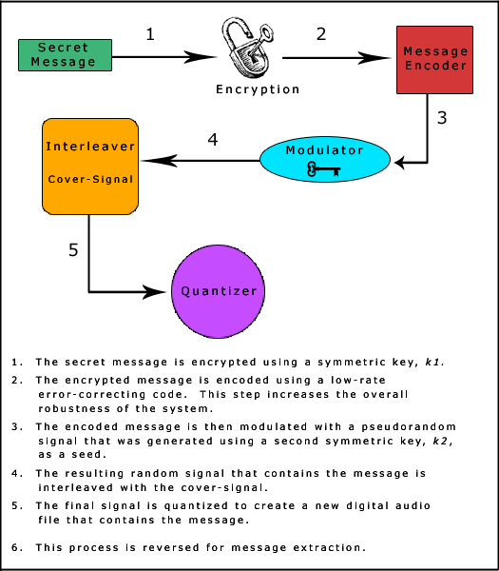
Steganographic techniques: Audio, Spread Spectrum
Spreads secret information across the audio signal’s frequency spectrum
Direct-sequence SS
Message is spread out by a constant called the “chip rate.”
Modulated with a pseudorandom signal
Interleaved with cover
Frequency-hopping SS
Audio file’s frequency spectrum is altered so that it hops randomly between frequencies
Notes:
Like pseudorandom LSB, scatters message across audio. SS, though, spreads the message over the sound file’s frequency spectrum using code that is independent of the actual signal. As a result, the final signal has a larger bandwidth then what’s needed for transmission.
Diagram is of generic direct-sequence SS.

Slide 16
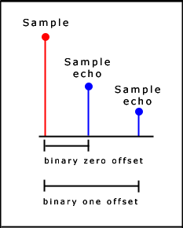
Steganographic techniques: Audio, Echo Hiding
Vary 3 characteristics of introduced echo
Amplitude
Decay rate
Offset (delay time)
Different vary times refer to different bit input
So small that humans don’t notice

Slide 17

Steganographic techniques: Audio, Echo Hiding
Break audio into segments
Message to be inserted is “Hey”
After code runs, recombine segments into final signal
Creates a noticeable mix of echoes, increasing chance of detection
init(Block blocks[]) { for (int i=0; i < blocks.length; i++) { if (blocks[i].echoValue() == 0) blocks[i] = offset0(blocks[i]); else blocks[i] = offset1(blocks[i]); } }Block offset0(Block block) { return (block + (block - OFFSET_0)); }
Block offset1(Block block) { return (block + (block - OFFSET_1)); }

Slide 18
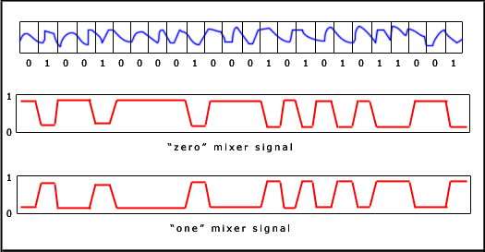
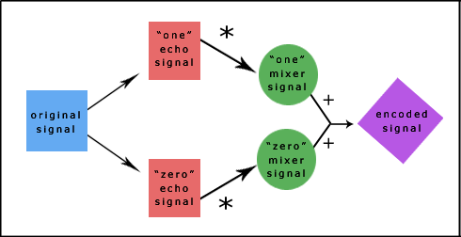
Steganographic techniques: Audio, Echo Hiding
Create two “mixer” signals
“Zero” mixer
“One” mixer
Less abrupt than before
Signals are compliments of each other
Ramp ups and downs help with smooth transitions between echoes
Recovery
Break signal into same block sequence
Autocorrelation function of the signal’s cepstrum
Reveals a spike at each echo time offset
Notes:
Cepstrum is the Forward Fourier Transform of the signal’s frequency spectrum

Slide 19
Steganographic techniques: Other Applications
Text steganography
Little noise in text to hide information in, but possibilities still exist:
“Since everyone can read, encoding text in neutral sentences is doubtfully eﬀective.”
Line number/character number
Vertical letter shifts
Font changes (make some b’s, d’s, p’s longer than others)
Video steganography
Combines ideas of both image and audio stego
Open systems environment steganography
TCP/IP
Containers
Notes:
You can’t hide messages inside of other letters or in any other kind of “noise.” (You can’t change the bits in the letter ‘e’ without getting another letter) Instead, move letters around, or hide message inside the words themselves.
3. TCP/IP can mask information in the TCP/IP headers to hide the true identity of one or more systems (useful for messages). Containers disguise themselves as a simple document or other file, but actually contain the hidden information you sent the sender to receive. People see harmless file except for recipient.

Slide 20
Steganalysis

Slide 21
Steganalysis: Overview
Detect
Defeat
Difficult
Need to understand technique in use
Involves statistical analysis
Especially difficult when Kerckhoff’s principle is applied
Easy
No understanding required
No statistical analysis required
As techniques evolve, will become more difficult

Slide 22
Steganalysis: Text
Detect
Defeat
Patterns being disturbed
Inappropriate (odd) use of language
Line height and white space
Difficult when secret key (outside text) is used
Rewrite
Change spacing, punctuation
Modify line heights or layout
Add or remove words
Does not work on public cover source
Key must be intercepted

Slide 23
Steganalysis: Images
Detect
Defeat
Changes in:
File size
File format
Last modified time stamp
Color palette
Statistical analysis
Examine the LSB
Compress using lossy compression
Destroys LSB modification
Alter image:
Resize
Modify color palette
Conversion to different file format
Luminescence
Notes:
Performing a statistical analysis on the LSB helps. Most people assume the LSB is random, but even when stripped to nothing but the LSB, a semblance of the image is still seen. Since this is the case, LSB must not really be random, but contain information on the whole image. Messing with LSB will make this noticeable (this even applies to the JPEG transform (DCT)).
Conversion to a different file format normally uses a different kind of compression

Slide 24
Steganalysis: Audio
Detect
Defeat
Statistical analysis
Similar to images, look at LSB
Examine inaudible frequencies
Patterns in background noise
Distortions
Similar to images
Compression special note:
Removes frequencies that cannot be heard (a hideout for some stego)
Lower bitrate
Less available space to store stego = at least some data loss

Slide 25
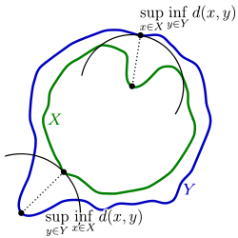
Steganalysis: Hausdorff Distance
Calculation of Hausdorff distance between lines X and Y
Notes:
Hausdorff: the furthest point of a set that you can be to the closest point of a different set
Used to measure the difference between two different representation of the same 3D object. Helpful for efficient display of 3D models.
Take probable stego-audio x and de-noised version x’. Run Hausdorff distance on distortion difference and compare. Tests run on multiple selected wavelet samples.

Slide 26
Uses in the Real World

Slide 27
Steganography: Uses
Copyright
Watermarks
Covert military operations
Keys

Slide 28

Steganography: Uses

Slide 29

Steganography: Uses

Slide 30

Steganography: Uses

Slide 31

Steganography: Uses

Slide 32
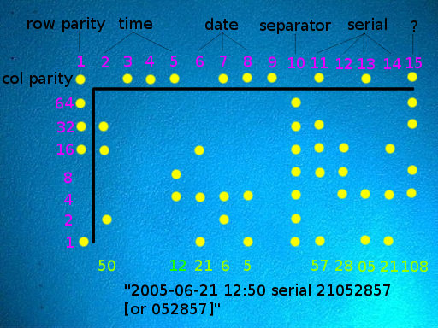
Steganography: Uses

Slide 33
Resources
“A Detailed look at Steganographic Techniques and their use in an Open-Systems Environment”
http://www.sans.org/reading_room/whitepapers/covert/detailed-steganographic-techniques-open-systems-environment_677
“Exploring Steganography: Seeing the Unseen” by Neil F. Johnson, Sushil Jajodia
http://www.jjtc.com/pub/r2026.pdf
“Steganography and Steganalysis” by J.R. Krenn
http://www.krenn.nl/univ/cry/steg/article.pdf
“Steganalysis: The Investigation of Hidden Information” by Neil F. Johnson, Sushil Jajodia
http://www.simovits.com/archive/it98jjgmu.pdf
“Echo Hiding” by Daniel Gruhl, Anthony Lu, Walter Bender
http://www.almaden.ibm.com/cs/people/dgruhl/edh2.pdf

Slide 34
Resources
“A Novel Audio Steganalysis Based on High-Order Statistics of a Distortion Measure with Hausdorff Distance” by Yali Liu, others
http://www.ece.ucdavis.edu/~yliu/pub/papers/Tracy_ISC08.pdf
“Methods of Audio Steganography”
http://www.snotmonkey.com/work/school/405/methods.html#phase
“Secret Code in Color Printers Lets Government Track You”
http://www.eff.org/press/archives/2005/10/16
“Hausdorff Distance”
http://en.wikipedia.org/wiki/Hausdorff_distance

