Slide 1
COP2800 – Computer Programming Using JAVA
University of Florida Department of CISE Spring 2013
Lecture 35 – Overview of Java Web Programming
Webpage: www.cise.ufl.edu/~mssz/JavaNM/Top-Level.html

Slide 2
COP2800 – Programming in JAVA
Course Objectives
Basic Knowledge of Computers & Programming
Specific Knowledge of JAVA Programming
Practical Programming Projects Build Skills
Today’s Class
Overview of Java for the Web
Java Design for a Simple Applet
Making the Components
Integrating Components into an Applet

Slide 3
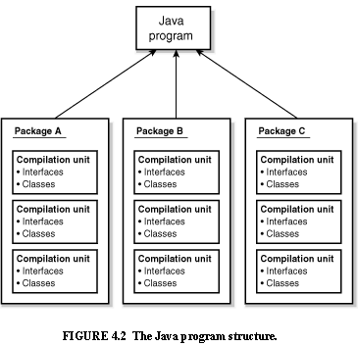
Review: Java Program Structure
HIGH-LEVEL VIEW
JAVA Units:
Packages
Classes
(Instances)
Methods
Instructions
Variables
PICTURE CREDIT: http://www.webbasedprogramming.com/JAVA-Developers-Guide/ch4.htm

Slide 4
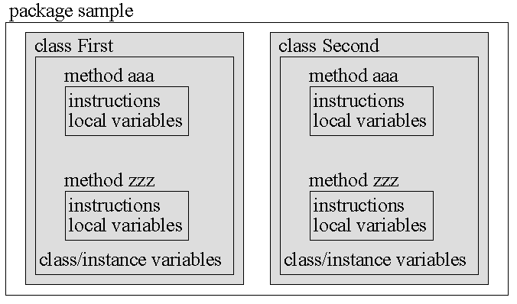
Review: Java Package Structure
PICTURE CREDIT: http://users.soe.ucsc.edu/~charlie/book/notes/summary1-4/sld016.htm

Slide 5
How Does Java Work with Web?
Three Principal Technologies:
JavaScript
Java Servlet
Java Applet
A Java applet is a program delivered to users as Java bytecode (platform independent). Java applets can be executed by browsers for many platforms, including Microsoft Windows, Unix, OS X and Linux.
Source: http://en.wikipedia.org/wiki/Java_applet

Slide 6
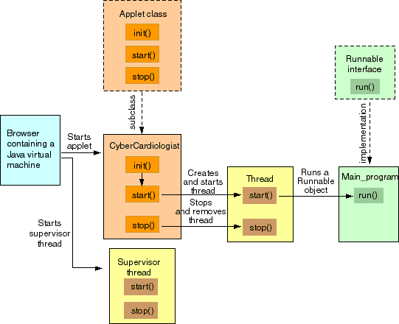
Java Working with Web (cont’d)
ARCHITECTURE OF AN APPLET
APPLET
Image Credit: sandriabudiendra.blogspot.com

Slide 7
Java Working with Web (cont’d)
Advantages of Applets:
It is simple to make it work
Applets are supported by most Web browsers
Execution can be fast
Computational work can be moved from server to client
Increased scalability with number of users and clients
Some Disadvantages of Applets:
Requires Java plug-in
Some browsers, notably mobile browsers running Apple iOS or Android do not run Java applets at all
Security and access restrictions may forbid applets
If a Java Runtime Environment is needed, download time may be quite long (depending on bandwidth & version)
http://en.wikipedia.org/wiki/Java_applet#Advantages

Slide 8
Example: Hello World Applet
Step 1. Create Java Code for “Hello World” Applet
import java.applet.Applet;
import java.awt.Graphics;
public class HelloWorld extends Applet {
public void paint(Graphics g) {
g.drawString("Hello world!", 50, 25);
}
}
Step 2. Compile the file HelloWorld.java
Compiler creates HelloWorld.class in the same directory (folder) as the Java source file (HelloWorld.java).
http://journals.ecs.soton.ac.uk/java/tutorial/getStarted/applet/

Slide 9
Ex: Hello World Applet (cont’d)
Step 3. Create HTML file named Hello.html
with the following text, in the same directory that contains HelloWorld.class :
<HTML>
<HEAD> <TITLE> HelloWorld Program </TITLE> </HEAD>
<BODY>
Here is the output of my program: <APPLET CODE="HelloWorld.class" WIDTH=150 HEIGHT=25> </APPLET>
</BODY>
</HTML>
http://journals.ecs.soton.ac.uk/java/tutorial/getStarted/applet/

Slide 10
Ex: Hello World Applet (cont’d)
Step 4. Run the “Hello World” Applet:
Load Hello.html into an application that runs Java applets:
Java-compatible browser
URL = file:/home/username/HTML/Hello.html
Java applet viewing program
Applet Viewer in JDK
The browser window will show a message similar to this:
Here is the output of my program: Hello world!
http://journals.ecs.soton.ac.uk/java/tutorial/getStarted/applet/

Slide 11
How We will Use Applets
Assignment 6:
Given IntelligentTTT Game and GUI Code
(from Assignments 4 and 5 – work in groups)
Make a Java Applet
Run the Java Applet on a Web Browser
All the Features of Assignment 5
We will help you with GUI and applet code ☺
… and more …

Slide 12
This Week: More GUIs, New Applets
Wednesday 17 Apr 2013:
GUIs and Applets in JAVA – Assignment #6
Approach, Code, and Analysis
Friday 19 Apr 2013:
Assignment #6 Hands-On Experience
Coding Examples (LAPTOPS)

