Slide 1
COP2800 – Computer Programming Using JAVA
University of Florida Department of CISE Spring 2013
Lecture 21 – Inheritance and Polymorphism (cont’d)
Webpage: www.cise.ufl.edu/~mssz/JavaNM/Top-Level.html

Slide 2
COP2800 – Programming in JAVA
Course Objectives
Basic Knowledge of Computers & Programming
Specific Knowledge of JAVA Programming
Practical Programming Projects Build Skills
Today’s Class
Review of Inheritance Concept(s)
Polymorphism
What is Polymorphism, and How is it Used?
Polymorphism in Java

Slide 3
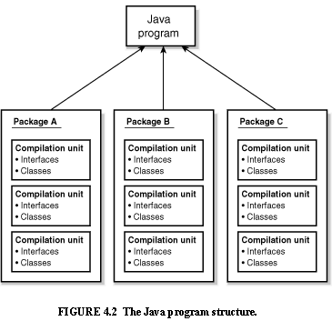
Review: Java Program Structure
HIGH-LEVEL VIEW
JAVA Units:
Packages
Classes
(Instances)
Methods
Instructions
Variables
PICTURE CREDIT: http://www.webbasedprogramming.com/JAVA-Developers-Guide/ch4.htm

Slide 4
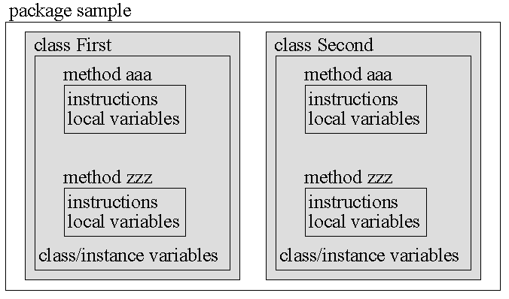
Review: Java Package Structure
PICTURE CREDIT: http://users.soe.ucsc.edu/~charlie/book/notes/summary1-4/sld016.htm

Slide 5
Review: Classes and Objects
Example:
String greeting = "Hello world!";
CLASS NAME: String
VARIABLE NAME: greeting
CLASS DESCRIPTION
Instance-of
Instance-of
Instance-of
OBJECT #1
OBJECT #2
. . .
OBJECT #n

Slide 6
Review: Inheritance
Example:
class Golfer extends Person;
SUBCLASS NAME: Golfer
SUPERCLASS NAME: Person
SUPERCLASS DESCRIPTION
extends
extends
extends
SUBCLASS #1 DESCRIPTION
SUBCLASS #2 DESCRIPTION
. . .
SUBCLASS #n DESCRIPTION

Slide 7
Inheritance
Inheritance is the capability of a class to use the properties and methods of another class while adding its own functionality.
Example 1:
SUPERCLASS PERSON
extends
extends
extends
SUBCLASS #1 GOLFER
SUBCLASS #2 STUDENT
. . .
SUBCLASS #n ELECTRICIAN
Subclass
Variables:
swing
stance
grip
score
Subclass
Variables:
gpa
health_status
major
extracurriculars
Subclass
Variables:
availability
hourly_rate
company
unionized
ADD
NEW
PROP-ERTIES
. . .

Slide 8
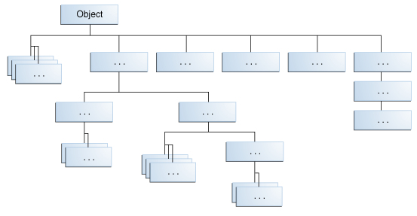
Inheritance: Highest Level?
Object is the highest-level class in Java
Object is extended to form all Java classes (which are Object’s subclasses)
Image Credit: http://docs.oracle.com/javase/tutorial/java/IandI/subclasses.html

Slide 9
Java: Class Specification
Example 2: A “Bicycle” class
CLASS VARIABLES
(see Constructor below)
CONSTRUCTOR INITIAL-IZES Class Variables
… but wait, there’s more …
WHAT ABOUT THE METHODS??
Code Credit: http://docs.oracle.com/javase/tutorial/java/IandI/subclasses.html

Slide 10
Java: Class Specification
Example 2: Bicycle class (cont’d)
speed = speed – decrement ;
speed = speed + increment ;
Code Credit: http://docs.oracle.com/javase/tutorial/java/IandI/subclasses.html

Slide 11
Java: Class Specification
Example 2: Bicycle class (Big Picture)
CLASS NAME:
CLASS VARIABLES
CONSTRUCTOR
METHOD #1
METHOD #2
METHOD #3
METHOD #4
Code Credit: http://docs.oracle.com/javase/tutorial/java/IandI/subclasses.html

Slide 12
Java: Subclass Specification
Example 2: MountainBike subclass
CLASS NAME:
NEW CLASS VARIABLE
CONSTRUCTOR
(MountainBike)
NEW
METHOD
Code Credit: http://docs.oracle.com/javase/tutorial/java/IandI/subclasses.html

Slide 13
Java: Subclass Specification
Example 2: MountainBike subclass
Inherits all variables (fields) and methods of Bicycle class
Adds variable (field) seatHeight
Adds method SetHeight to set the variable seatHeight
Original Bicycle class has 3 fields & 4 methods.
New MountainBike subclass has 4 variables (fields) and 5 methods (Bicycle’s + new ones).

Slide 14
New Concept: Polymorphism
Meaning: Poly = many Morph = shape
Example:
“+” operator can do many things
int + int integer addition
int + float decimal addition
string + string concatenation

Slide 15
Polymorphism (cont’d)
NEW WORD: Overloading
Example:
int + int integer addition
int + float decimal addition
string + string concatenation
We say the “+” operator is overloaded
because one operator performs many functions

Slide 16
Polymorphism (cont’d)
Polymorphism in programming:
Strategies:
1 – Write many functions to do many things
2 – Write one polymorphic function to do many things
OBJECT-ORIENTED DESIGN

Slide 17
Polymorphism (cont’d)
Write one function to do many things (cont’d)
Example: length() method
Class #1
… length method specification…
Class #2
… length method specification…

Slide 18
Polymorphism (cont’d)
JAVA: One function to act on many objects
Example: length() method
Class #1 object1 = <value>
Class #2 object2 = <value>
object.length
object.length

Slide 19
Polymorphism (cont’d)
Example 3: Animals and their Noises…
Let’s begin with a public class called Animal
public class Animal {
public boolean IsQuadruped = true;
Now let’s make a method called sleep:
public void sleep() {
System.out.println(“Zzzzz”);
}
}
Code Credits: http://www.java-made-easy.com/java-inheritance.html http://www.java-made-easy.com/polymorphism-in-java.html

Slide 20
Polymorphism (cont’d)
Example 3: Animals and their Noises (cont’d)
Let’s create subclass Dog from Animal
public class Dog extends Animal {
with a method for making waking noises:
public void makeNoise() {
public boolean awake = true;
System.out.println(“Woof!”);
}
}

Slide 21
Polymorphism (cont’d)
Example 3: Animals and their Noises (cont’d)
Let’s create subclass Cat from Animal
public class Cat extends Animal {
with a method for making waking noises:
public void makeNoise() {
public boolean awake = true;
System.out.println(“Meow!”);
}
}
This is Approach #1 – Many Functions to do Many Things – makeNoise is Polymorphic

Slide 22
Polymorphism (cont’d)
Example 3: Animals and their Noises (cont’d)
Let’s create an Abstract Class called Animal
public abstract class AbAnimal {
with a method for making waking noises:
public void makeNoise();
}
Note that there are no curly braces for the method makeNoise … just a semicolon

Slide 23
Polymorphism (cont’d)
Example 3: Animals and their Noises (cont’d)
As before, let’s create subclass Cat from AbAnimal
public class Cat extends AbAnimal {
public void makeNoise() {
public boolean awake = true;
System.out.println(“Meow!”);
}
}
In the next example (Dog), makeNoise will also appear as a specializing method…

Slide 24
Polymorphism (cont’d)
Example 3: Animals and their Noises (cont’d)
As before, let’s create subclass Dog from AbAnimal
public class Dog extends AbAnimal {
public void makeNoise() {
public boolean awake = true;
System.out.println(“Woof!”);
}
}
Approach #2: Method makeNoise is inherited from the abstract class specification AbAnimal

Slide 25
Polymorphism (cont’d)
Example 3: Animals and their Noises (cont’d)
Summary:
1 – Create an abstract class C
2 – Embed an abstract method M within class C
3 – Extend class C to create a subclass S₁
4 – Make a method M₁ within S₁ that specializes M
5 – Extend class C to create a subclass S₂
6 – Make a method M₂ within S₂ that specializes M
… and so forth (N times)…
Result: M_{i} is polymorphic and overloaded N-fold
MORE ON THIS AFTER SPRING BREAK…

Slide 26
More: Inheritance & Polymorphism
READING ASSIGNMENT: D. Liang: Chapter 10
(Thinking in Objects) and Chapter 11 (Inheritance and Polymorphism)
Friday 01 Mar 2013:
How to do Assignment #3, Part III (LAPTOPS)
After Spring Break:
More on Inheritance & Polymorphism in JAVA
Collections, Sets, Lists, and Queues

