Slide 1

COP2800 – Computer Programming Using JAVA
University of Florida Department of CISE Spring 2013
Lecture 20 – Inheritance and Polymorphism in Java
Webpage: www.cise.ufl.edu/~mssz/JavaNM/Top-Level.html

Slide 2
COP2800 – Programming in JAVA
Course Objectives
  Basic Knowledge of Computers & Programming
  Specific Knowledge of JAVA Programming
  Practical Programming Projects Build Skills
Today’s Class
  Review of Inheritance Concept(s)
  Polymorphism
    What is Polymorphism, and How is it Used?
    Polymorphism in Java

Slide 3
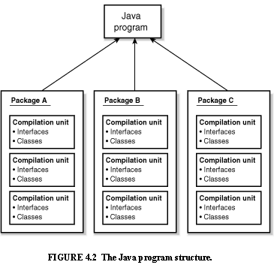
Review: Java Program Structure
HIGH-LEVEL VIEW
JAVA Units:
Packages
Classes
(Instances)
Methods
Instructions
Variables
PICTURE CREDIT: http://www.webbasedprogramming.com/JAVA-Developers-Guide/ch4.htm

Slide 4
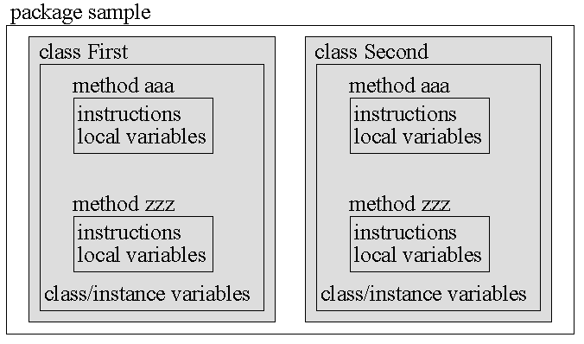
Review: Java Package Structure
PICTURE CREDIT: http://users.soe.ucsc.edu/~charlie/book/notes/summary1-4/sld016.htm

Slide 5
Review: Classes and Objects
Example:
String greeting = "Hello world!";
CLASS NAME: String
VARIABLE NAME: greeting
CLASS DESCRIPTION
Instance-of
Instance-of
Instance-of
OBJECT #1
OBJECT #2
. . .
OBJECT #n

Slide 6
Review: Inheritance
Example:
class Golfer extends Person;
SUBCLASS NAME: Golfer
SUPERCLASS NAME: Person
SUPERCLASS DESCRIPTION
extends
extends
extends
SUBCLASS #1 DESCRIPTION
SUBCLASS #2 DESCRIPTION
. . .
SUBCLASS #n DESCRIPTION

Slide 7
Review: Inheritance
Example:
SUPERCLASS PERSON
extends
extends
extends
SUBCLASS #1 GOLFER
SUBCLASS #2 STUDENT
. . .
SUBCLASS #n ELECTRICIAN
Subclass
Variables:
swing
stance
grip
score
Subclass
Variables:
gpa
health_status
major
extracurriculars
Subclass
Variables:
availability
hourly_rate
company
unionized
ADD
NEW
PROP-ERTIES
. . .

Slide 8
New Concept: Polymorphism
Meaning: Poly = many Morph = shape
Example:
“+” operator can do many things
int + int integer addition
int + float decimal addition
string + string concatenation

Slide 9
Polymorphism (cont’d)
NEW WORD: Overloading
Example:
int + int integer addition
int + float decimal addition
string + string concatenation
We say the “+” operator is overloaded
because one operator performs many functions

Slide 10
Polymorphism (cont’d)
Polymorphism in programming:
Strategies:
1 – Write many functions to do many things
2 – Write one polymorphic function to do many things
OBJECT-ORIENTED DESIGN

Slide 11
Polymorphism (cont’d)
Write one function to do many things (cont’d)
Example: length() method
Class #1
… length method specification…
Class #2
… length method specification…

Slide 12
Polymorphism (cont’d)
JAVA: One function to act on many objects
Example: length() method
Class #1 object1 = <value>
Class #2 object2 = <value>
object.length
object.length

Slide 13
This Week: Inheritance & Polymorphism
READING ASSIGNMENT: D. Liang: Chapter 10
(Thinking in Objects) and Chapter 11 (Inheritance and Polymorphism)
Wednesday 27 Feb 2013:
More on Inheritance & Polymorphism in JAVA
Coding Examples
Friday 01 Mar 2013:
How to do Assignment #3, Part III (LAPTOPS)

