Slide 1

COP2800 – Computer Programming Using JAVA
University of Florida Department of CISE Spring 2013
Lecture 16 – in Java
Webpage: www.cise.ufl.edu/~mssz/JavaNM/Top-Level.html

Slide 2

COP2800 – Programming in JAVA
Course Objectives
  Basic Knowledge of Computers & Programming
  Specific Knowledge of JAVA Programming
  Practical Programming Projects Build Skills
Today’s Class
  Use of Substrings and Associated Operations
  Applications for Substrings
    Converting Strings, Trimming ….
    Detection of Palindromes

Slide 3
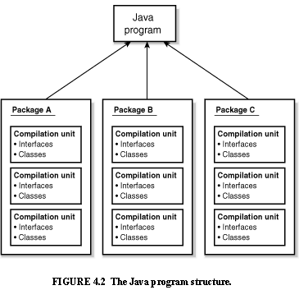
Review: Java Program Structure
HIGH-LEVEL VIEW
JAVA Units:
Packages
Classes
(Instances)
Methods
Instructions
Variables
PICTURE CREDIT: http://www.webbasedprogramming.com/JAVA-Developers-Guide/ch4.htm

Slide 4
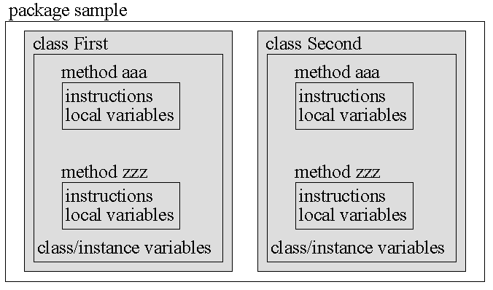
Review: Java Package Structure
PICTURE CREDIT: http://users.soe.ucsc.edu/~charlie/book/notes/summary1-4/sld016.htm

Slide 5
Review: Declaring a String in Java
Simple:
String greeting = "Hello world!";
Array to String (typecasting & constructor)
char[] helloArray = { 'h', 'e', 'l', 'l', 'o', '.' };
String helloString = new String( helloArray );
System.out.println( helloString );
CLASS NAME: String
VARIABLE NAME: greeting

Slide 6
How to Convert String to Array?
Meaning: Convert a String to a character array
Java Code:
public char[] toCharArray()
String s = new String(“Hello, world");
scharArray = s.toCharArray() ;
The output array will be structured as follows:
scharArray (“H”, “e”, “l”, “l”, “o”, … )

Slide 7
Some Operations on Strings
Length of String: length()
Concatenating Strings: string1 + string2
SubStrings: substring(begin_index)
substring(beginx,endx)
Trimming a String: trim()
Convert Value to String: valueOf(<type> <name>)
Reversing a String: reverse(stringname)

Slide 8
How to Extract Substring?
Meaning: Find substring from begin_x to end_x
Pseudocode: s = “Hello, world”; ss = s[1:5]
➔ ss = “Hello”
Java Code:
String s = new String(“Hello, world"); System.out.println( s.substring( 1, 6 ) );
The output will be Hello
Note: begin_x is inclusive
end_x is exclusive

Slide 9
How to Trim a String?
Meaning: Remove leading & trailing spaces
Pseudocode: s = “ Hello, world ”;
trim(s) ➔ “Hello”
Java Code:
import java.io.*; public String trim();
String s = new String(“ Hello, world "); System.out.println( s.trim() );
The output will be Hello, world

Slide 10
How to Convert Value to a String?
Meaning: Convert number to a string
Syntax: static String valueOf(<var-name>)
Java Code:
float floatVar = 123456.78923f;
String s = String.valueOf(floatVar); System.out.println( s );
The output will be 1.234567E5

Slide 11
How to Reverse a String?
Meaning: Reverse order of char’s in a string
Java Code: (uses StringBuffer class)
public String reverse(String s)
{ return new StringBuffer(s).reverse().toString(); }
Example:
String s = “alo!”; reverse(String s) ➔ “!ola”
Makes s a StringBuffer object
Reverses s
Converts s
to a String

Slide 12
How to Detect a Palindrome?
Meaning: Find if a string is a Palindrome
Java Code: (uses StringBuffer class)
public boolean isPalindrome(String s)
{ if s.equals(reverse(s))
{ System.out.println(“Is a Palindrome!”);
return true ; }
else
{System.out.println(“Not Palindrome!”);
return false ; } }
USE s.equals instead of “==“

Slide 13

How to Detect a Palindrome?
Meaning: Simpler Palindrome detection…
Java Code: (uses StringBuffer class)
public boolean isPalindrome(String s)
{return s.equals(reverse(s)) ;
}
USE s.equals instead of “==“
Evaluates to Boolean
Sneaky..

Slide 14
This Week: Arrays and Java
READING ASSIGNMENT: D. Liang: Chapter 9
By now, you should have read textbook Ch. 1-8
NEXT CLASS *LAPTOPS* (Friday 15 Feb 2013):
How to Submit Assignment #2
How to Start Assignment #3, Parts I and II
- Part I: Vocabulary (as usual)
- Part II: Setting up a Tic-Tac-Toe Game
MONDAY 18 Feb 2013 – EXAM REVIEW 7pm E404

