Slide 1
COP2800 – Computer Programming Using JAVA
University of Florida Department of CISE Spring 2013
Lecture 15 – in Java
Webpage: www.cise.ufl.edu/~mssz/JavaNM/Top-Level.html

Slide 2
COP2800 – Programming in JAVA
Course Objectives
Basic Knowledge of Computers & Programming
Specific Knowledge of JAVA Programming
Practical Programming Projects Build Skills
Today’s Class
The Concept of Strings
How to Define and Use Strings
Declaration Statements
Operations with Strings

Slide 3
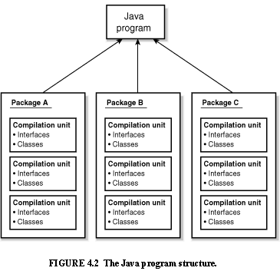
Review: Java Program Structure
HIGH-LEVEL VIEW
JAVA Units:
Packages
Classes
(Instances)
Methods
Instructions
Variables
PICTURE CREDIT: http://www.webbasedprogramming.com/JAVA-Developers-Guide/ch4.htm

Slide 4
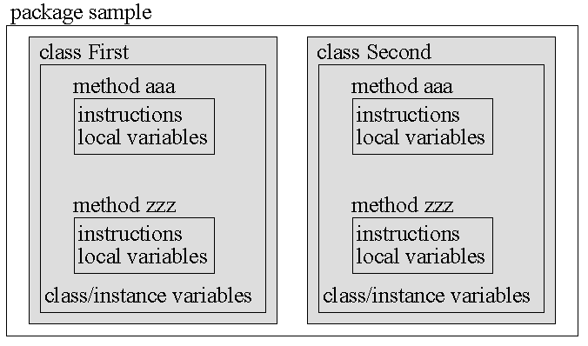
Review: Java Package Structure
PICTURE CREDIT: http://users.soe.ucsc.edu/~charlie/book/notes/summary1-4/sld016.htm

Slide 5
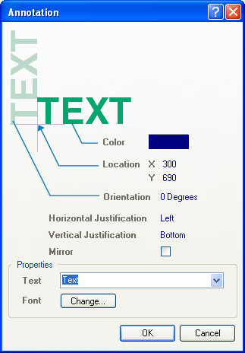
What Is A String?
Strings Are
Sequences of Characters
Object (instance of class String) in Java
Variables that can be manipulated
Strings Are Used For
Representing Text
Text Processing
Representing Data
(e.g., Genetics)
You are cordially invited to …
Image Credit: www.balisage.net

Slide 6
How to Declare a String?
Simple:
String greeting = "Hello world!";
More Complex: (typecasting & constructor)
char[] helloArray = { 'h', 'e', 'l', 'l', 'o', '.' };
String helloString = new String( helloArray );
System.out.println( helloString );
CLASS NAME: String
VARIABLE NAME: greeting

Slide 7
How to Measure Length of String?
Easy!
String greeting = "Hello world!";
int len = greeting.length();
System.out.println(“len = ” + len);
In this case, the string length is 12 char’s.

Slide 8
How to Concatenate Strings?
Meaning:
Pseudocode: “Hello” + “ “ + “world” + “!”
➔ “Hello world!”
Java Code:
String hellostr = “Hello," + " world" + "!“
System.out.println( hellostr );
The output will be Hello world!
We could also do this with:
System.out.println(“Hello," + " world" + "!“)

Slide 9
How to Format Strings?
Java Code: Assume we have a float called floatVar,
an int called intVar, and a string called stringVar.
String fs;
fs = String.format( "The value of the float "
+ "variable is %f, while "
+ "the value of the "
+ "integer variable is %d, "
+ " and the string is %s",
floatVar, intVar, stringVar );
System.out.println( fs );
USING THE CONCATENATE OPERATOR TO CONTINUE A STRING ACROSS MULTIPLE LINES

Slide 10
Alternative Method to Format Strings
Java Code: Assume we have a float called floatVar,
an int called intVar, and a string called stringVar.
String fs;
fs = "The value of the float "
+ "variable is” + floatVar + “, while "
+ "the value of the "
+ "integer variable is ” + intVar + “, "
+ " and the string is ” + stringVar ;
System.out.println( fs );

Slide 11
This Week: Arrays and Java
READING ASSIGNMENT: D. Liang: Chapter 9
By now, you should have read textbook Ch. 1-8
NEXT CLASS (Wednesday 13 Feb):
More on Manipulating Strings in Java
Some Thoughts About Assignment #3
LAPTOPS (Friday 15 Feb 2013):
How to Submit Assignment #2
How to Start Assignment #3, Parts I and II

