Slide 1

COP2800 – Computer Programming Using JAVA
University of Florida Department of CISE Spring 2013
Lecture 14 – How to Complete Assignment 2, Part III
Webpage: www.cise.ufl.edu/~mssz/JavaNM/Top-Level.html

Slide 2
COP2800 – Programming in JAVA
Course Objectives
  Basic Knowledge of Computers & Programming
  Specific Knowledge of JAVA Programming
  Practical Programming Projects Build Skills
Today’s Class
  The Concept of Number Filtering
  How to Complete Assignment 2
    Building Classes for Part III
    Adding/Modifying Methods

Slide 3
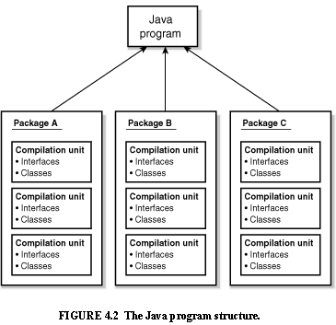
Review: Java Program Structure
HIGH-LEVEL VIEW
JAVA Units:
Packages
Classes
(Instances)
Methods
Instructions
Variables
PICTURE CREDIT: http://www.webbasedprogramming.com/JAVA-Developers-Guide/ch4.htm

Slide 4
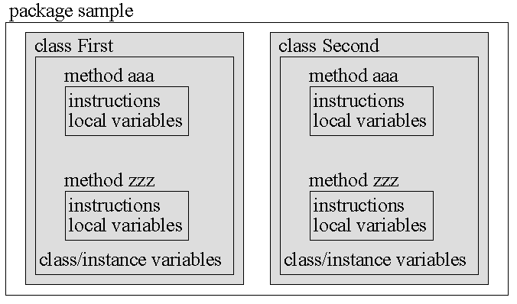
Review: Java Package Structure
PICTURE CREDIT: http://users.soe.ucsc.edu/~charlie/book/notes/summary1-4/sld016.htm

Slide 5
What Is An Array?
Arrays Are
  Regular, periodic data structures
  1-D : A vector of values (1,4,37,3)
  2-D : A matrix (like mailboxes at the Post Office)
Arrays Are Used For
  Storing Values for Regular Accessibility
  Sorting and Searching
  Regularizing Variable-Length Data

Slide 6
Assignment 2: The “Bins” Array
Two-Dimensional Array:
Array Name = “Bins”
// Declare array (2-D, NBins rows x 4 cols)
float a2[][] = new float[NBins][3] ;
Anatomy: Dimension #1 = Bin Number
(from 0 to Nbins-1)
Dimension #2 = Parameters:
1 – Lower Bound of Test Interval
2 – Upper Bound of Test Interval
3 – Count of Numbers in Bin

Slide 7
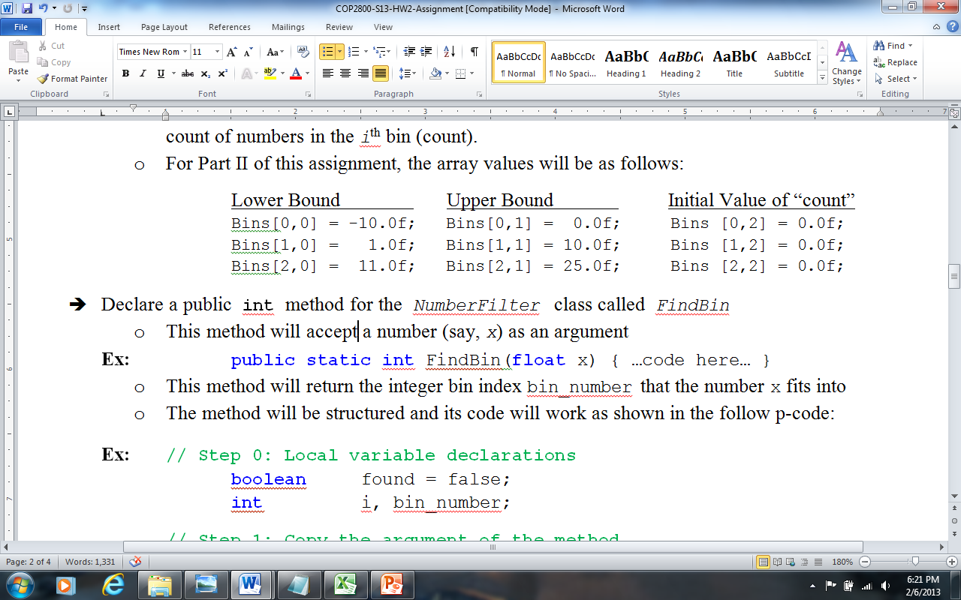
The “Bins” Array (Asn-2), cont’d
Two-Dimensional Array:
Array Name = “Bins”
Parameter #1 Parameter #2 Parameter #3
Lesson Learned: Arrays can be used for storing input parameters and results.
Bin Number

Slide 8
How the “Bins” Array Works
Number-Line Interval Is Defined By:
-- Lower Bound Bins[0][0] =
-- Upper Bound Bins[0][1] =
-10
0
x = -1.58
Interval from -10 to 0 writ-ten as [-10,0]
-10 -3 -2 -1 0 1 2 3 4
➔ Bin Count Bins[0][2] = Bins[0][2] + 1
incremented because x = -1.58 is within [-10,0].

Slide 9
How NumberFilter Works
Number-Line Interval Defined By:
-- Lower Bound Bins[0][0] =
-- Upper Bound Bins[0][1] =
-10
0
Test Number
x = -1.58
Pseudocode: (for the i^{th} Bin Bins[i][…])
if x > LowerBound AND x < UpperBound
then { x is in the i^{th} interval
so we increment the i^{th} bin_count }
else we try the next value of i or get next x
if bin-loop ends

Slide 10
This Week: Arrays and Java
READING ASSIGNMENT: D. Liang: Chapters 6 & 7
By now, you should have read textbook Ch. 1-8
Today (Friday 8 Feb 2013):
How to Do Assignment #2 – Part III
More on Multidimensional Arrays in Java
Monday 11 Feb 2013:
New Topic:
READ LIANG
CHAPTER 9

Slide 11

Happy Weekend!!
Image Credit: http://www.youtube.com/channel/HCYUZ_jJ8fRpM

