Slide 1

COP2800 – Computer Programming Using JAVA
University of Florida Department of CISE Spring 2013
Lecture 13 – Having Fun with Arrays in Java
Webpage: www.cise.ufl.edu/~mssz/JavaNM/Top-Level.html

Slide 2
COP2800 – Programming in JAVA
Course Objectives
  Basic Knowledge of Computers & Programming
  Specific Knowledge of JAVA Programming
  Practical Programming Projects Build Skills
Today’s Class
  What Can We Do With Arrays?
  Applications of Arrays in Java
    Parameterization
    Ordering Integers: “Injection Sort”

Slide 3
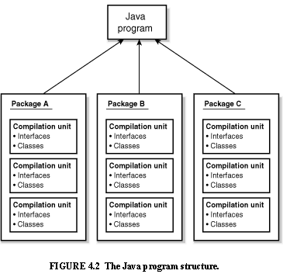
Review: Java Program Structure
HIGH-LEVEL VIEW
JAVA Units:
Packages
Classes
(Instances)
Methods
Instructions
Variables
PICTURE CREDIT: http://www.webbasedprogramming.com/JAVA-Developers-Guide/ch4.htm

Slide 4
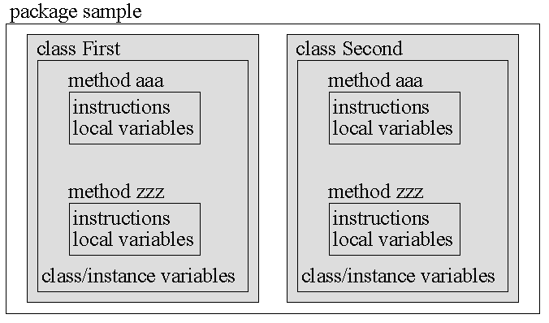
Review: Java Package Structure
PICTURE CREDIT: http://users.soe.ucsc.edu/~charlie/book/notes/summary1-4/sld016.htm

Slide 5
What Is An Array?
Arrays Are
  Regular, periodic data structures
  1-D : A vector of values (1,4,37,3)
  2-D : A matrix (like mailboxes at the Post Office)
Arrays Are Used For
  Storing Values for Regular Accessibility
  Sorting and Searching
  Regularizing Variable-Length Data

Slide 6
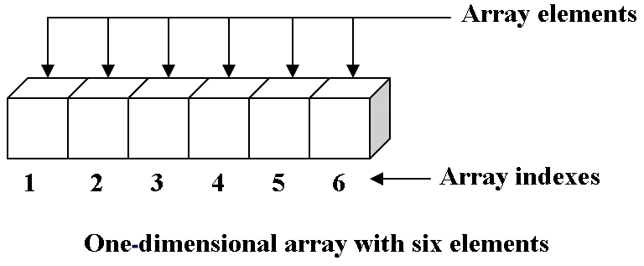
Review: 1-D Array
One-Dimensional Array:
Array Name = “a”
4 13 35 2 19 8
ARRAY ELEMENT VALUES
0 1 2 3 4 5
JAVA Arrays Are Zero-Indexed:
0, 1, …, N-1
a[1] = 13
a[5] = 8
Image Credit: 123codegenerator.blogspot.com

Slide 7
Let’s Do a 1-D Array with For Loop
One-Dimensional Array:
Array Name = “a”
// Declare the array (1-D, 6 elements)
int a[] = new int[6] ;
// Put the loop index into the array
for (int i = 0, i < a.length, i++)
{ a[i] = 2 * i;
}
RESULT: a = (0, 2, 4, 6, 8, 10)

Slide 8
Let’s Do Sorting with a 1-D Array
What is Sorting?
Sorting is an operation that orders values in a predetermined (e.g., ascending or descending) order.
Ex: {3, 4, 0, 2, 1, 4} → (0, 1, 2, 3, 4, 4)
The simplest sorting algorithm is injection sort.
SORT
Set Sequence

Slide 9
Injection Sorting with a 1-D Array
One-Dimensional Array:
Input Array = “a”
// 1: Declare the array (1-D, 6 elements)
int a[] = {3, 4, 0, 2, 1, 4};
int b[] = {0, 0, 0, 0, 0, 0};
// 2: Inject the values of a as loop indices
for (int i = 0, i < a.length, i++)
{ b[a[i]]++;
}
// 3: Print sorted values (ascending order)
for (int i = 0, i < b.length, i++)
{ if b[i] != 0 {System.out.print(i)};
}
b = (1, 1, 1, 1, 2, 0)

Slide 10
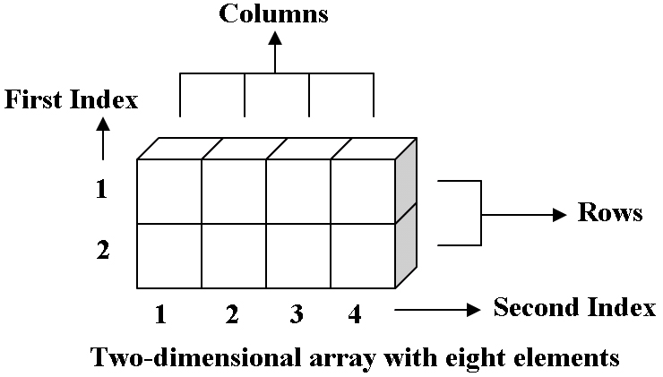
Review: 2-D Array
Two-Dimensional Array:
Array Name = “a2”
a2[0,2] = 49
ARRAY ELEMENT VALUES
0
1
27 4 49 3
6 8 13 77
JAVA Arrays Are Zero-Indexed:
0, 1, …, N-1
0 1 2 3
Image Credit: 123codegenerator.blogspot.com

Slide 11
Let’s Do a 2-D Array with For Loop
Two-Dimensional Array:
Array Name = “a2”
// Declare the array (2-D, 2 rows x 4 cols)
int Nrows = 2; int Ncols = 4;
int a2[][] = new int[Nrows][Ncols] ;
// Put the sum of loop indices into array
for (int i = 0, i < Nrows, i++)
{ for (int j = 0, j < Nrows, j++)
{ a2[i][j] = i + j;
}
}
RESULT: Row 0 of a2 = (0, 1, 2, 3)
Row 1 of a2 = (1, 2, 3, 4)

Slide 12
Case 1: the “Bins” Array (Asn-2)
Two-Dimensional Array:
Array Name = “Bins”
// Declare array (2-D, NBins rows x 4 cols)
float a2[][] = new float[NBins][3] ;
Anatomy: Dimension #1 = Bin Number
(from 0 to Nbins-1)
Dimension #2 = Parameters:
1 – Lower Bound of Test Interval
2 – Upper Bound of Test Interval
3 – Count of Numbers in Bin

Slide 13
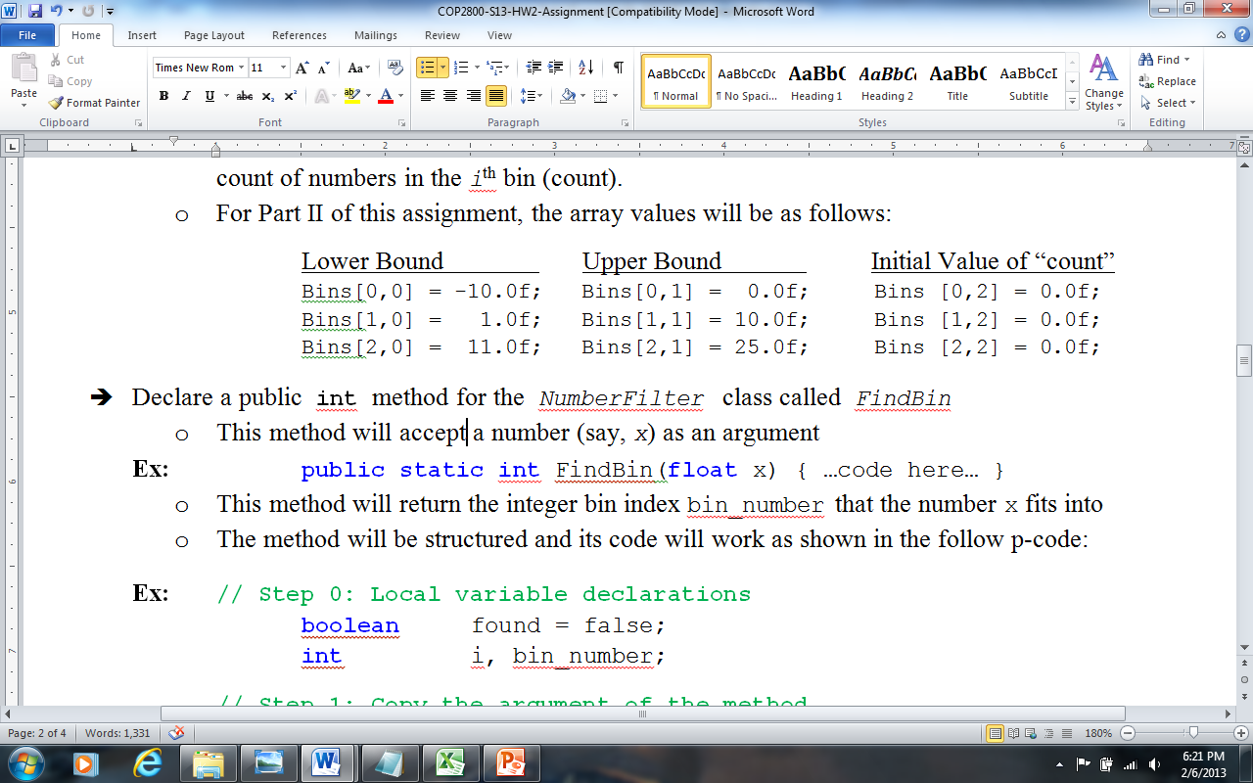
The “Bins” Array (Asn-2), cont’d
Two-Dimensional Array:
Array Name = “Bins”
Parameter #1 Parameter #2 Parameter #3
Lesson Learned: Arrays can be used for storing input parameters and results.
Bin Number

Slide 14
Case 2: TicTacToe Array (Asn-?)
Two-Dimensional Array:
Array Name = “TTT”
// Declare array (2-D, 3 rows x 3 cols)
char TTT[][] = new char[3][3] ;
Anatomy: Dimension #1 = Row Number
(from 0 to 2)
Dimension #2 = Column Number
(from 0 to 2)
Contents of Array? char = “–” or “X” or “O”

Slide 15
Case 2: TicTacToe Array (Asn-?)
Two-Dimensional Array:
Array Name = “TTT”
// Declare array (2-D, 3 rows x 3 cols)
char TTT[][] = new char[3][3] ;
Here’s Some Pseudocode!!
Initialize Array TTT with “–”
To insert an X or O at location (i,j):
input_char = “X”;
TTT[2][1] = input_char;
Array TTT
- O X
O X X
O X -

Slide 16
This Week: Arrays and Java
READING ASSIGNMENT: D. Liang: Chapters 6 & 7
By now, you should have read textbook Ch. 1-8
Next Class (Friday 08 February)
How to Do Assignment #2 – Part III
More on Multidimensional Arrays in Java

