Slide 1

COP2800 – Computer Programming Using JAVA
University of Florida Department of CISE Spring 2013
Lecture 10 – Programming with Java Datatypes
Type Casting and Type Conversion
Webpage: www.cise.ufl.edu/~mssz/JavaNM/Top-Level.html

Slide 2
COP2800 – Programming in JAVA
Course Objectives
Basic Knowledge of Computers & Programming
Specific Knowledge of JAVA Programming
Practical Programming Projects Build Skills
Today’s Class
What is Type Casting?
Examples of Type Conversion via Type Casting
Look-Ahead at Assignment #2
Filtering Numbers

Slide 3
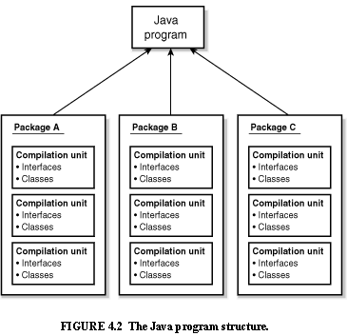
Review: Java Program Structure
HIGH-LEVEL VIEW
JAVA Units:
Packages
Classes
(Instances)
Methods
Instructions
Variables
PICTURE CREDIT: http://www.webbasedprogramming.com/JAVA-Developers-Guide/ch4.htm

Slide 4
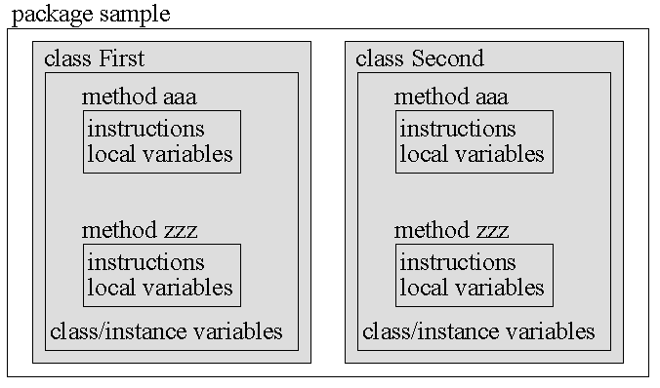
Review: Java Package Structure
PICTURE CREDIT: http://users.soe.ucsc.edu/~charlie/book/notes/summary1-4/sld016.htm

Slide 5
New: Java Typecasting
A typecast in Java:
One object reference can be type cast into
another object reference.
The cast can be to its own class type or to one of
its subclass or superclass types or interfaces.
There are compile-time rules and runtime rules
for casting in Java

Slide 6
Java Typecasting (cont’d)
A typecast in Java can implement
implicit type conversion:
Type conversion makes one datatype into
another datatype.
float ➔ double
double ➔ string
int ➔ long
byte ➔ short

Slide 7
Java Typecasting (cont’d)
Correct: (float to double)
float x = -1.2343;
double y = x ; # 32 bits to 64 bits
Incorrect: (float to short)
float x = -1.23e-7;
short y = x ; # 32 bits to 16 bits

Slide 8
Java Typecasting (cont’d)
TYPE CONVERSION HIERARCHY:
Type Hierarchy: integers: byte < short < int < long
decimals: float < double
RIGHT
WRONG

Slide 9
Java Type Conversion (cont’d)
A float (single-precision floating-point number)
is a positive or negative decimal number
specified by float descriptor (reserved word)
Example: float x = 10.98 ;
Can we convert an int to a float?
int x = 6;
float y = x;
System.out.println(y);
Output = 6.0 ← “.0” denotes floating-point

Slide 10
Java Type Conversion (cont’d)
Explicit Type Conversion: to-String
//Double to String String s=Double.toString(doublevalue); //Long to String String s=Long.toString(longvalue); //Float to String String s=Float.toString(floatvalue);

Slide 11
Java Type Conversion (cont’d)
Explicit Type Conversion: to-Int
//String to Integer String s=”7”; int i=Integer.valueOf(s).intValue(); - or - int i = Integer.parseInt(s);
//Character to Integer char c = ’9’; int i =(char)c;

Slide 12
Java Type Conversion (cont’d)
Explicit Type Conversion: from-String [String s;]
//String to Double double a=Double.valueOf(s).doubleValue(); //String to Long long b=Long.valueOf(s).longValue(); - or - long b=Long.parseLong(s);
//String to Float float x = Float.valueOf(s).floatValue()

Slide 13
NEW: Assignment #2
Part I Vocabulary Terms
Part II Simple Numerical Filter Program
Part III Numerical Filtering with Arrays and Loops
Step 1. Input a number
Step 2. Determine to which interval a number belongs
Step 3. Keep track of the count of numbers per interval
Step 4. Print out the counts of numbers in the intervals

Slide 14
What Code Shall We Start With?
From Last Class -- Java Code Fragment:
// assign datatypes and initial values to bounds
int y = 10, z = 15;
// test to see if number is in-range
void testNumber(int x) {
if ( x <= z && x >= y )
{ System.out.println(“Winner!”); }
else { System.out.println(“Loser!”); }
}
Boolean oper-ator means logical “and”

Slide 15
This Week: Java Program Design
Next Class (Friday)
How to e-submit Assignment #1
How to Start Assignment #2, Parts I and II
More on “type casting”
Look-Ahead (Monday)
More on Type Casting and Type Conversion
Arrays

