Slide 1

COP2800 – Computer Programming Using JAVA
University of Florida Department of CISE Spring 2013
Lecture 09 – Programming with Java Datatypes
and Flow Control
Webpage: www.cise.ufl.edu/~mssz/JavaNM/Top-Level.html

Slide 2
COP2800 – Programming in JAVA
Course Objectives
  Basic Knowledge of Computers & Programming
  Specific Knowledge of JAVA Programming
  Practical Programming Projects Build Skills
Today’s Class
  Review of Java Datatypes
  Review of Flow Control
  Numerical Decision Statements
  Filtering Numbers

Slide 3
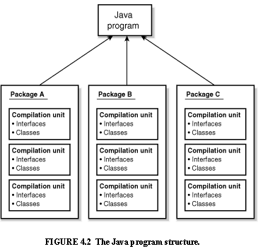
Review: Java Program Structure
HIGH-LEVEL VIEW
JAVA Units:
Packages
Classes
(Instances)
Methods
Instructions
Variables
PICTURE CREDIT: http://www.webbasedprogramming.com/JAVA-Developers-Guide/ch4.htm

Slide 4
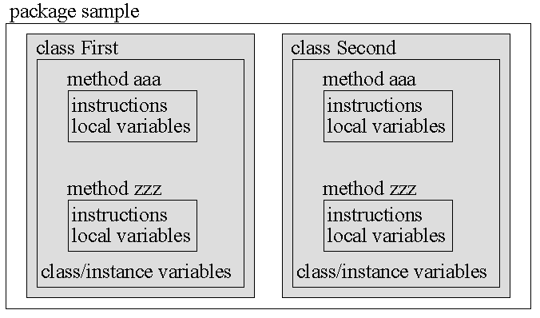
Review: Java Package Structure
PICTURE CREDIT: http://users.soe.ucsc.edu/~charlie/book/notes/summary1-4/sld016.htm

Slide 5
New: Java Datatypes
A datatype
is a way of specifying the value of a variable x
determines what actions can be performed on x
sometimes varies with the programming language
Java variables
are statically typed – datatype must be declared
before the variable can be used
have datatype declarations using special words
Example: byte, short, int, long, float, boolean,
  char, (string in the Java String class)

Slide 6
Java Datatypes (cont’d)
An int (integer)
is a 32-bit signed twos-complement integer
specified by int descriptor (reserved word)
Example: int i = 10;
A float (single-precision floating-point number)
is a positive or negative decimal number
specified by float descriptor (reserved word)
Example: float x = 10.98 ;
Usage Danger: F2C(-22.9f)

Slide 7
Java Datatypes (cont’d)
A short (integer)
is a 16-bit signed twos-complement integer
specified by short descriptor (reserved word)
Example: short i, j;
A long (integer)
is a 64-bit signed twos-complement integer
specified by long descriptor (reserved word)
Example: long j = 12412353525354L;
(Java compiler would convert this number to long)

Slide 8
Java Datatypes (cont’d)
A double (double-precision floating point number)
is a 64-bit IEEE 754 format decimal number
specified by double descriptor (reserved word)
Example: double y = 1.4e-32;
Usage Danger: function_name(-22.9e-47d)
A boolean (logical value)
has value true or false
specified by boolean descriptor (reserved word)
Example: boolean x = true;

Slide 9
Java Datatypes (cont’d)
A char (character)
is a 16-bit Unicode representation of a symbol
specified by char descriptor (reserved word)
Example: char c = \u0B17;
  char d = ‘e’
A byte (integer)
is an 8-bit signed twos-complement integer
specified by byte descriptor (reserved word)
Example: byte k = -27;

Slide 11
Simple Decision Control Structure
If .. then Java Example
in class Bike here
is the method
If Bike is moving
Then apply the brakes
void applyBrakes() {
if (isMoving) {
currentSpeed--;
}
}
“if”-part is stated
“then” is implied

Slide 12
If..Then..Else Control Structure
If .. then .. else Java Example
in class Bike here
is the method
If Bike is moving
Then apply the brakes
Else inform user: stopped
void applyBrakes() {
if (isMoving) {
currentSpeed--; }
else {
System.err.println(“Stopped!");
} }
“if”-part is stated
“then” is implied
“else” part stated

Slide 13
“for-loop” Control Structure
Syntax:
for(initialization; Boolean_expression; update) {
//Statements in body of loop
}
Meaning:
Initialization Declare/initialize loop varbls
Boolean_expression Controls loop execution
= true Loop continues to execute
= false Exit from loop to next statement
Update Optional: update loop varbls

Slide 14
“for-loop” Control Structure (cont’d)
Syntax:
for(initialization; Boolean_expression; update) {
//Statements in body of loop
}
Increment variable “x” by 1 at each iter-ation
Integer “x” has a starting value of 10
Loop runs as long as x < 20
Example:
for (int x = 10; x < 20; x = x+1) {
sum = sum + x;
}
x = 10 sum = 10
x = 11 sum = 21
x = 12 sum = 33
: :
x = 20 Exit Loop
Body of Loop: add x to a variable “sum” (assumed to initially be zero)

Slide 15
“while-loop” Control Structure
Syntax:
while(Boolean_expression) {
//Statements in body of loop
}
Meaning:
Boolean_expression Controls loop execution
= true Body of loop executes
= false Exit from loop to next statement

Slide 16
“while-loop” Control Structure (cont’d)
Syntax:
while(Boolean_expression) {
//Statements in body of loop
}
Integer “x” has a starting value of 10
Loop runs as long as x < 20
Example:
x = 10;
while (x < 20) {
sum = sum + x;
x = x + 1;
}
x = 10 sum = 10
x = 11 sum = 21
x = 12 sum = 33
: :
x = 20 Exit Loop
Body of Loop: add x to a variable “sum”

Slide 17
“do-while” Control Structure
Syntax:
do {
//Statements in body of loop
} while(Boolean_expression);
Body of loop executes once before Boolean expression is evaluted
Meaning:
Boolean_expression Controls loop execution
= true Body of loop executes
= false Exit from loop to next statement

Slide 18
“do-while” Control Structure (cont’d)
Syntax:
do {
//Statements in body of loop
} while(Boolean_expression) ;
Body of loop executes once before Boolean expression is evaluted
Integer “x” has a starting value of 10
Example:
x = 10;
do{
x = x + 1;
sum = sum + x;
} while (x < 20) ;
Loop runs as long as x < 20
x = 11 sum = 11
x = 12 sum = 23
x = 13 sum = 36
: :
x = 20 Exit Loop
Body of Loop: add x to a variable “sum”

Slide 19
Have You Won The Lotto?
Task: Decide if you’ve got a winning lotto number (based on a known list)
Algorithm:
Given a “test number” x
And a range of “winning numbers” [y,z]
Find if x is in range
Display “Winner ☺” or “Loser ☹”

Slide 20
Have You Won The Lotto? (cont’d)
Java Code Fragment:
// assign datatypes and initial values to bounds
int y = 10, z = 15;
// test to see if number is in-range
void testNumber( int x ) {
if ( x <= z ) {
if ( x >= y ) { System.out.println(“Winner!”); }
else { System.out.println(“Loser!”); } }
else { System.out.println(“Loser!”); }
}

Slide 21
Have You Won The Lotto? (cont’d)
A Better Designed Java Code Fragment:
// assign datatypes and initial values to bounds
int y = 10, z = 15;
// test to see if number is in-range
void testNumber(int x) {
if ( x <= z && x >= y )
{ System.out.println(“Winner!”); }
else { System.out.println(“Loser!”); }
}
Boolean oper-ator means logical “and”

Slide 22
This Week: Java Program Design
Next Class (Wednesday)
More programming with flow control
Introduction to “type casting”
Overview of Assignment #2
Look-Ahead (Friday)
How to e-Submit Assignment #1
How to Start Assignment #2, Parts I and II
  - Programming with Flow Control & Datatypes

