Slide 1
COP2800 – Computer Programming Using JAVA
University of Florida Department of CISE Spring 2013
Lecture 06 – Java Datatypes
Webpage: www.cise.ufl.edu/~mssz/JavaNM/Top-Level.html

Slide 2
COP2800 – Programming in JAVA
Course Objectives
Basic Knowledge of Computers & Programming
Specific Knowledge of JAVA Programming
Practical Programming Projects Build Skills
Today’s Class
Review of Java Datatypes
Datatypes For Assignment #1
float
int

Slide 3
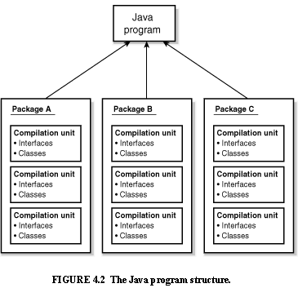
Review: Java Program Structure
HIGH-LEVEL VIEW
JAVA Units:
Packages
Classes
(Instances)
Methods
Instructions
Variables
PICTURE CREDIT: http://www.webbasedprogramming.com/JAVA-Developers-Guide/ch4.htm

Slide 4
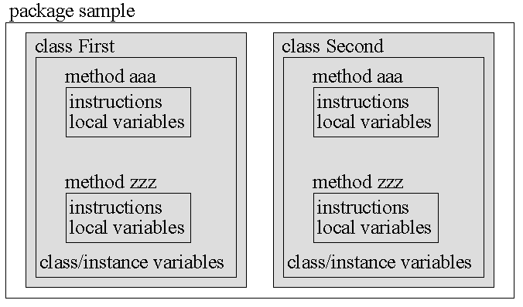
Review: Java Package Structure
PICTURE CREDIT: http://users.soe.ucsc.edu/~charlie/book/notes/summary1-4/sld016.htm

Slide 5
New: Java Datatypes
A datatype
is a way of specifying the value of a variable x
determines what actions can be performed on x
sometimes varies with the programming language
Java variables
are statically typed – datatype must be declared
before the variable can be used
have datatype declarations using special words
Example: byte, short, int, long, float, boolean,
char, (string in the Java String class)

Slide 6
Java Datatypes (cont’d)
An int (integer)
is a 32-bit signed twos-complement integer
specified by int descriptor (reserved word)
Example: int i = 10;
A float (single-precision floating-point number)
is a positive or negative decimal number
specified by float descriptor (reserved word)
Example: float x = 10.98 ;
Usage Danger: F2C(-22.9f)

Slide 7
Java Datatypes (cont’d)
A short (integer)
is a 16-bit signed twos-complement integer
specified by short descriptor (reserved word)
Example: short i, j;
A long (integer)
is a 64-bit signed twos-complement integer
specified by long descriptor (reserved word)
Example: long j = 12412353525354L;
(Java compiler would convert this number to long)

Slide 8
Java Datatypes (cont’d)
A double (double-precision floating point number)
is a 64-bit IEEE 754 format decimal number
specified by double descriptor (reserved word)
Example: double y = 1.4e-32;
Usage Danger: function_name(-22.9e-47d)
A boolean (logical value)
has value true or false
specified by boolean descriptor (reserved word)
Example: boolean x = true;

Slide 9
Java Datatypes (cont’d)
A char (character)
is a 16-bit Unicode representation of a symbol
specified by char descriptor (reserved word)
Example: char c = \u0B17;
char d = ‘e’
A byte (integer)
is an 8-bit signed twos-complement integer
specified by byte descriptor (reserved word)
Example: byte k = -27;

Slide 10
This Week: Java Program Design
Next Class (Friday)
Build a Java Superclass TemperatureConverter
Make a Subclass “F2C” and develop method
You will Develop Class & Method for “C2F”
Work on Programming Project #1, Part III
Look-Ahead (Monday)
Fun with Java Datatypes
Programming with Datatypes & Flow Control

