Slide 1
COP2800 – Computer Programming Using JAVA
University of Florida Department of CISE Spring 2013
Lecture 05 – Java Classes and Flow Control
Webpage: www.cise.ufl.edu/~mssz/JavaNM/Top-Level.html

Slide 2
COP2800 – Programming in JAVA
Course Objectives
Basic Knowledge of Computers & Programming
Specific Knowledge of JAVA Programming
Practical Programming Projects Build Skills
Today’s Class
Review of Java Classes
Java Program Flow Control
Decision Statements
Loops

Slide 3
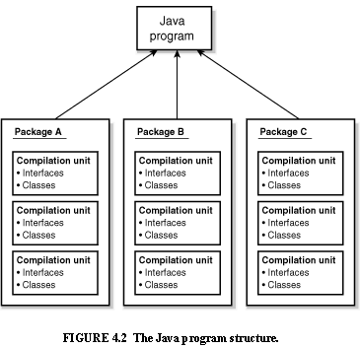
Review: Java Program Structure
HIGH-LEVEL VIEW
JAVA Units:
Packages
Classes
(Instances)
Methods
Instructions
Variables
PICTURE CREDIT: http://www.webbasedprogramming.com/JAVA-Developers-Guide/ch4.htm

Slide 4
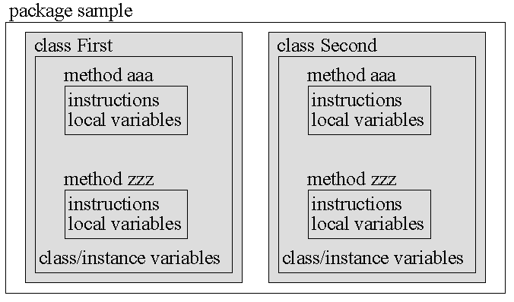
Review: Java Package Structure
PICTURE CREDIT: http://users.soe.ucsc.edu/~charlie/book/notes/summary1-4/sld016.htm

Slide 5
Review: Java Definitions
A class
specifies the design of an object
states what data an object can hold
states the way the object can behave when
using the data.
An object is an instance of a class.
Many objects can be created from one class.
Each object has its own data.
Its underlying structure (i.e., the type of data it
stores, its behaviors) are defined by the class.

Slide 6
Review: Java Definitions (cont’d)
A constructor
creates an Object of the Class that it is in
initializes all the instance variables
creates a place in memory to hold the Object.
Usage: with reserved keyword new and Class Name
Person JoeDoaks = new Person();
constructs a new Person object called JoeDoaks

Slide 7
Review: Java Definitions (cont’d)
Inheritance is a mechanism wherein a new class is derived from an existing class.
In Java, classes may inherit or acquire the properties and methods of other classes.
Subclass = class derived from another class
Superclass = class from which subclass is derived
A subclass can have only one superclass
A superclass may have one or more subclasses.

Slide 8
Review: Java Definitions (cont’d)
Extends (reserved keyword) derives a subclass from a superclass, as illustrated by the following syntax:
class subclass_name extends superclass_name { //new fields and methods to define the subclass go here }
Example: Derive a subclass Golfer from a superclass Person:
class Golfer extends Person { //variables and methods specific to golfers here }

Slide 9
Today: Flow Control
Programs Execute Sequentially
From Start to Finish
Instruction Sequencer determines next statement to be executed in order
“Flow of Execution”
To Control the Flow, we use
Decision Statements (if..then..else)
Iterative Control (“loops”)
Stmt 1
Stmt 2
:
Stmt N

Slide 10
Simple Decision Control Structure
If .. then Java Example
in class Bike here
is the method
If Bike is moving
Then apply the brakes
void applyBrakes() {
if (isMoving) {
currentSpeed--;
}
}
“if”-part is stated
“then” is implied

Slide 11
If..Then..Else Control Structure
If .. then .. else Java Example
in class Bike here
is the method
If Bike is moving
Then apply the brakes
Else inform user: stopped
void applyBrakes() {
if (isMoving) {
currentSpeed--; }
else {
System.err.println(“Stopped!");
} }
“if”-part is stated
“then” is implied
“else” part stated

Slide 12
“for-loop” Control Structure
Syntax:
for(initialization; Boolean_expression; update) {
//Statements in body of loop
}
Meaning:
Initialization Declare/initialize loop varbls
Boolean_expression Controls loop execution
= true Loop continues to execute
= false Exit from loop to next statement
Update Optional: update loop varbls

Slide 13
“for-loop” Control Structure (cont’d)
Syntax:
for(initialization; Boolean_expression; update) {
//Statements in body of loop
}
Increment variable “x” by 1 at each iter-ation
Integer “x” has a starting value of 10
Loop runs as long as x < 20
Example:
for (int x = 10; x < 20; x = x+1) {
sum = sum + x;
}
x = 10 sum = 10
x = 11 sum = 21
x = 12 sum = 33
: :
x = 20 Exit Loop
Body of Loop: add x to a variable “sum” (assumed to initially be zero)

Slide 14
“while-loop” Control Structure
Syntax:
while(Boolean_expression) {
//Statements in body of loop
}
Meaning:
Boolean_expression Controls loop execution
= true Body of loop executes
= false Exit from loop to next statement

Slide 15
“while-loop” Control Structure (cont’d)
Syntax:
while(Boolean_expression) {
//Statements in body of loop
}
Integer “x” has a starting value of 10
Loop runs as long as x < 20
Example:
x = 10;
while (x < 20) {
x = x + 1;
sum = sum + x;
}
x = 11 sum = 11
x = 12 sum = 23
x = 13 sum = 36
: :
x = 20 Exit Loop
Body of Loop: add x to a variable “sum”

Slide 16
“do-while” Control Structure
Syntax:
do {
//Statements in body of loop
} while(Boolean_expression);
Body of loop executes once before Boolean expression is evaluted
Meaning:
Boolean_expression Controls loop execution
= true Body of loop executes
= false Exit from loop to next statement

Slide 17
“do-while” Control Structure (cont’d)
Syntax:
do {
//Statements in body of loop
} while(Boolean_expression) ;
Body of loop executes once before Boolean expression is evaluted
Integer “x” has a starting value of 10
Example:
x = 10;
do{
x = x + 1;
sum = sum + x;
} while (x < 20) ;
Loop runs as long as x < 20
x = 11 sum = 11
x = 12 sum = 23
x = 13 sum = 36
: :
x = 20 Exit Loop
Body of Loop: add x to a variable “sum”

Slide 18
Computer Programming Tools (cont’d)
If you haven’t done this already, do for Fri:
Download Free Software (legally)
that You Will Need on Your Laptop
“How-to” Videos from our TA Bill Chapman
http://www.cise.ufl.edu/~wchapman/COP2800/gettingstarted.html

Slide 19
This Week: Java Program Design
Next Class (Friday)
Build a Java Class TemperatureConverter
Make the Class have method “F2C”
You will Develop Code for Method “C2F”
Start Programming Project #1, Part 1: “C2F”
Look-Ahead (Wednesday)
Java Datatypes
Examples of Programming with Flow Control

