Slide 1

COP2800 – Computer Programming Using JAVA
University of Florida Department of CISE Spring 2013
Lecture 04 – Object Oriented Programming & Classes
Webpage: www.cise.ufl.edu/~mssz/JavaNM/Top-Level.html

Slide 2
COP2800 – Programming in JAVA
Course Objectives
  Basic Knowledge of Computers & Programming
  Specific Knowledge of JAVA Programming
  Practical Programming Projects Build Skills
Today’s Class
  Principles of Object Oriented Programming
  Java Program Structure
    Classes, Instances, and Inheritance
    Example of Java Coding with Classes and Instances

Slide 3
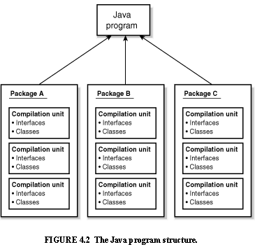
Java Program Structure
HIGH-LEVEL VIEW
JAVA Units:
Packages
Classes
(Instances)
Methods
Instructions
Variables
PICTURE CREDIT: http://www.webbasedprogramming.com/JAVA-Developers-Guide/ch4.htm

Slide 4
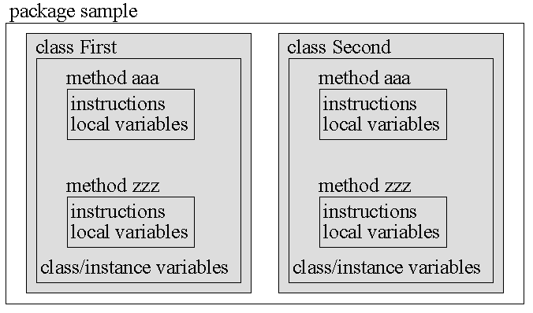
Java Package Structure
PICTURE CREDIT: http://users.soe.ucsc.edu/~charlie/book/notes/summary1-4/sld016.htm

Slide 5
Java Package Structure (cont’d)
A PACKAGE contains multiple Classes
A CLASS contains multiple Methods
A METHOD contains
instructions (program)
local variables (specific to the method)
LOCAL VARIABLES are specific to a given method
CLASS/INSTANCE VARIABLES are specific to a given Class or Instance of a Class
PICTURE CREDIT: http://users.soe.ucsc.edu/~charlie/book/notes/summary1-4/sld016.htm

Slide 6
Java Definitions
A class
specifies the design of an object
states what data an object can hold
states the way the object can behave when
using the data.
An object is an instance of a class.
Many objects can be created from one class.
Each object has its own data.
Its underlying structure (i.e., the type of data it
stores, its behaviors) are defined by the class.

Slide 7
Java Definitions (cont’d)
A constructor
creates an Object of the Class that it is in
initializes all the instance variables
creates a place in memory to hold the Object.
Usage: with reserved keyword new and Class Name
Person JoeDoaks = new Person();
constructs a new Person object called JoeDoaks

Slide 8
Java Definitions (cont’d)
Inheritance is a mechanism wherein a new class is derived from an existing class.
In Java, classes may inherit or acquire the properties and methods of other classes.
Subclass = class derived from another class
Superclass = class from which subclass is derived
A subclass can have only one superclass
A superclass may have one or more subclasses.

Slide 9
Java Definitions (cont’d)
Extends (reserved keyword) derives a subclass from a superclass, as illustrated by the following syntax:
class subclass_name extends superclass_name {
//new fields and methods to define the subclass go here
}
Example: Derive a subclass Golfer from a superclass Person:
class Golfer extends Person {
//variables and methods specific to golfers here
}

Slide 10
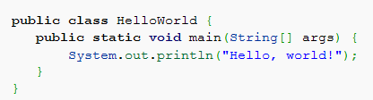
Example of Java Program
Example: “Hello, world!”
HelloWorld is a name for the public class HelloWorld
main is a Method within the Class HelloWorld
void indicates that main returns no value

Slide 11
Example of Java Program (cont’d)
Example: “Hello, world!”
static A static method means that all objects created from this class (HelloWorld) have only one method main. You can call main without instantiating the class. You can directly invoke this method with the name of the class, for example: HelloWorld.main()

Slide 12
Computer Programming Tools
Assignment: If you haven’t done this already…
Request a CISE class account per the instructions on this Web page:
http://www.cise.ufl.edu/help/account.shtml
This will allow you to run and check your programs on the same machines we use to grade them.

Slide 13
Computer Programming Tools (cont’d)
NOW: Downloading Free Software (legally)
That You Will Need on Your Laptop
“How-to” Videos from our TA Bill Chapman
http://www.cise.ufl.edu/~wchapman/COP2800/gettingstarted.html

Slide 14
This Week: Java Program Design
Next Class (Wednesday)
Datatypes
Flow Control
Next Class (Friday)
Build a Java Class TemperatureConverter
Extend the Class to be “F2C” and “C2F”
Develop Code for Subclass “C2F”
Do Programming Project #1: “F2C”

