Slide 1
COP2800 – Computer Programming Using JAVA
University of Florida Department of CISE Spring 2013
Lecture 03 – Java Program Structure + Software
Webpage: www.cise.ufl.edu/~mssz/JavaNM/Top-Level.html

Slide 2
COP2800 – Programming in JAVA
Course Objectives
Basic Knowledge of Computers & Programming
Specific Knowledge of JAVA Programming
Practical Programming Projects Build Skills
Today’s Class
Java Program Structure
Java Software to Download
For Compiling and Executing your Programs
Windows Notepad++, Sun Java Development Tools

Slide 3
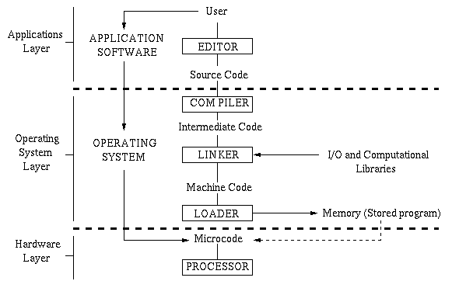
How Computer Programming Works
JAVA

Slide 4
JAVA: Write Once, Run Anywhere
Portable = More Economical
Write one JAVA Application : Don’t Need to Reprogram Every Time New HW is Acquired
Runs on any JVM/JRE
Runs on Web (Javascript) as Applet

Slide 5
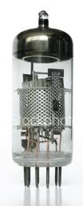
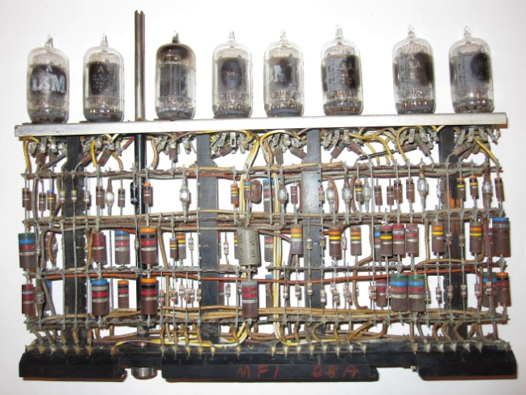
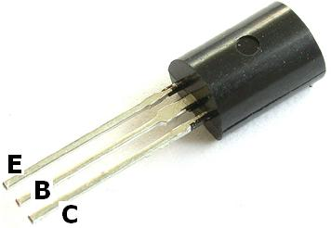
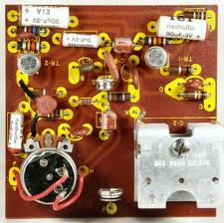
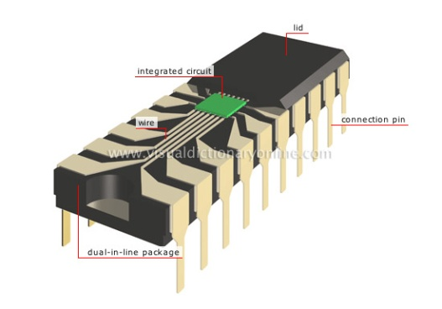
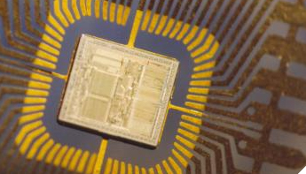
Computer Circuit Technology
Vacuum Tubes (Gen-1)
Transistors (Gen-2)
Integrated Circuits (Gen-3)
Very Large-Scale
Integration (Gen-4)
Large, Hot, Failure-Prone
Power-Consumptive (not Green)
Smaller, Cooler, More Reliable
Less Power-Consumptive
Smaller, Faster, Less Power
Many More
Transistors
Packed onto
a Chip
Smaller, Faster, Less Power

Slide 6
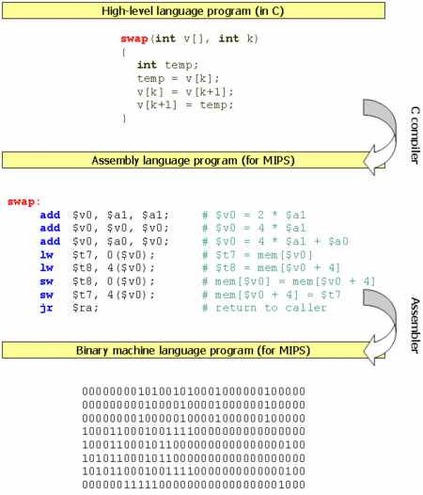
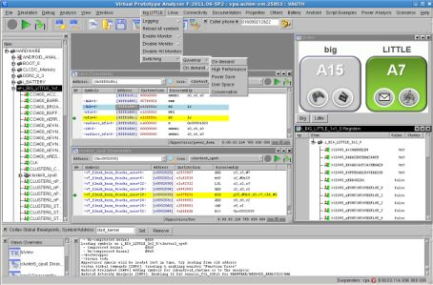
Computer Programming Technologies
Not as Much Change As HW
Slow Programming Process
Error-Prone Code Entry
Compiler errors
Still Need Assembly Language
Modern SW Development Tools: Interactive, Virtual

Slide 7
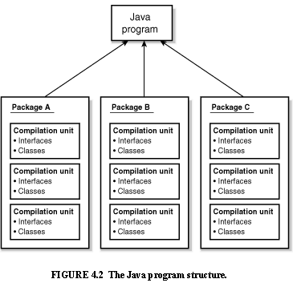
Java Program Structure
HIGH-LEVEL VIEW
JAVA Units:
Packages
Classes
(Instances)
Methods
Instructions
Variables
PICTURE CREDIT: http://www.webbasedprogramming.com/JAVA-Developers-Guide/ch4.htm

Slide 8
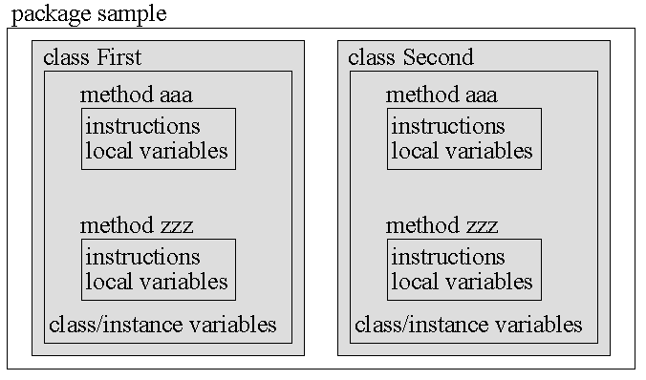
Java Package Structure
PICTURE CREDIT: http://users.soe.ucsc.edu/~charlie/book/notes/summary1-4/sld016.htm

Slide 9
Java Package Structure (cont’d)
A PACKAGE contains multiple Classes
A CLASS contains multiple Methods
A METHOD contains
instructions (program)
local variables (specific to the method)
LOCAL VARIABLES are specific to a given method
CLASS/INSTANCE VARIABLES are specific to a given Class or Instance of a Class
PICTURE CREDIT: http://users.soe.ucsc.edu/~charlie/book/notes/summary1-4/sld016.htm

Slide 10
Example of Java Program
Example: “Hello, world!”
HelloWorld is a name for the public class HelloWorld
main is a Method within the Class HelloWorld
void indicates that main returns no value

Slide 11
Example of Java Program (cont’d)
Example: “Hello, world!”
static A static method means that all objects created from this class (HelloWorld) have only one method main. You can call main without instantiating the class. You can directly invoke this method with the name of the class, for example: HelloWorld.main()

Slide 12
Example of Java Program (cont’d)
Example: “Hello, world!”
void indicates that main RETURNS NO VALUE
String[] args means that the class.method called as HelloWorld.main()has an argument that is a string array.

Slide 13
Example of Java Program (cont’d)
Example: “Hello, world!”
System.out.println out is a static member in the class System, being an instance of the class PrintStream. And println is a normal (overloaded) method of the PrintStream class.
The purpose is to print the output to what C language calls the “stdout” (standard output device, usually the screen).

Slide 14
Computer Programming Tools
Assignment: To Be Done by Friday
Request a CISE class account per the instructions on this Web page:
http://www.cise.ufl.edu/help/account.shtml
This will allow you to run and check your programs on the same machines we use to grade them.

Slide 15
Computer Programming Tools (cont’d)
NOW: Downloading Free Software (legally)
That You Will Need on Your Laptop
Our source code editing tool:
- Windows Notepad++
Our compilation and debugging tools:
- Sun Java distribution

Slide 16
Next Week: Java Program Design
Next Class (Monday)
Structure of JAVA Programming Language
Packages, Classes, and Instances
What a Method is within a Java Class
If time permits: Constructors, Inheritance
Next Class (Wednesday)
Datatypes
Flow Control

