Slide 1
COP2800 – Computer Programming Using JAVA
University of Florida Department of CISE Spring 2013
Lecture 02 – Computer Programming Languages
Webpage: www.cise.ufl.edu/~mssz/JavaNM/Top-Level.html

Slide 2
COP2800 – Programming in JAVA
Course Objectives
Basic Knowledge of Computers & Programming
Specific Knowledge of JAVA Programming
Practical Programming Projects Build Skills
Today’s Class
Programming Languages
History
Object Oriented Programming (OOPs)
Example: “Hello, world!”

Slide 3
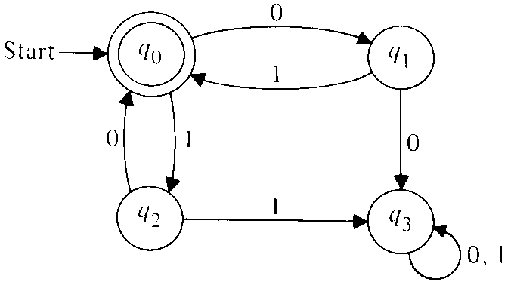
Review: What is a Computer?
Machine that
Changes Its State
How is State Represented?
Zeroes and Ones : 0010101011000101101…
Called a “State Map”
Computer Hardware (HW) is Equipment
CPU, Memory, Mouse, Printer, Flat-Panel Display…
Hardware Must Be Controlled by Software (SW)

Slide 4
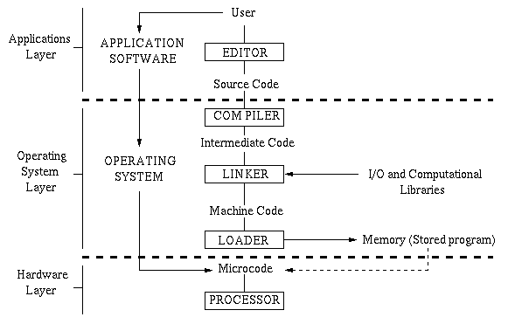
How Computer Programming Works
JAVA

Slide 5
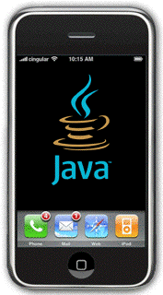
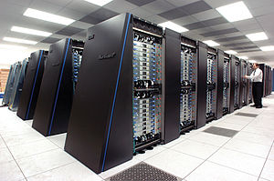
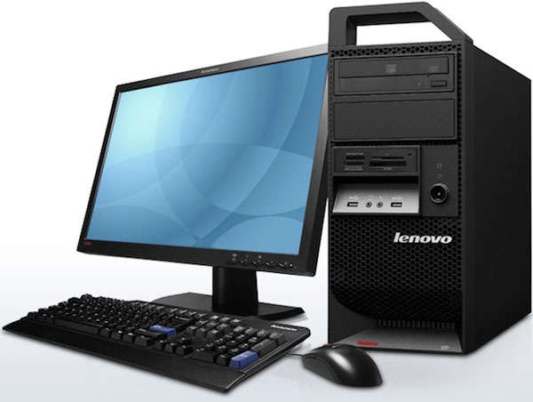
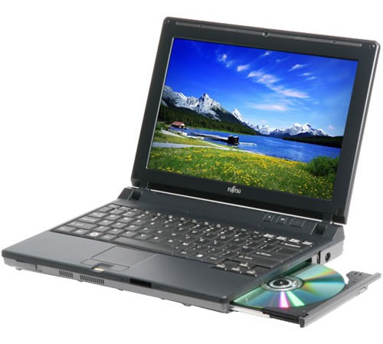
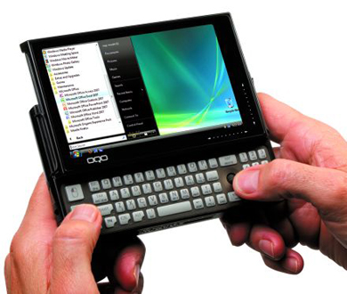
JAVA: Write Once, Run Anywhere
Portable = More Economical
Write one JAVA Application : Don’t Need to Reprogram Every Time New HW is Acquired
Runs on any JVM/JRE
Runs on Web (Javascript) as Applet

Slide 6
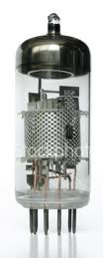
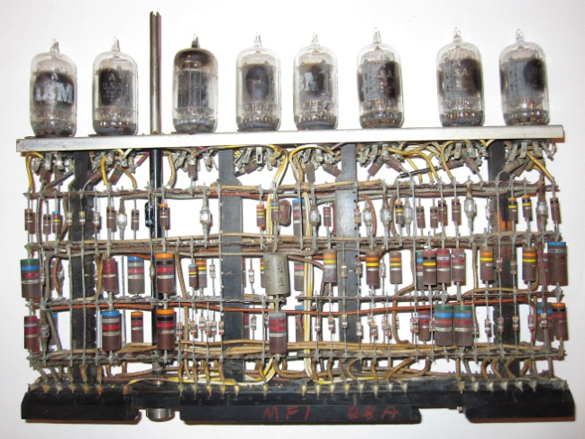
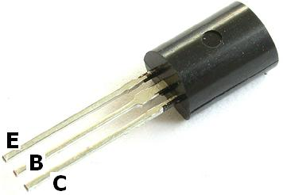
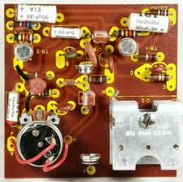
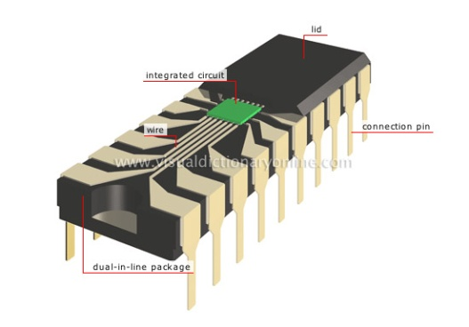
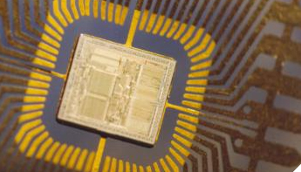
Computer Circuit Technology
Vacuum Tubes (Gen-1)
Transistors (Gen-2)
Integrated Circuits (Gen-3)
Very Large-Scale
Integration (Gen-4)
Large, Hot, Failure-Prone
Power-Consumptive (not Green)
Smaller, Cooler, More Reliable
Less Power-Consumptive
Smaller, Faster, Less Power
Many More
Transistors
Packed onto
a Chip
Smaller, Faster, Less Power

Slide 7
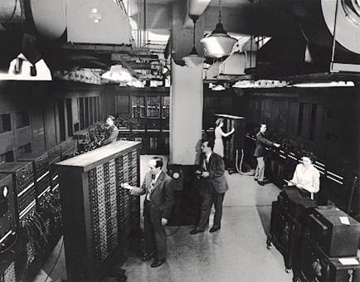
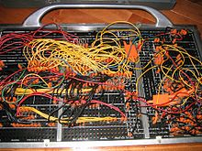
In The Beginning…
1940s Vacuum Tube Computers (Gen-1)
COMPUTER HARDWARE COMPUTER PROGRAMMING
ENIAC Computer (vacuum-tube calculator) Plugboard Programming (spaghettiware)

Slide 8
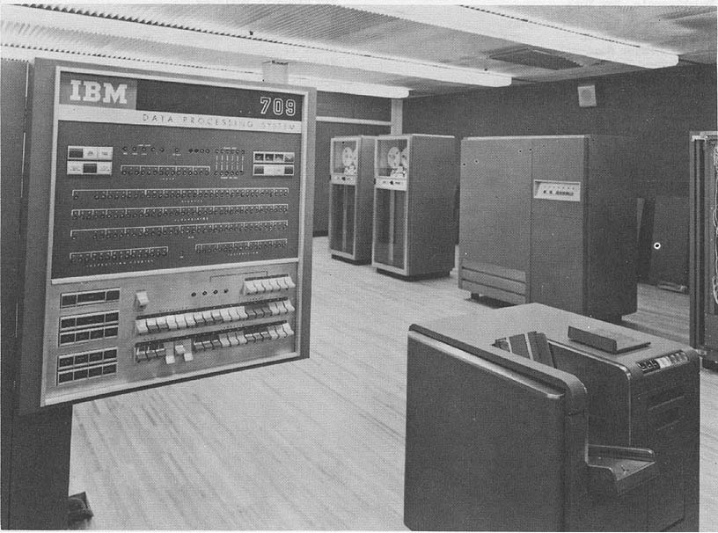
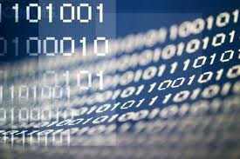
Machine Code
1950s Vacuum Tube Computers (Gen-1)
COMPUTER HARDWARE COMPUTER PROGRAMMING
IBM 709 Computer (stored-program) Machine Language Programming

Slide 9
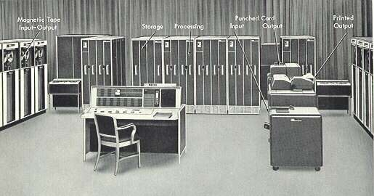
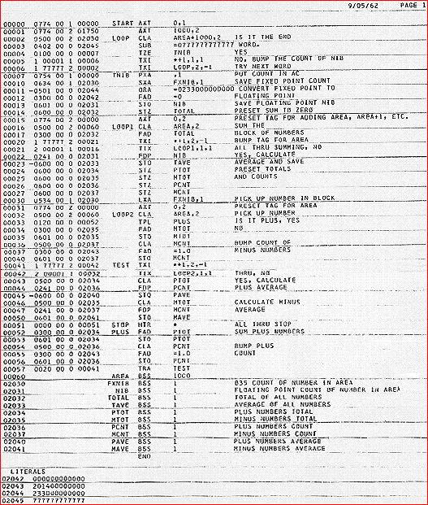
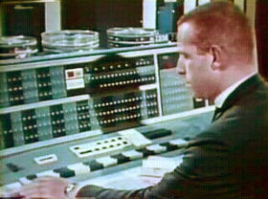
Assembly Language
Early 1960s Transistorized Computers (Gen-2)
COMPUTER HARDWARE COMPUTER PROGRAMMING
IBM 7090 (scientific computer) Assembly Language Program

Slide 10
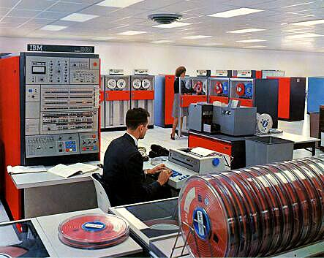
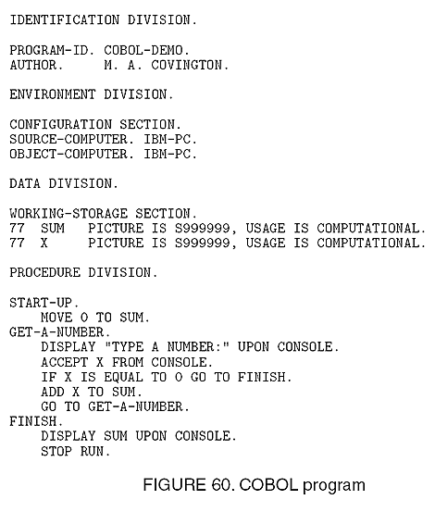
High-Level Language (HLL)
Mid 1960s Transistorized Computers (Gen-2)
COMPUTER HARDWARE COMPUTER PROGRAMMING
IBM System/360 (interoperable) HLL Program (COBOL)

Slide 11
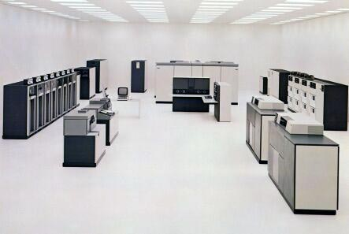
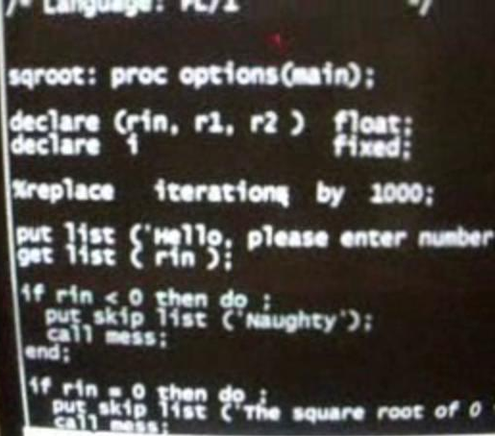
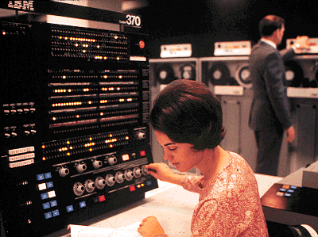
Integrated Circuits (ICs)
Early 1970s IC-Based Computers (Gen-3)
COMPUTER HARDWARE COMPUTER PROGRAMMING
IBM System/370 (interoperable) HLL Program (PL/1)

Slide 12
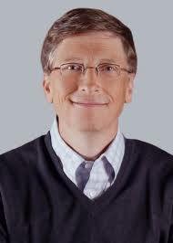
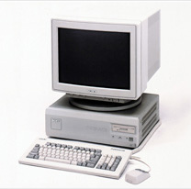
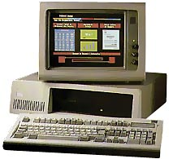
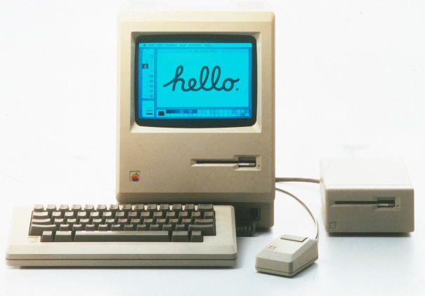
Very Large-Scale Integration
1980s/1990s VLSI-Based Computers (Gen-4)
COMPUTER HARDWARE COMPUTER PROGRAMMING
Workstation
IBM PC Apple Macintosh HLL Program (JAVA language)

Slide 13
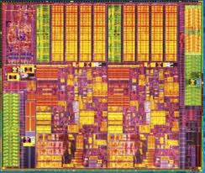
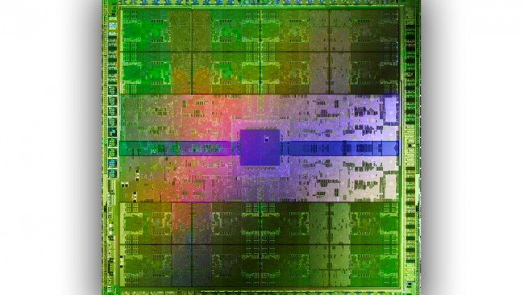
Very Large-Scale Integration (cont’d)
2010s VLSI-Based “Supercomputer-on-a-Chip”
Billions of Transistors Per Chip
Central Processing Unit (CPU) Graphics Processing Unit (GPU)
Intel Ivy Bridge Multicore CPU Nvidia Tesla C2090 GPU

Slide 14
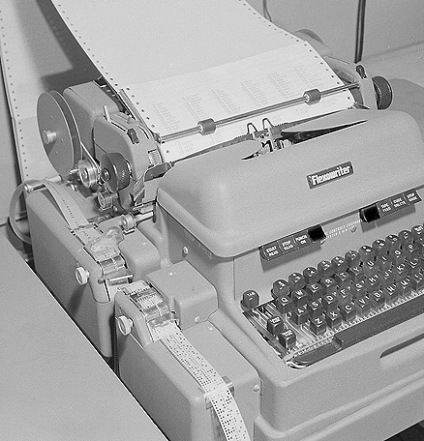
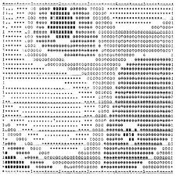
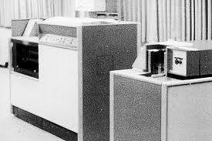
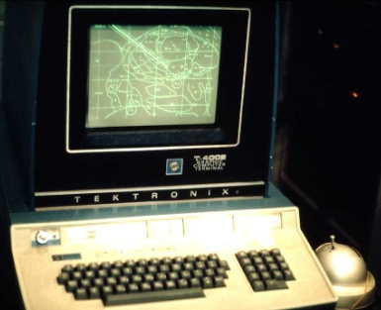
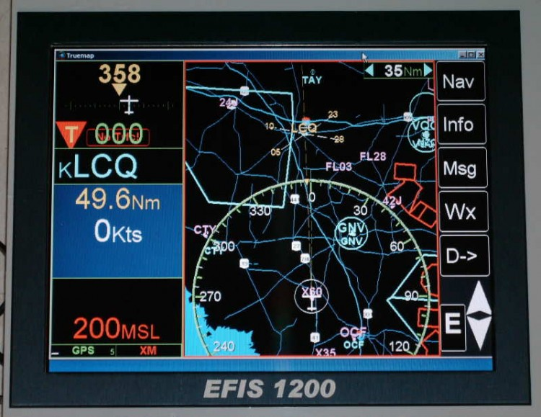
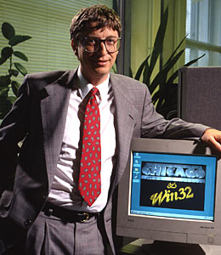
Computer Interfaces & Output
1940s-50s: Typewriter Output
1960s: Line Printer Output
1970s: Graphics Terminal
1980s ff: Graphical User Interface
with Hi-Resolution Display

Slide 15
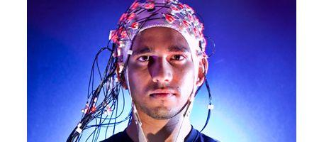
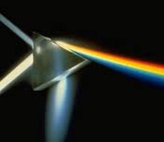
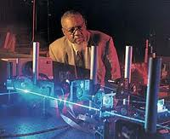
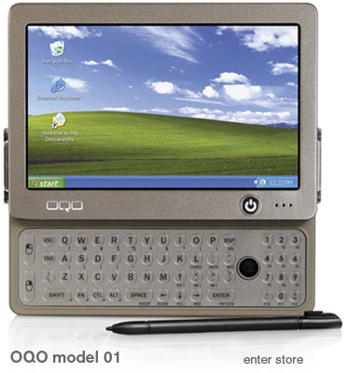
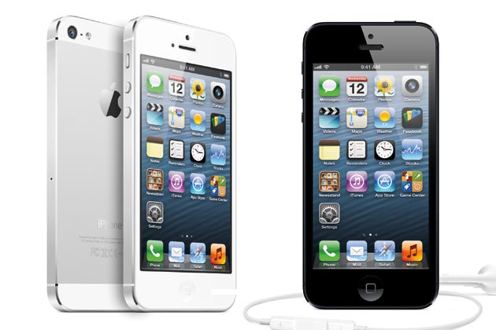
Future Computing HW Technologies
Faster, More Interactive Computers
Cortically Controlled Computers Optical Computer Uses Lightwaves
Mobile, Network-Connected Computers

Slide 16
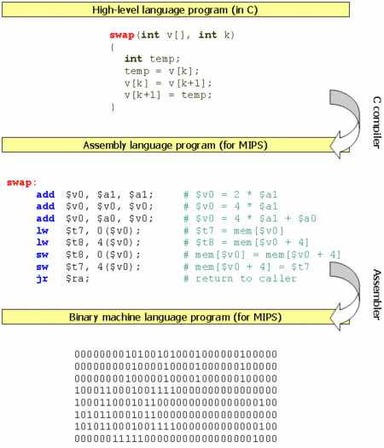
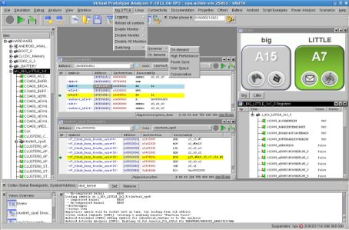
Computer Programming Technologies
Not as Much Change As HW
Slow Programming Process
Error-Prone Code Entry
Compiler errors
Still Need Assembly Language
Modern SW Development Tools: Interactive, Virtual

Slide 17
Computer Programming Language
Example: “Hello, world!”
1950s:
COBOL
1960s:
FORTRAN
1970s:
Pascal
1970s-present:
C language
2000s:
JAVA
Assignment: Read the Webpage http://en.wikipedia.org/wiki/Hello_world_program_examples

Slide 18
Computer Programming Tools
Assignment: To Be Done by Friday
Request a CISE class account per the instructions on this Web page:
http://www.cise.ufl.edu/help/account.shtml
This will allow you to run and check your programs on the same machines we use to grade them.

Slide 19
Computer Programming Tools
Next Class (Friday)
Overview of JAVA Programming Language
Access JAVA Programming Tools
Download JAVA Tools to Your Laptop
Write a “Hello, world!” Program
Run the Program
Bring Your Laptops

