Slide 1
Human Computation
Human-Computer Interfaces

Slide 2
Human computation
Humans helping solve large problems
Using humans WITH computers to solve problems not solvable be either alone
Humans unknowingly helping solve large problems

Slide 3
Mechanical Turk
Having many workers solve a problem
Fix database holes
Human database queries (e.g. videos, google images, etc.)
Image tagging

Slide 4
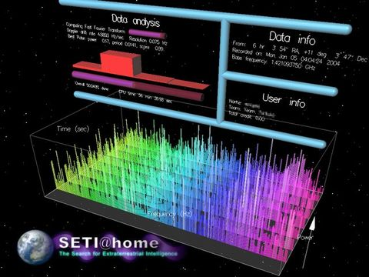
Citizen Science
Science research using nonprofessionals
Using their computing power
What unused cycles do you have?
SETI@Home
(from 2013), 10 million people, 500 TeraFLOPs/sec
Video

Slide 5
Citizen Science
Problems difficult for computers
Humans can help!
Give tasks to volunteers
SETI Live
FoldIt
Questions
Qualifications
Wrong answers
Malicious users

Slide 6
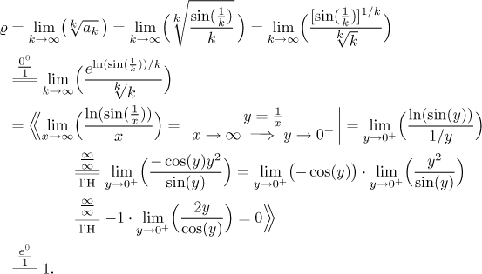
Solving Problems Using Humans
Some problems are easy to do for a computer, but hard for a human
(from http://math.feld.cvut.cz/mt/txte/2/txe3ec2g.htm)

Slide 7
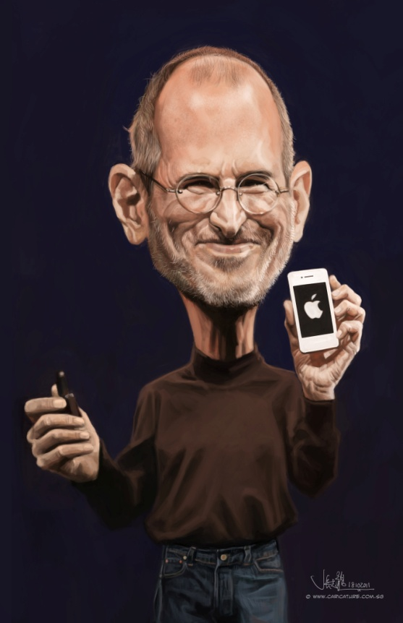
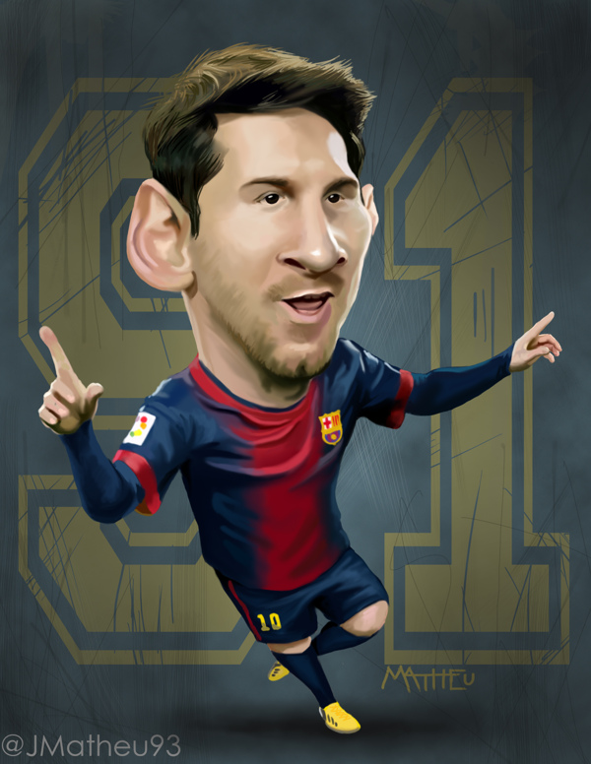
Solving Problems Using Humans
Some problems are really hard for computers to do, but easy for humans to do
(from: http://www.dezineguide.com/wp-content/uploads/2012/05/Celebrities-Caricature-3.jpg)
http://sketchoholic.com/uploads/old_files/11122/digitalcaricatureofSteveJobssmall.jpg
https://m1.behance.net/rendition/modules/60353381/disp/b16d396cffd2090a184f6c9ebf134cfc.jpg

Slide 8
Incomplete information
Shopping.google.com (search for ipad air 2)

Slide 9
Luis von Ahn’s ESP game
Games with a purpose
Leverage computational power of humans
Perform a task that computers can not do
Package as a game
Let’s play
I’ll show an image
You and your partner each write down three words (in order)
Figure out what’s the first word you both agree on.

Slide 10
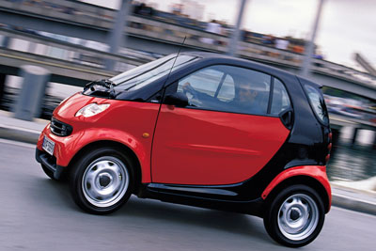
http://auto.howstuffworks.com/smart-car.htm

Slide 11
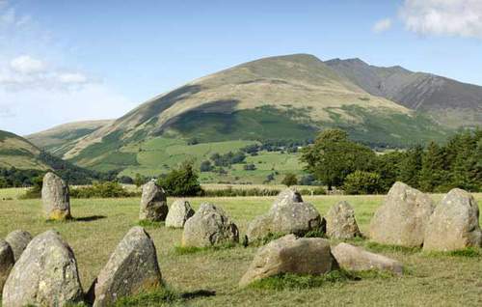
http://www.thephotoargus.com/wp-content/uploads/2010/06/ls5.jpg

Slide 12
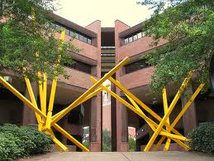

Slide 13
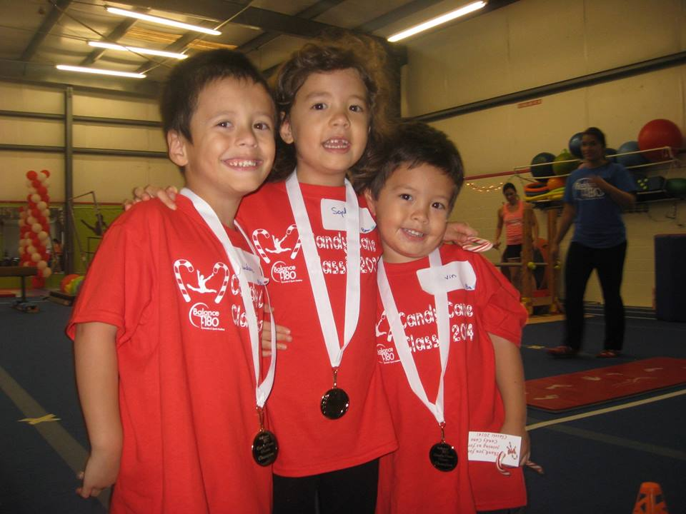

Slide 14
Captcha
Completely Automated Turing Test to tell Computers and Humans Apart
Von Ahn et al.
Turing test – to see if user is a human or computer administered by a human (chatting)
Reverse test – computer administers to human or computer
What happens with those who are vision impaired?

Slide 15
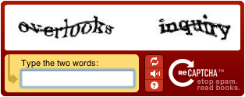
reCaptcha
Fix OCR problems (www.captcha.net)
Completely Automated Public Turing Test to Tell Computer and Humans Apart
One word is a control (known answer)

Slide 16
Other crowdsourcing problems
Learn a language
www.duolingo.com
https://www.youtube.com/watch?v=WyzJ2Qq9Abs
Aggregate information
www.wikipedia.org

Slide 17
Virtual People Factory
Virtual Human conversation modeling
If we have virtual humans, how do you know what it should respond to?
Q: ?
A: “My name is Benjamin Lok”
Two approaches:
Artificial intelligence (Natural Language Processing)
Brute force
http://vpf2.cise.ufl.edu/Classic/Interaction/Public/14143?skiprails=1

Slide 18
Old Approach
How would you build a virtual patient to present a stomach ache?

Slide 19
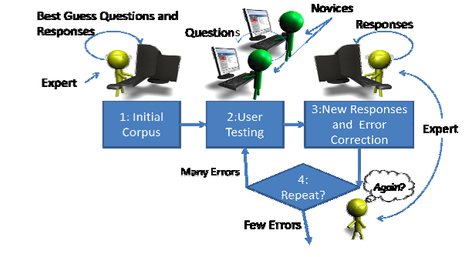
Human-distributed conversational modeling

Slide 20
Mechanical Turk
Having many workers solve a problem
Fix database holes
Human database queries
Image tagging

