Slide 1
Conducting a User Study
Human-Computer Interaction

Slide 2
Overview – Usability Testing
What is a study?
Empirically testing a hypothesis
Evaluate interfaces, e.g. which browser is easiest to use?
Why run a study?
Evaluate if a statement is ‘true’
‘To learn more’
To ensure quality in product development
To compare solutions
To get a scientific statement (instead of personal opinion)
Notes:
2

Slide 3
You should
Be able to design a two condition experimental study
Apply t-test
Interpret results of t-test
Explain biases and confounds
Notes:
3

Slide 4
Example Overview
Ex. A person’s weight is correlated with their blood pressure
Many ways to do this:
Look at data from a doctor’s office
Descriptive design: What are the pros and cons?
Pro: findings lead to new hypotheses
Cons: observer bias, can’t determine causality
Analytic design: What are the pros and cons?
Pro: show cause and effect relationships
Con: results may not generalize to real life
Notes:
4

Slide 5
Example Overview
Ideal solution: have everyone in the world get weighed and measure blood pressure
Participants are a sample of the population
You should immediately question this!
Restrict population
Notes:
5

Slide 6
Study Components
Design
Hypothesis
Population
Task
Metrics
Procedure
Data Analysis
Conclusions
Confounds/Biases/Limitations
Notes:
6

Slide 7
Study Design
How are we going to evaluate the interface?
Hypothesis
What statement do you want to evaluate?
Population
Who?
Task
What will people do so you make evaluations?
Metrics
How will you measure?

Slide 8
Hypothesis
Statement that you want to evaluate
Ex. People will favor my interface over Google Translate to communicate with another person to get directions
Create a hypothesis
Ex. Participants using my interface will recommend it to their friends to find directions from a person whose primary language is different than theirs more than Google Translate.
Identify Independent and Dependent Variables
Independent Variable – the variable that is being manipulated by the experimenter (interaction method)
Dependent Variable – the variable that is caused by the independent variable (participant’s recommendation rating)
Notes:
8

Slide 9
Variables
Independent variable
Influences
Dependent variable
Manipulated
Observed/
Measured

Slide 10
Hypothesis Testing
Hypothesis: Participants using my interface will recommend it to their friends to find directions from a person whose primary language is different than theirs more than Google Translate
US Court system: Innocent until proven guilty
NULL Hypothesis: Assume people who use your interface will recommend it to their friends at the same or less than Google Translate
Your job to prove that the NULL hypothesis isn’t true!
Notes:
10

Slide 11
Population/sample
The people going through your study
Two general approaches
Have lots of people from the general public
Results are generalizable
Logistically difficult
People will always surprise you with their variance
Select a niche population to obtain sample from
Results more constrained
Lower variance
Logistically easier
Number
The more, the better
How many is enough?
Logistics
Recruiting (n>15 per condition)
Notes:
11

Slide 12
Two Group Design
Design Study
Participants are allocated to conditions
How many participants?
Do the groups need the same # of participants?
Task
What is the task?
What are considerations for task?

Slide 13
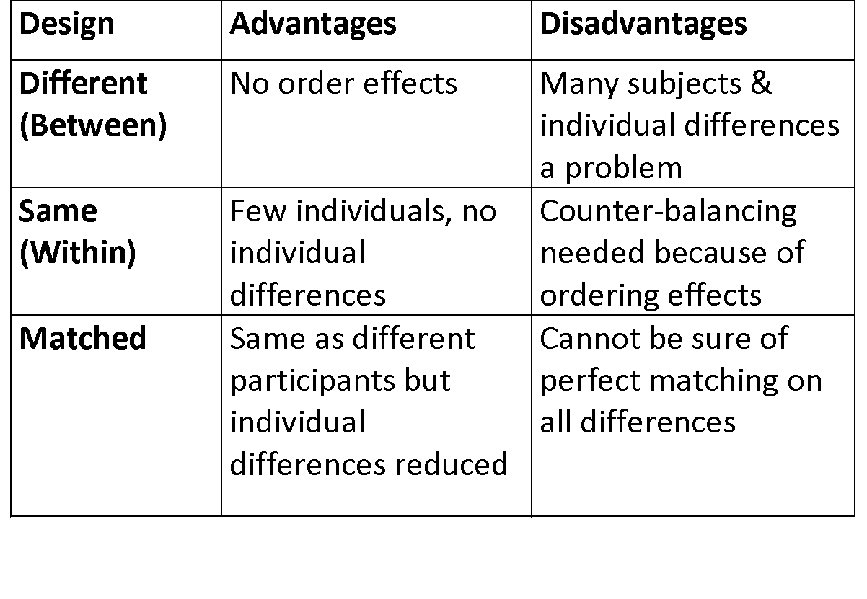
Participant Design

Slide 14
Validity
Degree that your task correlates with real world
Face and content validity – estimate if your task appears to measure what it intends to measure
Take in at face value
Ask expert
Construct validity – measure a theoretical construct or trait
Does the task measure what you think it does? E.g. does IQ test measure intelligence? All of intelligence?
Notes:
14

Slide 15
Validity
Internal validity
Measurements are accurate
Measurements are due to manipulations, not caused by other factors
External validity
Results should be similar to other similar studies
Use accepted questionnaires, methods
Findings are representative of humanity
Not only valid in experiment setting
Generalizable!

Slide 16
To Ensure Validity
Design tasks that:
Do not favor one condition over another
Are as close as possible to actual use settings
Get expert input
Use measures that:
Have internal and external validity (others have used)

Slide 17
Design
Power – how much meaning do your results have?
The more people the more you can say that the participants are a sample of the population
Pilot your study!!!
Generalization – how much do your results apply to the true state of things
Are they specific for your scenario only or can they be applied to other scenarios?

Slide 18
Design
People who use a mouse and keyboard will be faster in filling out a form than keyboard alone
Let’s create a study design
Hypothesis
Population
Procedure
Two types:
Between Subjects
Within Subjects

Slide 19
Procedure
Formally have all participants sign up for a time slot (if individual testing is needed)
Informed Consent (we’ll look at one next class)
Execute study
Questionnaires/Debriefing (let’s look at one)

Slide 20
Biases Examples
Hypothesis Guessing
Participants guess what you are trying hypothesis
Learning Bias
Users get better as they become more familiar with the task
Experimenter Bias
Subconscious bias of data and evaluation to find what you want to find
Systematic Bias
Bias resulting from a flaw integral to the system
E.g. An incorrectly calibrated thermostat
List of biases
http://en.wikipedia.org/wiki/List_of_cognitive_biases

Slide 21
Confounds
Confounding factors – factors that affect outcomes, but are not related to the study
Population confounds
Who you get?
How you get them?
How you reimburse them?
How do you know groups are equivalent?
Design confounds
Unequal treatment of conditions
Learning
Time spent

