Slide 1
Evaluating User Interfaces
Chapter 4

Slide 2
Introduction
Why evaluate?
Designers become too entranced
What I like
Sunk cost fallacy
Experienced designers know extensive testing is required
How do you test?
A web site?
Air traffic control system?
How much would you budget for testing?
When do you test?
Are you required to test? (e.g. military, government, saftey)

Slide 3
What does testing not do?
Guarantee perfection
Hard to “finish” testing
Difficult to test unusual situations
Military attack
Heavy load (e.g. voting)
Simulate accurate situations
E.g. driving games, military games, medical sims

Slide 4
Expert Review
Colleagues or Customers
Ask for opinions
Considerations:
What is an expert? User or designer?
Half day to week

Slide 5
Heuristic Evaluation
Give Expert heuristic, ask them to evaluate
Eight Golden Rules
Specific to application area
Box 4.1 Heuristics for gaming (Pinelle 2008)
Provide consistent responses to user’s actions
Allow users to customize video and audio setting, difficulty, and game speed
Provide users with information on game status.

Slide 6
Guidelines Review
Interface is checked against organizational guidelines.
Military
Government
Security
Education

Slide 7
Consistency Inspection
Verify consistency across family of interfaces
Check terminology, fonts, color, layout, i/o formats
Look at documentation and online help
Also can be used in conjunction with software tools

Slide 8
Cognitive Walkthrough
Experts “simulate” being users going through the interface
Tasks are ordered by frequency
Good for interfaces that can be learned by “exploratory browsing” (Wharton 1994) [novices]
Usually walkthrough by themselves, then report their experiences (written, video) to designers meeting
Useful if application is geared for group the designers might not be familiar with:
Military, Assistive Technologies

Slide 9
Metaphors of human Thinking (MOT)
Experts consider metaphors for five aspects of human thinking
Habit
Stream of thought
Awareness and Associations
Relation between utterances and thought
Knowing
Appears better than cognitive walkthgrough and heuristic evaluation

Slide 10
Formal Usability Inspection
Experts hold courtroom-style meeting
Each side gives arguments (in an adversarial format)
There is a judge or moderator
Extensive and expensive
Good for novice designers and managers

Slide 11
Expert Reviews
Can be conducted at any time in the design process
Focus on being comprehensive rather than being specific on improvements
Example review recommendations
Change log in procedure (from 3 to 5 minutes, because users were busy)
Reordering sequence of displays, removing nonessential actions, providing feedback.
Also come up with features for future releases

Slide 12
Expert Review
Placed in situation similar to user
Take training courses
Read documentation
Take tutorials
Try the interface in a realistic work environment (complete with noise and distractions)
Bird’s eye view
Studying a full set of printed screens laid on the floor or pinned to the walls
See topics such as consistency
Software tools
WebTango

Slide 13
Usability Testing and Labs
1980s, testing was luxury (but deadlines crept up)
Usability testing was incentive for deadlines
Fewer project overlays
Sped up projects
Cost savings
Rubin and Chisenll 2008, Sherman 2006, Dumas and Redish 1999
Labs are different than academia
Less general theory
More practical studies

Slide 14
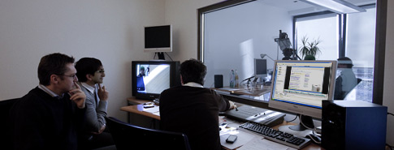
Usability Labs
IBM early leader
Microsoft next (>25 labs)
Now hundreds of companies
From http://www.ergosign.de/

Slide 15
Staff
Expertise in testing (psych, hci, comp sci)
10 to 15 projects per year
Meet with UI architect to plan testing (Figure 4.2)
Participate in early task analysis and design reviews
T – 2-6 weeks, creates study design and test plan
E.g. Who are participants? Beta testers, current customers, in company staff, advertising
T -1 week, pilot test (1-3 participants)

Slide 16
Participants
Labs categorize users based on:
Computing background
Experience with task
Motivation
Education
Ability with the language used in the interface
Controls for
Physical concerns (e.g. eyesight, handedness, age)
Experimental conditions (e.g. time of day, physical surroundings, noise, temperature, distractions)

Slide 17
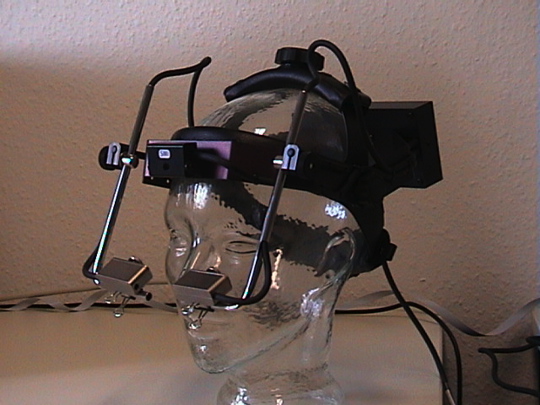
Recording Participants
Logging is important, yet tedious
Software to help (Live Logger, Morae, Spectator)
Powerful to see people use your interface
New approaches: eye tracking
IRB items
Focus users on interface
Tell them the task, duration

Slide 18
Thinking Aloud
Concurrent think aloud
Invite users to think aloud
Nothing they say is wrong
Don’t interrupt, let the user talk
Spontaneous, encourages positive suggestions
Can be done in teams of participants
Retrospective think aloud
Asks people afterwards what they were thinking
Issues with accuracy
Does not interrupt users (timings are more accurate)

Slide 19
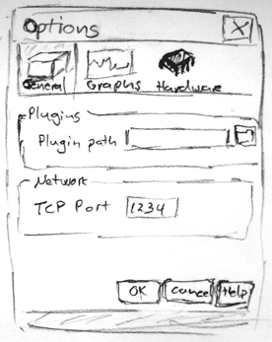
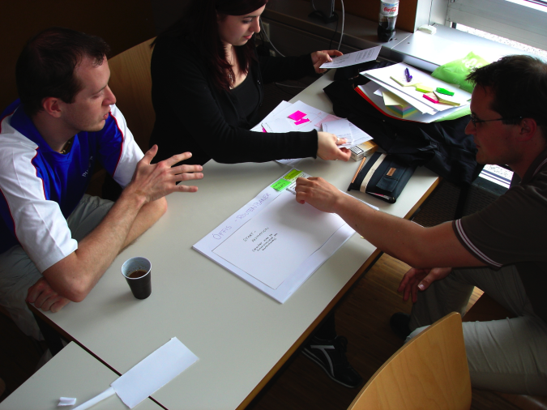
Types of Usability Testing
Paper mockups and prototyping
Inexpensive, rapid, very productive
Low fidelity is sometimes better (Synder, 2003)
Mythical Man Month – Prototype to throw away
http://expressionflow.com/wp-content/uploads/2007/05/paper-mock-up.png
http://user.meduni-graz.at/andreas.holzinger/holzinger/papers%20en/

Slide 20
Types of Usability Testing
Discount usability testing
Test early and often (with 3 to 6 testers)
Pros: Most serious problems can be found with 6 testers. Good for formative evaluation (early)
Cons: Complex systems can’t be tested this way. Not good for summative evaluation (late)
Competitive usability testing
Compare against prior or competitor’s versions
Experimenter bias, be careful to not “prime the user”
Within-subjects is preferred

Slide 21
Types of Usability Testing
Universal usability testing
Test with highly diverse
Users (experience levels, ability, etc.)
Platforms (mac, pc, linux)
Hardware (old (how old is old?) -> latest)
Networks (dial-up -> broadband)
Field tests and portable labs
Tests UI in realistic environments
Beta tests

Slide 22
Types of Usability Testing
Remote usability testing (via web)
Recruited via online communities, email
Large n
Difficulty in logging, validating data
Software can help (NetMeeting, WebEx, Sametime)
Can You Break this Test
Challenge testers to break a system
Games, security, public displays (MOSI)

Slide 23
Limitations
Focuses on first-time users
Limited coverage of interface features
Emergency (military, medical, mission-critical)
Rarely used features
Difficult to simulate realistic conditions
Testing mobile devices
Signal strength
Batteries
User focus
Yet formal studies on user studies have identified
Cost savings
Return on investment (Sherman 2006, Bias and Mayhew 2005)
Formal usability test reports

Slide 24
Survey Instruments
Questionnaires
Paper or online (e.g. surveymonkey.com)
Easy to grasp for many people
The power of many can be shown
80% of the 500 users who tried the system liked Option A
3 out of the 4 experts like Option B
Success depends on
Clear goals in advance
Focused items

Slide 25
Designing survey questions
Ideally
Based on existing questions
Reviewed by colleagues
Pilot tested
Direct activities are better than gathering statistics
Fosters unexpected discoveries
Important to pre-test questions
Understandability
Bias

Slide 26
Likert Scales
Most common methodology
Strongly Agree, Agree, Neutral, Disagree, Strongly Disagree
5, 7, 9-point scales
Examples
Improves my performance in book searching and buying
Enables me to search and by books faster
Makes it easier to search for an purchase books
What does 1.5 mean?

Slide 27
Most Used Likert-scales
Questionnaire for User Interaction Satisfaction
E.g. questions
How long have you worked on this system?
Learning to operate
Difficult 1 2 3 4 5 6 7 8 9 Easy
System Usability Scale (SUS) – Brooke 1996
Post-Study System Usability Questionniare
Computer System Usability Questionniare
Software usability Measurement Inventory
Website Analysis and MeasureMent Inventory
Mobile Phone Usability Questionnaire
Questionnaire websites
Gary Perlman’s website
Jurek Kirakowski’s website
Validity, Reliability

Slide 28
Bipolar Semantically Anchored
Coleman and Williges (1985)
Pleasant versus Irritating
Hostile 1 2 3 4 5 6 7 Friendly
If needed, take existing questionnaires and alter them slightly for your application

Slide 29
Acceptance Tests
Set goals for performance
Objective
Measurable
Examples
Mean time between failures (e.g. MOSI)
Test cases
Response time requirements
Readability (including documentation and help)
Satisfaction
Comprensability

Slide 30
Let’s discuss
We want the software to be user friendly.
How could we rephrase it?
Use a metric such as Shneiderman’s goals for interface design
Time for users to learn specific function
Speed of Task performance
Rate of Errors
User retention
Subjective satisfaction

Slide 31
Examples (page 155 in book)
Test A
The participants will be
35 adults (25-45 years old)
Native speakers with no disabilities
Hired from an employment agency
Moderate web-use experience (1-5 hours/week) for at least one year
>30 of the 35 should complete the benchmark tests within 30 minutes
Test B
The participants will be
10 older adults 55-65
10 adult users with varying motor, visual, and auditory disabilities
10 adult users who are recent immigrants and use English as a second language
Test C
Ten participants will be recalled after one week
Carry out new set of benchmark tests
In 20 minutes, at least 8 should be able to complete tasks

Slide 32
Acceptance Tests
By completing the acceptance tests
Can be part of contractual fulfillment
Demonstrate objectivity
Different than usability tests
More adversarial
Neutral party should conduct that
Ex. Video game and smartphone companies
App Store, Microsoft, Nintendo, Sony

Slide 33
Evaluation during use
Evaluation methods after a product has been released
Interviews with individual users
Get very detailed on specific concerns
Costly and time-consuming
Focus group discussions
Patterns of usage
Certain people can dominate or sway opinion
Targeted focus groups
Case Study
45 min interviews with 66 of the 4300 users of an internal message system
Happy with: legibility, convenience, online access
Concerns with: reliability, confusing, and accessibility
42 enhancements that differed from what designers thought they should implement.
How would you change the system architecture for suggested changes? Could you change your projects easily?

Slide 34
Continuous Logging
The system itself logs user usage
Video game example
Other examples
Track frequency of errors (gives an ordered list of what to address via tutorials, training, text changes, etc.)
Speed of performance
Track which features are used and which are not
Web Analytics
Privacy? What gets logged? Opt-in/out?
What about companies?

Slide 35
Online and Telephone Help
Users enjoy having people ready to help (real-time chat online or via telephone)
E.g. Netflix has 8.4 million customers, how many telephone customer service reps?
375
Expensive, but higher customer satisfaction
Cheaper version are Bug Report systems
Windows, Chrome, Bugzilla

Slide 36
Automated Evaluation
Software for evaluation
Low level: Spelling, term concordance
Metrics: number of displays, tabs, widgets, links
E.g. Tullis’s Display Analysis Program (1988)
Inputs: alphanumeric screen designs
Output ex.: Upper-case letters: 77%, the percentage of upper-case letters is high. Consider using more lower-case letters, since text printed in normal upper and lower case letters is read about 13% faster than all upper case.
World Wide Web Consortium Markup Validation
US NIST Web Metrics Testbed
Section 508 for accessibility
New research areas: Evaluation of mobile platforms

