Slide 1
CNT 4007C Computer Networks Fundamentals
Ahmed Helmy (www.cise.ufl.edu/~helmy)
Computer & Information Science & Engineering (CISE) Dept
University of Florida
Fall 2011

Slide 2
Course Outline
4 homeworks & 2 prog. assign. + 2 major exams
1 mid-term covering the first half of semester
The Internet (Overview), Layering, Multiplexing, Applications, Transport, Congestion Control, MAC protocols (partial !) [depending on lecture progress]
2nd exam (final or 2nd mid-term) covering 2nd half
MAC protocols (partial), Wireless Networking and Mobility, Routing (unicast, multicast), Security (partial!) [depending on progress]
1 required text book (Kurose, Ross… 5th Edition)
Lecture slides: modified version of book slides

Slide 3
(Open) Questions to think about:
Throughout the semester we can ask the following questions about the services and the design of the Internet:
What do you like about the Internet?
What do you not like about the Internet and would want to change?
How would you change it and how would you achieve such change?

Slide 4
Intro & Motivation
What’s the Internet to you?
Web browsers, wireless Internet Cafés, cellular phones!, home networks, networked cars, networked embedded devices, inter-planetary networks?…
Complex, time-varying, hard to capture & represent!
Why study the Internet?
To learn engineering lessons from history
Analyze today’s problems and improve performance
Provide future designs for better Internet and apps
Is the Internet the only form of computer networking?

Slide 5
Topics (Chapters) to Cover
From main text book (Kurose, Ross)
Ch1: Overview, Intro
Ch2: Applications
Ch3: Transport Layer
Ch4: Network Layer
Ch5: Link Layer, MAC, LANs
Ch6: Wireless, Mobile Networks
Ch7: Multimedia [partial?: Diffserv, Intserv]
Ch8: Security [partial]?
Notes:
Ordering maybe slightly modified as semester progresses.
Personal notes, additions will be provided by Prof. as needed.
This is not a programming class (although we will use some prog.). It is not a security class, although we’ll introduce security issues and discuss briefly!

Slide 6

Chapter 1 Introduction
Computer Networking: A Top Down Approach , 4th edition. Jim Kurose, Keith Ross Addison-Wesley, July 2007. (Updated Apr 09, Sept 10).

Slide 7
Chapter 1: Introduction
Overview:
what’s the Internet?
what’s a protocol?
network edge; hosts, access net, physical media
network core: Internet structure
protocol layers, service models
network core: packet/circuit switching,
performance: loss, delay, throughput
security
history

Slide 8
Chapter 1: roadmap
1.1 What is the Internet?
1.2 Network edge
end systems, access networks, links
1.3 Network core
circuit switching, packet switching, network structure
1.4 Delay, loss and throughput in packet-switched networks
1.5 Protocol layers, service models
1.6 Networks under attack: security
1.7 History

Slide 9

What’s the Internet: “nuts and bolts” view
PC
millions of connected computing devices: hosts = end systems
run network apps
Mobile network
server
Global ISP
wireless
laptop
cellular
handheld
Home network
communication links
fiber, copper, radio, satellite
transmission rate (bandwidth)
Regional ISP
access
points
Institutional network
wired
links
routers:
forward packets (chunks of data)
router

Slide 10
What’s the Internet: “nuts and bolts” view
protocols control sending, receiving of msgs
TCP, IP, HTTP, Ethernet
Internet:
“network of networks”
loosely hierarchical
public Internet versus private intranet
Internet standards
RFC: Request for comments
IETF: Internet Engineering Task Force
Mobile network
Global ISP
Home network
Regional ISP
Institutional network

Slide 11
What’s the Internet: a service view
communication infrastructure enables distributed applications:
Web, VoIP, email, games, e-commerce, file sharing
communication services provided to apps:
reliable data delivery from source to destination
“best effort” (unreliable) data delivery

Slide 12
What’s a protocol?
Network protocols:
All communication in Internet governed by protocols
Generic protocol:
specific messages sent
specific actions taken when messages are received, or other events (e.g., timer expiration, exception detection)
Protocol Representation:
Finite State Machines
Protocol Specification, via Standards
protocols define format, order of messages sent and received among network entities, and actions taken on message transmission, receipt

Slide 13
What’s a protocol?
Example sequence of a computer network protocol:
host
server
TCP connection
request
TCP connection
response
Get http://www.ufl.edu
<file>
time
Protocol Design and Analysis are extremely important in Internet study, development and research

Slide 14
Chapter 1: roadmap
1.1 What is the Internet?
1.2 Network edge
end systems, access networks, links
1.3 Network core
circuit switching, packet switching, network structure
1.4 Delay, loss and throughput in packet-switched networks
1.5 Protocol layers, service models
1.6 Networks under attack: security
1.7 History

Slide 15
A closer look at network structure:
Network edge: applications and hosts
Access networks, physical media: wired, wireless communication links
Network core:
interconnected routers
network of networks

Slide 16
The network edge:
end systems (hosts):
run application programs
e.g. Web, email
at “edge of network”
peer-peer
client-server model
client host requests, receives service from always-on server
e.g. Web browser/server; email client/server
client/server
peer-to-peer model:
minimal (or no) use of dedicated servers
e.g. Skype, BitTorrenth

Slide 17
Network edge: reliable data transfer service
Goal: data transfer between end systems
handshaking: setup (prepare for) data transfer ahead of time
Hello, initial establishment
set up “state” in two communicating hosts
TCP - Transmission Control Protocol
Internet’s reliable data transfer service
TCP service [RFC 793]
reliable, in-order byte-stream data transfer
loss: acknowledgements and retransmissions
flow control:
sender won’t overwhelm receiver
congestion control:
senders “slow down sending rate” when network congested

Slide 18
Network edge: best effort (unreliable) data transfer service
Goal: data transfer between end systems
same as before!
UDP - User Datagram Protocol [RFC 768]:
connectionless
unreliable data transfer
no flow control
no congestion control
App’s using TCP:
HTTP (Web), FTP (file transfer), Telnet (remote login), SMTP (email)
App’s using UDP:
streaming media, teleconferencing, DNS, Internet telephony

Slide 19
Access networks and physical media
Q: How to connect end systems to edge router?
residential access nets
institutional access networks (school, company)
mobile access networks
Keep in mind:
bandwidth (bits per second) of access network?
shared or dedicated?

Slide 20
Residential access: point to point access
Dialup via modem
up to 56Kbps direct access to router (often less)
Can’t surf and phone at same time: can’t be “always on”
DSL: digital subscriber line
deployment: telephone company (typically)
up to 1 Mbps upstream (today typically < 256 kbps)
up to 8 Mbps downstream (today typically < 1 Mbps)
dedicated physical line to telephone central office

Slide 21
Residential access: cable modems
uses cable TV infrastructure, rather than telephone infrastructure
HFC: hybrid fiber coax
asymmetric: up to 30Mbps downstream, 2 Mbps upstream
network of cable and fiber attaches homes to ISP router
homes share access to router
unlike DSL, which has dedicated access

Slide 22
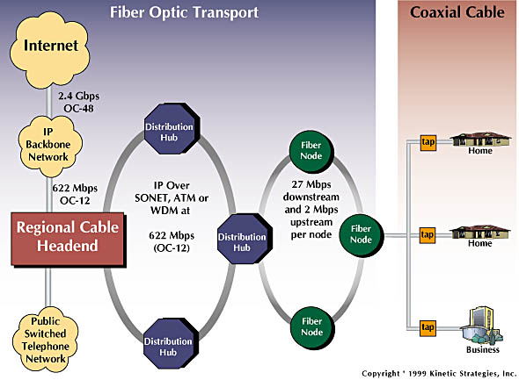
Residential access: cable modems

Slide 23

Cable Network Architecture: Overview
Typically 500 to 5,000 homes
cable headend
cable distribution
network (simplified)
home

Slide 24
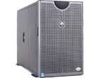
Cable Network Architecture: Overview
server(s)
cable headend
cable distribution
network
home

Slide 25
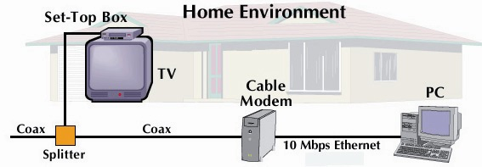
Cable Network Architecture: Overview
cable headend
cable distribution
network (simplified)
home

Slide 26
Cable Network Architecture: Overview
FDM (frequency
division multiplexing)
[more shortly]
C
O
N
T
R
O
L
V
I
D
E
O
V
I
D
E
O
V
I
D
E
O
V
I
D
E
O
V
I
D
E
O
V
I
D
E
O
D
A
T
A
D
A
T
A
1
2
3
4
5
6
7
8
9
Channels
cable headend
cable distribution
network
home

Slide 27
Ethernet Internet access
100 Mbps
institutional
router
Ethernet
switch
to institution’s ISP
100 Mbps
1 Gbps
100 Mbps
server
typically used in companies, universities, etc
10 Mbps, 100Mbps, 1Gbps, 10Gbps Ethernet
today, end systems typically connect into Ethernet switch
Introduction 1-27

Slide 28
Wireless access networks
shared wireless access network connects end system to router
via base station aka “access point”
wireless LANs:
802.11b/g/n (WiFi): 11, 54, 111 Mbps
wider-area wireless access
provided by telco operator
~1Mbps over cellular (EVDO, HSDPA)
WiMAX , LTE (10’s Mbps) over wide area?
Wireless Networks: Chapter 6
Future:
Mobile Ad Hoc and Sensor Networks!
router
base
station
mobile
hosts

Slide 29
Home networks
Typical home network components:
DSL or cable modem
router/firewall/NAT
Ethernet
wireless access point
wireless
laptops
to/from
cable
headend
cable
modem
router/
firewall
wireless
access
point
Ethernet

Slide 30
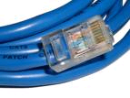
Physical Media
Twisted Pair (TP)
two insulated copper wires
Category 3: traditional phone wires, 10 Mbps Ethernet
Category 5: 100Mbps Ethernet
Bit: propagates between transmitter/rcvr pairs
physical link: what lies between transmitter & receiver
guided media:
signals propagate in solid media: copper, fiber, coax
unguided media:
signals propagate freely, e.g., radio

Slide 31


Physical Media: coax, fiber
Fiber optic cable:
glass fiber carrying light pulses, each pulse a bit
high-speed operation:
high-speed point-to-point transmission (100’s Gps)
WDM Networks: Wavelength
division multiplexing
low error rate: repeaters spaced far apart ; immune to electromagnetic noise
Coaxial cable:
two concentric copper conductors
bidirectional
baseband:
single channel on cable
legacy Ethernet
broadband:
multiple channels on cable
HFC (hybrid fiber-coax)

Slide 32
Physical media: radio
signal carried in electromagnetic spectrum
no physical “wire”, …
bidirectional
propagation environment effects:
reflection
obstruction by objects
Interference
dynamic link characteristics …
Radio link types:
terrestrial microwave
e.g. up to 45 Mbps channels
LAN (e.g., Wifi)
11Mbps, 54 Mbps
wide-area (e.g., cellular)
3G cellular: ~ 1 Mbps
satellite
Kbps to 45Mbps channel (or multiple smaller channels)
270 msec end-end delay
geosynchronous versus low altitude

Slide 33
Chapter 1: roadmap
1.1 What is the Internet?
1.2 Network edge
end systems, access networks, links
1.3 Network core
network structure, circuit switching, packet switching
1.4 Delay, loss and throughput in packet-switched networks
1.5 Protocol layers, service models
1.6 Networks under attack: security
1.7 History

Slide 34
Internet Structure: loose hierarchy
hierarchy based on administrative regions/providers

Slide 35
Internet Hierarchy
hierarchy based on routing (more later)

Slide 36
Internet structure: network of networks
roughly hierarchical
at center: small # of well-connected large networks
“tier-1” commercial ISPs (e.g., Verizon, Sprint, AT&T, Qwest, Level3), national & international coverage
large content distributors (Google, Akamai, Microsoft)
treat each other as equals (no charges)
IXP
IXP
Tier-1 ISPs &
Content Distributors, interconnect (peer) privately
Tier 1 ISP
Large Content
Distributor
(e.g., Akamai)
Large Content
Distributor
(e.g., Google)
Tier 1 ISP
Tier 1 ISP
… or at Internet Exchange Points IXPs
Introduction 1-36

Slide 37
Tier-1 ISP: e.g., Sprint
POP: point-of-presence
to/from backbone
…
peering
….
…
…
…
to/from customers
Introduction 1-37

Slide 38
Internet structure: network of networks
“tier-2” ISPs: smaller (often regional) ISPs
connect to one or more tier-1 (provider) ISPs
each tier-1 has many tier-2 customer nets
tier 2 pays tier 1 provider
tier-2 nets sometimes peer directly with each other (bypassing tier 1) , or at IXP
Tier 2
ISP
IXP
IXP
Tier 2
ISP
Tier 2
ISP
Tier 1 ISP
Large Content
Distributor
(e.g., Akamai)
Large Content
Distributor
(e.g., Google)
Tier 1 ISP
Tier 1 ISP
Tier 2
ISP
Tier 2
ISP
Tier 2
ISP
Tier 2
ISP
Tier 2
ISP
Tier 2
ISP
Introduction 1-38
Notes:
38

Slide 39
Internet structure: network of networks
“Tier-3” ISPs, local ISPs
customer of tier 1 or tier 2 network
last hop (“access”) network (closest to end systems)
Tier 2
ISP
IXP
IXP
Tier 2
ISP
Tier 2
ISP
Tier 1 ISP
Large Content
Distributor
(e.g., Akamai)
Large Content
Distributor
(e.g., Google)
Tier 1 ISP
Tier 1 ISP
Tier 2
ISP
Tier 2
ISP
Tier 2
ISP
Tier 2
ISP
Tier 2
ISP
Tier 2
ISP
Introduction 1-39
Notes:
39

Slide 40
Internet structure: network of networks
a packet passes through many networks from source host to destination host
Tier 2
ISP
IXP
IXP
Tier 2
ISP
Tier 2
ISP
Tier 1 ISP
Large Content
Distributor
(e.g., Akamai)
Large Content
Distributor
(e.g., Google)
Tier 1 ISP
Tier 1 ISP
Tier 2
ISP
Tier 2
ISP
Tier 2
ISP
Tier 2
ISP
Tier 2
ISP
Tier 2
ISP
Introduction 1-40
Notes:
40

Slide 41
Internet structure: network of networks
a packet passes through many networks down and up the hierarchy!
local
ISP
Tier 3
ISP
local
ISP
local
ISP
local
ISP
Tier-2 ISP
Tier-2 ISP
Tier 1 ISP
Tier 1 ISP
Tier 1 ISP
Tier-2 ISP
Tier-2 ISP
Tier-2 ISP
local
ISP
local
ISP
local
ISP
local
ISP

Slide 42
So, what does the Internet look like? Have you seen it lately?!
100 node transit-stub topology

Slide 43
Map of the multicast backbone [Mbone] (~3000 nodes) [2002]

Slide 44

Map of the Internet (~50,000 nodes)

Slide 45
It is not simple…
It is really complex
in scale
in interactions and dynamics
in failure modes (loss, crashes, loops, etc)
We need a very systematic approach to design protocols for such a complex network

Slide 46
Chapter 1: roadmap
1.1 What is the Internet?
1.2 Network edge
end systems, access networks, links
1.3 Network core
circuit switching, packet switching, network structure
1.4 Delay, loss and throughput in packet-switched networks
1.5 Protocol layers, service models
1.6 Networks under attack: security
1.7 History

Slide 47
Protocol “Layers”
Networks are complex!
many “pieces”:
hosts
routers
links of various media
applications
protocols
hardware, software
Question:
Is there any hope of organizing structure of network?
Or at least our discussion of networks?

Slide 48
Why layering?
Dealing with complex systems:
explicit structure allows identification, relationship of complex system’s pieces
layered reference model for discussion
modularization eases maintenance, updating of system
change of implementation of layer’s service transparent to rest of system
change in one layer doesn’t affect rest of system
(is this true?!)
Can layering be considered harmful?

Slide 49
Internet protocol stack
application: supporting network applications
FTP, SMTP, HTTP
transport: process-process data transfer
TCP, UDP
network: routing of datagrams from source to destination
IP, routing protocols
link: data transfer between neighboring network elements
PPP, Ethernet
physical: bits “on the wire”
application
transport
network
link
physical

Slide 50
ISO/OSI reference model
presentation: allow applications to interpret meaning of data, e.g., encryption, compression, machine-specific conventions
session: synchronization, checkpointing, recovery of data exchange
Internet stack “missing” these layers!
these services, if needed, must be implemented in application
needed?
application
presentation
session
transport
network
link
physical

Slide 51
Encapsulation
source
message
M
application
transport
network
link
physical
segment
H_{t}
M
H_{t}
datagram
H_{n}
H_{n}
H_{t}
M
frame
H_{l}
H_{n}
H_{t}
M
link
physical
switch
destination
H_{n}
H_{t}
M
network
link
physical
M
application
transport
network
link
physical
H_{l}
H_{n}
H_{t}
M
H_{n}
H_{t}
M
H_{t}
M
H_{n}
H_{t}
M
H_{l}
H_{n}
H_{t}
M
router

Slide 52
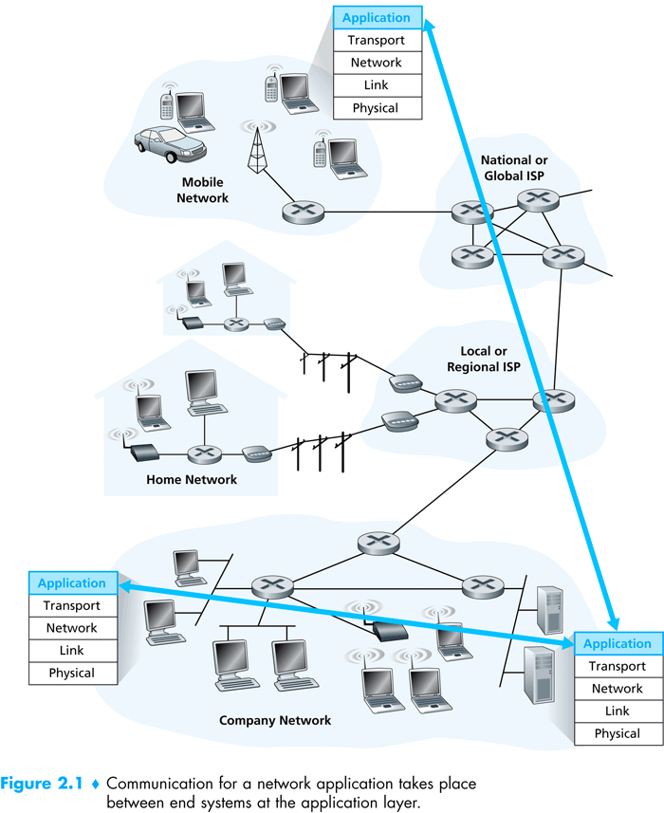

Slide 53
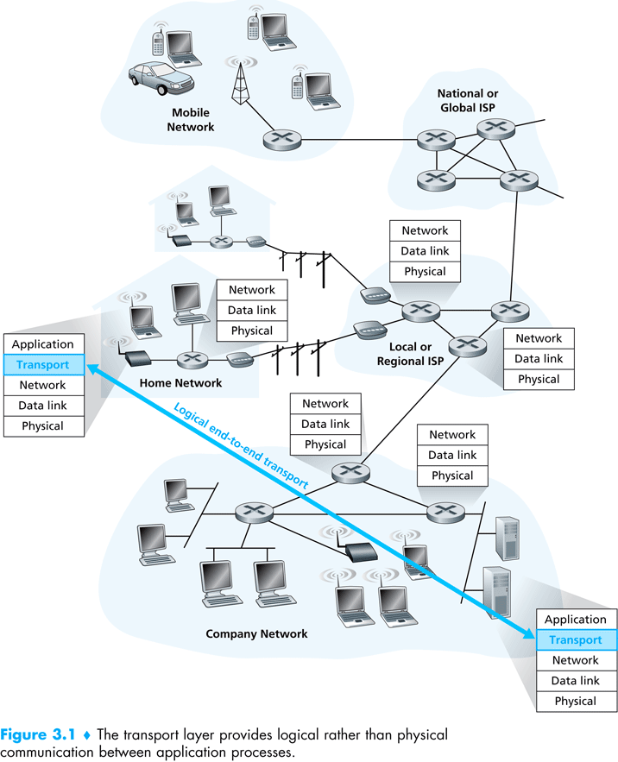

Slide 54
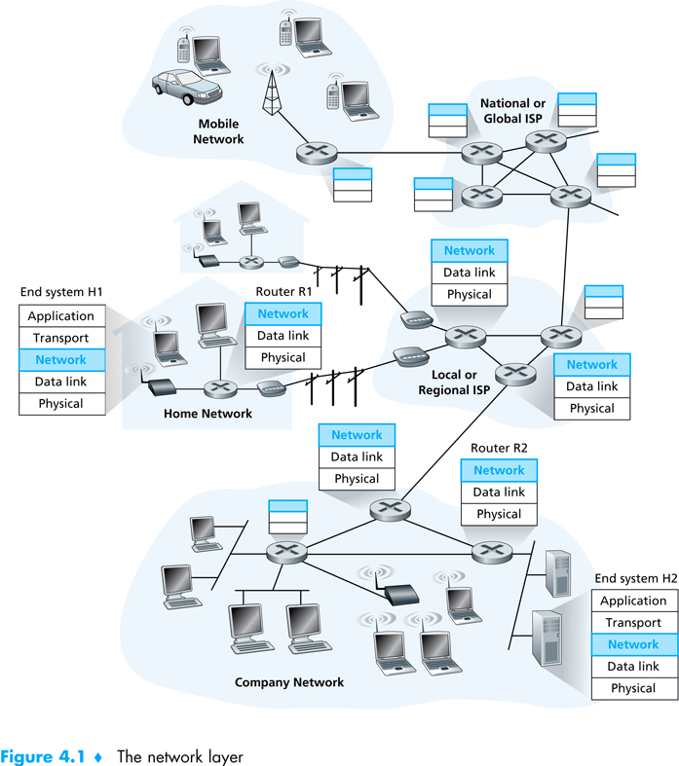

Slide 55
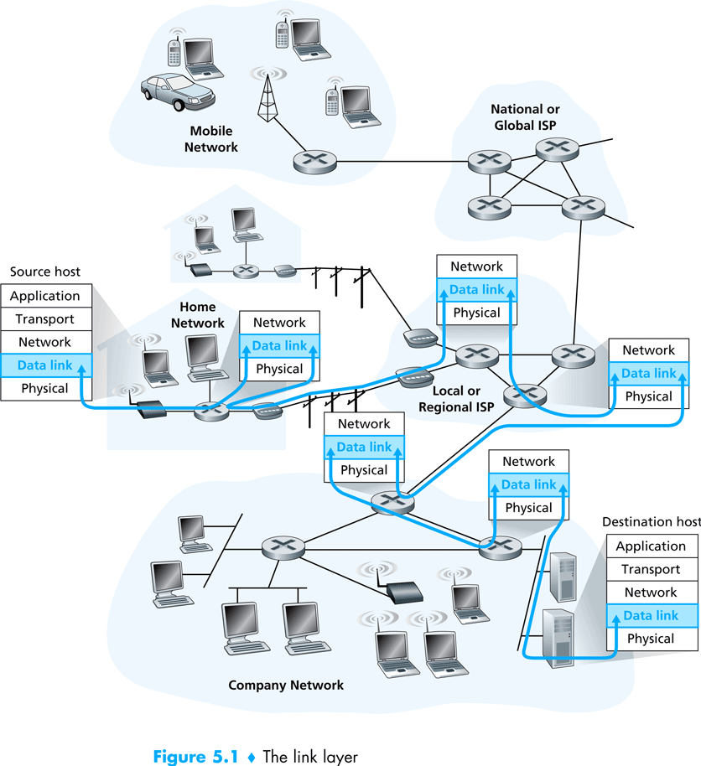

Slide 56
Layering & protocol stacks: (the protocol hour glass)

Slide 57
Chapter 1: roadmap
1.1 What is the Internet?
1.2 Network edge
end systems, access networks, links
1.3 Network core
circuit switching, packet switching, network structure
1.4 Delay, loss and throughput in packet-switched networks
1.5 Protocol layers, service models
1.6 Networks under attack: security
1.7 History

Slide 58
The Network Core
mesh of interconnected routers
the fundamental question: how is data transferred through net?
circuit switching: dedicated circuit per call: telephone net
packet-switching: data sent thru net in discrete “chunks”

Slide 59
Network Core: Circuit Switching
End-end resources reserved for “call”
link bandwidth, switch capacity
dedicated resources: no sharing
circuit-like (guaranteed) performance
call setup required
re-establish call upon failure

Slide 60
Network Core: Circuit Switching
network resources (e.g., bandwidth) divided into “pieces”
pieces allocated to calls
resource piece idle if not used by owning call (no sharing)
dividing link bandwidth into “pieces”
frequency division
time division

Slide 61
Circuit Switching: FDM and TDM
Example:
FDM
4 users
frequency
time
TDM
frequency
time
Notes:
Two simple multiple access control techniques.
Each mobile’s share of the bandwidth is divided into portions for the uplink and the downlink. Also, possibly, out of band signaling.
As we will see, used in AMPS, GSM, IS-54/136

Slide 62
Numerical example
How long does it take to send a file of 640,000 bits from host A to host B over a circuit-switched network?
All links are 1.536 Mbps
Each link uses TDM with 24 slots/sec
500 msec to establish end-to-end circuit
Let’s work it out!
Each link gets 1.536Mbps/24=64kbps
Time needed for 640kbps=640/64+0.5=10.5 seconds
Plus propagation!

Slide 63
Network Core: Packet Switching
each end-end data stream divided into packets
user A, B packets share network resources
each packet uses full link bandwidth
resources used as needed
resource contention:
aggregate resource demand can exceed amount available
congestion: packets queue, wait for link use
store and forward: packets move one hop at a time
Node receives complete packet before forwarding
Bandwidth division into “pieces”
Dedicated allocation
Resource reservation

Slide 64
Packet Switching: Statistical Multiplexing
100 Mb/s
Ethernet
A
C
statistical multiplexing
1.5 Mb/s
B
queue of packets
waiting for output
link
D
E
Sequence of A & B packets does not have fixed pattern, bandwidth shared on demand ➔ statistical multiplexing.
TDM: each host gets same slot in revolving TDM frame.

Slide 65
Packet-switching: store-and-forward
L
R
R
R
takes L/R seconds to transmit (push out) packet of L bits on to link at R bps
store and forward: entire packet must arrive at router before it can be transmitted on next link
delay = 3L/R (assuming zero propagation delay)
Example:
L = 7.5 Mbits
R = 1.5 Mbps
transmission delay = 15 sec
more on delay shortly …

Slide 66
Packet switching versus circuit switching
Packet switching allows more users to use network!
1 Mb/s link
each user:
100 kb/s when “active”
active 10% of time
circuit-switching:
10 users
packet switching:
with 35 users, probability > 10 active at same time is less than .0004
N users
1 Mbps link
Q: how did we get value 0.0004?

Slide 67
Packet switching versus circuit switching
Is packet switching a “slam dunk winner?”
great for bursty data
resource sharing (scalable!)
simpler, no call setup, more robust (re-routing)
excessive congestion: packet delay and loss
Without admission control: protocols needed for reliable data transfer, congestion control
Q: How to provide circuit-like behavior?
bandwidth guarantees needed for audio/video apps
still an unsolved problem (chapter 7), virtual circuit
Q: human analogies of reserved resources (circuit switching) versus on-demand allocation (packet-switching)?

Slide 68
Chapter 1: roadmap
1.1 What is the Internet?
1.2 Network edge
end systems, access networks, links
1.3 Network core
circuit switching, packet switching, network structure
1.4 Delay, loss and throughput in packet-switched networks
1.5 Protocol layers, service models
1.6 Networks under attack: security
1.7 History

Slide 69
How do loss and delay occur?
packets queue in router buffers
packet arrival rate to link exceeds output link capacity
packets queue, wait for turn
packet being transmitted (delay)
A
B
packets queueing (delay)
free (available) buffers: arriving packets
dropped (loss) if no free buffers

Slide 70
Four sources of packet delay
1. nodal processing:
check bit errors
determine output link
2. queueing
time waiting at output link for transmission
depends on congestion level of router
transmission
A
propagation
B
nodal
processing
queueing

Slide 71
Delay in packet-switched networks
3. Transmission delay:
R=link bandwidth (bps)
L=packet length (bits)
time to send bits into link = L/R
4. Propagation delay:
d = length of physical link
s = propagation speed in medium (~2x10⁸ m/sec)
propagation delay = d/s
Note: s and R are very different quantities!
transmission
A
propagation
B
nodal
processing
queueing

Slide 72
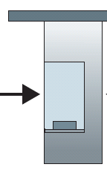
Caravan analogy
100 km
100 km
ten-car
caravan
toll
booth
toll
booth
cars “propagate” at 100 km/hr
toll booth takes 12 sec to service car (transmission time)
car~bit; caravan ~ packet
Q: How long until caravan is lined up before 2nd toll booth?
Time to “push” entire caravan through toll booth onto highway = 12*10 = 120 sec
Time for last car to propagate from 1st to 2nd toll both: 100km/(100km/hr)= 1 hr
A: 62 minutes

Slide 73
Caravan analogy (more)
100 km
100 km
ten-car
caravan
toll
booth
toll
booth
cars now “propagate” at 1000 km/hr
toll booth now takes 1 min to service a car
Q: Will cars arrive to 2nd booth before all cars serviced at 1st booth?
A: Yes! After 7 min, 1st car arrives at second booth; three cars still at 1st booth.
1st bit of packet can arrive at 2nd router before packet is fully transmitted at 1st router! (see Ethernet applet at AWL Web site
Introduction 1-73

Slide 74
Nodal delay
d_{proc} = processing delay
typically a few microsecs or less
d_{queue} = queuing delay
depends on congestion
d_{trans} = transmission delay
= L/R, significant for low-speed links
d_{prop} = propagation delay
a few microsecs to hundreds of msecs

Slide 75
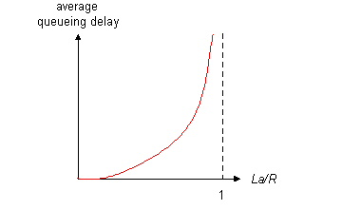

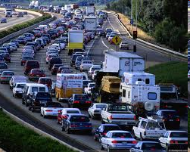
Queueing delay (revisited)
R: link bandwidth (bps)
L: packet length (bits)
a: average packet arrival rate
average queueing delay
traffic intensity
= La/R
La/R ~ 0
La/R ~ 0: avg. queueing delay small
La/R -> 1: avg. queueing delay large
La/R > 1: more “work” arriving
than can be serviced, average delay infinite!
La/R -> 1
Introduction 1-75

Slide 76
“Real” Internet delays and routes
What do “real” Internet delay & loss look like?
Traceroute program: provides delay measurement from source to router along end-end Internet path towards destination. For all i:
sends three packets that will reach router i on path towards destination
router i will return packets to sender
sender times interval between transmission and reply.
3 probes
3 probes
3 probes

Slide 77
“Real” Internet delays and routes
traceroute: gaia.cs.umass.edu to www.eurecom.fr
Three delay measurements from
gaia.cs.umass.edu to cs-gw.cs.umass.edu
1 cs-gw (128.119.240.254) 1 ms 1 ms 2 ms
2 border1-rt-fa5-1-0.gw.umass.edu (128.119.3.145) 1 ms 1 ms 2 ms
3 cht-vbns.gw.umass.edu (128.119.3.130) 6 ms 5 ms 5 ms
4 jn1-at1-0-0-19.wor.vbns.net (204.147.132.129) 16 ms 11 ms 13 ms
5 jn1-so7-0-0-0.wae.vbns.net (204.147.136.136) 21 ms 18 ms 18 ms
6 abilene-vbns.abilene.ucaid.edu (198.32.11.9) 22 ms 18 ms 22 ms
7 nycm-wash.abilene.ucaid.edu (198.32.8.46) 22 ms 22 ms 22 ms
8 62.40.103.253 (62.40.103.253) 104 ms 109 ms 106 ms
9 de2-1.de1.de.geant.net (62.40.96.129) 109 ms 102 ms 104 ms
10 de.fr1.fr.geant.net (62.40.96.50) 113 ms 121 ms 114 ms
11 renater-gw.fr1.fr.geant.net (62.40.103.54) 112 ms 114 ms 112 ms
12 nio-n2.cssi.renater.fr (193.51.206.13) 111 ms 114 ms 116 ms
13 nice.cssi.renater.fr (195.220.98.102) 123 ms 125 ms 124 ms
14 r3t2-nice.cssi.renater.fr (195.220.98.110) 126 ms 126 ms 124 ms
15 eurecom-valbonne.r3t2.ft.net (193.48.50.54) 135 ms 128 ms 133 ms
16 194.214.211.25 (194.214.211.25) 126 ms 128 ms 126 ms
17 * * *
18 * * *
19 fantasia.eurecom.fr (193.55.113.142) 132 ms 128 ms 136 ms
trans-oceanic
link
* means no response (probe lost, router not replying)

Slide 78
Packet loss
queue (aka buffer) preceding link in buffer has finite capacity
packet arriving to full queue dropped (aka lost)
lost packet may be retransmitted by previous node, by source end system, or not at all
buffer
(waiting area)
packet being transmitted
A
B
packet arriving to
full buffer is lost

Slide 79
Throughput
throughput: rate (bits/time unit) at which bits transferred between sender/receiver
instantaneous: rate at given point in time
average: rate over long(er) period of time
link capacity
R_{s} bits/sec
link capacity
R_{c} bits/sec
server, with
file of F bits
to send to client
pipe that can carry
fluid at rate
R_{s} bits/sec)
pipe that can carry
fluid at rate
R_{c} bits/sec)
server sends bits
(fluid) into pipe

Slide 80
Throughput (more)
R_{s} < R_{c} What is average end-end throughput?
R_{s} bits/sec
R_{c} bits/sec
R_{s} > R_{c} What is average end-end throughput?
R_{s} bits/sec
R_{c} bits/sec
bottleneck link
link on end-end path that constrains end-end throughput

Slide 81
Throughput: Internet scenario
R_{s}
per-connection end-end throughput: min(R_{c},R_{s},R/10)
in practice: R_{c} or R_{s} is often bottleneck
R_{s}
R_{s}
R
R_{c}
R_{c}
R_{c}
10 connections (fairly) share backbone bottleneck link R bits/sec

Slide 82
Chapter 1: roadmap
1.1 What is the Internet?
1.2 Network edge
end systems, access networks, links
1.3 Network core
circuit switching, packet switching, network structure
1.4 Delay, loss and throughput in packet-switched networks
1.5 Protocol layers, service models
1.6 Networks under attack: security
1.7 History

Slide 83
Network Security
field of network security:
how bad guys can attack computer networks
how we can defend networks against attacks
how to design architectures that are immune to attacks
Internet not originally designed with (much) security in mind
original vision: “a group of mutually trusting users attached to a transparent network” ☺
Internet protocol designers playing “catch-up”
security considerations in all layers!
Introduction 1-83

Slide 84
Bad guys: put malware into hosts via Internet
malware can get in host from a virus, worm, or Trojan horse.
spyware malware can record keystrokes, web sites visited, upload info to collection site.
infected host can be enrolled in botnet, used for spam and DDoS attacks.
malware often self-replicating: from one infected host, seeks entry into other hosts
Introduction 1-84

Slide 85
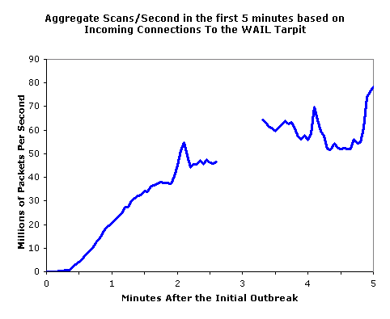
Bad guys: put malware into hosts via Internet
Trojan horse
hidden part of some otherwise useful software
today often in Web page (Active-X, plugin)
virus
infection by receiving object (e.g., e-mail attachment), actively executing
self-replicating: propagate itself to other hosts, users
worm:
infection by passively receiving object that gets itself executed
self- replicating: propagates to other hosts, users
Sapphire Worm: aggregate scans/sec
in first 5 minutes of outbreak (CAIDA, UWisc data)
Introduction 1-85

Slide 86
Bad guys: attack server, network infrastructure
Denial of Service (DoS): attackers make resources (server, bandwidth) unavailable to legitimate traffic by overwhelming resource with bogus traffic
1. select target
2. break into hosts around the network (see botnet)
3. send packets to target from compromised hosts
target
Introduction 1-86

Slide 87
The bad guys can sniff packets
Packet sniffing:
broadcast media (shared Ethernet, wireless)
promiscuous network interface reads/records all packets (e.g., including passwords!) passing by
A
C
src:B dest:A payload
B
Wireshark software used for end-of-chapter labs is a (free) packet-sniffer
Introduction 1-87

Slide 88
The bad guys can use false source addresses
IP spoofing: send packet with false source address
A
C
src:B dest:A payload
B
Introduction 1-88

Slide 89
The bad guys can record and playback
record-and-playback: sniff sensitive info (e.g., password), and use later
password holder is that user from system point of view
C
A
src:B dest:A user: B; password: foo
B
… lots more on security (throughout, Chapter 8)
Introduction 1-89

Slide 90
Network Security
chapter 8: focus on security
crypographic techniques: obvious uses and not so obvious uses
provides challenging issues, esp. for emerging mobile networks

Slide 91
Chapter 1: roadmap
1.1 What is the Internet?
1.2 Network edge
end systems, access networks, links
1.3 Network core
circuit switching, packet switching, network structure
1.4 Delay, loss and throughput in packet-switched networks
1.5 Protocol layers, service models
1.6 Networks under attack: security
1.7 History

Slide 92
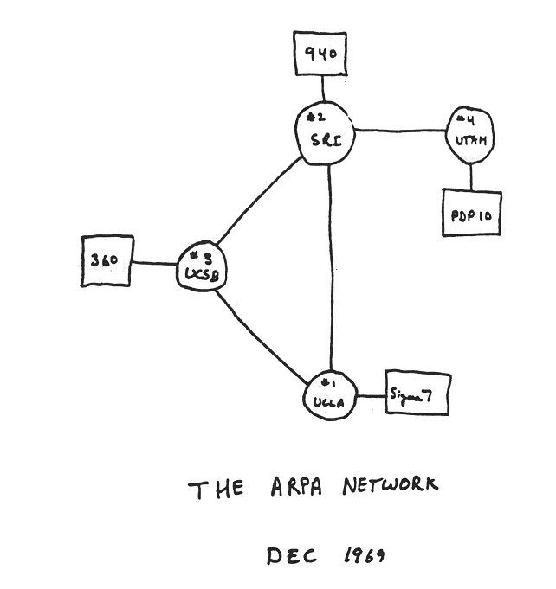
Internet History
1961-1972: Early packet-switching principles
1961: Kleinrock - queueing theory shows effectiveness of packet-switching
1964: Baran - packet-switching in military nets
1967: ARPAnet conceived by Advanced Research Projects Agency
1969: first ARPAnet node operational
1972:
ARPAnet public demonstration
NCP (Network Control Protocol) first host-host protocol
first e-mail program
ARPAnet has 15 nodes

Slide 93
Internet History
1972-1980: Internetworking, new and proprietary nets
1970: ALOHAnet satellite network in Hawaii
1974: Cerf and Kahn - architecture for interconnecting networks
1976: Ethernet at Xerox PARC
ate70’s: proprietary architectures: DECnet, SNA, XNA
late 70’s: switching fixed length packets (ATM precursor)
1979: ARPAnet has 200 nodes
Cerf and Kahn’s internetworking principles:
minimalism, autonomy - no internal changes required to interconnect networks
best effort service model
stateless routers
decentralized control
define today’s Internet architecture

Slide 94
Internet History
1980-1990: new protocols, a proliferation of networks
1983: deployment of TCP/IP
1982: smtp e-mail protocol defined
1983: DNS defined for name-to-IP-address translation
1985: ftp protocol defined
1988: TCP congestion control
new national networks: Csnet, BITnet, NSFnet, Minitel
100,000 hosts connected to confederation of networks

Slide 95
Internet History
1990, 2000’s: commercialization, the Web, new apps
Early 1990’s: ARPAnet decommissioned
1991: NSF lifts restrictions on commercial use of NSFnet (decommissioned, 1995)
early 1990s: Web
hypertext [Bush 1945, Nelson 1960’s]
HTML, HTTP: Berners-Lee
1994: Mosaic, later Netscape
late 1990’s: commercialization of the Web
Late 1990’s – 2000’s:
more killer apps: instant messaging, P2P file sharing
network security to forefront
est. 50 million host, 100 million+ users
backbone links running at Gbps

Slide 96
Internet History
2007:
~500 million hosts
Voice, Video over IP
P2P applications: Napster, BitTorrent (file sharing) Skype (VoIP), PPLive (video)
more applications: YouTube, gaming, social networking
wireless, mobility, networked embedded sensors,…

Slide 97
Introduction: Summary
Covered a “ton” of material!
Internet overview
what’s a protocol?
network edge, core, access network
packet-switching versus circuit-switching
Internet structure
performance: loss, delay, throughput
layering, service models
security
history
You now have:
context, overview, “feel” of networking
more depth, detail to follow!

Slide 98
Probability Background
Discrete random variables:
where E[X] is the expected (or mean) value
2nd moment:

Slide 99
Continuous random variables:
where F[x] is the cumulative distribution, f(y) is the probability density function,
F[-∞]=0, F[∞]=1
Variance:
Var[X]=E[(X-E[X])²]=E[X²]-(E[X])²
Standard deviation

Slide 100

Bernoulli experiment:
probability of success p, failure q=1-p
Geometric distribution:
X is the number of (independent identically distributed i.i.d.) Bernoulli experiments to get success
Pr[X=k]=q^{k-1}p (1st k-1 failures then success)
E(X)=ΣkPr[X=k]=1/p
p=0.1, E(X)=1/p=10

Slide 101
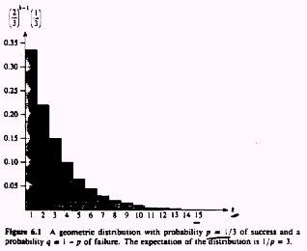

Slide 102
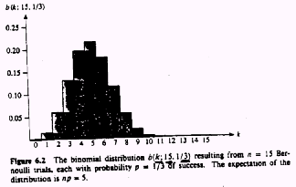
Binomial distribution:
x is the number of successes in n Bernoulli experiments/trials
E[X]=np

Slide 103
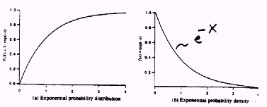
Exponential distribution:
F[x]=1-e^{-λx}, f(x)=λe^{-λx}, Pr[X>x]=1-F[x]=e^{-λx}, E[X]=1/λ

Slide 104
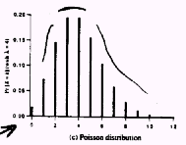
Poisson Distribution:
Pr[X=k]= (λ^{k}/k!) e^{-λ},E[X]=Var[X]= λ
Used in queuing theory:
Pr[k items arriving in T interval]= ((λT)^{k}/k!) e^{-λT},
Expected number of items to arrive in T=λT, where λ is the rate of arrival

Slide 105
Poisson processes are used in M/M/1 and M/D/1 queuing models
Inter-arrival times Ta
Pr[Ta<t]=1-e^{-λt}, E[Ta]=1/λ, is exponentially distributed
good for modeling human generated actions
phone call arrivals
call duration
telnet/ftp session arrivals

Slide 106
Autocorrelation function R(t1,t2) is a measure of the relationship between the instances of the stochastic process at time t1 & t2 [x(t1) & x(t2)]
R(t1,t2)=E[x(t1).x(t2)]
A related measure is the autocovariance C(t1,t2)=R(t1,t2)-μ(t1).μ(t2), where μ(t) is the mean of the stochastic process
Autocorrelation measures the degree of dependence between instances of the stochastic process
If R→0 as t2-t1 is large → no correlation between the different instants → short memory process
If R is substantial for large Δt, then there is high correlation between values and this is considered a long memory process

