Slide 1
Bluetooth Ad Hoc Networks
Kriti Agrawal, Marcus Miguez, and David Moore

Slide 2
What is Bluetooth?
Open standard for short-range radio frequency communication.
Range of wireless signals transmitted is up to 10 meters (30 ft.)
Bluetooth Devices generally communicate at less than 1 Mbps

Slide 3
Bluetooth Characteristics
Operates in the unlicensed 2.4 GHz to 2.4835 GHz ISM frequency band
Employs Frequency Hopping Spread Spectrum technology for all transmissions

Slide 4
Bluetooth Architecture
Bluetooth permits devices to establish either ad hoc or infrastructure networks
Infrastructure networks use fixed Bluetooth Access Points
A Bluetooth client is a device with a bluetooth radio and software incorporating the Bluetooth protocol stack and interfaces

Slide 5
Bluetooth Networks
Used to establish wireless personal area networks (PAN)
Creates small wireless networks on an ad-hoc basis, known as piconets
Typically contain a minimum of two and a maximum of eight Bluetooth peer devices

Slide 6
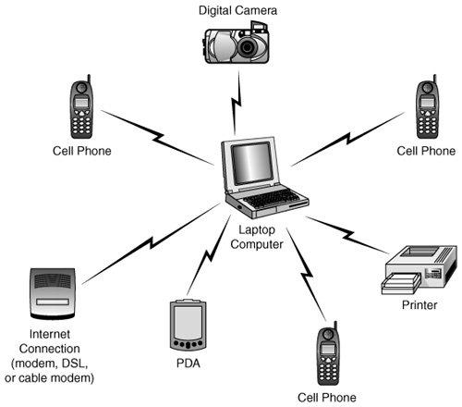
Bluetooth Network Example

Slide 7
Piconets
Two or more Bluetooth devices in close physical proximity that operate on the same channel
One device acts as the master while the others act as slaves
An example is connection between a mobile phone and a Bluetooth-enabled ear phone.

Slide 8
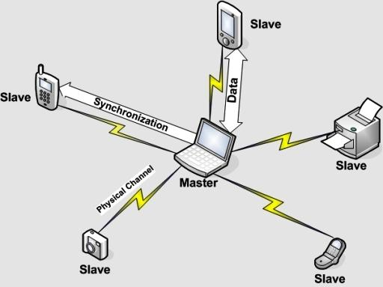
Piconet Example

Slide 9
Scatternets
Two or more inter-connected piconets form a scatternet
Time Division Multiplexing allows scheduling of nodes in multiple piconets to be active in only one piconet at a time
Could be used to expand the physical size of the network beyond Bluetooth's limited range

Slide 10
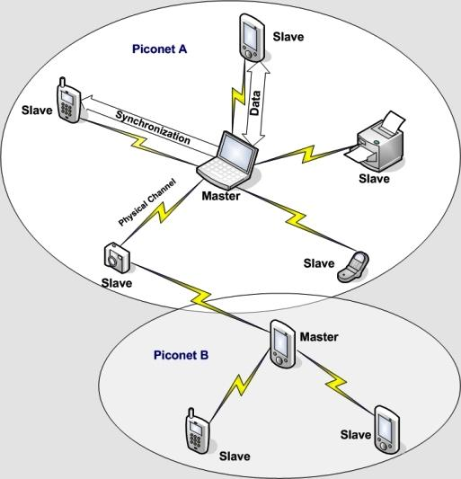
Scatternet Example

Slide 11
Routing in Bluetooth Networks
Most popular Bluetooth applications communicate on a point-to-point basis
Communication between two Bluetooth devices is identified through a PAN profile

Slide 12
Bluetooth PAN Profile
PAN Specification defines three operational roles:
Personal Area Network User (PANU)
Device acts as a client in either of the following cases
Group Ad-Hoc Network (GN)
Connects PAN Users, forwarding packets between them
Network Access Point (NAP)
Device acts as a bridge to connect a wireless piconet to a wired IP Network

Slide 13
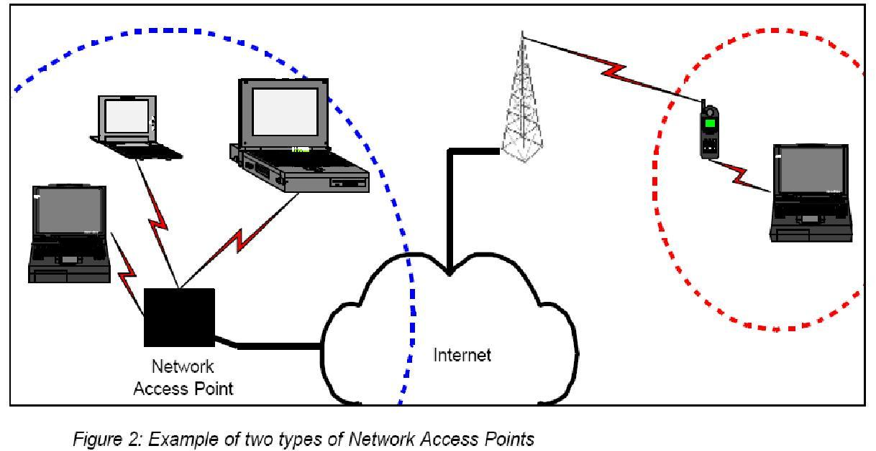
Network Access Point

Slide 14
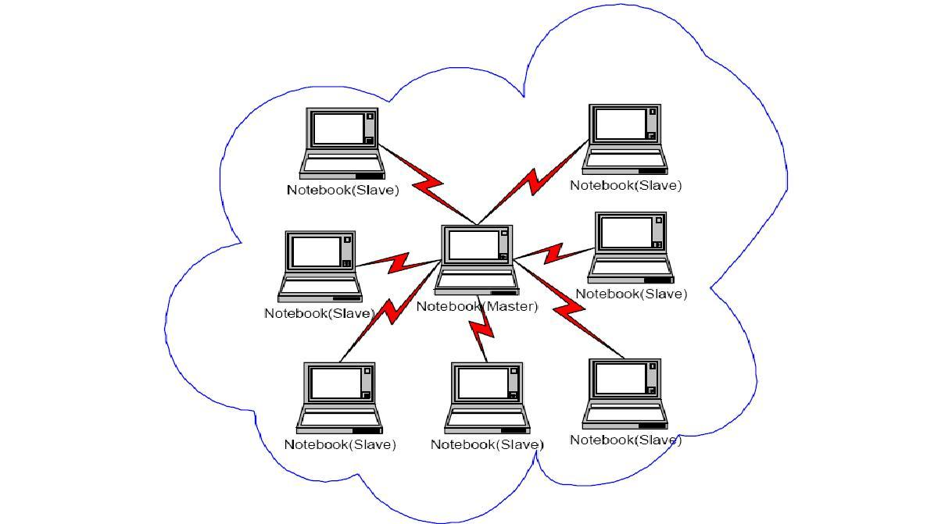
Group Ad-Hoc Network

Slide 15
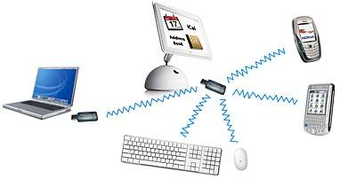
Personal Area Network User

Slide 16
Suggested Routing Protocols
Routing Vector Method (RVM)
Bluetooth Master-Managed Routing (BMR)
Location Aware Mobility-based Routing Protocol (LAMP)

Slide 17
Routing Vector Method (RVM)
Route construction via packet forwarding
Similar to AODV
No routing tables
Fair amount of overhead
Changes to Bluetooth packet at baseband level

Slide 18
Routing Vector Method (RVM)
SEARCH packet broadcast from source
  Node IDs placed in packet header
REPLY packet unicast from destination
SEARCH2 packet broadcast from source
  Used to handle mobility of nodes

Slide 19
Bluetooth Master-Managed Routing (BMR)
Table-driven routing protocol
Coupled with Bluetooth Scatternet Formation Protocol (BSFP)
Design driven by three characteristics:
  Explicit roles (master, leaf slave, or bridge)
  All traffic must transit via its master
  Connection losses and establishments are promptly notified to the nodes that take part in the connection

Slide 20
Scatternet Formation with BSFP
Each node hold one of three states: Init, Ready, and Complete.
In the Init state, a node tries to identify its nearby nodes by scanning for nearby Inquiries.
Upon finding a node, a temporary connection is established.

Slide 21
Scatternet Formation with BSFP
The node shifts to the Ready state when it has made seven temporary links or when it fails to find a new node for a predefined period.
Among the neighbor nodes in the Ready state, the node that has the largest number of temporary links becomes the master.
The temporary links of the master become regular links.

Slide 22
Scatternet Formation with BSFP
The node shifts to the Complete state when it loses all of its temporary links, because of their being chaged into regular links or because they are removed to prevent nested piconets.
Once a node enters Complete state, it may then start communication.

Slide 23
Bluetooth Master-Managed Routing (BMR) Operation
Each piconet master manages and uses the following three tables for operation:
  Adjacent Piconet Table
    Bridge nodes
  Piconet Member Table
    Sequence numbers
  Piconet Routing Table
    Shortest path to each piconet

Slide 24
Bluetooth Master-Managed Routing (BMR)
Advantages
  Motivated to address the issue of managing mobility in Bluetooth ad hoc networks
Disadvantages
  In the case where multiple nodes exit and enter the scatternet, PMT updates will cause much overhead

Slide 25
Location Aware Mobility-based Routing Protocol (LAMP)
Route Search Phase
  Source floods a Route Search Packet with ID of destination node appended
Route Reply Phase
  Construction of final shortest and backup routing path
    Backup Path Rule
    Reduction Rule
    Replacement Rule
Route Construction Phase
  Executed after Route search and Route Reply phase

Slide 26
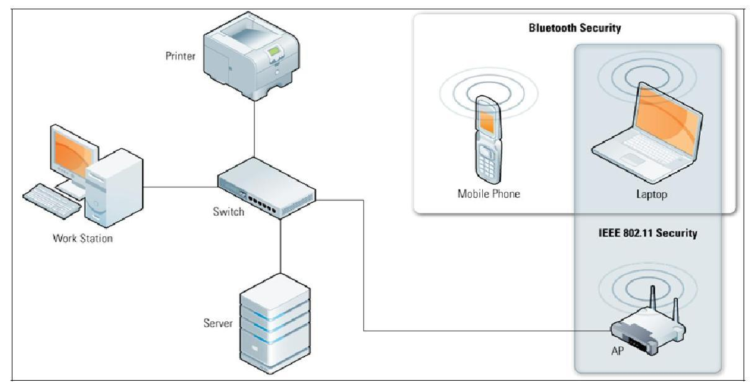
Bluetooth Security

Slide 27
Bluetooth Security Services
Authentication
Verifying the identity of communicating devices. User authentication is not provided natively by Bluetooth
Confidentiality
Preventing information compromise by ensuring that only authorised devices can access data
Authorization
Allowing control of resources by ensuring that a device is authorised

Slide 28
Authentication
Bluetooth Device Authentication is in the form of Challenge-Response scheme
Validates devices by verifying the knowledge of a secret key - the Bluetooth Link Key
The security associated with authentication is solely based on the secrecy of the link key

Slide 29
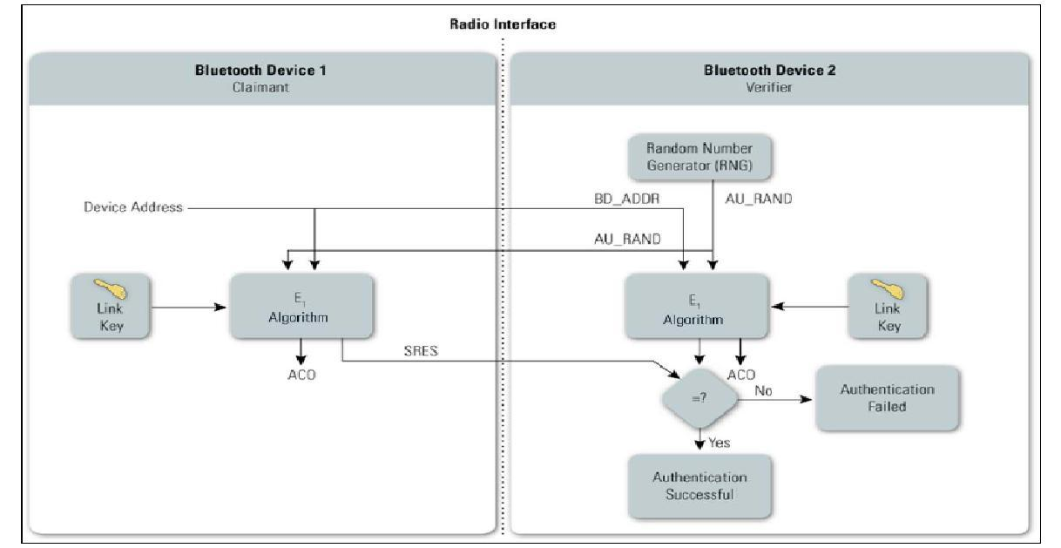
Bluetooth Authentication

Slide 30
Confidentiality
Bluetooth has three encryption modes to provide confidentiality:
Encryption Mode 1 - No encryption is performed on any traffic
Encryption Mode 2 - Individually addressed traffic is encrypted, broadcast traffic is not encrypted
Encryption Mode 3 - All traffic is encrypted using an encryption key based on the master link key

Slide 31
Authorization
Bluetooth allows two levels of trust and three levels of service security.
Two trust levels are trusted and untrusted
  Trusted Device - Fixed relationship with another device and full access to all services
  Untrusted Device - No established relationship with another device and restricted access to services

Slide 32
Service Security Levels
Service level 1 - Requires authorization and authentication
Service level 2 - Requires authentication only
Service level 3 - Open to all devices with no authentication required

Slide 33
Bluetooth Vulnerabilities
Link keys are stored improperly
Repeated Authentication Attempts
Negotiable Encryption Key Length
Shared Master Key
Lack of User Authentication

Slide 34
Bluetooth Threats
Bluesnarfing
Enables attackers to gain access to a Bluetooth device by exploiting firmware flaw in older devices
Bluejacking
Attack initiated by sending unsolicited messages to a user of bluetooth-enabled device
Bluebugging
Exploits a security flaw in firmware of older Bluetooth devices to gain access to the device and its commands

Slide 35
Bluetooth Threats Continued
Car Whisperer
Software tool that exploits key implementation issues in hands free kits installed in automobiles
Denial of Service
Making a device's Bluetooth interface unusable and draining the device's battery
Fuzzing attacks
Sending malformed or otherwise non-standard data to a device's Bluetooth radio and observing how the device reacts

Slide 36
References
Dunne, Kevin, Elaine Roche, David O’Loghlin, and Ewis Rhatigan. "Bluetooth for Ad-Hoc Networking." NTRG: Networks & Telecommunications Research Group. Networks And Telecommunications Research Group (NTRG), Trinity College Dublin, Ireland, 25 Feb. 2005. Web. 29 Feb. 2012. <http://ntrg.cs.tcd.ie/undergrad/4ba2.05/group3/index.html>.
Whitelock, Ron. "Bluetooth! A New Technology for Transportation?" IMSA Journal (2011): 20. Print.
Sheng-Wen Chang; Sahoo, P.K.; Li-Ling Hung; Chih-Yung Chang; , "A location-and-mobility aware routing protocol for Bluetooth radio networks," Pervasive Computing (JCPC), 2009 Joint Conferences on , vol., no., pp.137-142, 3-5 Dec. 2009 doi: 10.1109/JCPC.2009.5420199 URL: http://ieeexplore.ieee.org/stamp/stamp.jsp?tp=&arnumber=5420199&isnumber=5420061
Bhagwat, P.; Segall, A.; , "A routing vector method (RVM) for routing in Bluetooth scatternets ," Mobile Multimedia Communications, 1999. (MoMuC '99) 1999 IEEE International Workshop on , vol., no., pp.375-379, 1999 doi: 10.1109/MOMUC.1999.819514 URL: http://ieeexplore.ieee.org/stamp/stamp.jsp?tp=&arnumber=819514&isnumber=17761

Slide 37
References
Song, O.; Chaegwon, L.; Chong-Ho, C.; , "Mobility Management in Bluetooth ad hoc networks," Samsung Electronics, 2004. The 14th Joint Conference on Communications & Information, JCCI 2004. URL: http://csl.snu.ac.kr/publication/paper/JCCI_BMR_final.pdf
Thakur G.S. , Sharma M. , Helmy A. “SHIELD: Social sensing and Help In Emergency using mobiLe Devices.” Global Telecommunications Conference (GLOBECOM 2010), 2010 IEEE : 1-5 . Print.
Zhang Jian, Zhang Fei, Wang Bin. “Cluster based routing in Bluetooth ad-hoc network.” International Conference on Wireless Communications, Networking and Mobile Computing, 2005. Proceedings. 2005 : V2 747-752

