Slide 1
RapidER (Mobile Healthcare)
Group2:
Ashish Bhat
Vishnu Sanjit

Slide 2
Agenda
Motivation/Goal
Sensing
Types of Sensing
Challenges / Approaches / Trade offs
Networking
Rationale
USP
Design: Fall back Stack
Technology / Implementation

Slide 3
Motivation/Goal
Harness the power of the plethora of sensors found on the modern smartphones and use the ubiquity of these smartphones to our advantage, to solve the problem of detecting emergency health situations and providing speedy help in such circumstances
Develop an Android application with a suite of features for sensing emergency medical situations and autonomic/voluntary dissemination of SOS to individuals in the vicinity, as well as to a cloud-based infrastructure to deploy emergency response teams
Features include:
- Fall Detection
- Location Tracking
- Heart Rate Monitoring

Slide 4
Application Components
Kinetic Sensing, Location Sensing, Audio Sensing
Network Fallback Stack(Wi-Fi Direct, Bluetooth, Telephony etc.)
Cloud Infrastructure [SaaS]

Slide 5
Kinetic Sensing(Motion)
A slew of motion sensors available on modern Android devices: Accelerometer, Gyroscope, Gravity, Linear Acceleration (synthetic), Magnetic field, Orientation, Rotation Vector
Android consolidates analog input from multiple sensors(using SensorFusion) and presents numerical floating point values to the applications, that make more sense to a programmer

Slide 6
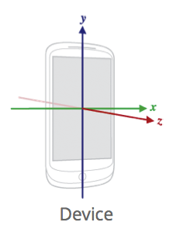
Kinetic Sensing(Fall Detection)
Coordinate System
Fall Detection Algorithm employs a finite state machine to monitor resultant acceleration along the three axes
√(x² + y² + z²)

Slide 7
Kinetic Sensing(Fall Detection)
The state machine has four states[2], that it transitions between:
STATE_INIT (User starts Fall Detection Service, a = 9.81 m/s²)
STATE_FREE_FALL (LOWER_THRESHOLD < 9.81 m/s²)
STATE_HIT_GROUND (UPPER_THRESHOLD > 9.81 m/s²)
STATE_MOTIONLESS (a = 9.81 m/s²)
If the device reaches the state STATE_MOTIONLESS after transitioning through all the states above it sequentially, and lies in this state for 5 seconds, a ‘fall’ is said to have been detected.
We could also employ a state machine that monitors the scalar acceleration on 3 individual axes separately and determine the type of fall [3] (Forward Fall, Backward Fall etc.).

Slide 8
Kinetic Sensing(Challenges)
The LOWER_THRESHOLD used to detect the state STATE_FREE_FALL depends upon the height of the fall, and may not be reached if the device falls from smaller heights.
A configuration option can be provided to the user, to set a higher value for LOWER_THRESHOLD when felt appropriate, in the application settings.

Slide 9
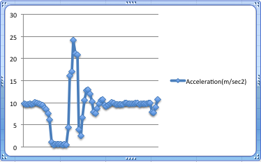
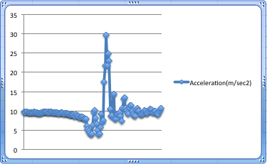
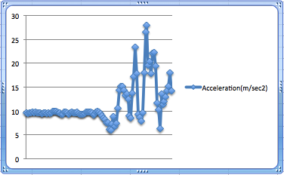
True Free Fall
Device in upper pocket
Device in lower pocket

Slide 10
Kinetic Sensing(Challenges)
Power Consumption and Sampling Rate
The Android sensor subsystem calls back into the application code 5 times a second(at its
slowest rate!) to report the sensor values. May drain the battery in a few hours.
We plan to sample at a low rate upon bootstrapping the service(STATE_INIT), but as soon as the first sample with acceleration equal to LOWER_THRESHOLD is found, we switch to a higher sampling rate. Upon moving back to STATE_INIT we switch back to the lower sampling rate.
Android SDK provides four built in modes for sampling:
SENSOR_DELAY_NORMAL (0.2 sec delay)
SENSOR_DELAY_UI (0.06 sec delay)
SENSOR_DELAY_GAME (0.02 sec delay)
SENSOR_DELAY_FASTEST (0 sec delay)
We may choose to use a higher delay than the ones described above, but these are only hints to the Android sensor subsystem and in most cases the sampling rate is higher than specified. Other options may include using a dedicated motion sensor device capable of communicating with the phone via USB/Bluetooth.

Slide 11
Location Sensing
Multiple location providers on an Android smartphone: GPS, Network(Wifi/Cellular Network)
GPS is more accurate(upto 10 mts)
Network: Wi-Fi has better accuracy than Cellular
network, because of closer proximity to the
access point. (30-100 mts)
In some cases, where the cellular network strength is particularly good, the accuracy may be much better than the value described above.

Slide 12
Location Sensing(Application)
The user is provided an option to switch on location sensing in the application settings, when the fall-detection service is started.
Location updates are recorded upon movement of every 500 mts (may be provided as a configuration option) and stored on the filesystem
We employ the best available location provider available at any point of time and do not mandate the use of GPS(Accuracy of location may be affected).

Slide 13
Location Sensing(Challenges)
Power Consumption
Location Sensing using GPS involves two stages – locking period and sensing period. These two stages draw 400mW and 600mW of power respectively(translating to a few hours of battery life on a standard 1400-2000mAh battery).
Location sensing using the network location provider, however isn’t very battery intensive.
We do not require the user to have the GPS switched on all the time, in our application. We register listeners for the best available location providers at any given instant in time and switch if a better location provider is enabled by the user (Network ➔ GPS)
Also the sampling interval i.e. the distance between two consecutive location updates in our application is large and thus doesn’t cause the GPS hardware to wake up very frequently

Slide 14
Location Sensing(Challenges)
Need to get a quick estimate of current location
To get around this we check the last known location of the user recorded by our application and verify that it isn’t a stale record(not older than 5 minutes) and has accuracy within tolerable limits(> 70%). If it confirms to our tests, we report this location immediately.
If however we do not get an accurate location estimate, we resort to turning on GPS momentarily and wait for a current location update from it.

Slide 15
Location Sensing(Challenges)
Location Updates may not be sent by the network location provider(Cellular network), even upon crossing the minimum sampling distance(500mts), unless there is a switch from one cellular tower to another, by the device.
Needs to be tested

Slide 16
Location Sensing(Other Power saving techniques)
We may suppress location updates during the time the device is stationary[4].
The state of the device is constantly reported to our application by the motion sensors and we may use this state to unregister any location update receivers if the user has come to a standstill.

Slide 17
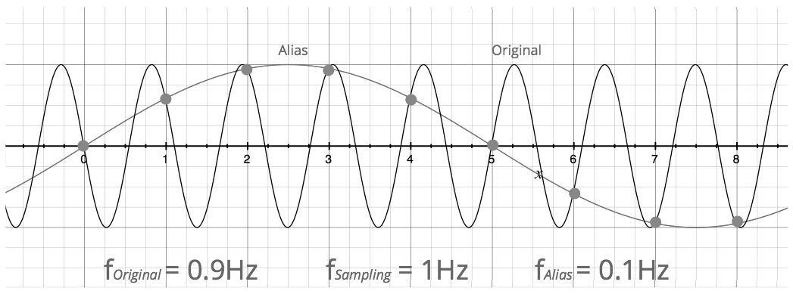
Audio Sensing(Basics)
Sound travels through air in the form a wave
The human audible range of frequency is between 20 Hz to 20KHz
The input sound wave is treated as an analog signal
Nyquist Rate: We need to sample an incoming signal at a rate equal to or higher than twice the highest frequency of the signal, to avoid aliasing. In the case of an audio signal this translates to 40KHz.
This is why Android and most other audio applications support sampling of audio at 44.1 KHz.

Slide 18
Audio Sensing(Basics)
Conversion of signal from Time Domain to Frequency Domain
Easier to analyze audio signal when we break it down into its component frequencies. Further we can apply low-pass filters in frequency domain, to eliminate noise.
We make use of a mathematical technique called Discrete Fourier Transform(DFT) to perform this conversion. DFT is computationally intensive(O(n²)). Fast Fourier Transform(FFT) is faster(O(nlgn)).
Many open source FFT libraries available(eg. FFTPACK)

Slide 19
Audio Sensing(Heart rate monitor)
We collect audio samples in a byte buffer of pre-defined length and apply the Fourier Transform on this raw data.
We then pass this data through a low pass filter to eliminate extraneous noise from the signal.
Finally we monitor this data for amplitude peaks that cross a certain threshold defined for heartbeat sounds and measure the frequency of such peaks to report the heartbeat rate

Slide 20
There’s only so much the smartphone sensors can do..
Extend the idea to Body Sensor Networks[1] for even granular activity monitoring of the individual. The smartphone acts as the aggregator for the sensor network(Wired/Wireless).
The smartphone can even act as an aggregator for implantable under-the-skin micro sensors capable of identifying concentrations of various substances in blood and reporting the data wirelessly (http://sti.epfl.ch/page-92004.html).

Slide 21
Networking
Background
Scenario
Design : Fall Back Mechanism
Implementation Details
USP

Slide 22
Background
Survey
California Health Care foundation Survey[5]
6000 iStore, Ratio : 73/27
Study
Open garden ( not open-source)
Pocket Lab value
Wi fi direct (p2p)
iTrust

Slide 23
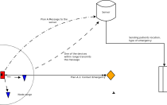
Scenario

Slide 24
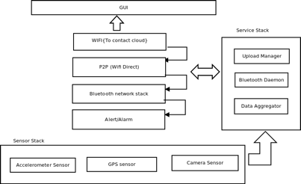
Design: 4 way Fall back protocol

Slide 25
Implementation
Android App
43% of the smartphone users Use Android
Cloud based
Leveraging a infrastructure!
JSON obj, Google map API Visualization
P2P using Wi-Fi Direct
android.net.wifi.p2p.WifiP2pManager
android.content.BroadcastReceiver

Slide 26
Implementation
Bluetooth
Bypassing the Pairing request: Rationale
CreateInsecureRfcommSocketToServiceRecord(UUID)
ListenUsingInsecureRfcommWithServiceRecord
UUID class
iTrust study for Energy Efficient mode.
Fibo inc seq
Skipfactor/Max Threshold
Accessibilty

Slide 27
USP
Problem at hand !
MIT App Inventor
Open mhealth
{ Generic Platform }
Future improvements :
track my friend, server heuristics .
collaboration with more stronger p2p network like open garden.
Social/Point system.

Slide 28
Citations
[1] Matthew Keally, Gang Zhou, Guoliang Xing, Jianxin Wu, Andrew Pyles, PBN: towards practical activity recognition using smartphone-based body sensor networks, SenSys '11 Proceedings of the 9th ACM Conference on Embedded Networked Sensor Systems
[2] Posaro F., Tyson G., “iFall: an Android application for fall monitoring and response”, Conf Proc IEEE Eng Med Biol Soc. 2009;2009:6119-22. doi: 10.1109/IEMBS.2009.5334912.
[3] Su, Ming Hsiung, Liu Lu Feng, Jiang Wey-Wen , “A Finite State Machine-Based Fall Detection Mechanism on Smartphones”, Ubiquitous Intelligence & Computing and 9th International Conference on Autonomic & Trusted Computing (UIC/ATC), 2012 9th International Conference on, 4-7 Sept, 2012.
[4] Zhenyun Zhuang, Kyu-Han Kim, Jatinder Pal Singh, "Improving energy efficiency of location sensing on smartphones", MobiSys '10 Proceedings of the 8th international conference on Mobile systems, applications, and services
[5].http://www.chcf.org/publications/2010/04/how-smartphones-are-changing-health-care-for-consumers-and-providers.
[6] Maged N Kamel, Boulos Steve Wheeler, Carlos Tavares, Ray Jones, “How smartphones are changing the face of mobile and participatory healthcare: an overview, with example from eCAALYX”, BioMedical Engineering OnLine.
[7] Sensing Meets Mobile Social Networks: The Design, Implementation and Evaluation of the CenceMe Application. Emiliano Miluzzo† , Nicholas D. Lane† , Kristóf Fodor† , Ronald Peterson† , Hong Lu† , Mirco Musolesi† , Shane B. Eisenman§ , Xiao Zheng† , Andrew T. Campbell†

Slide 29
Questions

Slide 30
Thank you!

