Slide 1
CNT 5106C Computer Networks
Ahmed Helmy
Computer & Information Science & Engineering (CISE) Dept
University of Florida
http://www.cise.ufl.edu/~helmy

Slide 2

What’s the Internet: “nuts and bolts” view
PC
millions of connected computing devices: hosts = end systems
  run network apps
Mobile network
server
Global ISP
wireless
laptop
cellular
handheld
Home network
communication links
  fiber, copper, radio, satellite
  transmission rate (bandwidth)
Regional ISP
access
points
Institutional network
wired
links
routers:
  forward packets (chunks of data)
router

Slide 3
What’s a protocol?
Network protocols:
All communication in Internet governed by protocols
Generic protocol:
  specific messages sent
  specific actions taken when messages are received, or other events (e.g., timer expiration, exception detection)
Protocol Representation:
  Finite State Machines
  Protocol Specification, via Standards
protocols define format, order of messages sent and received among network entities, and actions taken on message transmission, receipt

Slide 4
What’s a protocol?
Example sequence of a computer network protocol:
host
server
TCP connection
request
TCP connection
response
Get http://www.ufl.edu
<file>
time
Protocol Design and Analysis are extremely important in Internet study, development and research

Slide 5
The network edge:
End systems (hosts):
  run application programs
  e.g. Web, email
  at “edge of network”
peer-peer
Client-server model
  client host requests, receives service from always-on server
  e.g. Web browser/server; email client/server
client/server
Peer-to-peer model:
  minimal (or no) use of dedicated servers
  e.g. Skype, BitTorrenth

Slide 6
Network edge: best effort (unreliable) data transfer service
Goal: data transfer between end systems
  same as before!
UDP - User Datagram Protocol [RFC 768]:
  connectionless
  unreliable data transfer
  no flow control
  no congestion control
App’s using TCP:
HTTP (Web), FTP (file transfer), Telnet (remote login), SMTP (email)
App’s using UDP:
streaming media, teleconferencing, DNS, Internet telephony

Slide 7
Access networks and physical media
Q: How to connect end systems to edge router?
residential access nets
institutional access networks (school, company)
mobile access networks
Keep in mind:
bandwidth (bits per second) of access network?
shared or dedicated?

Slide 8
Ethernet Internet access
100 Mbps
institutional
router
Ethernet
switch
to institution’s
ISP
100 Mbps
1 Gbps
100 Mbps
server
typically used in companies, universities, etc
  10 Mbps, 100Mbps, 1Gbps, 10Gbps Ethernet
  today, end systems typically connect into Ethernet switch
Introduction 1-8

Slide 9
Wireless access networks
shared wireless access network connects end system to router
  via base station aka “access point”
wireless LANs:
  802.11b/g/n (WiFi): 11, 54, 111 Mbps
wider-area wireless access
  provided by telco operator
  ~1Mbps over cellular (EVDO, HSDPA)
  WiMAX, LTE (10’s Mbps) over wide area
Wireless Networks: Chapter 6
Future:
  Mobile Ad Hoc and Sensor Networks!
router
base
station
mobile
hosts

Slide 10
Home networks
Typical home network components:
DSL or cable modem
router/firewall/NAT
Ethernet
wireless access point
wireless
laptops
to/from
cable
headend
cable
modem
router/
firewall
wireless
access
point
Ethernet

Slide 11
Internet structure: network of networks
roughly hierarchical
at center: small # of well-connected large networks
  “tier-1” commercial ISPs (e.g., Verizon, Sprint, AT&T, Qwest, Level3), national & international coverage
  large content distributors (Google, Akamai, Microsoft)
  treat each other as equals (no charges)
IXP
IXP
Tier-1 ISPs &
Content Distributors, interconnect (peer) privately
Tier 1 ISP
Large Content
Distributor
(e.g., Akamai)
Large Content
Distributor
(e.g., Google)
Tier 1 ISP
Tier 1 ISP
… or at Internet Exchange Points IXPs
Introduction 1-11

Slide 12
Internet structure: network of networks
a packet passes through many networks from source host to destination host
Tier 2
ISP
IXP
IXP
Tier 2
ISP
Tier 2
ISP
Tier 1 ISP
Large Content
Distributor
(e.g., Akamai)
Large Content
Distributor
(e.g., Google)
Tier 1 ISP
Tier 1 ISP
Tier 2
ISP
Tier 2
ISP
Tier 2
ISP
Tier 2
ISP
Tier 2
ISP
Tier 2
ISP
Introduction 1-12
Notes:
12

Slide 13
Internet structure: network of networks
a packet passes through many networks down and up the hierarchy!
local
ISP
Tier 3
ISP
local
ISP
local
ISP
local
ISP
Tier-2 ISP
Tier-2 ISP
Tier 1 ISP
Tier 1 ISP
Tier 1 ISP
Tier-2 ISP
Tier-2 ISP
Tier-2 ISP
local
ISP
local
ISP
local
ISP
local
ISP

Slide 14
Internet Hierarchy
hierarchy based on routing (more later)

Slide 15
Hierarchical Architecture (+s, -s)
Advantages
  Isolates and scopes internal dynamics: dampens oscillations, providing stability to the overall network
  Supports scalability: aggregation/summary per domain for smaller, more efficient routing tables
  Allows for flexibility: domains deploy different protocols, policies …
Disadvantages
  Overhead of establishing and maintaining the hierarchy (esp. for mobile, dynamic nets)
  Sub-optimality of routing …

Slide 16
Protocol “Layers”
Networks are complex!
many “pieces”:
  hosts
  routers
  links of various media
  applications
  protocols
  hardware, software
Question:
Is there any hope of organizing structure of network?
Or at least our discussion of networks?

Slide 17
Why layering?
Dealing with complex systems:
explicit structure allows identification, relationship of complex system’s pieces
  layered reference model for discussion
modularization eases maintenance, updating of system
  change of implementation of layer’s service transparent to rest of system
  change in one layer doesn’t affect rest of system
  (is this true?!)
Can layering be considered harmful?

Slide 18
Internet protocol stack
application: supporting network applications
  FTP, SMTP, HTTP
transport: process-process data transfer
  TCP, UDP
network: routing of datagrams from source to destination
  IP, routing protocols
link: data transfer between neighboring network elements
  PPP, Ethernet
physical: bits “on the wire”
application
transport
network
link
physical

Slide 19
ISO/OSI reference model
presentation: allow applications to interpret meaning of data, e.g., encryption, compression, machine-specific conventions
session: synchronization, checkpointing, recovery of data exchange
Internet stack “missing” these layers!
  these services, if needed, must be implemented in application
  needed?
Other protocol stacks? ATM, …
application
presentation
session
transport
network
link
physical

Slide 20
Encapsulation
source
message
M
application
transport
network
link
physical
segment
H_{t}
M
H_{t}
datagram
H_{n}
H_{n}
H_{t}
M
frame
H_{l}
H_{n}
H_{t}
M
link
physical
switch
destination
H_{n}
H_{t}
M
network
link
physical
M
application
transport
network
link
physical
H_{l}
H_{n}
H_{t}
M
H_{n}
H_{t}
M
H_{t}
M
H_{n}
H_{t}
M
H_{l}
H_{n}
H_{t}
M
router

Slide 21
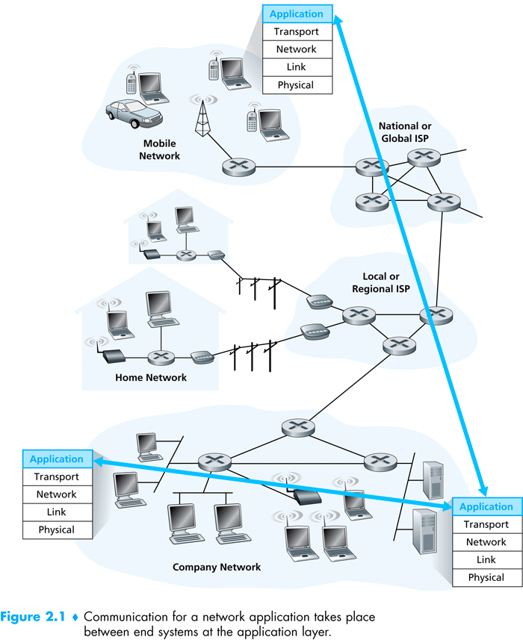

Slide 22
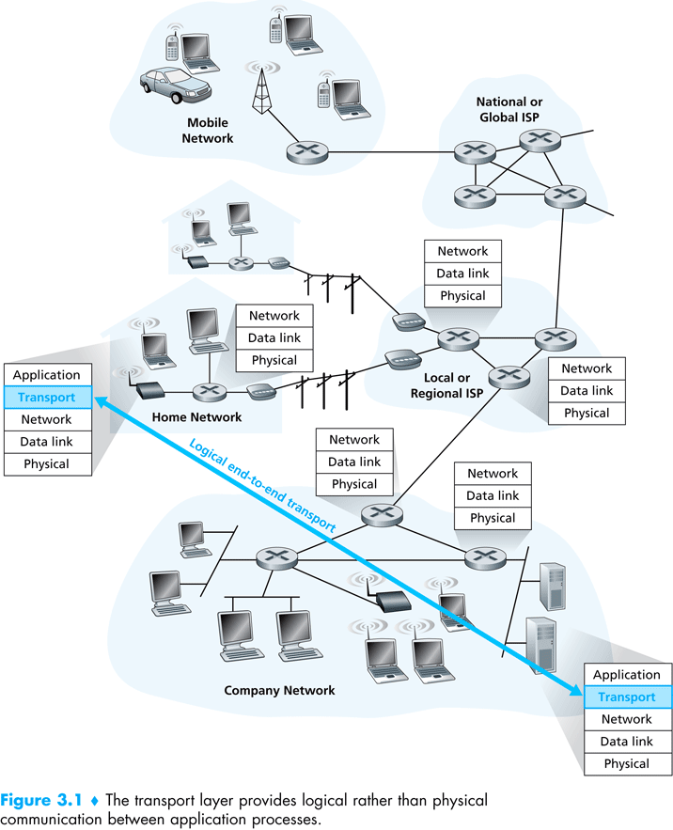

Slide 23
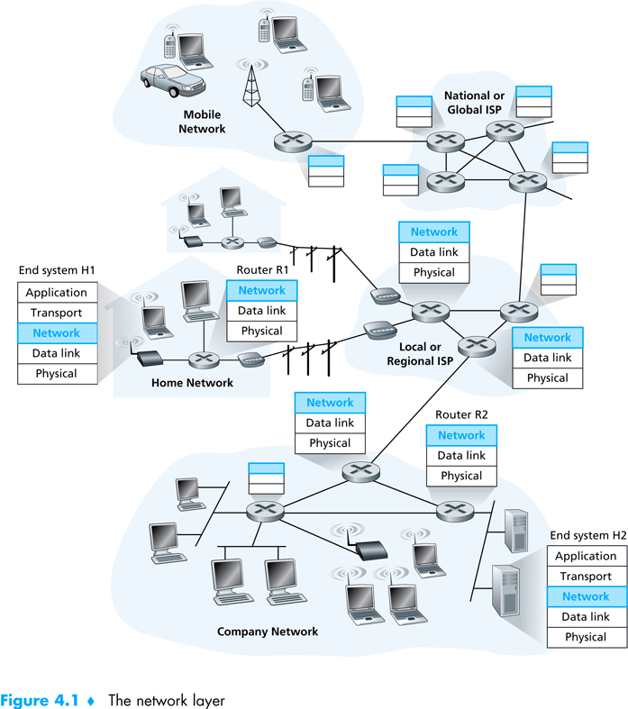

Slide 24
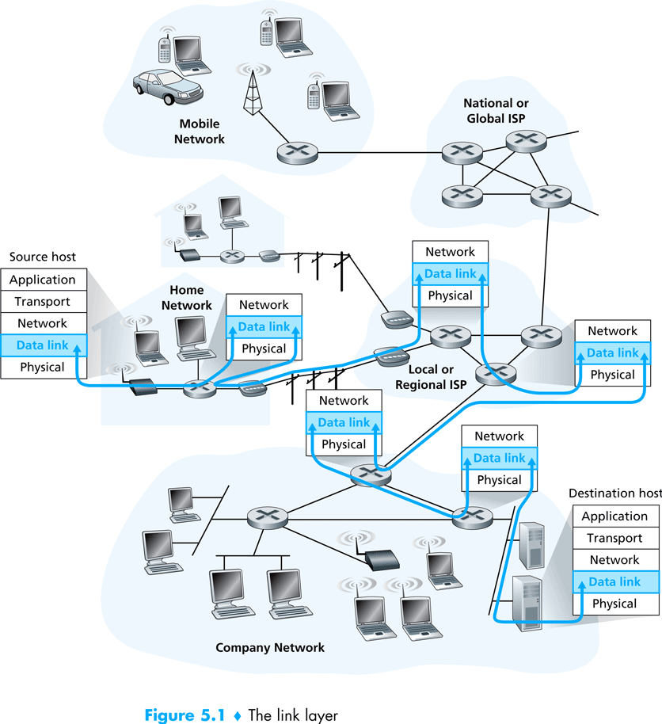

Slide 25
Layering & protocol stacks: (the protocol hour glass – thin waste)

Slide 26
The Network Core
mesh of interconnected routers
the fundamental question: how is data transferred through net?
  circuit switching: dedicated circuit per call: telephone net
  packet-switching: data sent thru net in discrete “chunks”

Slide 27
Network Core: Circuit Switching
End-to-end resources reserved for “call”
link bandwidth, switch capacity
dedicated resources: no sharing
circuit-like (guaranteed) performance
call setup required
re-establish call upon failure

Slide 28
Network Core: Circuit Switching
network resources (e.g., bandwidth) divided into “pieces”
pieces allocated to calls
resource piece idle if not used by owning call (no sharing)
MULTIPLEXING: dividing link bandwidth into “pieces”
  frequency division
  time division
Multiplexing is so fundamental and influences many aspects of the technology, including congestion, buffering, delays, routing, …

Slide 29
Circuit Switching: FDM and TDM
Example:
FDM
4 users
frequency
time
TDM
frequency
time
Notes:
Two simple multiple access control techniques.
Each mobile’s share of the bandwidth is divided into portions for the uplink and the downlink. Also, possibly, out of band signaling.
As we will see, used in AMPS, GSM, IS-54/136

Slide 30
Internet Design Goals/Principles
Scalability & economic access:
  Resource sharing, reduce reservations, allow for higher utilization
  Use of packet switching (statistical multiplexing) instead of circuit switching
Robustness:
  Re-routing around failures
  Stateless connections, dynamic routing
Reliablility:
  Timed retransmission, based on acks, seq. #s
Evolvable:
  Minimize complexity in the network and push functionality to the edges (end-to-end principles)
* to revisit during history discussion

Slide 31
Network Core: Packet Switching
each end-end data stream divided into packets
user A, B packets share network resources
each packet uses full link bandwidth
resources used as needed
resource contention:
aggregate resource demand can exceed amount available
congestion: packets queue, wait for link use
store and forward: packets move one hop at a time
  Node receives complete packet before forwarding
Bandwidth division into “pieces”
Dedicated allocation
Resource reservation

Slide 32
Packet Switching: Statistical Multiplexing
100 Mb/s
Ethernet
A
C
statistical multiplexing
1.5 Mb/s
B
queue of packets
waiting for output
link
D
E
Sequence of A & B packets does not have fixed pattern, bandwidth shared on demand ➔ statistical multiplexing.
TDM: each host gets same slot in revolving TDM frame.

Slide 33
Packet-switching: store-and-forward
L
R
R
R
takes L/R seconds to transmit (push out) packet of L bits on to link at R bps
store and forward: entire packet must arrive at router before it can be transmitted on next link
delay = 3L/R (assuming zero propagation delay)
Example:
L = 7.5 Mbits
R = 1.5 Mbps
transmission delay = 15 sec
more on delay shortly …

Slide 34
Packet switching versus circuit switching
Packet switching allows more users to use network!
1 Mb/s link
each user:
  100 kb/s when “active”
  active 10% of time
circuit-switching:
  10 users
packet switching:
  with 35 users, probability > 10 active at same time is less than .0004
N users
1 Mbps link
Q: how did we get value 0.0004?
Use binomial distribution …

Slide 35
Packet switching versus circuit switching
Is packet switching a “slam dunk winner?”
great for bursty data
  resource sharing (scalable!)
  simpler, no call setup, more robust (re-routing)
excessive congestion: packet delay and loss
  Without admission control: protocols needed for reliable data transfer, congestion control
Q: How to provide circuit-like behavior?
  bandwidth guarantees needed for audio/video apps
  still an unsolved problem (chapter 7), virtual circuit

Slide 36
How do loss and delay occur?
packets queue in router buffers
packet arrival rate to link exceeds output link capacity
packets queue, wait for turn
packet being transmitted (delay)
A
B
packets queueing (delay)
free (available) buffers: arriving packets
dropped (loss) if no free buffers

Slide 37
Four sources of packet delay
1. nodal processing:
  check bit errors
  determine output link
2. queueing
  time waiting at output link for transmission
  depends on congestion level of router
transmission
A
propagation
B
nodal
processing
queueing

Slide 38
Delay in packet-switched networks
3. Transmission delay:
R=link bandwidth (bps)
L=packet length (bits)
time to send bits into link = L/R
4. Propagation delay:
d = length of physical link
s = propagation speed in medium (~2x10⁸ m/sec)
propagation delay = d/s
Note: s and R are very different quantities!
transmission
A
propagation
B
nodal
processing
queueing

Slide 39
Nodal delay
d_{proc} = processing delay
  typically a few microsecs or less
d_{queue} = queuing delay
  depends on congestion
d_{trans} = transmission delay
  = L/R, significant for low-speed links
d_{prop} = propagation delay
  a few microsecs to hundreds of msecs

Slide 40
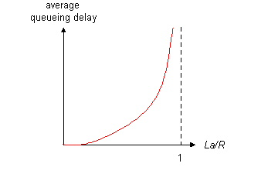

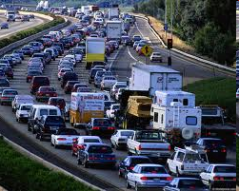
Queueing delay (revisited)
R: link bandwidth (bps)
L: packet length (bits)
a: average packet arrival rate
average queueing delay
traffic intensity
= La/R
La/R ~ 0
La/R ~ 0: avg. queueing delay small
La/R -> 1: avg. queueing delay large
La/R > 1: more “work” arriving
than can be serviced, average delay infinite!
La/R -> 1
Introduction 1-40

Slide 41
“Real” Internet delays and routes
What do “real” Internet delay & loss look like?
Traceroute program: provides delay measurement from source to router along end-end Internet path towards destination. For all i:
  sends three packets that will reach router i on path towards destination
  router i will return packets to sender
  sender times interval between transmission and reply.
3 probes
3 probes
3 probes

Slide 42
Packet loss
queue (aka buffer) preceding link in buffer has finite capacity
packet arriving to full queue dropped (aka lost)
lost packet may be retransmitted by previous node, by source end system, or not at all
buffer
(waiting area)
packet being transmitted
A
B
packet arriving to
full buffer is lost

Slide 43
Throughput
throughput: rate (bits/time unit) at which bits transferred between sender/receiver
  instantaneous: rate at given point in time
  average: rate over long(er) period of time
link capacity
R_{s} bits/sec
link capacity
R_{c} bits/sec
server, with
file of F bits
to send to client
pipe that can carry
fluid at rate
R_{s} bits/sec)
pipe that can carry
fluid at rate
R_{c} bits/sec)
server sends bits
(fluid) into pipe

Slide 44
Throughput (more)
R_{s} < R_{c} What is average end-end throughput?
R_{s} bits/sec
R_{c} bits/sec
R_{s} > R_{c} What is average end-end throughput?
R_{s} bits/sec
R_{c} bits/sec
bottleneck link
link on end-end path that constrains end-end throughput

Slide 45
Network Security
field of network security:
  how bad guys can attack computer networks
  how we can defend networks against attacks
  how to design architectures that are immune to attacks
Internet not originally designed with (much) security in mind
  original vision: “a group of mutually trusting users attached to a transparent network” ☺
  Internet protocol designers playing “catch-up”
  security considerations in all layers!
Introduction 1-45

Slide 46
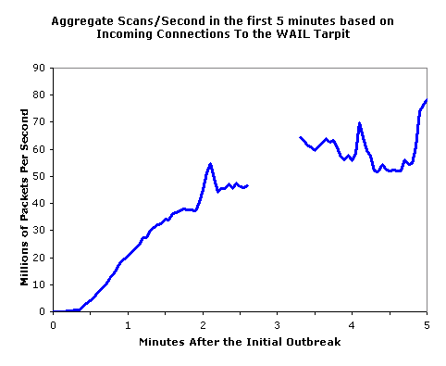
Bad guys: put malware into hosts via Internet
Trojan horse
  hidden part of some otherwise useful software
  today often in Web page (Active-X, plugin)
virus
  infection by receiving object (e.g., e-mail attachment), actively executing
  self-replicating: propagate itself to other hosts, users
worm:
  infection by passively receiving object that gets itself executed
  self- replicating: propagates to other hosts, users
Sapphire Worm: aggregate scans/sec
in first 5 minutes of outbreak (CAIDA, UWisc data)
Introduction 1-46

Slide 47
Bad guys: attack server, network infrastructure
Denial of Service (DoS): attackers make resources (server, bandwidth) unavailable to legitimate traffic by overwhelming resource with bogus traffic
1. select target
2. break into hosts around the network (see botnet)
3. send packets to target from compromised hosts
target
Introduction 1-47

Slide 48
The bad guys can sniff packets
Packet sniffing:
  broadcast media (shared Ethernet, wireless)
  promiscuous network interface reads/records all packets (e.g., including passwords!) passing by
A
C
src:B dest:A payload
B
  Wireshark software used for end-of-chapter labs is a (free) packet-sniffer
Introduction 1-48

Slide 49
The bad guys can use false source addresses
IP spoofing: send packet with false source address
A
C
src:B dest:A payload
B
Introduction 1-49

Slide 50
The bad guys can record and playback
record-and-playback: sniff sensitive info (e.g., password), and use later
  password holder is that user from system point of view
C
A
src:B dest:A user: B; password: foo
B
… lots more on security (throughout, Chapter 8)
Introduction 1-50

Slide 51
Internet History
1972-1980: Internetworking, new and proprietary nets
1970: ALOHAnet satellite network in Hawaii
1974: Cerf and Kahn - architecture for interconnecting networks
1976: Ethernet at Xerox PARC
ate70’s: proprietary architectures: DECnet, SNA, XNA
late 70’s: switching fixed length packets (ATM precursor)
1979: ARPAnet has 200 nodes
Cerf and Kahn’s internetworking principles:
  minimalism, autonomy - no internal changes required to interconnect networks
  best effort service model
  stateless routers
  decentralized control
define today’s Internet architecture

