Slide 1
Panpsychism and Compositionality: A solution to the Hard Problem
Anand Rangarajan
Dept. of Computer and Information Science and Engineering
University of Florida
Gainesville, FL, USA

Slide 2
Realistic physicalism & experience
How do we accommodate experience (Hard Problem)?
When more radical alternatives like idealism or mysticism are ruled out, only physicalism remains.
Emergence - most popular physicalist approach.
Complexity problem: When does experience emerge?
Does realistic physicalism entail panpsychism?
Combination problem: How do qualia combine?
Are these the only alternatives at present?

Slide 3
Panpsychism, Emergence & Physicalism
Physicalism
Panpsychism
Emergence
Combination problem
Complexity problem
Conservative option
Emergence
Radical option
Reformulate physicalism
Conservative option
Panpsychism

Slide 4
Phenomenology: Thin Subjects
Persons and selves as subjects of experience (SoE) (Lowe).
“A subject of experience is something that exists only if experience exists of which it is a subject” (Strawson).
“The thinking or the existence of the thought and the existence of my own self are one and the same” (Kant).
Thin subjects (SESMET): subjects that persist for brief periods of time, a “gappy process” (Strawson).
mere self in Mahayana Buddhism (Tsongkhapa).
Notion goes back at least to Frege in the west.

Slide 5
Physicalism = Physicalism + X
Add ingredient X to physicalism.
Physicalism should remain physicalism despite X.
Re-examine panpsychism and emergence in light of new physicalism.
It is accompanied by experience because X is always accompanied by experience.

Slide 6
Compositionality
A counter-intuitive proposal.
Assertion: Physicalism + Compositionality accompanied by experience.
Letter but not the spirit of panpsychism: fundamental but not pan.
Spirit but not the letter of emergence: non-reductive but fundamental.
New ingredient
X
Physicalism
Experience
Subjects
Compositionality

Slide 7
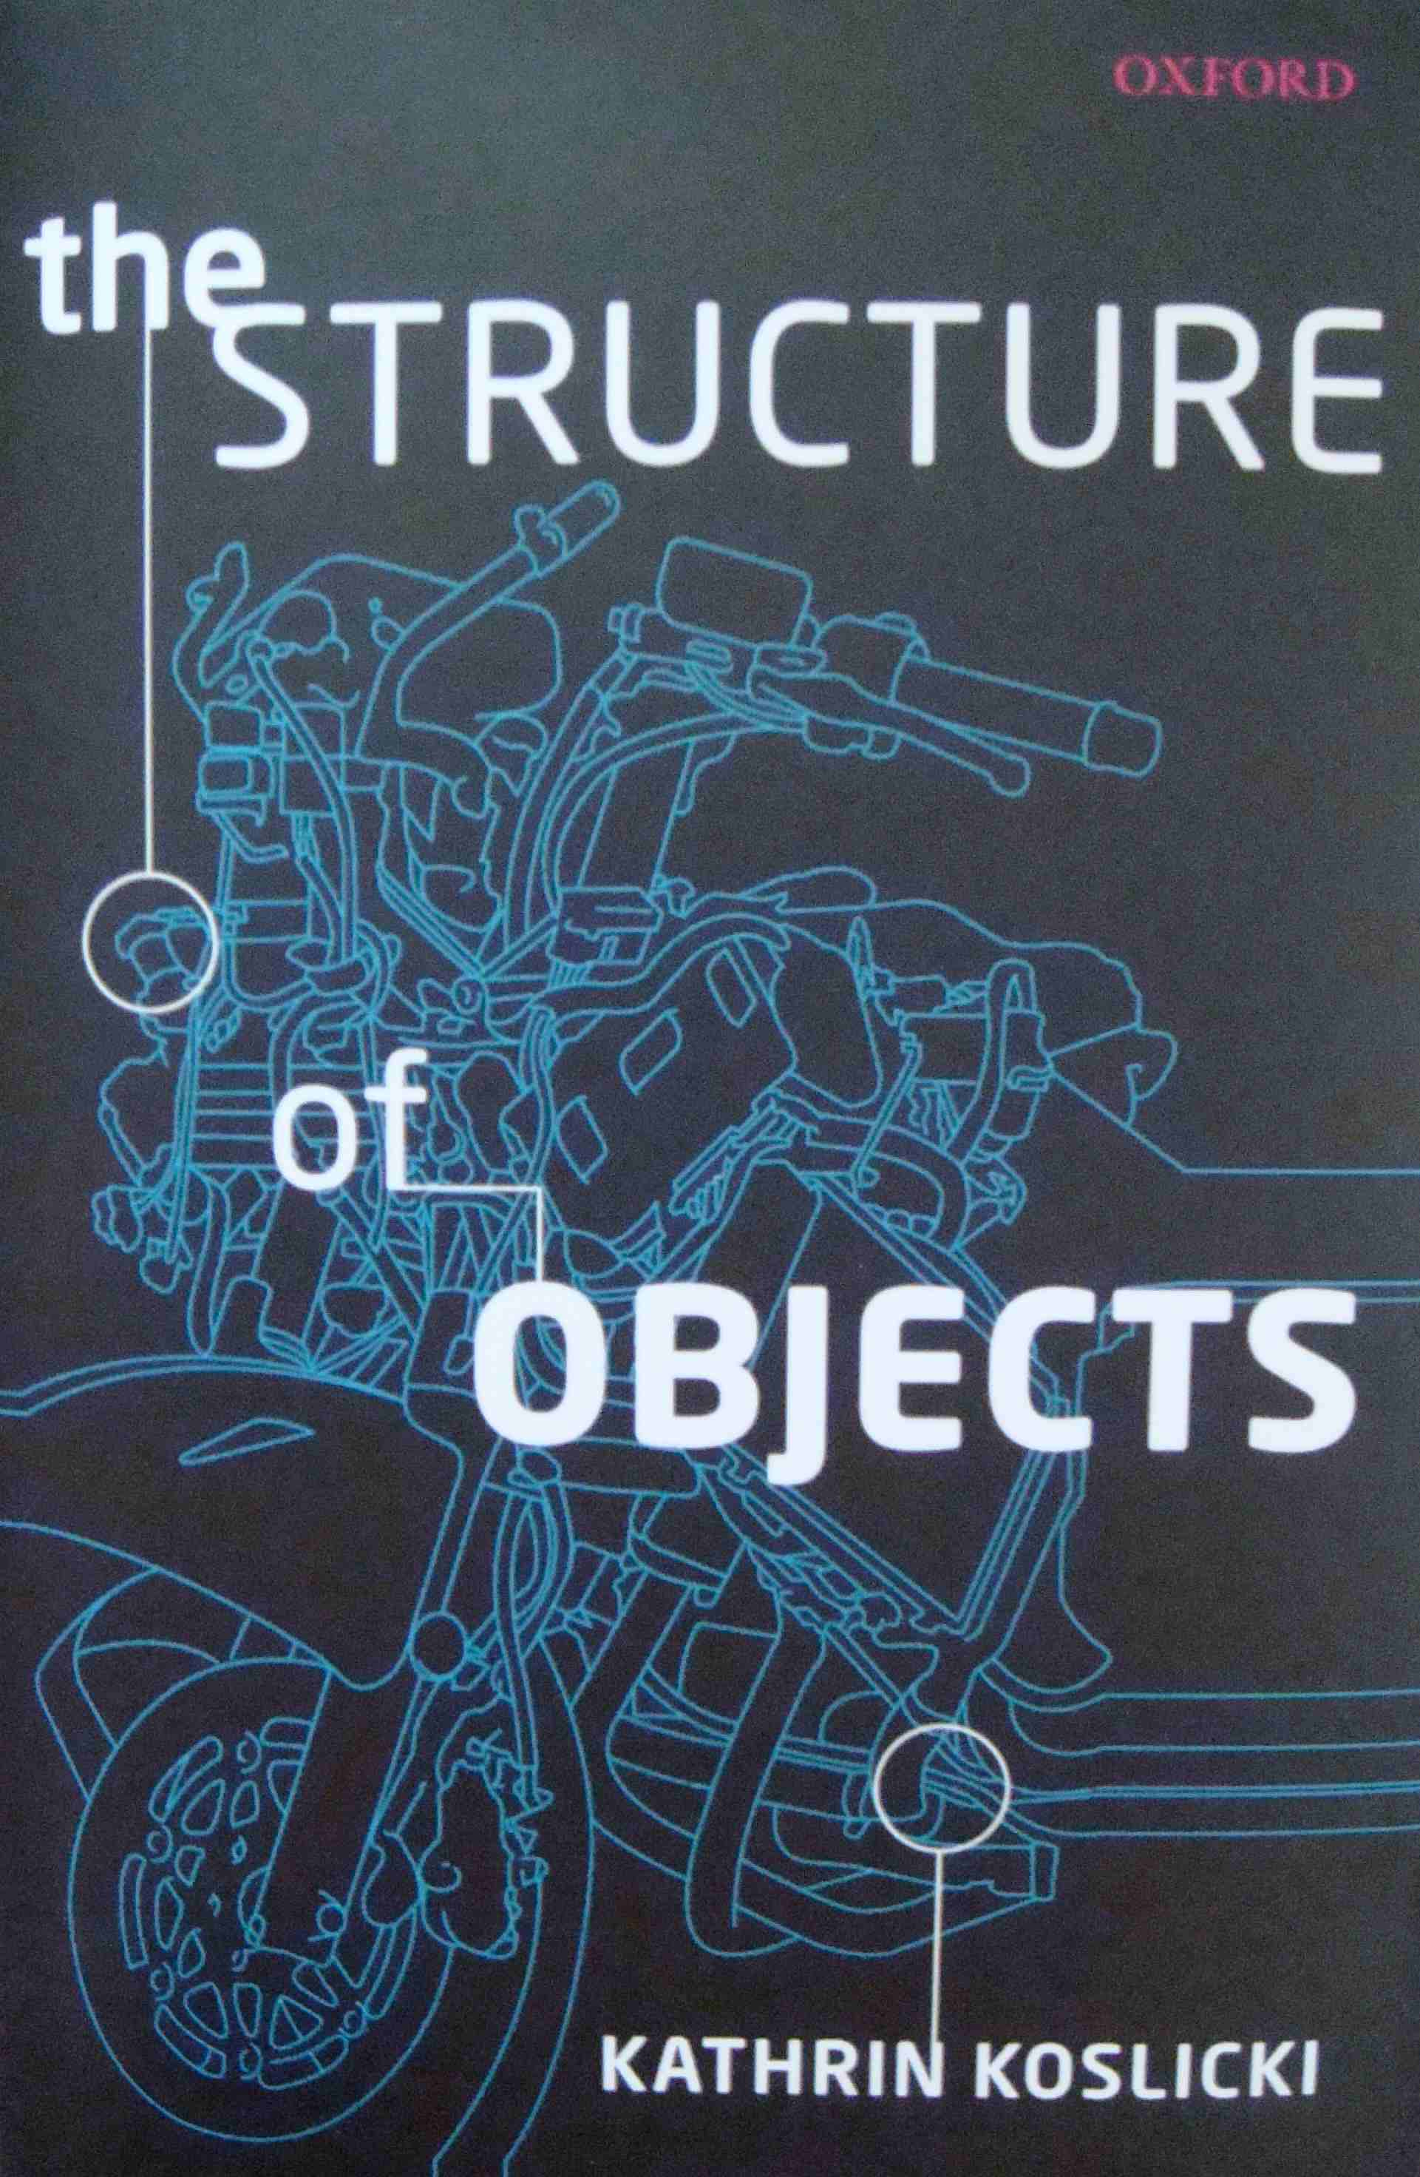
Restricted Compositionality Principle (RCP)
New ingredient
X
Physicalism
Experience
Subjects
Compositionality
Kathrin Koslicki’s work.
RCP: Some objects compose an object O, of kind K, just in case satisfy the constraints dictated by some formal components, associated with objects of kind, K.
Weak Supplementation Principle.
Avoid proliferation of sui generis relations.
Relies on ontology of natural kinds.
Material and formal parts of object (composition).

Slide 8
SoE as Natural Kinds
Subjects of Experience (SoE): Restricted compositionality principle requires commitment to ontology of natural kinds.
SoE as a natural kind term:
Appeal to same-kind relation between SoE objects.
Non-descriptive and does not require rigidity (Koslicki).
Requires specification for picking out same kind object.
Intersubjectivity as specification? Clearly controversial.
I see You, Y’All, namaste.
Second person as foundation for SoE?
Could be wrong but more importantly could also be right.
SoE in psychology:
analogous to species in biology.
Different SoE: prehension, sensation, emotion, cognition, visualization.
Physics of Compositionality?

Slide 9
From Physicalism to Physics
Need new idea to set up compositionality in physics

Slide 10
Second Quantization
Tucson series of conferences obsessed with first quantization: how do particles act like waves.
Second quantization: How do waves act like particles? Sets up field-particle relation.
Set up SoE compositionality relation using second quantization.
``First quantization is a mystery but second quantization is a functor”
John Baez, Somewhere on the Internet.

Slide 11
SelfOn: Physical thin subjects
Fundamental physics: Set of quantum fields.
Compositionality relation linking SoE to physical.
SelfOn (selfon): Thin subjects realized from basic fields.
Akin to a new particle formed by second quantization.
SoEs: objects of natural kind SelfOn.
Star Trek DS9: The Search (Part I)
URL withheld

Slide 12
Phenomenology, Philosophy and Physics
Phenomenology | Philosophy | Physics
Thin subject | Subject of Experience | SelfOn
 | Compositionality relation | 2nd quantization: Akin to Particle Field
Experience | Physical property | SelfOn state
Intersubjectivity | SoEs form natural kind | SelfOn interactions
Gappiness | Spatiotemporal bound | SelfOns appear and decay

Slide 13
Fields, Particles and SelfOns
Eliminativism: There are only (quantum) fields, no particles, no selfons.
Naturalistic dualism: There are only (quantum) fields and selfons.
Materialistic dualism: There are (quantum) fields, particles and selfons.
Interactionist dualism: There are only particles and selfons.
Materialistic monism: There are only (quantum) fields and particles, no selfons.

Slide 14
Objections
There is experience (Chalmers).
Experience implies (thin) subjects of experience (Strawson).
Everything is physical or entailed by the physical (Stoljar).
SoE are physical compositions of a certain natural kind (foll. Koslicki).
SelfOns are SoEs set up via new compositionality relation akin to field to particle 2nd quantization.
Denied by eliminativists.
Denied by materialists and some panpsychists.
Denied by interactionist dualists.
Denied by idealists and property dualists.
Denied by physicists?

Slide 15
Discussion
“Why is it accompanied by experience?” (Chalmers).
“Everything is physical or entailed by the physical” (Stoljar).
“Until more is said it amounts to simply dismissing of…the intuition that the experiential cannot emerge from the non-experiential” (Strawson).
Expand physicalism: Physicalism = Physicalism + y (Montero).
Compositionality: “There exists a y the x’s compose if and only if the activity of the x’s compose a life” (van Inwagen).
Experience implies a subject of experience (Lowe, Frege).
Subjects of experience (SoE) are physical compositions of a certain natural kind (following Koslicki).
SelfOns – formed by 2nd quantization - are SoEs accompanied by experience.

Slide 16
References
The Conscious Mind: In Search of a Fundamental Theory, David J. Chalmers, Oxford University Press, 1996.
Ignorance and Imagination: The Epistemic Origin of the Problem of Consciousness, Daniel Stoljar, Oxford University Press, 2006.
Physicalism, Daniel Stoljar, Routledge, 2010.
Selves: An essay in revisionary metaphysics, Galen Strawson, Clarendon Press, 2009.
Subjects of Experience, Edward J. Lowe, Cambridge University Press, 1996.
Material Beings, Peter van Inwagen, Cornell University Press, 1990.
What’s Wrong with Microphysicalism, Andreas Hüttemann, Routledge, 2004.
Everything Must Go, James Ladyman and Don Ross with David Spurrett and John Collier, Oxford University Press, 2010.
The Structure of Objects, Kathrin Koslicki, Oxford University Press, 2008.
Natural Kinds and Conceptual Change, Joseph LaPorte, Cambridge University Press, 2004.
Objects and Persons, Trenton Merricks, Clarendon Press, 2001.
More Kinds of Being, Edward J. Lowe, Wiley-Blackwell, 2009.

Slide 17
Thank You
We are indebted to Leopold Stubenberg for pointing out Koslicki’s work
All mistakes are of course ours

Slide 18
Substances versus properties
Approach raises intriguing picture of substance (SoE) linked to properties via compositionality relation.
Not property or substance dualism but weird hybrid.
No worry over natural kinds if there is only one kind of substance, namely, SoE.
Substance introduced only to accommodate experience seems jury rigged.
May be democratizing Spinoza (matter and mind as properties of single substance/God).

