Slide 1
Using Category & Constructor Theories to Build a Solution to the Hard Problem
Anand Rangarajan
Dept. of Computer and Information Science and Engineering
University of Florida

Slide 2
The Hard Problem
Why is anything accompanied by experience (Chalmers)?
Mainstream response: Emergence
Alternatives
Structure and dynamics
Information processing
Neuronal dynamics
Physicalism and Materialism
Panpsychism (Rosenberg, Skrbina, Strawson)
Dual aspect Theory (Atmanspacher)
Neutral Monism (Banks)
Idealism (Kastrup)
Russellian Monism (Stoljar)
Self-organization
Complexity
Systems theory
Confused with holism

Slide 3
Systems versus Particles
Our slogan: Complex AI systems are not accompanied by experience
Age old distinction: systems versus particles (back to 19th century atomism)
Systems: Capable of complex information processing
Particles: Highly unified and spatiotemporally bounded
Systems: Wrong way of thinking about consciousness
Intuition: Connection between radically unified experience and particles?
Strawson’s subjects of experience suggestive

Slide 4
Subjects of Experience, the Physical and Selfons
SoE more akin to a particle than a system (crazy hypothesis)
Natural rather than artifactual or cultural
Bid goodbye to the 19th century: Particles are formed in quantum field theory (QFT) via second quantization
SoEs are special “selfons” accompanied by experience (Rangarajan)
Second quantization in QFT creates particles from basic fields
But second quantization is a functor (as in category theory pointed out by Edward Nelson)!
Can we model SoEs (or selfons) using category theory?
Generalize from QM, QFT and move to modeling using category theory

Slide 5
Category Theory: Basics
$$id_{y}$$
$$id_{x}$$
$$x$$
$$f$$
$$y$$
$$g$$
$$h$$
$$id_{z}$$
Definition: A category $𝒞$ has constituents:
Objects: A collection $Ob(𝒞)$, elements called objects
Morphisms: For every pair $x, y∈Ob\left(𝒞\right)$ a set of morphisms $f:x→y$ from $x$ to $y$
Identity: For every object $x∈Ob(𝒞)$ an identity morphism ${id}_{x}$ on $x$
Composition: For every three objects $x, y, z∈Ob\left(𝒞\right)$, if $f:x→y$, $g:y→z$ and $h:x→z$ then $h=g∘f:x→z$
Intuition: Morphisms are the glue relating objects
Composition formula: Transitivity in object relations
Relevance to HP: Selfons as objects (accompanied by experience) and intersubjectivity as evidence of morphisms
$$z$$

Slide 6

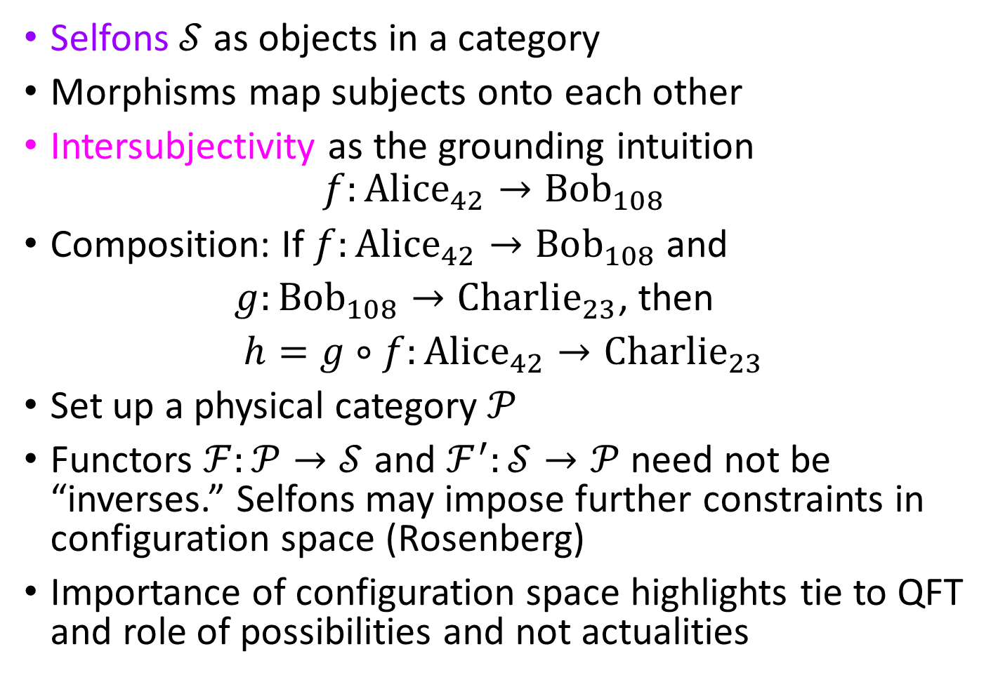
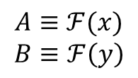
Selfons as a Category
$$id_{B}$$
$$id_{A}$$
$$A$$
$$f$$
Selfons $𝒮$ as objects in a category
Morphisms map subjects onto each other
Intersubjectivity as the grounding intuition
$$f:Alice_{42}→Bob_{108}$$
Composition: If $f:Alice_{42}→Bob_{108}$ and
$g:Bob_{108}→Charlie_{23}$, then
$h=g∘f:Alice_{42}→Charlie_{23}$
Set up a physical category $𝒫$
Functors $ℱ:𝒫→𝒮$ and $ℱ^{′}:𝒮→𝒫$ need not be “inverses.” Selfons may impose further constraints in configuration space (Rosenberg)
Importance of configuration space highlights tie to QFT and role of possibilities and not actualities
$$B$$
$$A:Alice_{42}$$
$$B:Bob_{108}$$
$$C:Charlie_{23}$$
$$g$$
$$h$$
$$id_{C}$$
$$C$$
$$id_{ℱ(x)}$$
$$A$$
$$ℱ(f)$$
$$B$$
$$id_{ℱ(y)}$$
$$ℱ(x)$$
$$ℱ(y)$$
$$𝒮$$
$$A≡ℱ(x)$$
$$B≡ℱ\left(y\right)$$
$$ℱ$$
$$ℱ′$$
$$id_{x}$$
$$x$$
$$f$$
$$y$$
$$id_{y}$$
$$𝒫$$

Slide 7
Constructor Theory
Very little coverage in TSC series of conferences
Move away from trajectories, initial conditions and dynamical laws
Formulate physics based on what is possible and what is impossible in specific tasks
David Deutsch: pioneer of this approach
Chiara Marletto: a leading figure in present day constructor theory

Slide 8
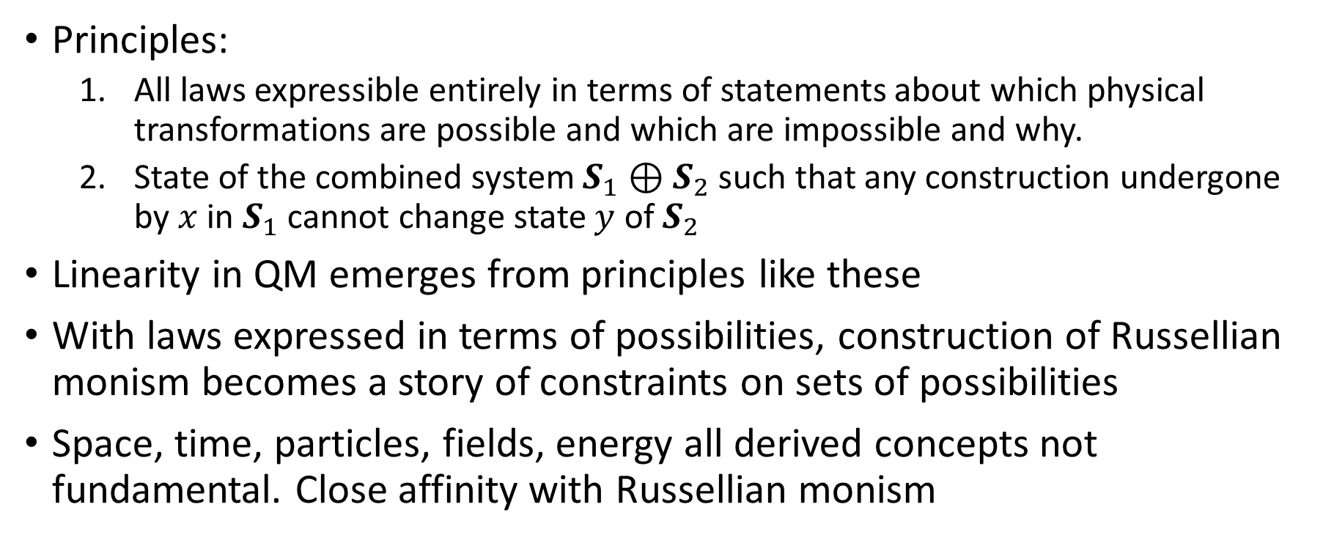
Relevance to Consciousness Studies
Principles:
All laws expressible entirely in terms of statements about which physical transformations are possible and which are impossible and why.
State of the combined system $S_{1}⊕S_{2}$ such that any construction undergone by $x$ in $S_{1}$ cannot change state $y$ of $S_{2}$
Linearity in QM emerges from principles like these
With laws expressed in terms of possibilities, construction of Russellian monism becomes a story of constraints on sets of possibilities
Space, time, particles, fields, energy all derived concepts not fundamental. Close affinity with Russellian monism

Slide 9
Categories need not be equivalent
Functors can exist between non-equivalent categories
Brains | Subjects of Experience
Functor from the physical to the category of brain states | Functor from the physical to selfons
Equivalent categories | Non-equivalent categories
Information processing in brains: a convenient shorthand | Selfons can enact constraints restricting sets of possibilities
Natural fit: phase space dynamics | Natural fit: configuration space
Model: Lagrangian dynamics | Model: Constructor Theory

Slide 10
References
Dual-aspect Monism à la Pauli and Jung, Harald Atmanspacher, J. Conscious Studies, 19(9-10):96-120, 2012.
The Conscious Mind: In Search of a Fundamental Theory, David J. Chalmers, Oxford University Press, 1996.
The Constructor Theory of Information, David Deutsch and Chiara Marletto, arXiv:1405.5563 [quant-ph]
The Structure of Objects, Kathrin Koslicki, Oxford University Press, 2008.
The Ultimate Constituents of the Material World: In Search of an Ontology for Fundamental Physics, Meinard Kuhlmann, Ontos Verlag, 2010
Natural Kinds and Conceptual Change, Joseph LaPorte, Cambridge University Press, 2004.
Subjects of Experience, Edward J. Lowe, Cambridge University Press, 1996.
Can a Quantum Field Theory Ontology help resolve the Problem of Consciousness, Anand Rangarajan, Quantum Reality and Theory of Śūnya, Springer Nature, pp. 13-26, 2019.
A Place For Consciousness: Probing the Deep Structure of the Natural World, Gregg Rosenberg, Oxford Univ. Press, 2004.
Quantum Field Theory and the Standard Model, Matthew D. Schwartz, Cambridge Univ. Press, 2013
Category Theory for the Sciences, David I. Spivak, The MIT Press, 2014.
Ignorance and Imagination: The Epistemic Origin of the Problem of Consciousness, Daniel Stoljar, Oxford University Press, 2006.
Physicalism, Daniel Stoljar, Routledge, 2010.
Selves: An Essay in Revisionary Metaphysics, Galen Strawson, Clarendon Press, 2009.
Material Beings, Peter van Inwagen, Cornell University Press, 1990.

Slide 11
Contact information:
Prof. Anand Rangarajan
Department of Computer and Information Science and Engineering
University of Florida
E-mail: anandr@ufl.edu

