Slide 1
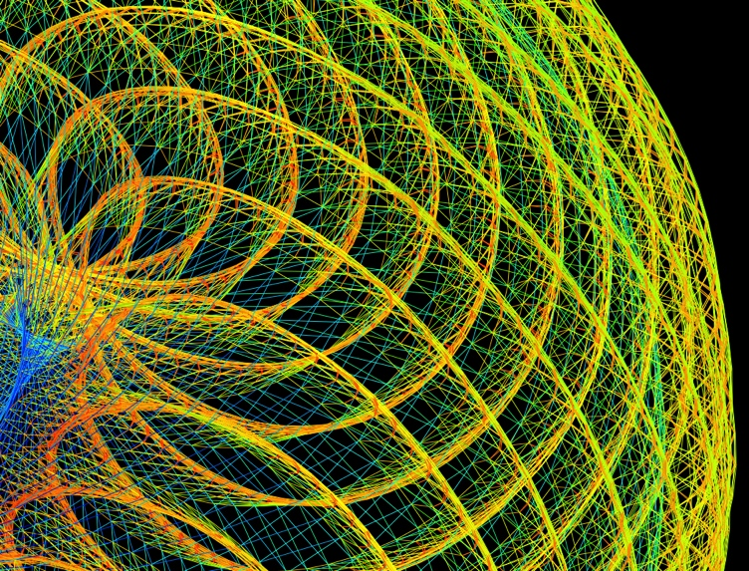
The Beauty of Mathematics : As Illustrated by the University of Florida Sparse Matrix Collection
Tim Davis, CISE
Yifan Hu, AT&T Research
Art in Engineering, Harn Museum
October 13, 2011
Notes:
I'm Tim Davis, a faculty member in the Computer and Information Science and Engineering Department at the University of Florida. I'd like to share with you the Beauty of Mathematics - as illustrated by the University of Florida Sparse Matrix Collection. This work is in collaboration with Dr. Yifan Hu at AT&T Research.

Slide 2
“Why are numbers beautiful? It's like asking why is Beethoven's Ninth Symphony beautiful. If you don't see why, someone can't tell you. I know numbers are beautiful. If they aren't beautiful, nothing is.”
-- Paul Erdős (1913-1996)
Notes:
Erdos was a brilliant mathematician of legendary eccentricity, who had many collaborators at the University of Florida.

Slide 3
“Where there is number, there is beauty.”
-- Proclus (412-485)
Notes:
Proclus was a Greek mathematician and philosopher of the 5th century AD. Math is true ... do you know it? Math is beautiful ... can you see it? Let me illustrate it for you.

Slide 4
Math is true ... do you know it?
Math is beautiful ... can you see it?
Let me illustrate it ...

Slide 5
Say we have 4 equations
and 4 unknowns (w, x, y, z)
w + 2y = 7
x - y + z = 42
4w - x + 3y - z = 4
x + y + 2z = -1
Notes:
Say we have 4 equations and 4 unknowns, w, x, y, z. Not every equation involves every unknown, and this gives the set of equations an interesting structure. A mathematician would see it and might call it beautiful -- but can you see it?

Slide 6
As a matrix equation, Ax=b
1 2 w 7
1 -1 1 x 42
4 -1 3 -1 y 4
1 1 2 z -1
=
Notes:
The coefficients of each equation can be placed in a 4-by-4 matrix, and the 4 equations can be written as the single matrix equation Ax=b. Consider the matrix structure -- just the position of the nonzeros.

Slide 7
Now consider the matrix structure:
nonzeros as “ ” and diagonals 1 to 4
1
2
4 3
1 1 4

Slide 8
A graph can illustrate how the 4 equations/unknowns are related.
1
2
4 3
1 1 4
1 and 3 are related, 1 and 2 are not

Slide 9
1
2
4 3
1 1 4
Draw a circle (node)
for each equation.
And an edge between related nodes.

Slide 10
1
2
4 3
1 1 4
But is it beautiful?
Notes:
The nonzeros are now replaced by dots, and the diagonal is numbered 1 to 4 for reference. A graph (on the top) can illustrate how the 4 equations and unknowns are related. 1 and 3 are related, but 1 and 2 are not. So, draw a circle (a node) for each equation, and draw an edge between related nodes. The result is the graph at the top of the slide, with nodes 1 to 4 and the edges between them. But is it beautiful? Is this the right way to draw the graph?

Slide 11
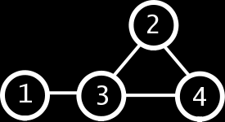
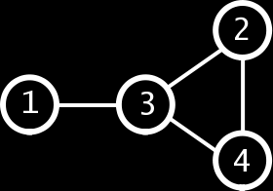
Where is “1”?
Where do we draw “2” ?
Notes:
All these are pictures of the same graph. They differ only by where the nodes are drawn. So where is node 1? Where do we draw 2? Is the number 3 here, or there, anywhere, or nowhere? For a 4-node graph, just about any node positions will do. We can still see the relationships between the 4 nodes in any of the 3 graphs. The graph on the bottom right is best, in one sense. Nodes that are related to each other are close to each other, and the graph is symmetric. Nodes 2 and 4 look just the same (only flipped). This is a better depiction of the structure, as compared with the other two graphs which treat nodes 2 and 4 differently.

Slide 12
But what if the matrix is bigger?
... what if we just dropped them
randomly on the page?
Notes:
What if we dropped them randomly on the page?

Slide 13
But what if the matrix is bigger?
Notes:
But what if the matrix is bigger? Can we just drop them randomly on the page and hope to get a good picture of the structure of the graph? Ouch. This is not beautiful. Perhaps in an abstract sense, but this picture does not reveal the structure of this problem. It's hidden in the random jumbling of the node positions.

Slide 14
To compute aesthetically pleasing
positions for the nodes, we use a
physics-based computational rule:
Give each node an electrical charge.
Make each edge a spring. Drop it
on the floor and let it wobble until
it reaches a minimum energy state.
Notes:
To compute aesthetically pleasing positions for the nodes, we use a physics-based computational rule: Give each node an electrical charge. Make each edge a spring. Drop it on the floor and let it wobble until it reaches a minimum energy state.

Slide 15
Notes:
The graph wobbles into a low-energy state.

Slide 16
Notes:
And it reveals the elegant structure of the graph that was previously hidden when the nodes were jumbled randomly on the page.

Slide 17
Some matrices come from mathematical modeling of a real object … so we know where the
nodes are supposed to be.
Consider a Comanche helicopter...

Slide 18
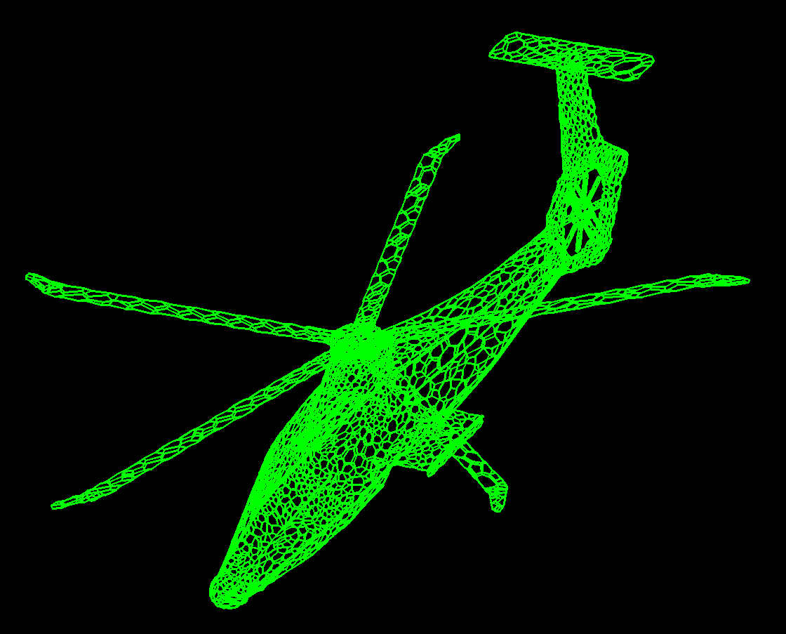
The Comanche helicopter:
with known node positions
Notes:
Some matrices come from the mathematical modeling of a real object. So we know where the nodes are supposed to be. Consider this Comanche helicopter. The equations represent the structure of the surface of the helicopter. They are written to determine how external forces will affect the aircraft while in flight. How will it fly? We don't want to build it first to find out, so a computational simulation is used, such as the one you see here.

Slide 19
Or, let the physics-based rule
compute the positions of the nodes.
Color short edges red, medium ones
green, and long ones blue.

Slide 20
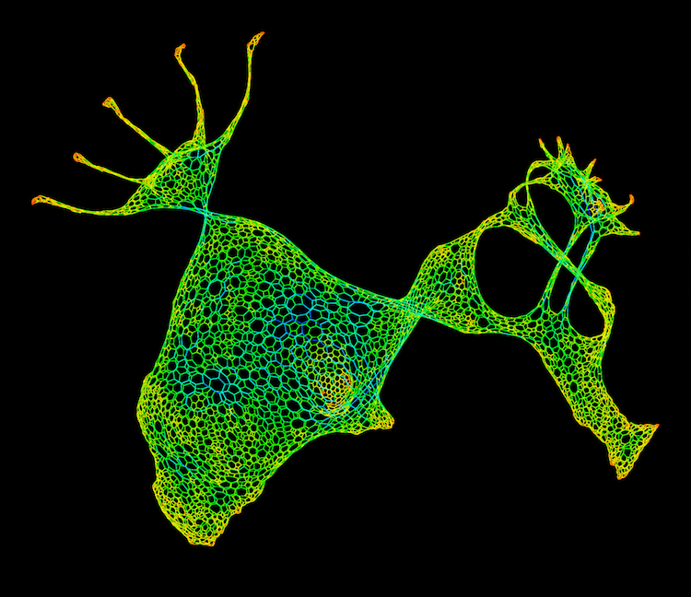
The Comanche helicopter:
using the physics-based rule
Notes:
We can also let the physics-based rule compute the positions of the nodes, just for comparison. Next, to show more relationships in the structure of the graph, we can color the edges. Short edges are red, medium ones are green, and long ones are blue.

Slide 21
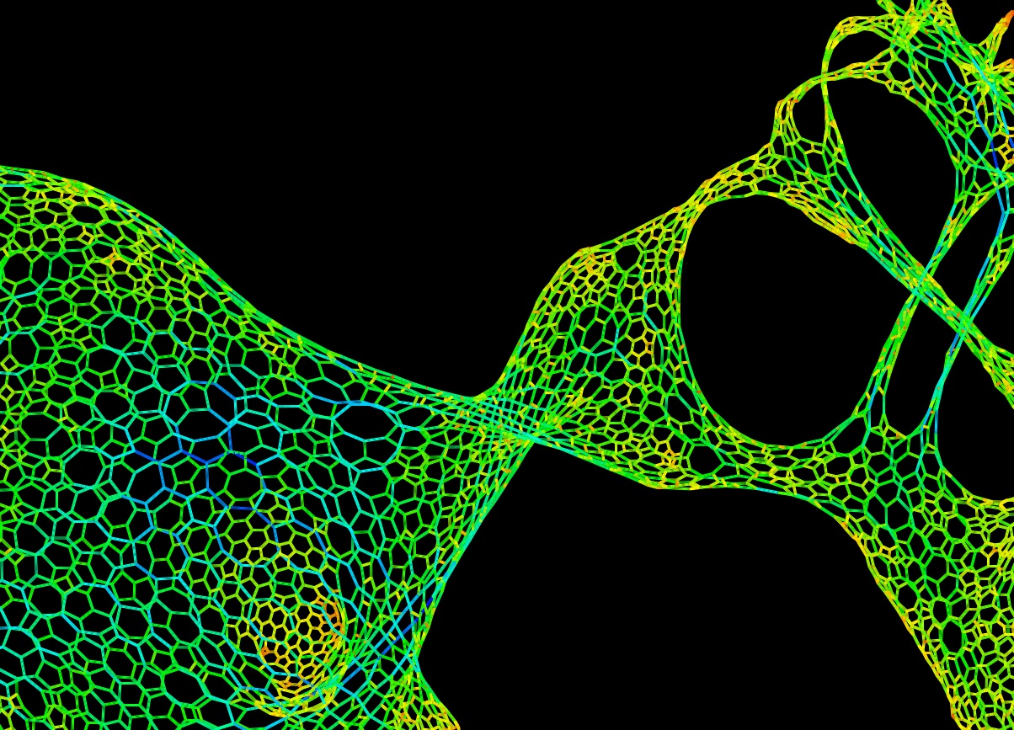
Notes:
In this close-up, you can see shorter edges colored orange or yellow, and some longer edges in shades of blue. Typical edges are in green. Many mathematical problems have no natural node positions, but we can use the physics-based rule to view them anyway.

Slide 22
Many mathematical problems
have no natural node positions,
but we can use the physics-based
rule to view them anyway.

Slide 23
Sparse matrices arise in ...
computational fluid dynamics, finite-element methods, statistics, time/frequency
domain circuit simulation, dynamic and static modeling of chemical processes,
cryptography, magneto-hydrodynamics, electrical power systems, differential
equations, quantum mechanics, structural mechanics (buildings, ships, aircraft,
human body parts...), heat transfer, MRI reconstructions, vibroacoustics, linear
and non-linear optimization, financial portfolio optimization, semiconductor
process simulation, economic modeling, oil reservoir modeling, astrophysics,
crack propagation, Google page rank, 3D computer vision, cell phone tower
placement, tomography, multibody simulation, model reduction, nano-technology,
acoustic radiation, density functional theory, quadratic assignment, elastic
properties of crystals, natural language processing, DNA electrophoresis, ...
... to name just a few.
Notes:
Sparse matrices arise in ... many applications -- far too many to list here. Some have natural 2D or 3D node positions, such as problems in computational fluid dynamics, structural mechanics, heat transfer, semiconductor simulation, and any other problem that comes from the discretization of a 2D or 3D object or space. Some have no natural node positions. For example, computing the Google Page rank leads to a matrix equation, but without any natural positions of the nodes. Where is a web page? Here, or there? What is important is what pages it links to not ``where'' it is. Likewise example, a system of equations can be written to optimize your financial portfolio.

Slide 24
Financial portfolio optimization
Notes:
Here is one. The equations are based on probabilities of different outcomes of future economic events: What if interest rates go up? Or down? In this graph, a stock or bond in each possible future outcome is a node. So where is a stock? Or bond? They have no natural position on a 2-dimensional piece of paper. The different branches of this graph reflect different possible outcomes of future economic events. It's a matrix with over 37,000 equations and 37,000 unknowns -- fairly small as matrices go. So a physics-based rule is essential if we have a graph like this one that we want to visualize. But it's also beautiful.

Slide 25
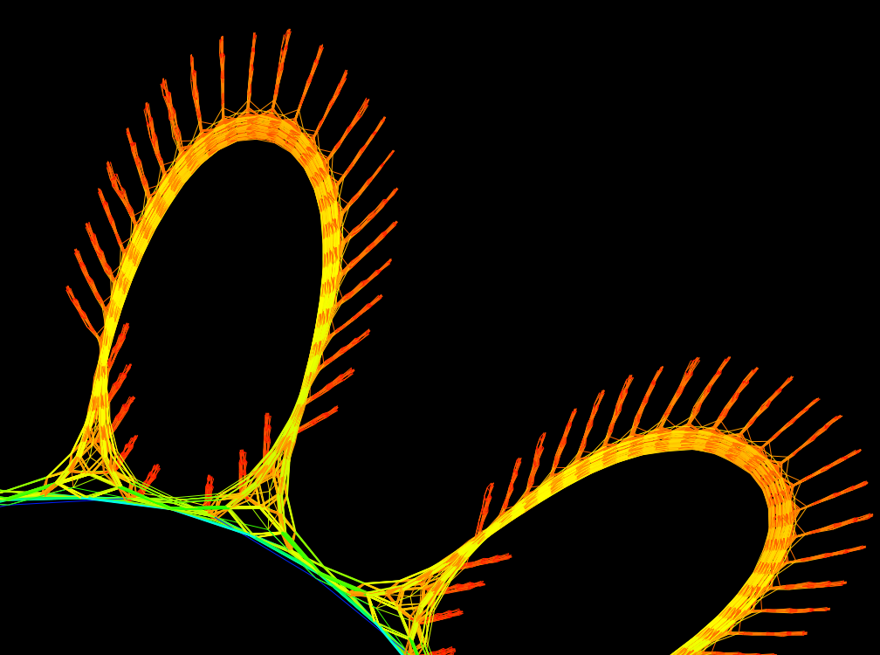
Notes:
Here is a close-up of the different financial scenarios. What I'd like to do next is to give you a tour of a few of the most beautiful images in the University of Florida Sparse Matrix Collection.

Slide 26
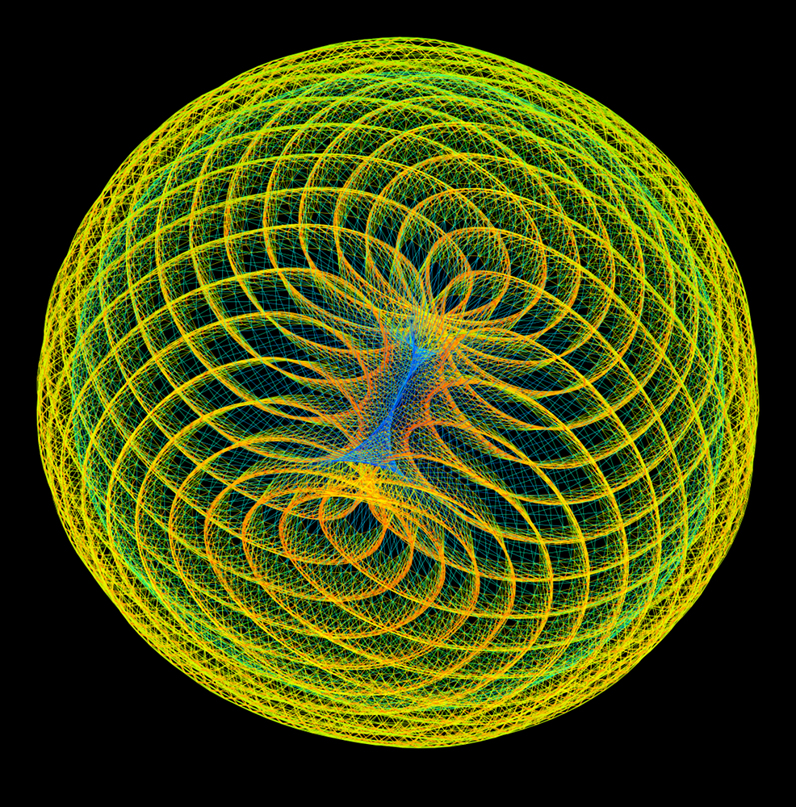
Hessian matrix from a quadratic programming problem
Notes:
The goal is to compute the best solution to an optimization problem.

Slide 27
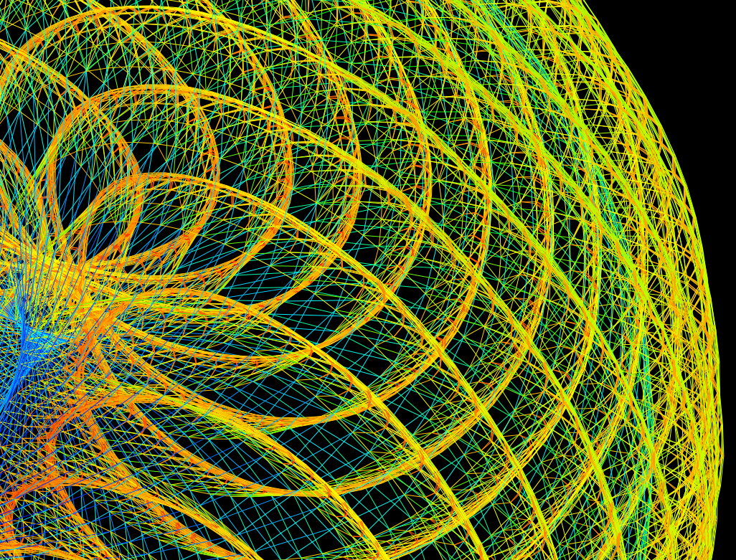

Slide 28
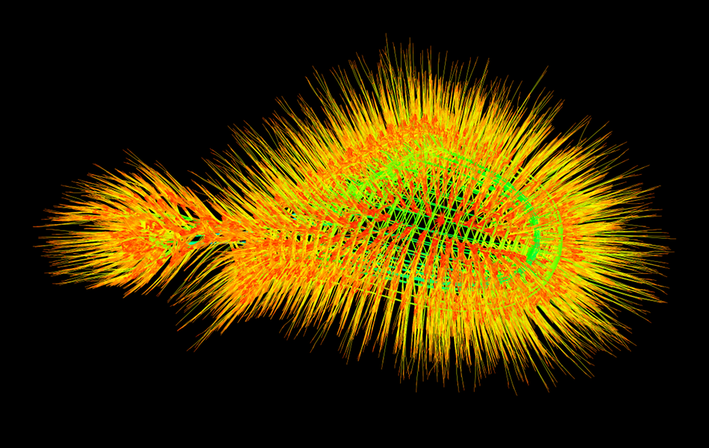
Frequency-domain circuit simulation
Notes:
This matrix comes from the frequency-domain simulation of a complex semiconductor circuit. The green lines underneath the fuzz are the circuit, and the fuzz coming off that describes what happens to the circuit at different frequencies.

Slide 29
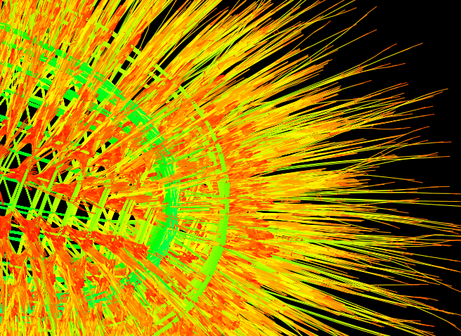
Notes:
This graph is larger, with about 660,000 nodes.

Slide 30
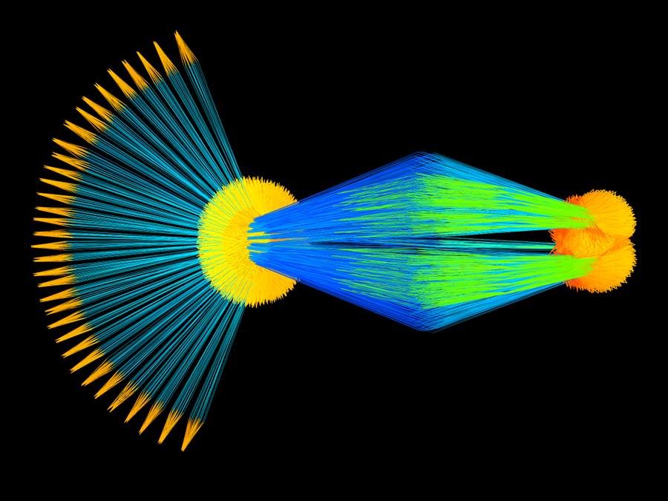
Linear programming problem
Notes:
Here is another linear programming problem.

Slide 31
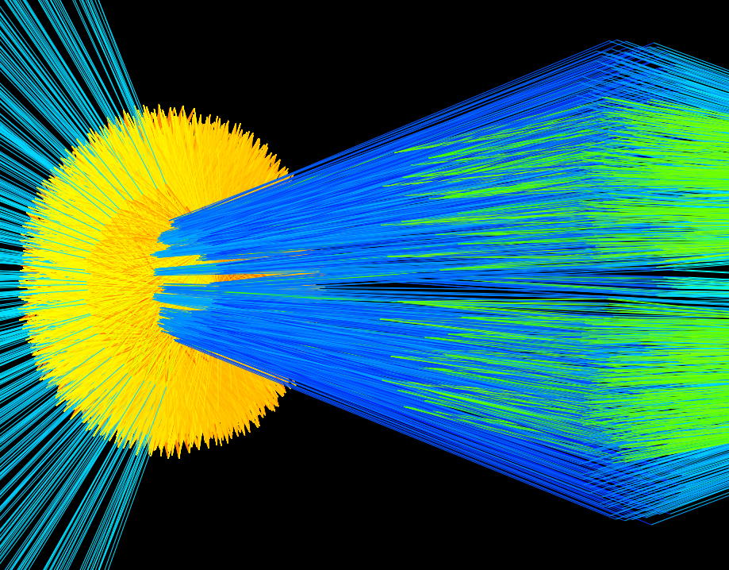
Notes:
And a close-up.

Slide 32
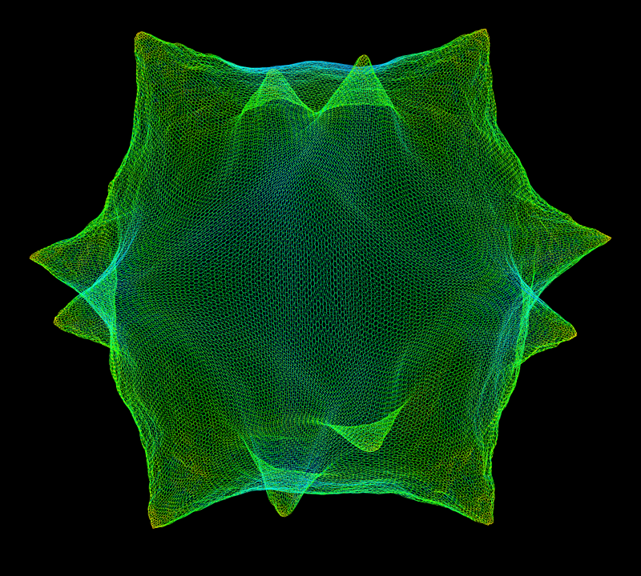
Computational fluid dynamics: shallow-water equations
Notes:
This elegant mesh represents the fluid flow in a shallow bay of water. It could be used to simulate where pollutants would flow.

Slide 33
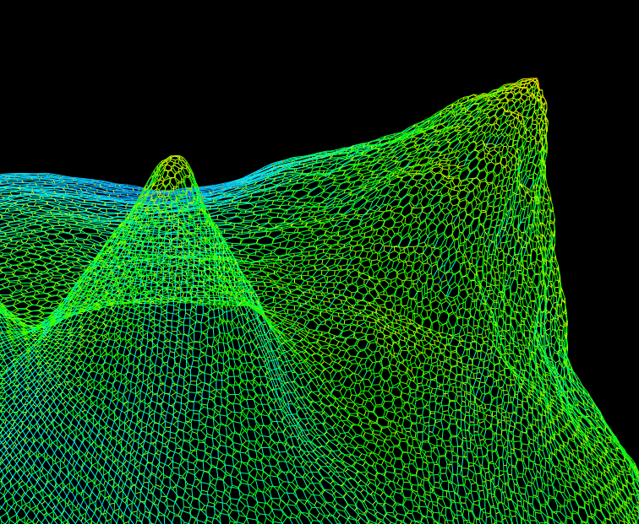
Notes:
In the closeup, you can see the underlying hexagonal mesh. The shallow bay is divided into small triangular wedges, and the relationship between adjacent wedges gives a hexagonal mesh. The mesh is regular because the problem being modeled has a natural 2D or 3D structure.

Slide 34
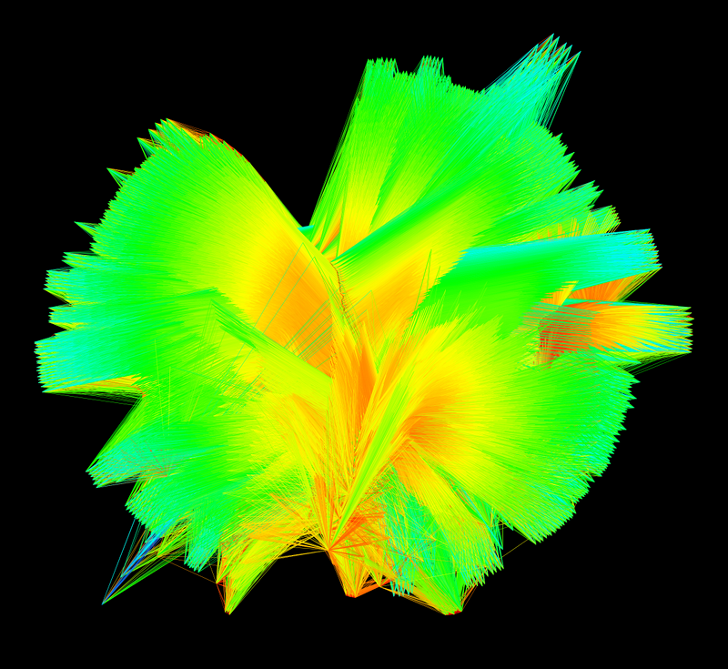
Linear programming problem
Notes:
Here, the lines are so close together they seem to form a solid surface. But it's just a set of lines that connect the many equations. It's not a surface.

Slide 35
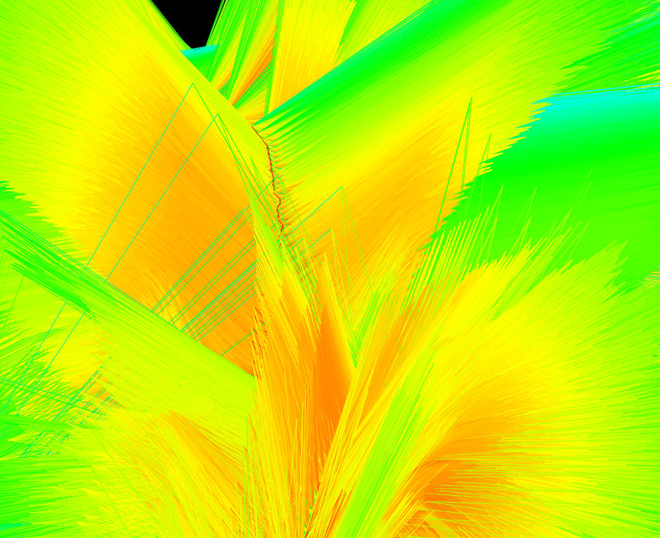

Slide 36
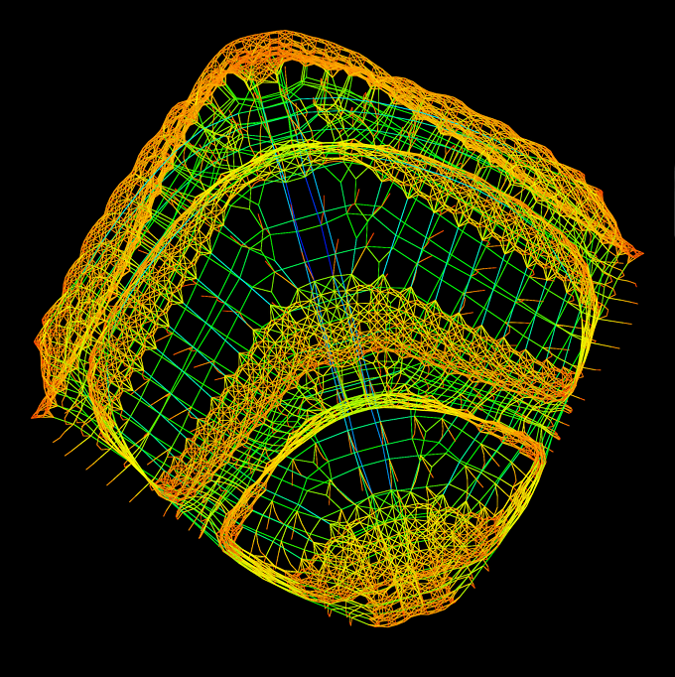
Finite-element method applied to a physical structure
Notes:
Here, the graph reveals that the matrix comes from the discretization of a 2D or 3D object, just like the Comanche helicopter.

Slide 37
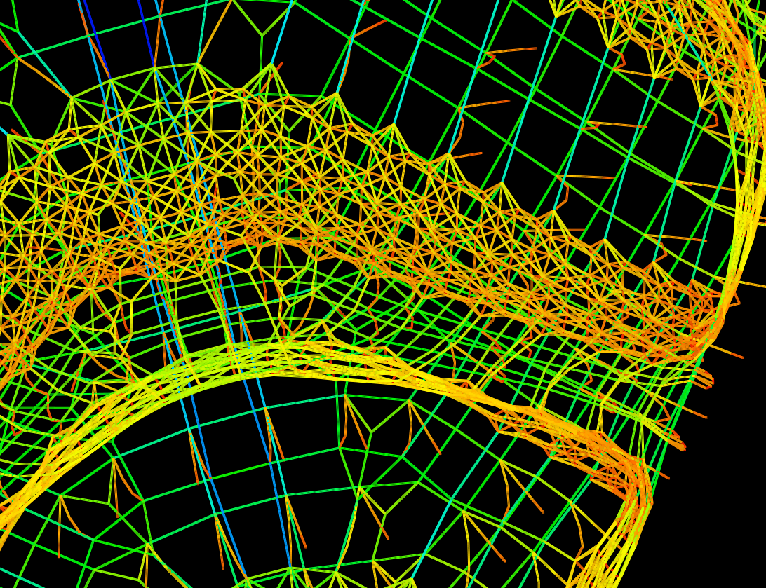
Notes:
In the close-up, you can see the regular 3D mesh.

Slide 38
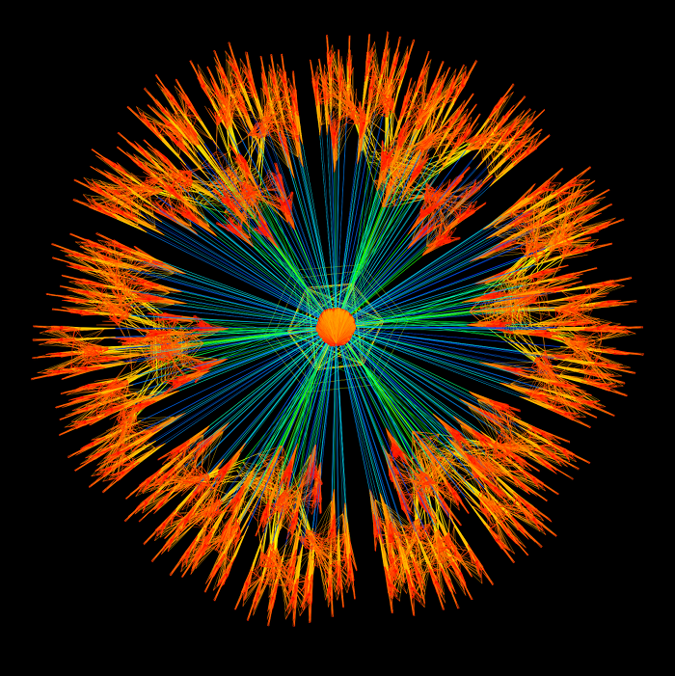
Linear programming problem

Slide 39
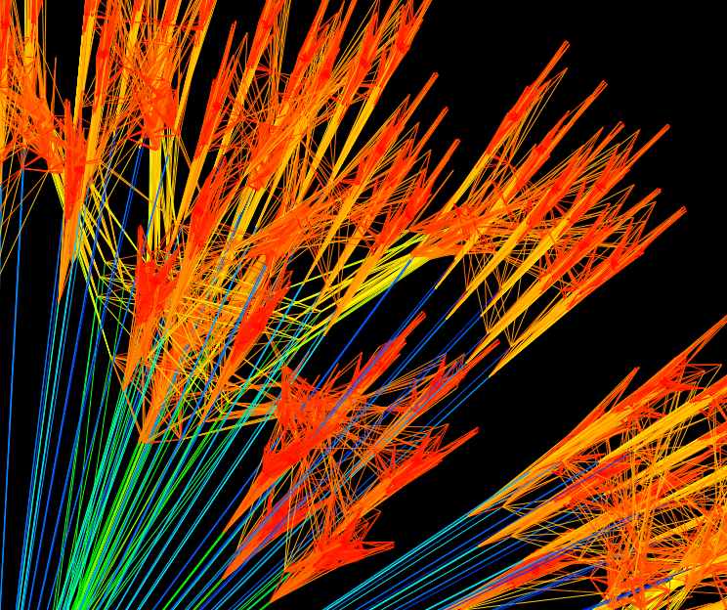

Slide 40
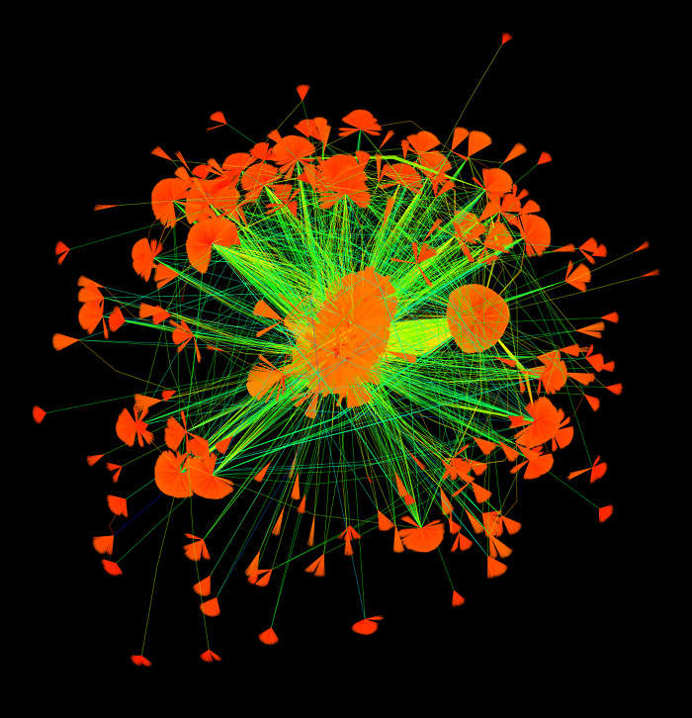
Social network: people and the web pages they like
Notes:
This graph is from a student of mine who now works at Amazon.com. It's a social network, where each node is either a person or a web page, and an edge is drawn between a person and each web page they like. Not surprisingly, the graph is very irregular.

Slide 41
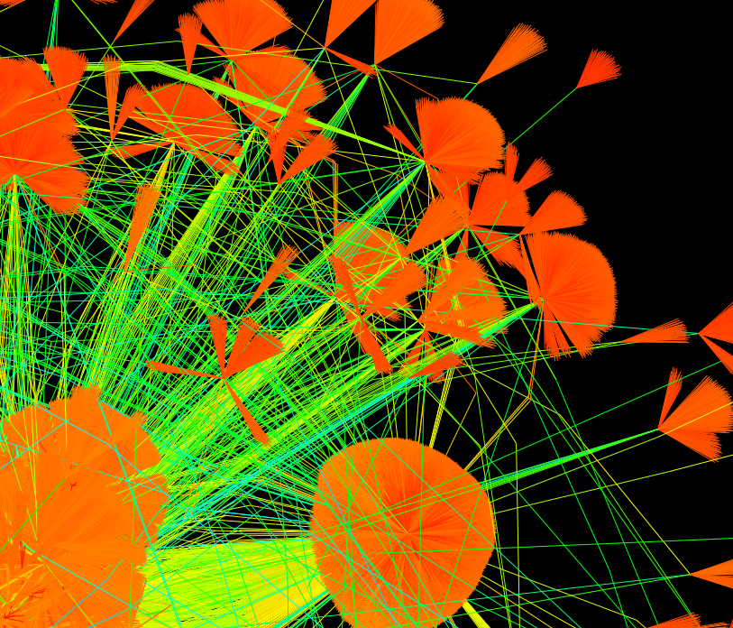

Slide 42
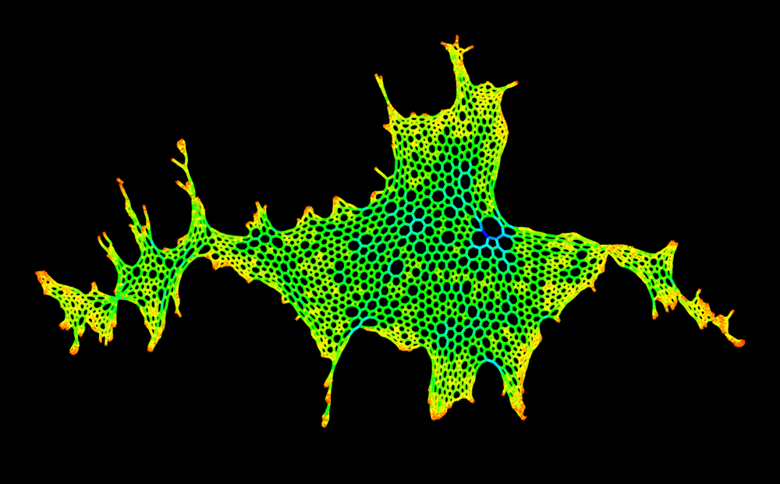
The United Kingdom (Scotland is to the left)
Notes:
This is a 2D problem that represents England, Scotland and Wales. Scotland is to the left ... the physics-based rule knows nothing about north or south.

Slide 43
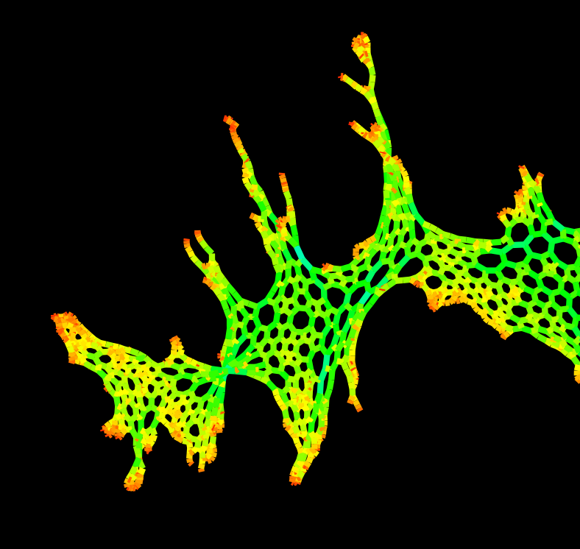
Scotland
Notes:
Here's Scotland.

Slide 44
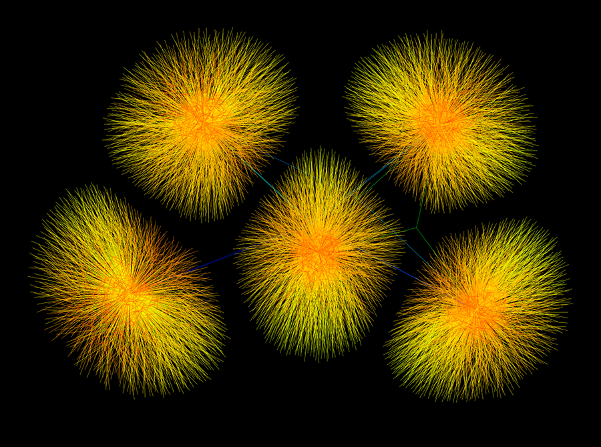
Airline crew scheduling
Notes:
This graph represents an airline crew scheduling problem, mapping 100's of crew to 1000's of commercial airline flights. You're and Airline, and you need to come up with a crew schedule that maximizes profits while meeting specific constraints. For example, a pilot has a limit of the number of hours per week spent in the cockpit. Also, a pilot is normally not permitted to fly two airplanes at the same time.

Slide 45
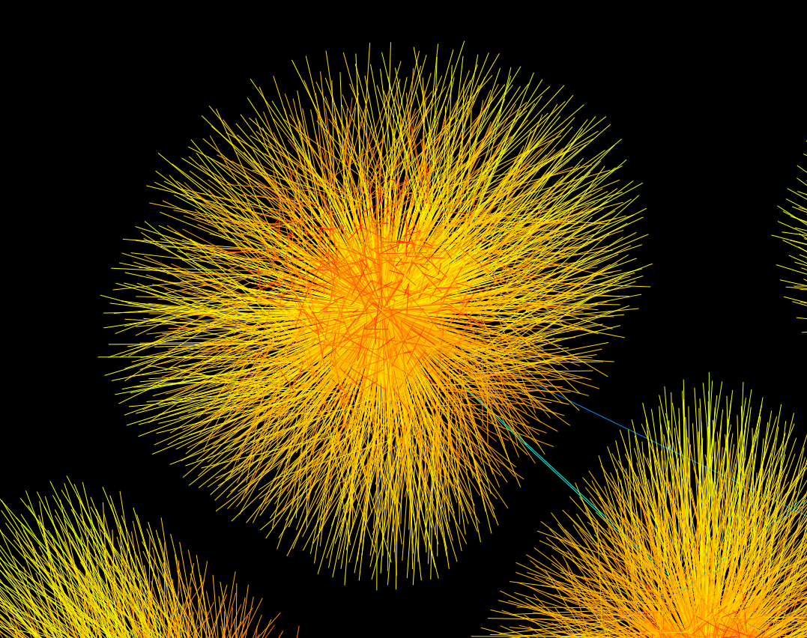

Slide 46
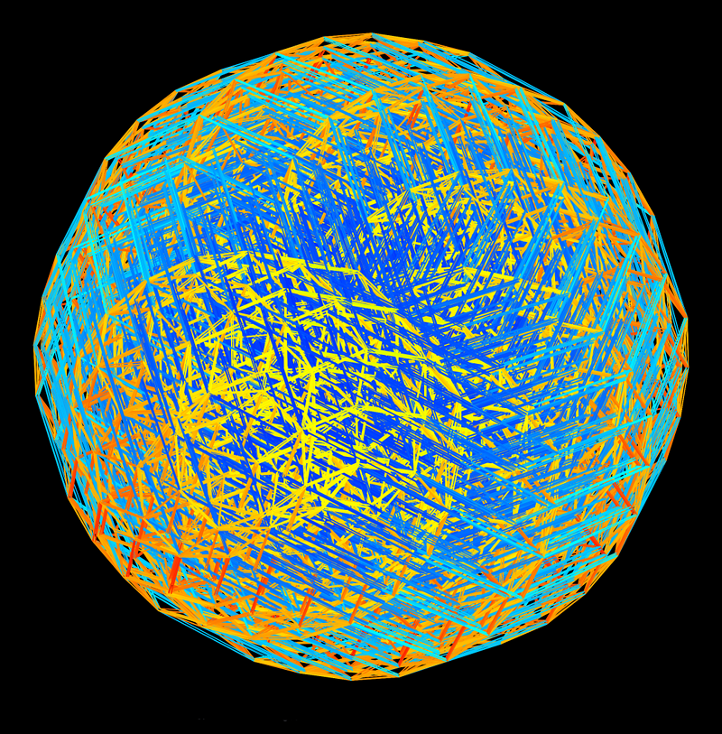
Quantum chromodynamics
Notes:
This problem comes from a simulation of quantum theory.

Slide 47
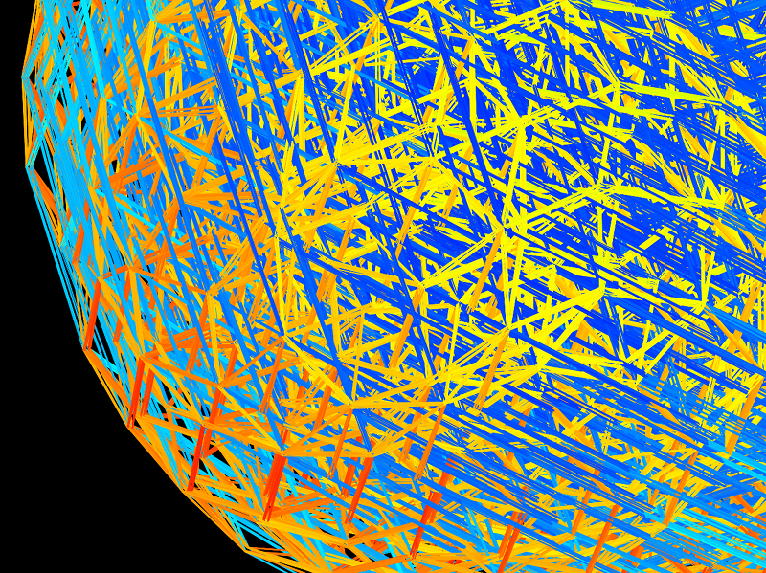

Slide 48
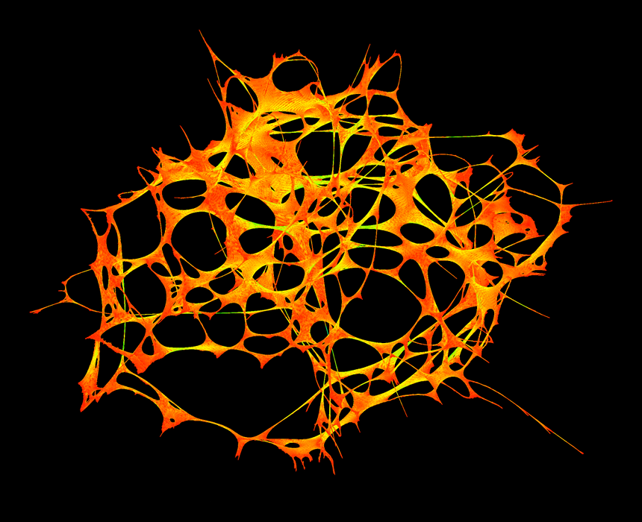
Inside the human bone
Notes:
This comes from a matrix that simulates the forces and stresses on a human bone. Not surprisingly, the graph looks like a bone. This graph has about a million nodes and 20 million edges between them.

Slide 49
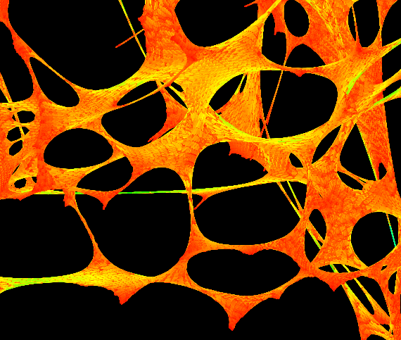

Slide 50
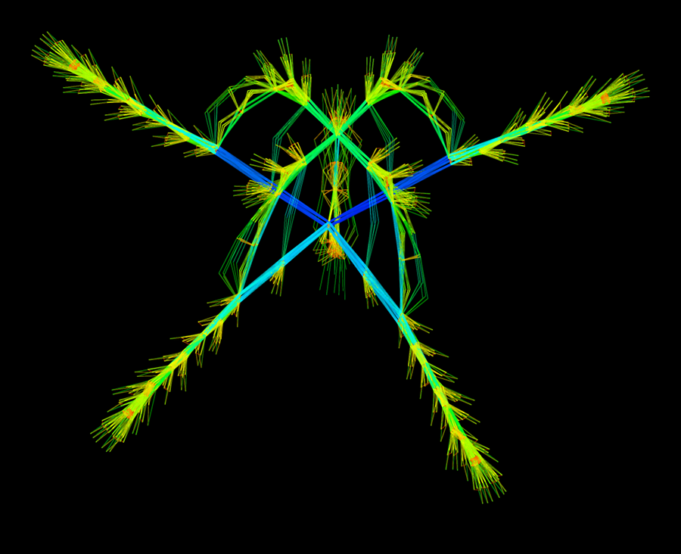
Multibody simulation of a helicopter rotor
Notes:
This helicopter rotor has 4 blades, connected by a complex control structure in the center. Looks like a spider with fuzzy legs, too.

Slide 51
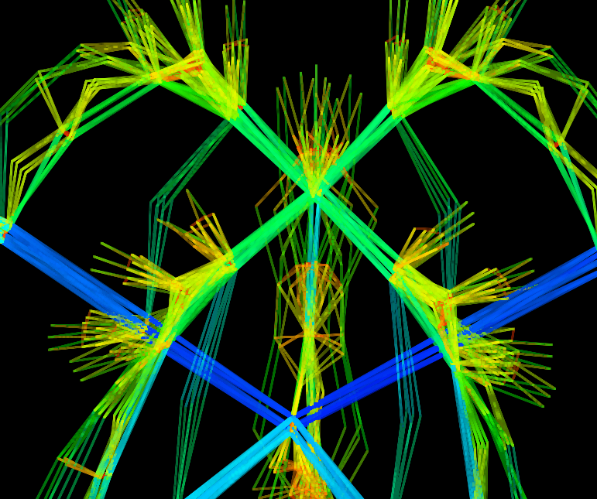

Slide 52
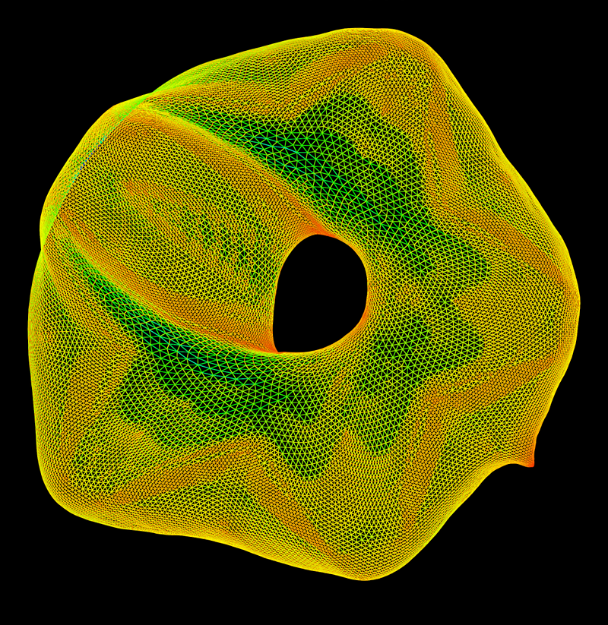
Computational fluid dynamics: airflow around a wing
Notes:
Take a slice of an airplane wing. This gives a 2D model. The hole in the middle is the wing itself, which is distorted into a near-circle. The nodes represent the airflow around the wing.

Slide 53
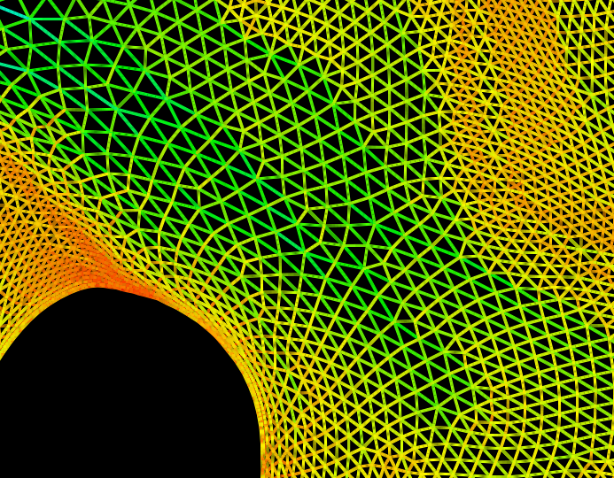

Slide 54
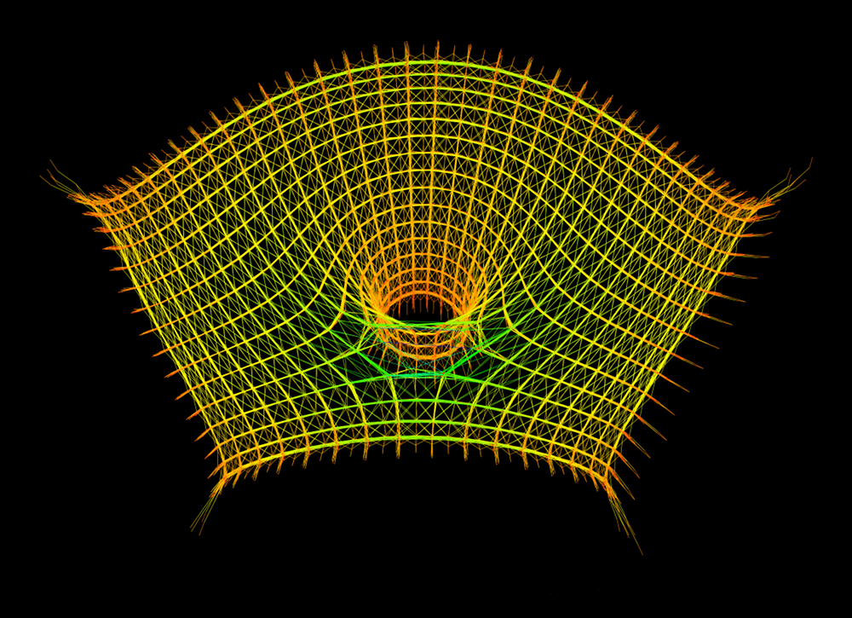
TOKOMAK (magnetic field to constrain plasma in a torus for fusion power)
Notes:
A TOKOMAK is a device that creates an intensely strong magnetic field to constrain high-temperate plasma in a torus (or doughnut), to harness fusion power.

Slide 55
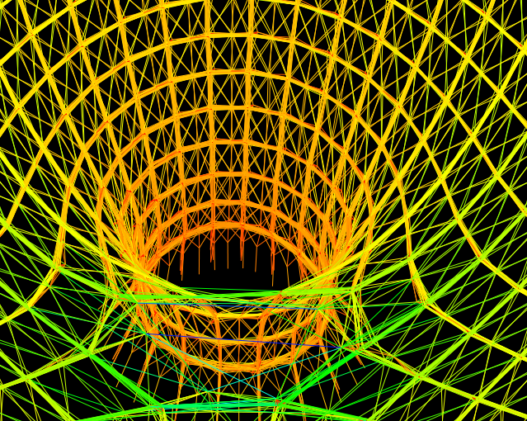

Slide 56
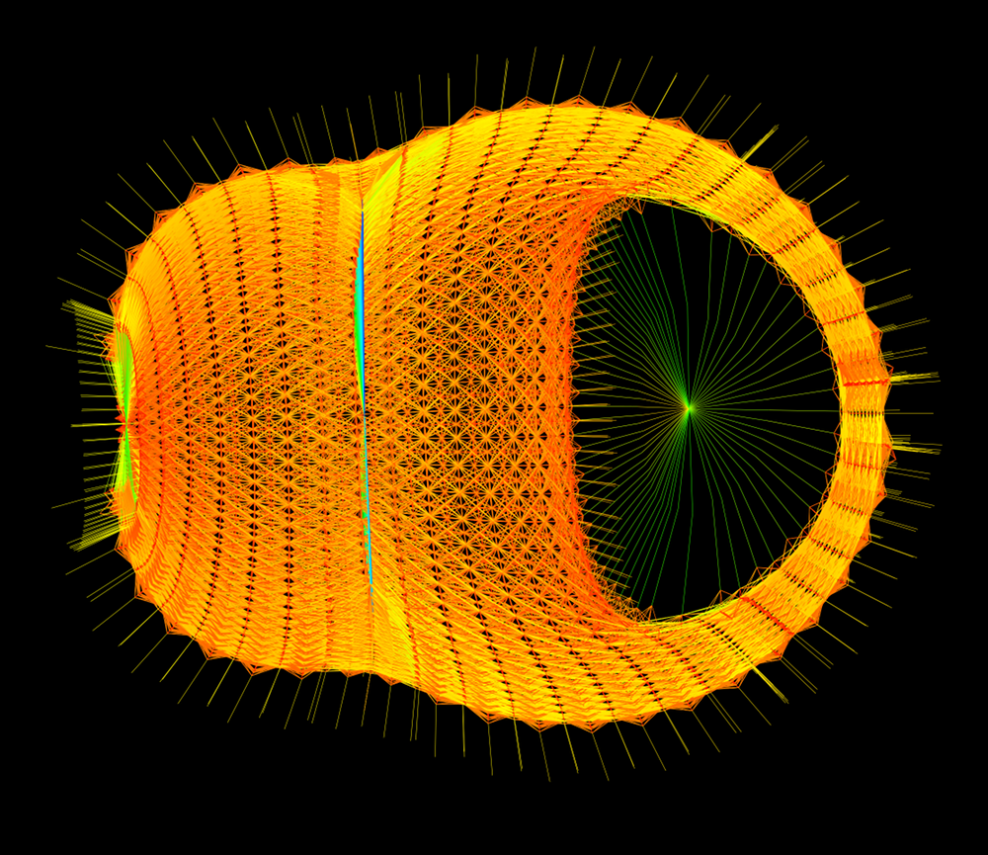
Galerkin finite-element discretization of 2-phase fluid flow
Notes:
This problem represents fluid flow around an fixed object placed inside a cylinder. The object is in the middle, and the boundary conditions (the cylinder wall) are the hair-like follicles all around the edge of the graph. This picture appears in the October 2010 issue of IEEE Spectrum.

Slide 57
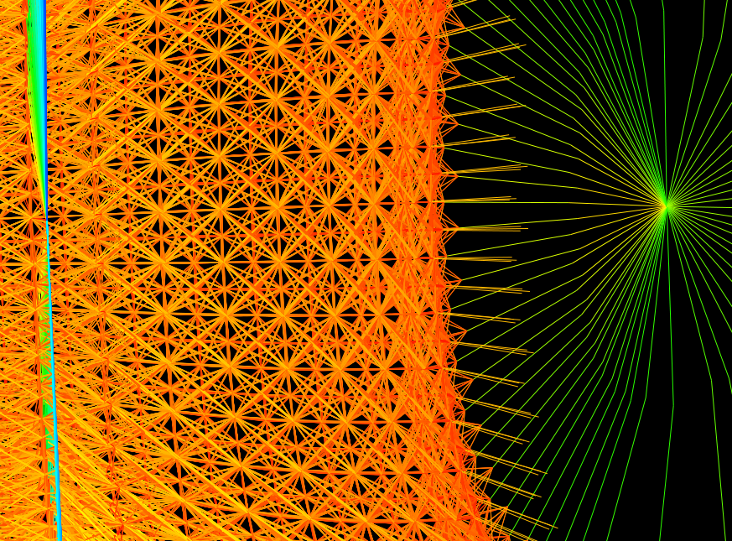

Slide 58
Math = truth + beauty
Can you see it?
Notes:
Math is both true, and amazingly beautiful. Can you see it?

Slide 59
Translating math into poetry ...
Notes:
You’ve seen math translated into art, now I’d like to translate art into mathematical poetry. Erdös was fond of quoting his mathematician friend and colleague, Alfred Renyi who said a mathematician is a device for turning coffee into theorems. Thus, from caf to math ...

Slide 60
From Caf to Math, Tim Davis (2007)
An ode to caf I think I'll cue.
Espresso caf, I think I'll brew.
Oh no, decaf? A task Tim blew!
Alas! the gaffe! You see I'm blue!
My output math is cut in two!
No caf I hath, no math, I'm through.
Fear not the wrath, no one I'll sue;
With half and half, try two I'll do.
A cup o' caf I shall imbue.
To turn the caf, equations' glue,
Into the math, said Erdős too.
From caf to math: the theorem's true.

Slide 61
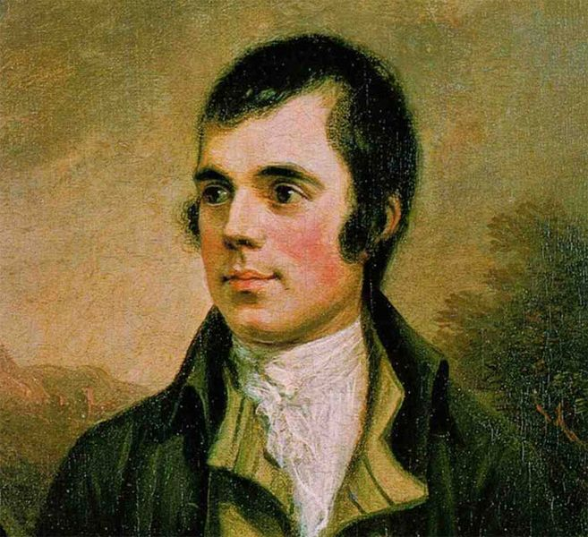
A Translation of Robert Burns
for the Gator Nation
To a Mouse (1785)
To a Gator (2008)
Notes:
Now I’d like to share with you a translation of a deep and passionate, yet inaccessible, poem. Robert Burn’s poem is the origin of the phrase “the best laid schemes of mice and men go oft astray”. Just like pure mathematics, the Scots dialect of Burns can be hard to understand. As I read his original poem, you can listen to the Scots dialect and follow along with English subtitles. The original will be on the top left of each slide, and the English paraphrase will be on the bottom right. To a Mouse, by Robert Burns...

Slide 62
Wee, sleekit, cowrin, tim’rous beastie,
O, what a panic’s in thy breastie!
Thou need na start awa sae hasty,
Wi’ bickering brattle!
I wad be laith to rin an’ chase thee,
Wi’ murd’ring pattle!
Little sleek cowering timorous beast,
Oh what a panic is in your breast!
You need not start away so hasty
With bickering noises!
I would be loath to run and chase you,
With murdering paddle!

Slide 63
I’m truly sorry man’s dominion
Has broken nature’s social union,
An’ justifies that ill opinion,
Which makes thee startle
At me, thy poor, earth-born companion,
An’ fellow mortal!
I’m truly sorry man’s dominion
Has broken nature’s social union,
An’ justifies that ill opinion,
Which makes you startle
At me, thy poor, earth-born companion,
An’ fellow mortal!

Slide 64
I doubt na, whiles, but thou may thieve;
What then? poor beastie, thou maun live!
A daimen-icker in a thrave
’S a sma’ request;
I’ll get a blessin wi’ the lave,
An’ never miss’t!
I do not doubt that you may steal;
What then? poor beastie, you must live!
A bit of grain in all the heaps
Is a small request;
I’ll get a blessing with the rest,
And never miss it!

Slide 65
Thy wee bit housie, too, in ruin!
Its silly wa’s the win’s are strewin!
An’ naething, now, to big a new ane,
O’ foggage green!
An’ bleak December’s winds ensuin,
Baith snell an’ keen!
Your tiny household, too, in ruin!
Its silly walls the winds are strewing!
And nothing, now, to build a new one
Of stubble green!
And bleak December’s winds ensuing,
Both sharp and keen!

Slide 66
Thou saw the fields laid bare an’ waste,
An’ weary winter comin fast,
An’ cozie here, beneath the blast,
Thou thought to dwell–
Till crash! the cruel coulter past
Out thro’ thy cell.
You saw the fields laid bare and waste,
And weary winter coming fast,
And cozy here, beneath the blast,
You thought to dwell–
Till crash! the cruel plowshare past
Threw out your cell.

Slide 67
That wee bit heap o’ leaves an’ stibble,
Has cost thee mony a weary nibble!
Now thou’s turn’d out, for a’ thy trouble,
But house or hald,
To thole the winter’s sleety dribble,
An’ cranreuch cauld!
That little heap of leaves and stubble,
Has cost you many a weary nibble!
Now you’re turned out, for all your trouble,
From house and hold,
To suffer Winter’s sleety drizzle,
And hoar-frost cold!

Slide 68
But Mousie, thou are no thy-lane,
In proving foresight may be vain;
The best-laid schemes o’ mice an’ men
Gang aft agley,
An’ lea’e us nought but grief an’ pain,
For promis’d joy!
But Mousie, you are not alone,
In proving foresight may be vain;
The best-laid schemes of mice and men
Go oft astray,
And leave us nothing but grief and pain,
For promised joy!

Slide 69
Still thou art blest, compared wi’ me.
The present only toucheth thee:
But och! I backward cast my e’e,
On prospects drear!
An forward, tho’ I canna see,
I guess an’ fear!
Still, you are blessed, compared with me.
The present only touches you:
Alas! I backward cast my eye,
On prospects drear!
And forward, though I cannot see,
I guess and fear!

Slide 70
To a Mouse,
on Turning Her Up
in Her Nest with a Plough
(Burns, 1785)
To a Gator,
on Cutting Him Up
in His Swamp, and How
(Davis, 2008)
Notes:
Hard to understand, wasn’t it? You probably would not have followed without the English subtitles. To better understand the deep thoughts and passions of Robert Burns, follow along with me as I read a translation that describes the effect of budget cuts on the Gator Nation. Burns’ poem will be in the top left as before, and I’ll read the Gator translation on the bottom right. So, From A Mouse, on Turning Her Up in Her Nest with a Plough, To a Gator, on Cutting Him Up in His Swamp, and How.

Slide 71
Wee, sleekit, cowrin, tim’rous beastie,
O, what a panic’s in thy breastie!
Thou need na start awa sae hasty,
Wi’ bickering brattle!
I wad be laith to rin an’ chase thee,
Wi’ murd’ring pattle!
Wee, sleekit, cowerin’, tim’rous Gator,
O, what a panic, soon or later,
When Tallahassee’s comin’ at yer,
To axe thy budget!
Oh what departments, Legislature,
You’ll tell ‘Go budge it!’ ?

Slide 72
I’m truly sorry man’s dominion
Has broken nature’s social union,
An’ justifies that ill opinion,
Which makes thee startle
At me, thy poor, earth-born companion,
An’ fellow mortal!
It’s truly sad the State’s dominion
Has broken nature’s social union,
An’ justifies the pols’ opinion,
Which makes them throttle
Me, or faculty companion,
An’ fellow mortal!

Slide 73
I doubt na, whiles, but thou may thieve;
What then? poor beastie, thou maun live!
A daimen-icker in a thrave
’S a sma’ request;
I’ll get a blessin wi’ the lave,
An’ never miss’t!
I doubt na, whiles, but thou may teach;
What then? poor Gator, thou beseech
A fifty million, this year each,
’S a small request;
From politician’s flowery speech;
They’ll never miss’t!

Slide 74
Thy wee bit housie, too, in ruin!
Its silly wa’s the win’s are strewin!
An’ naething, now, to big a new ane,
O’ foggage green!
An’ bleak December’s winds ensuin,
Baith snell an’ keen!
Thy wee bit Swampie, too, in ruin!
Its once strong majors: winds are strewin!
An’ nothing, now, to take a freshman,
O’ cash once green!
An’ Bernie Machen’s hands they’re forcin’
Cuts sharp an’ keen!

Slide 75
Thou saw the fields laid bare an’ waste,
An’ weary winter comin fast,
An’ cozie here, beneath the blast,
Thou thought to dwell–
Till crash! the cruel coulter past
Out thro’ thy cell.
Thou saw the academic fields,
An’ thought thy Futures Bright to yield,
An’ cozy here, with cuts that healed,
Thou hoped to say–
Till crash! thy Sutures Bleak revealed,
Cuts fell and fey.

Slide 76
That wee bit heap o’ leaves an’ stibble,
Has cost thee mony a weary nibble!
Now thou’s turn’d out, for a’ thy trouble,
But house or hald,
To thole the winter’s sleety dribble,
An’ cranreuch cauld!
That wee bit heap o’ profs an’ majors,
Has cost them money; legislators
Have turned thee out, and skinned a Gator,
With hearts turned cold!
Perhaps they hope to heal thee later,
If breath be hold!

Slide 77
But Mousie, thou are no thy-lane,
In proving foresight may be vain;
The best-laid schemes o’ mice an’ men
Gang aft agley,
An’ lea’e us nought but grief an’ pain,
For promis’d joy!
But Gator, thou hast known thy game,
In proving foresight may be vain;
The best-laid schemes o’ Governmen’
Go oft astray,
An’ leave us nought but grief an’ pain,
For promised pay!

Slide 78
Still thou art blest, compared wi’ me.
The present only toucheth thee:
But och! I backward cast my e’e,
On prospects drear!
An forward, tho’ I canna see,
I guess an’ fear!
Still thou art blessed, compared with me,
The President has cut me free!
And och! with backward cuts, his eye
Wells up in tears!
Yet forward, look and clearly see:
Election nears!

Slide 79
Notes:
Thank you. Can I entertain any questions?

Slide 80
Notes:
Thank you. Can I entertain any questions?

