Slide 1
Enabling Surgeons to Create Simulation-Based Teaching Modules
Young In Yeo∗, Saleh Dindar ∗, George Sarosi⁺, Jörg Peters ∗
∗ Dept CISE , ⁺ Dept Surgery
University of Florida

Slide 2
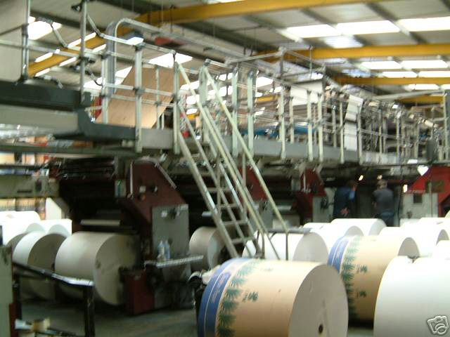
Surgeons do what?
At the U of Florida, laparoscopic surgeons are creating Simulation-Based Teaching Modules (TIPS)
UF has a $150K commercial lap trainer.
Why are surgeons spending their time? Should they spend time?
Missing modules, anatomic variants, tools, techniques
Why not ask the vendor to add?
(time, customization, cost)
TIPS modules are efficient to create

Slide 3
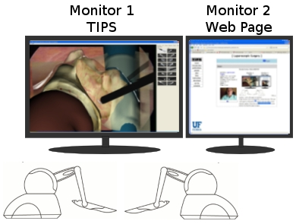
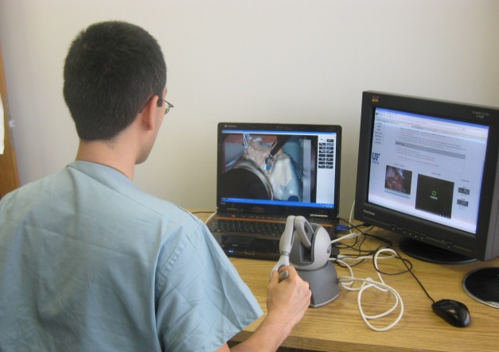
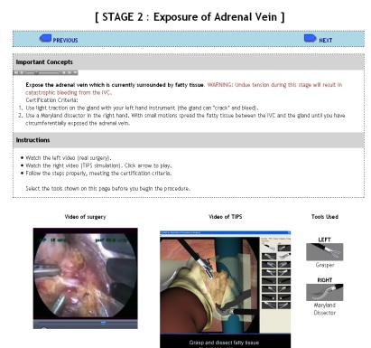
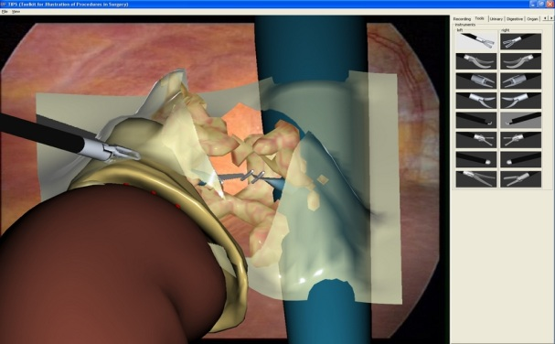
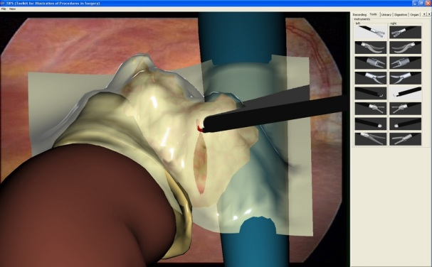
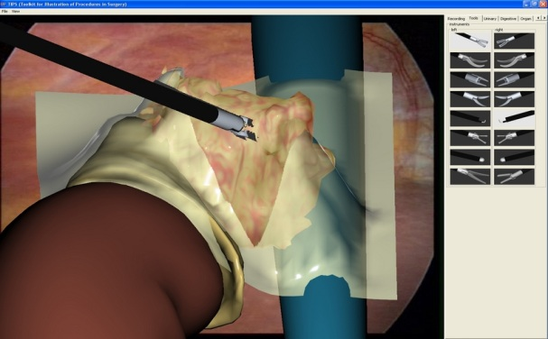
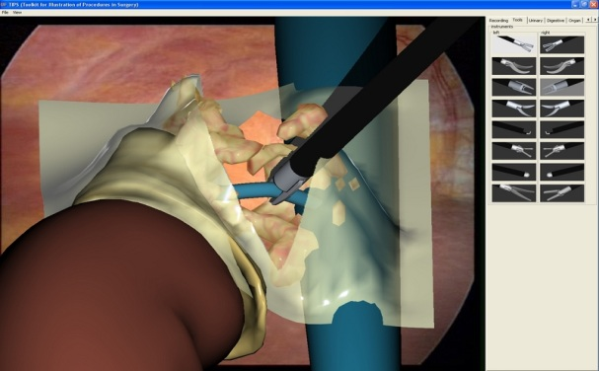
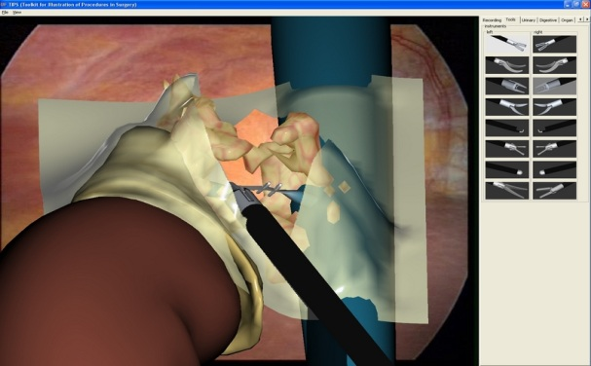
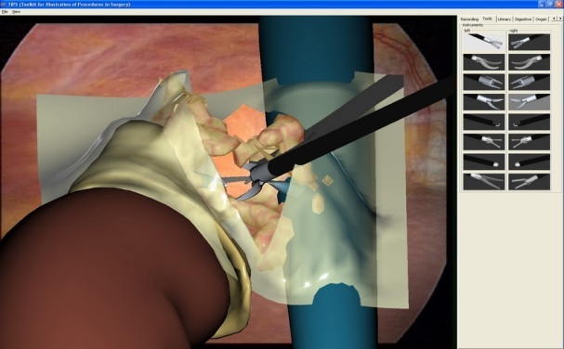
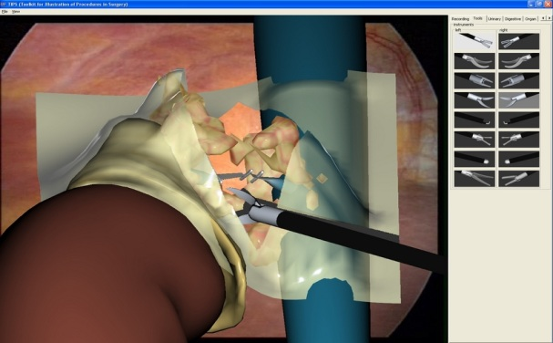
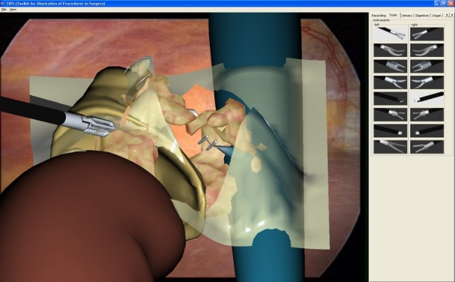
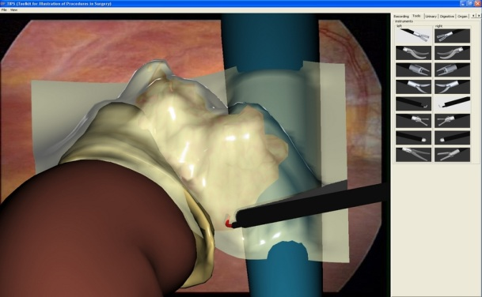
TIPS Module (Toolkit for Illustration of Procedures in Surgery)

Slide 4
CHALLENGE
Technology
Interface
computational simulation techniques in the biomedical, computer and mechanical engineering CUDA OPENCL
make the simulation tools accessible, modifiable and sharable by users with moderate computer and VR experience

Slide 5
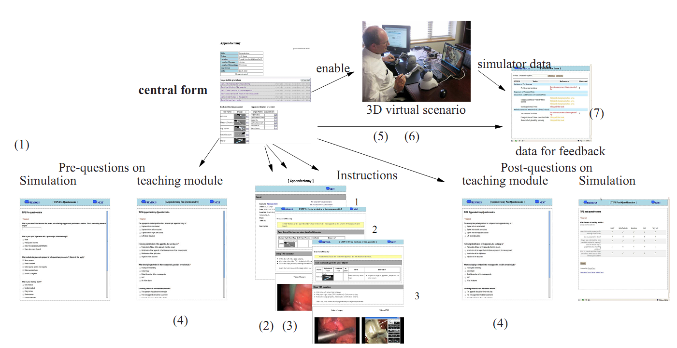
AUTOGENERATED TEMPLATES

Slide 6
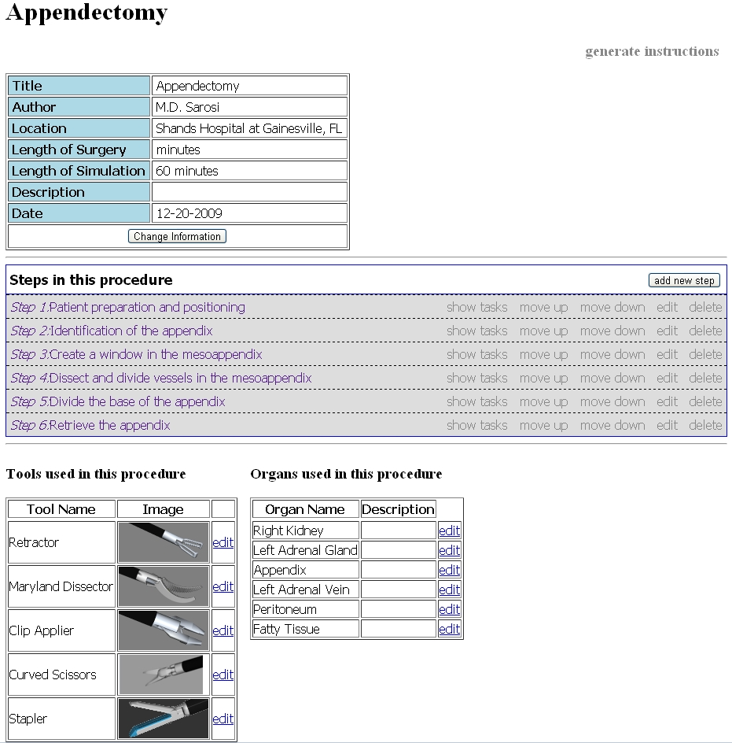
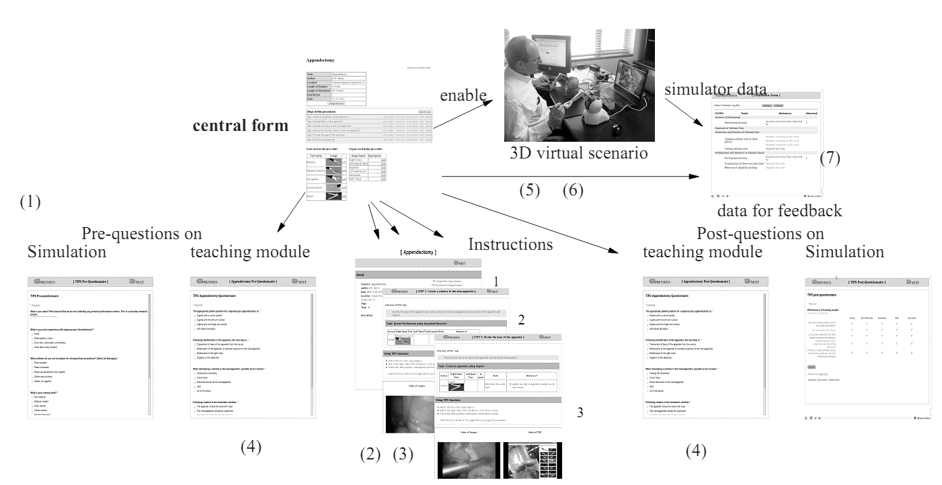
CENTRAL FORM
AUTOGENERATED TEMPLATES

Slide 7
CENTRAL FORM
SPECIFY STEPS ATTACH VIDEO
SPECIFY TASKS

Slide 8
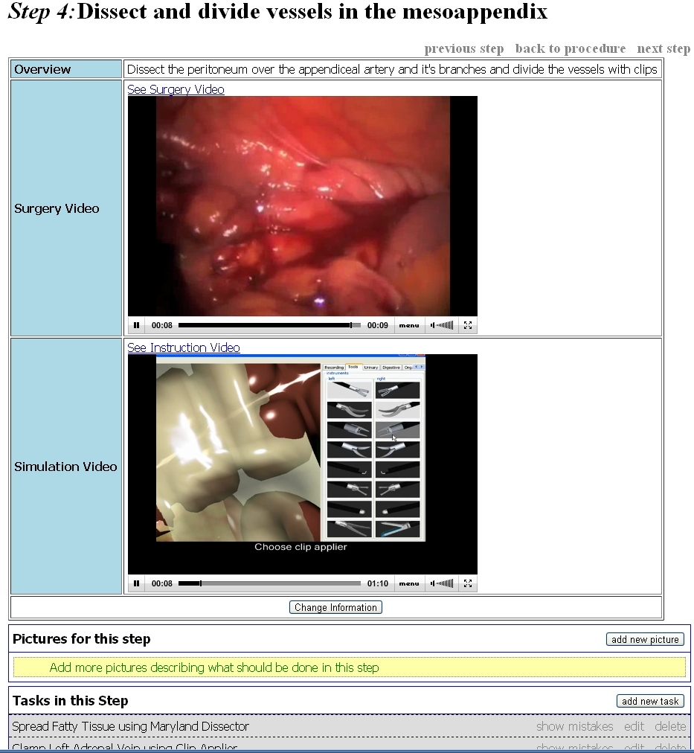
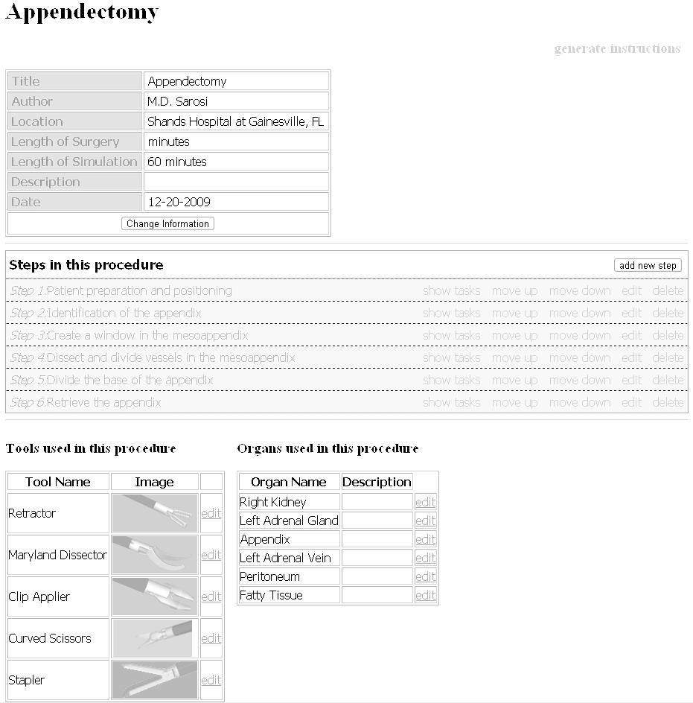
CENTRAL FORM
SPECIFY STEPS ATTACH VIDEO
SPECIFY TASKS

Slide 9
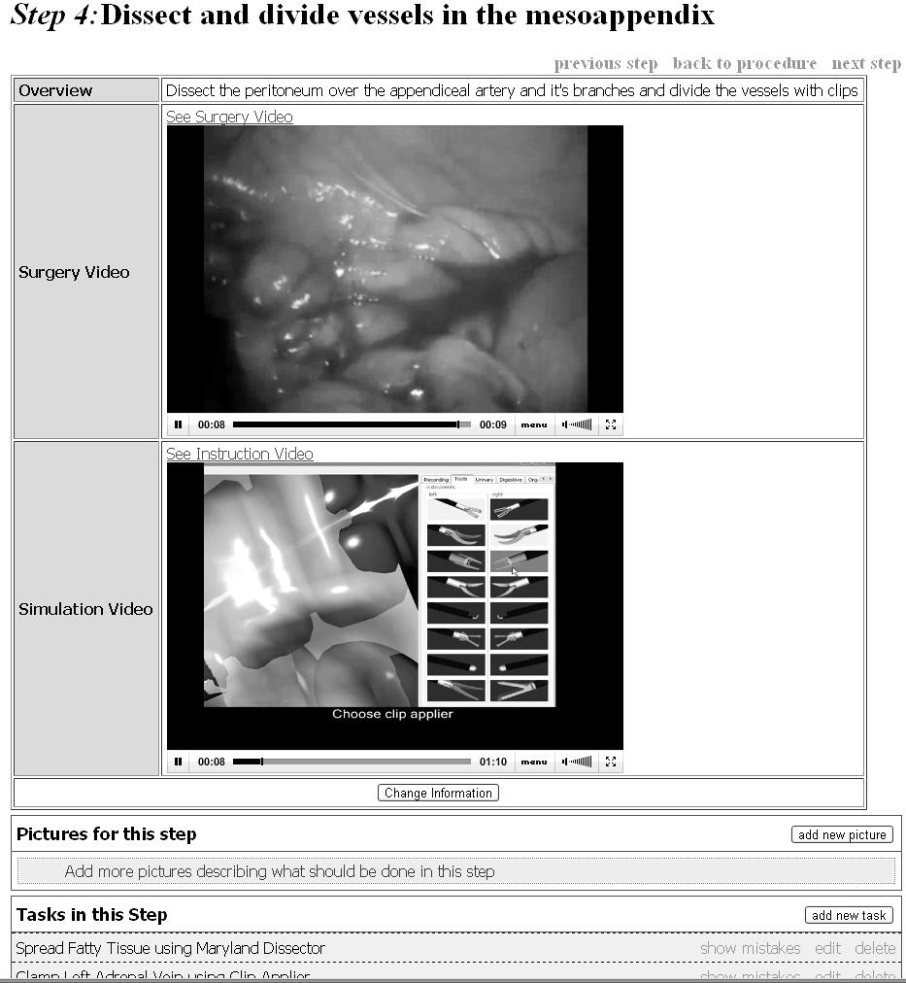
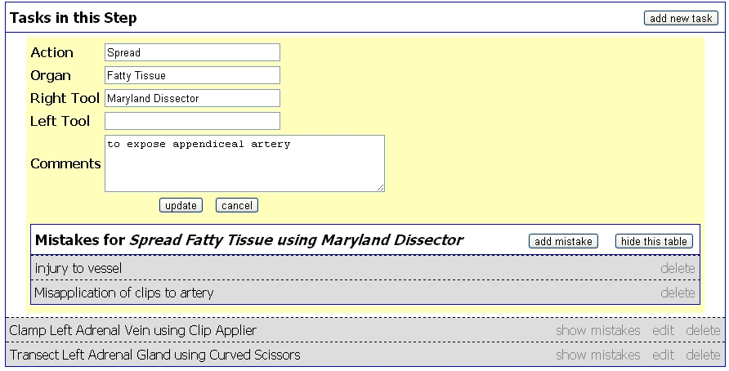
CENTRAL FORM
SPECIFY STEPS ATTACH VIDEO
SPECIFY TASKS

Slide 10
CENTRAL FORM
AUTOGENERATED TEMPLATES

Slide 11
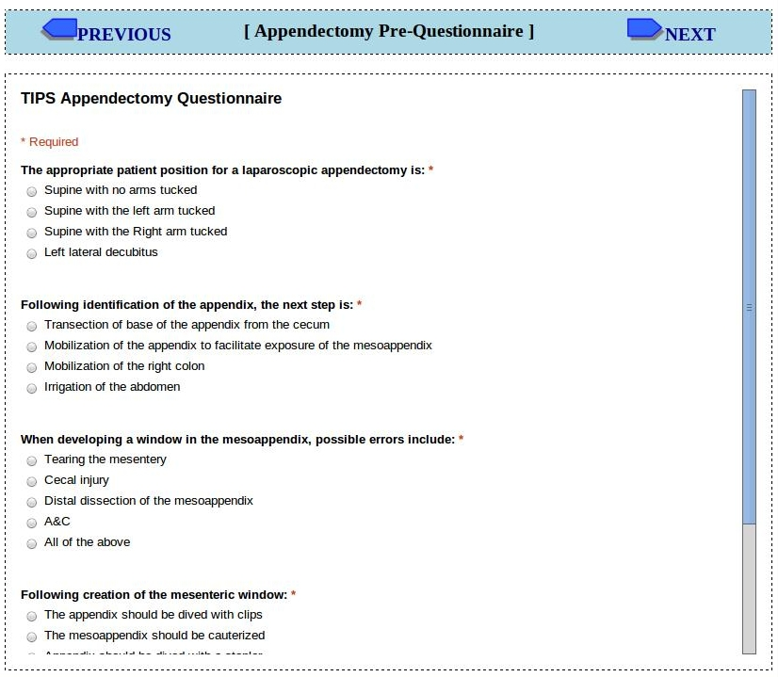
PRE-QUESTIONNARE
AUTOGENERATED TEMPLATES

Slide 12
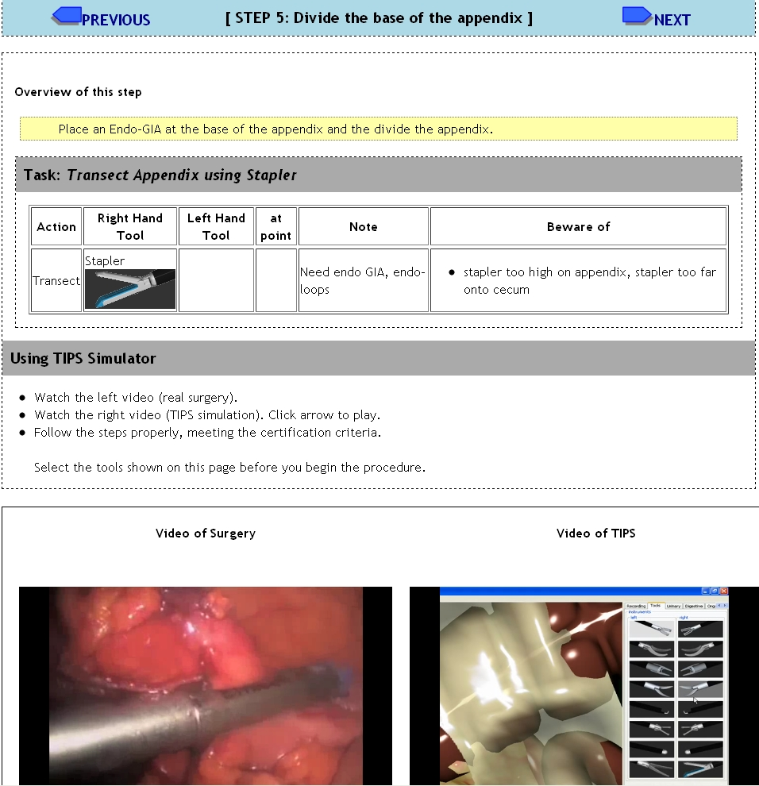
INSTRUCTION (SIMULATION)
AUTOGENERATED TEMPLATES

Slide 13
POST-QUESTIONNARE
AUTOGENERATED TEMPLATES

Slide 14
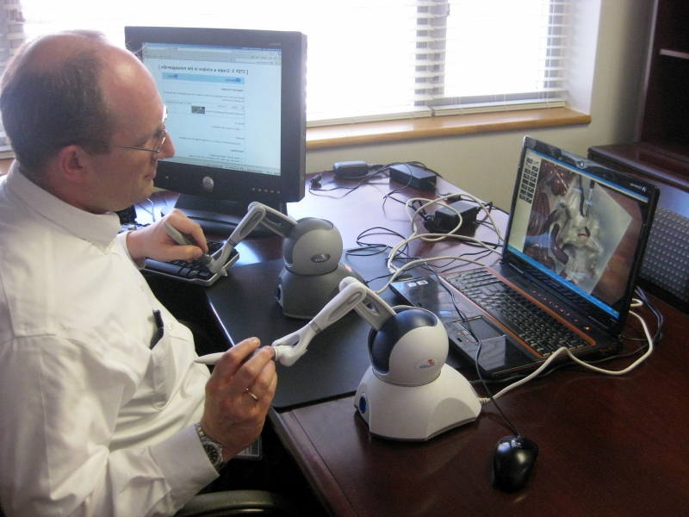
MASTER-PERFORMANCE(S)
AUTOGENERATED TEMPLATES

Slide 15
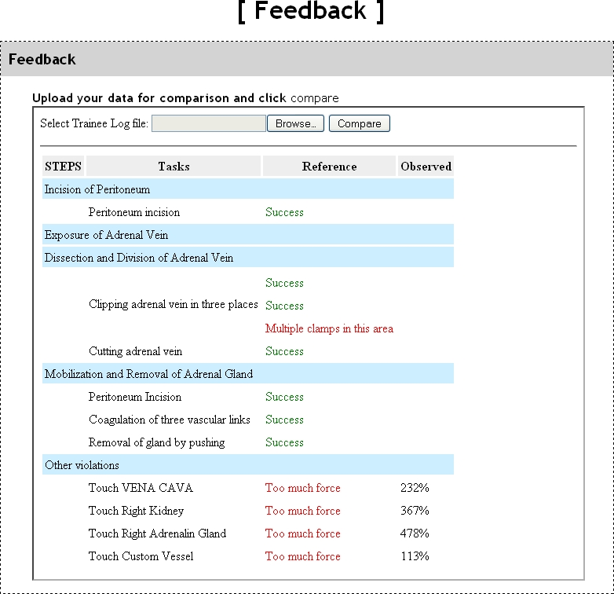
FEEDBACK
AUTOGENERATED TEMPLATES

Slide 16
AUTHORING EFFORT
Technician
Surgeon-Author
Estimated Time (hours)
0.5
Deconstruct procedure into steps
0.5
Collect operative videos
1.0
Fill out central form
Check list of tools, organs, and operations against existing DB
No
Request to add items into DB and TIPS
0.5
Create 3D mesh for the requested items
0.5
Yes
Add operations into TIPS
1.0
0.5
Assemble/modify scene
0.5
Set ranges (run TIPS module)
APPENDECTOMY MODULE

Slide 17
AUTHORING EFFORT
Technician
Surgeon-Author
Estimated Time (hours)
0.5
Deconstruct procedure into steps
Collect operative videos
Fill out central form
Check list of tools, organs, and operations against existing DB
Request to add items into DB and TIPS
Create 3D mesh for the requested items
Add operations into TIPS
Assemble/modify scene
Set ranges (run TIPS module)

Slide 18
AUTHORING EFFORT
Technician
Surgeon-Author
Estimated Time (hours)
0.5
Deconstruct procedure into steps
0.5
Collect operative videos
Fill out central form
Check list of tools, organs, and operations against existing DB
Request to add items into DB and TIPS
Create 3D mesh for the requested items
Add operations into TIPS
Assemble/modify scene
Set ranges (run TIPS module)

Slide 19
AUTHORING EFFORT
Technician
Surgeon-Author
Estimated Time (hours)
0.5
Deconstruct procedure into steps
0.5
Collect operative videos
1.0
Fill out central form
Check list of tools, organs, and operations against existing DB
Request to add items into DB and TIPS
Create 3D mesh for the requested items
Add operations into TIPS
Assemble/modify scene
Set ranges (run TIPS module)

Slide 20
AUTHORING EFFORT
Technician
Surgeon-Author
Estimated Time (hours)
0.5
Deconstruct procedure into steps
0.5
Collect operative videos
1.0
Fill out central form
Check list of tools, organs, and operations against existing DB
Request to add items into DB and TIPS
Create 3D mesh for the requested items
Add operations into TIPS
Assemble/modify scene
Set ranges (run TIPS module)

Slide 21
AUTHORING EFFORT
Technician
Surgeon-Author
Estimated Time (hours)
0.5
Deconstruct procedure into steps
0.5
Collect operative videos
1.0
Fill out central form
Check list of tools, organs, and operations against existing DB
No
Request to add items into DB and TIPS
0.5
Create 3D mesh for the requested items
Yes
Add operations into TIPS
Assemble/modify scene
Set ranges (run TIPS module)

Slide 22
AUTHORING EFFORT
Technician
Surgeon-Author
Estimated Time (hours)
0.5
Deconstruct procedure into steps
0.5
Collect operative videos
1.0
Fill out central form
Check list of tools, organs, and operations against existing DB
No
Request to add items into DB and TIPS
0.5
Create 3D mesh for the requested items
0.5
Yes
Add operations into TIPS
Assemble/modify scene
Set ranges (run TIPS module)

Slide 23
AUTHORING EFFORT
Technician
Surgeon-Author
Estimated Time (hours)
0.5
Deconstruct procedure into steps
0.5
Collect operative videos
1.0
Fill out central form
Check list of tools, organs, and operations against existing DB
No
Request to add items into DB and TIPS
0.5
Create 3D mesh for the requested items
0.5
Yes
Add operations into TIPS
1.0
Assemble/modify scene
Set ranges (run TIPS module)

Slide 24
AUTHORING EFFORT
Technician
Surgeon-Author
Estimated Time (hours)
0.5
Deconstruct procedure into steps
0.5
Collect operative videos
1.0
Fill out central form
Check list of tools, organs, and operations against existing DB
No
Request to add items into DB and TIPS
0.5
Create 3D mesh for the requested items
0.5
Yes
Add operations into TIPS
1.0
0.5
Assemble/modify scene
Set ranges (run TIPS module)

Slide 25
AUTHORING EFFORT
Technician
Surgeon-Author
Estimated Time (hours)
0.5
Deconstruct procedure into steps
0.5
Collect operative videos
1.0
Fill out central form
Check list of tools, organs, and operations against existing DB
No
Request to add items into DB and TIPS
0.5
Create 3D mesh for the requested items
0.5
Yes
Add operations into TIPS
1.0
0.5
Assemble/modify scene
0.5
Set ranges (run TIPS module)
APPENDECTOMY MODULE

Slide 26
CHALLENGE
Technology
computational simulation techniques in the biomedical, computer and mechanical engineering CUDA OPENCL
Interface
make the simulation tools accessible, modifiable and sharable by users with moderate computer and VR experience

Slide 27
CONTRIBUTION
Workflow (auto-generated templates) that
makes the authoring process efficient
promotes consistency between instruction and measurement
Thank you

Slide 28
GOAL (TIPS)
Software framework (Toolkit for Illustration of Procedures in Surgery) within which surgeons themselves define and adjust (=author) interactive simulation teaching modules
document novel surgical techniques and variants by example
Environment/workflow that allows surgeon-educators to create teaching modules efficiently and consistently

Slide 29
TRENDS
Increasing deployment of commercial simulators in surgical education
especially of minimally invasive surgical techniques
The cost structure favors the most common and the most basic surgical procedures
Broaden the use of simulation for teaching
New procedures, low-volume procedures
NEEDED

