Slide 1
3DP / Additive Manufacturing Overview

Slide 2
Major Technologies
Fused Deposition Modeling (FDM) (term trademarked by Stratasys Inc.) aka Fused Filament Fabrication (FFF) technique, a thin filament of hot thermoplastic material is extruded from a nozzle onto a platform (video)
Stereolithography (SLA) uses an ultraviolet curable liquid (resin) and an ultraviolet laser to solidify layers of the liquid into the desired shape. (video)
Selective Laser Sintering (SLS) makes use of granular material that can be either thermoplastics, metal or ceramic. (video)
PolyJet 3D printing (newest) is similar to inkjet document printing. But instead of jetting drops of ink onto paper, PolyJet 3D printers jet layers of liquid photopolymer onto a build tray and cure them with UV light. Fully cured models can be handled and used immediately, without additional post-curing. (video)

Slide 3
Printer Comparison
Technology | Name | Resolution (microns) | Build Volume (inches) | Price | Speed (mm/sec)
Mini-SLA: | 3DSystems ProJet 1200 | 56 | 1.69x1.06x7.086 | $5K
 | Pegasus Touch by FSL3D | 25-100 | 7x7x9 | $2750 | 3000
 | DWS XFAB (multi-material) | 10-100 | 7.08x7.08 | $5K
 | OWL Nano | 0.1 | 6x6x8 | $4.9K
 | Formlabs Form 1 | 25 | 4.9x4.9.6.5 | $3,299
 | mUVe 1 Ultimate ($45 resin) | 100 | 5.7x5.7x7.28 | $1,699 | 300-600
FDM: | Leapfrog Creatr | 50 | 9x10.6x7.9 | $2.4K
 | 3DSystems Cubify CubeX | 100 | 10.75x10.75x9.8 | $2.5K
 | MakerBot Replicator 2 | 100 | 11.2x6x6.1 | $2.5K
 | Ultimaker 2 | 20-200 | 9x8.85x8 | $2.6K | 300
 | XYZPrintin da Vinci 1.0 | 100-400 | 7.8x7.8x7.8 | $499 | 150
 | 3DSystems Alibre 3D Touch | 125 | 10.75x10.75x8.25 | $4K
 | Stratasys Mojo 3D | 170? | 5x5x5 | $10K
 | Stratasys uPrintSE Plus | 254? | 8x8x6 | $20K
PolyJet: | Stratasys Objet24 | 28 | 9.21x7.55x5.85 | $20K

Slide 4
Getting Started With 3D Printing
Model Printability Considerations (link)
CAN: 3D solids, watertight meshes, and appropriately scaled versions of them
CANNOT: surfaces, 2D geometry, text, colors*, materials*
NOTE: model printability varies with each 3DP technology
Resources:
3D Printing with Blender (video1) (video2)
Repositories: Thingiverse, Shapeways, GrabCAD, many more (link)
Facilities:
SurfLab @ CISE
A² FabLab @ UF
Marston Science Library @ UF
Shapeways (outsourced printing)
News & updates: 3dprintingindustry.com

Slide 5
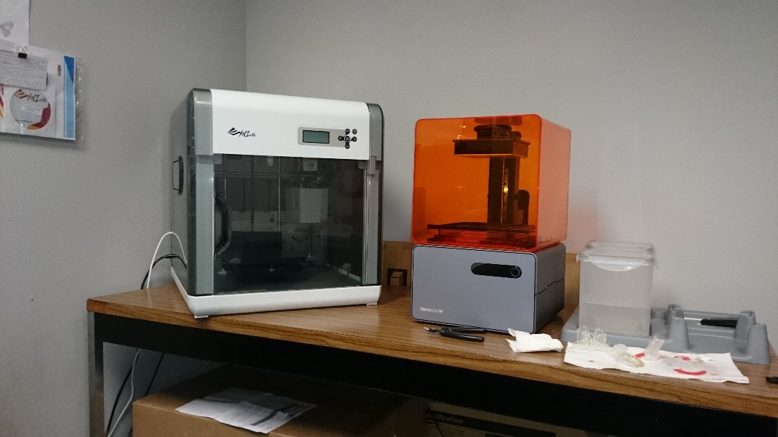
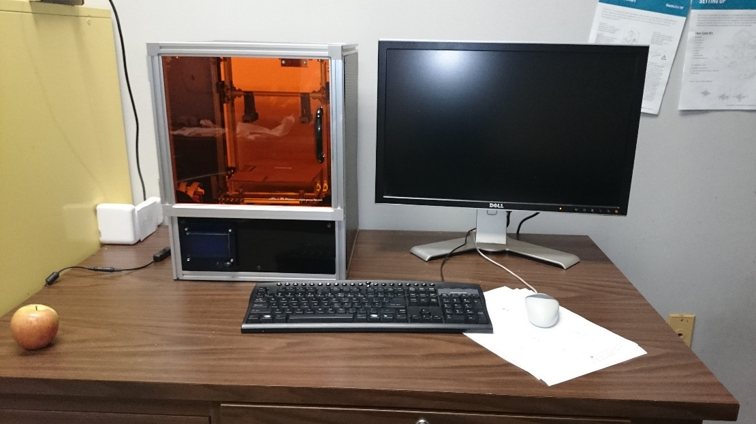
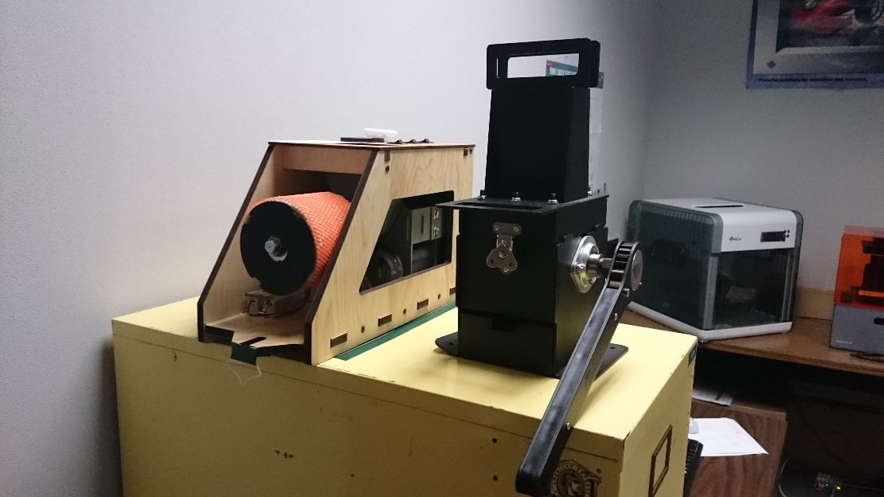
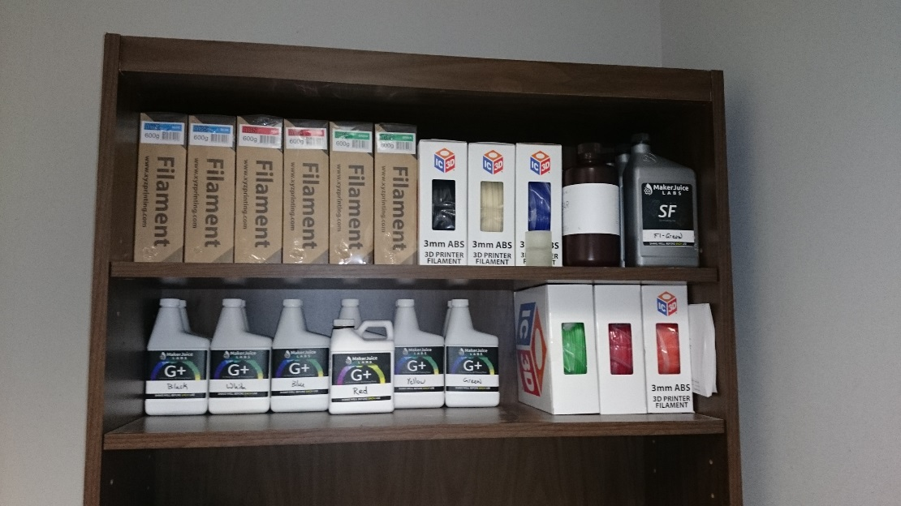
SurfLab 3DP Lab

Slide 6
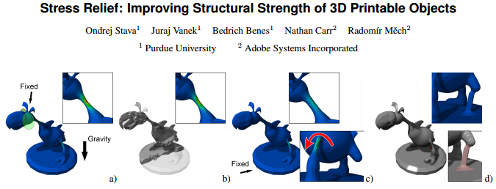
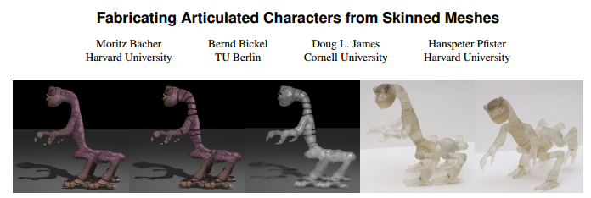
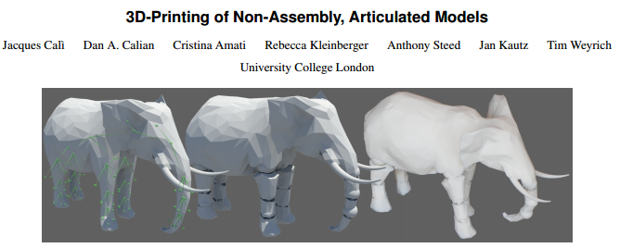
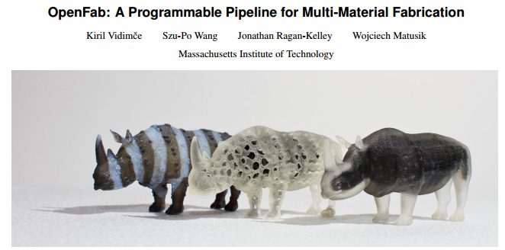
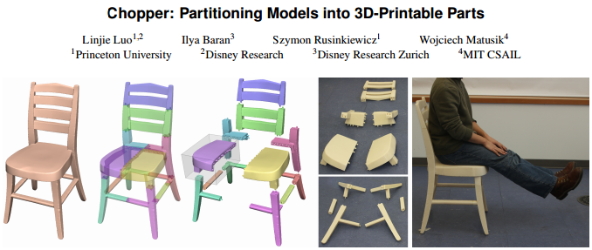
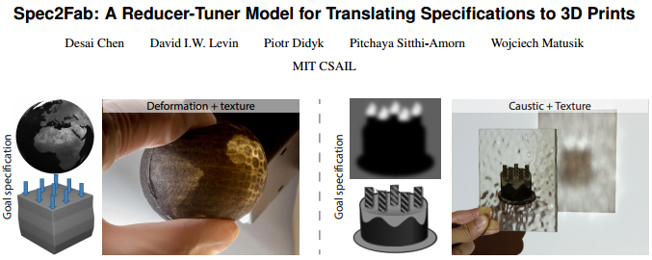
Research in 3DP
… and many more ...

Slide 7
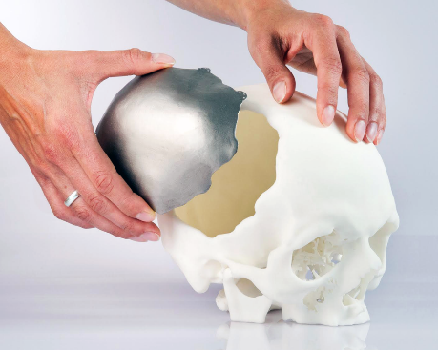
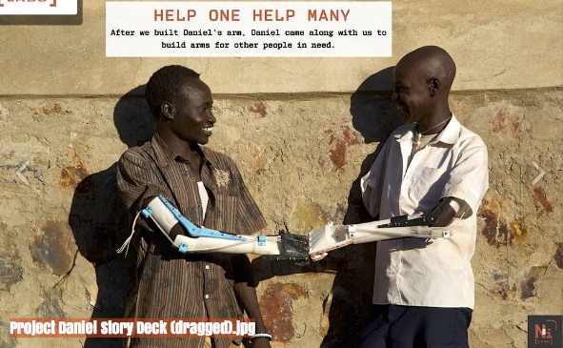
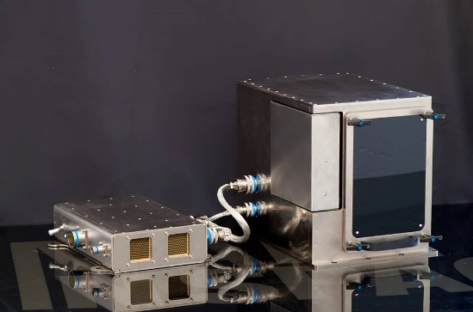
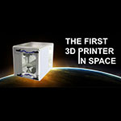
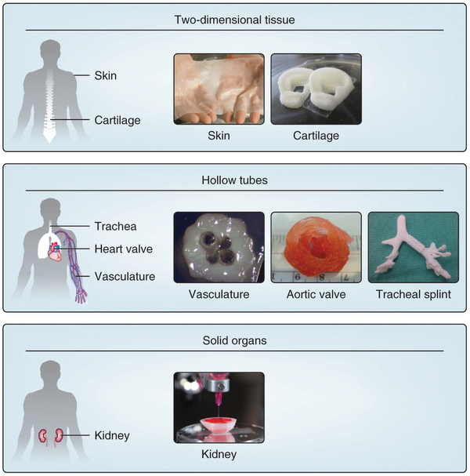
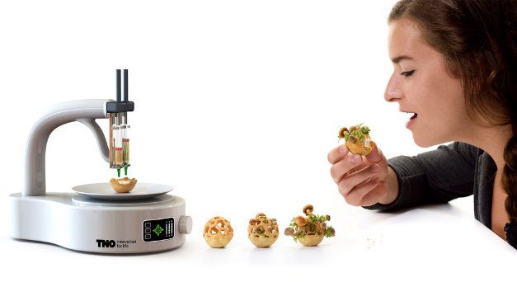
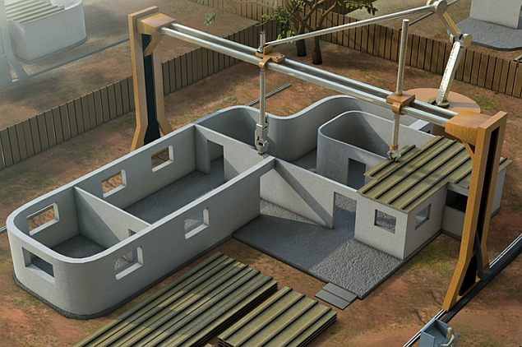
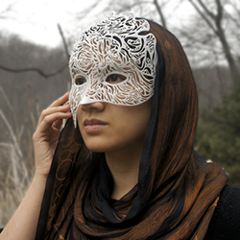
A Wide Range of Applications

Slide 8
CIS6930/CIS4930 3DP Challenges
Replacement components for the Phantom Omni devices
Requires careful modeling and prototyping
Lid for the resin basin of our mUVe RepRap printer
Requires basic modeling. Multiple prints and assembly may be needed due to size
Replacement/improvement of parts for the mUVe printer
Requires improving the existing model files and ensuring proper fitment
Open ended:
Articulated models
Complex models requiring assembly
Exploratory:
Take a model and choose a printer. Then print using different settings trade-offing smoothness for print time. What is the best compromise? Record metrics of print jobs.
Printer limitations study: Take a variety of models and test their printability on our printers

