Slide 1
A Distributed and Privacy Preserving Algorithm for Identifying Information Hubs in Social Networks M.U. Ilyas, Z Shafiq, Alex Liu, H Radha Michigan State University INFOCOM’11 Mini Conference

Slide 2
Background and Motivation
Information hubs in social network
Definition: users that have a large number of interactions with others.
Interaction=transmission of information from one user to another such as posting a comment.
Hubs are important for the spread of propaganda, ideologies, or gossips.
Applications
Free sample distribution
Samsung used Twitter feeds to identify dissatisfied iPhone 4 owners who are the most active in terms of communication with their friends and offer them free GalaxyS phones.
Word of mouth advertisement

Slide 3
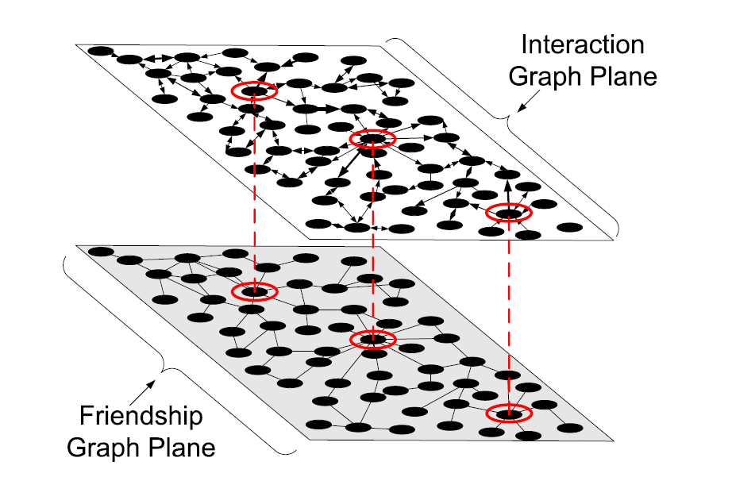
Problem Statement
Top-k information hub identification from friendship graph
Ground truth: interaction graph degree
Identifying top-k hubs from interaction graph is difficult.
Data collection is difficult.
Interaction graph requires to collect data over a long time.
More user information to keep private.
Distributed
Friendship graph may not be accessible
Privacy-preserving
Users do not reveal friends’ lists

Slide 4
Limitations of Prior Art
Use interaction graph information
Influence maximization [Leskovec07,Goyal08]
Centralized
Need access to complete graph
Use friendship graph information [Marsden02,Shi08]
Degree centrality = # friends of a node
Measures the immediate rate of spread of a replicable commodity by a node
Closeness centrality = 1/(sum of lengths of shortest paths from a node to rest of the nodes)
Optimizes detection time of information flows
Betweeness centrality = fraction of all pair shortest paths passing through a node
Optimizes detection probability of information flows
Eigenvector centrality
Better than the other three metrics.

Slide 5
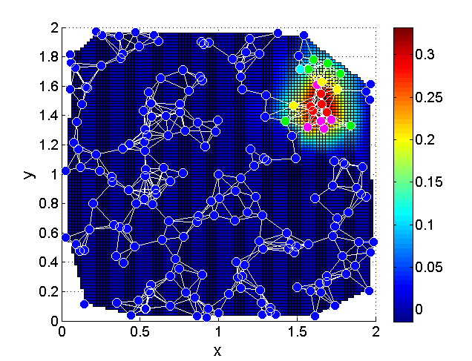
Limitations of Eigenvector Centrality
Eigenvector Centrality
Principal eigenvector of adjacency matrix
EVC works well enough in graphs consisting of a single cluster/community of nodes
Principal eigenvector is “pulled” in the direction of the largest community

Slide 6
Proposed Approach
Top-k information hub identification
Principal Component Centrality (PCC)
Distributed and Privacy-preserving
Power method [Lehoucq96]
Kempe-McSherry (KM) algorithm [Kempe08]

Slide 7
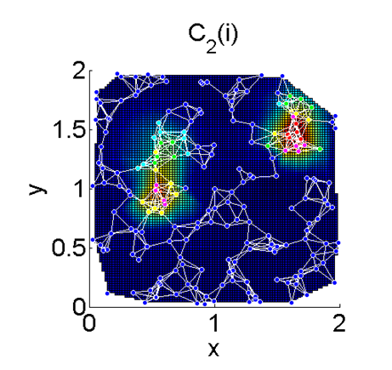
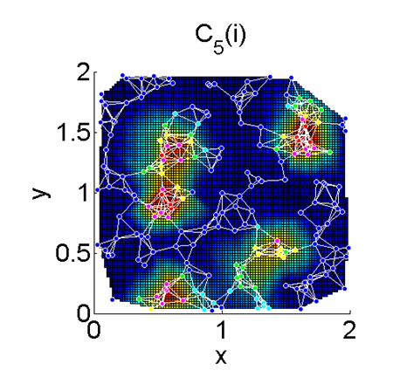
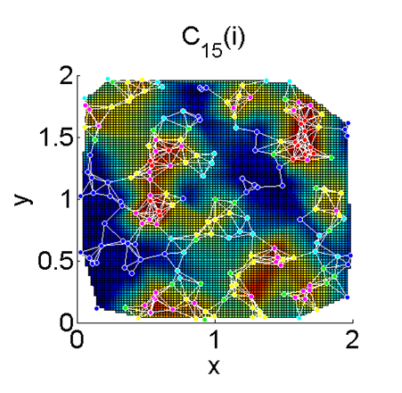
Principal Component Centrality
Principal Component Centrality (PCC)
Use P<<N, not 1, most significant eigenvectors.

Slide 8
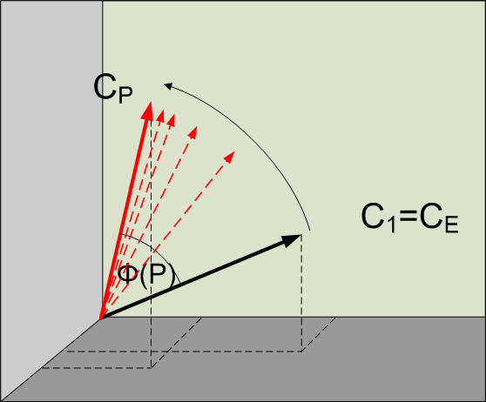
Determine Approriate # of Eigenvectors in PCC
Method: phase angle between EVC vector and PCC vector
For our data set, P=10 is good enough.

Slide 9
Distributed and Privacy-Preserving
Iterative algorithms
Power algorithm
Pros: implement is simple
Cons:
Communication overheads grow exponentially with each additional eigenvector computation
Suffers from rounding errors
Kempe & McSherry’s (KM) algorithm
Pros:
Communication overheads grow linearly with each additional eigenvector computation
Accurate estimation, good convergence
Cons: Implementation is more complex
Users don’t reveal friends’ lists to others

Slide 10
Data Set
Facebook data collected by Wilson et al. at UCSB
Consists of:
Friendship graph [Input data]
Messages exchanged [Ground truth]
# Users 3,097,165
# Friendship Links 23,667,394
Average Clustering Coefficient 0.0979
# Cliques 28,889,110

Slide 11
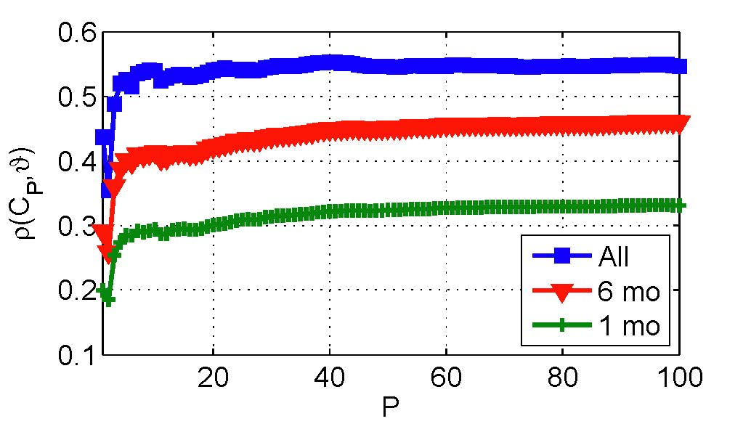
Experimental Results (1/2)
Correlation coefficient between PCC vector and degree centrality vector from interaction graph
Logs of 3 time durations
1 month, 6 months, ~ 1 year
Observation 1: PCC outperforms EVC
Observation 2: Better accuracy for longer duration data

Slide 12
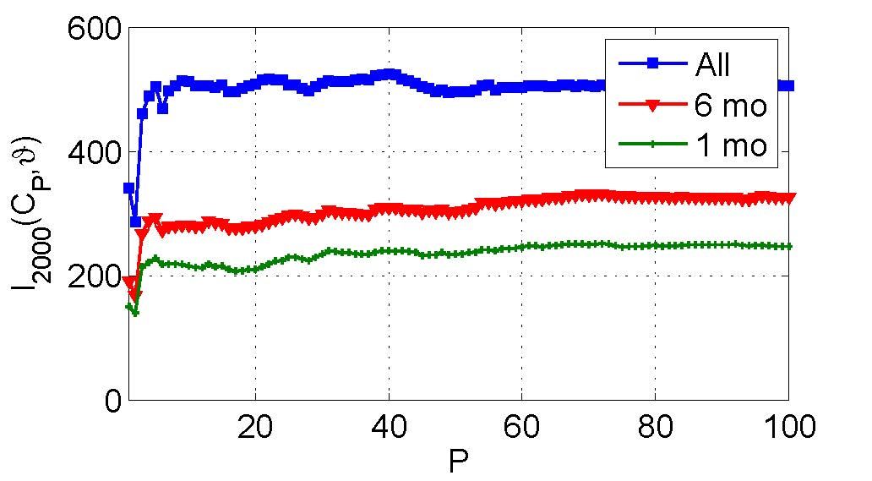
Experimental Results (2/2)
Evaluate |top-k users identified by PCC vector ∩
top-k users identified by degree centrality vector from interaction graph | / k
K=2000 in our experiments
Observation 1: PCC outperforms EVC
Observation 2: Better results for longer duration data

Slide 13

Questions?

