Slide 1
The duality of duality and non-duality
Anand Rangarajan
Department of Computer and Information Science and Engineering
University of Florida
Notes:
The problem of consciousness as the underlying reason for conferences such as this one
Need to re-examine the fundamental tenets of leading edge theories of everything
(Primarily) western science has produced two frameworks: quantum field theory and general relativity
(Primarily) eastern science has produced: no-self (Buddhism) and awareness (Hinduism
QFT: possibilities
General relativity: no fixed background spacetime
Buddhism: no self
Hinduism: awareness
Four pillars of our approach
Problem of qualia forces us to make experience fundamental
Relationship between science and experience is the key problem
Quantum measurement problem offers a clue
Also offers one of the most tailor-made cases for the causal role of consciousness via an observer
We cannot have observers – no self remember
But we can have experience resulting in the setting of wave functions
Experience and possibilities
No fixed background spacetime: wavefunction does not evolve
Instead event occurs at a moment of awareness: What time and where?
Static Schrodinger equation with constraints givn by MoAs.
Both combined into operator constraints on wavefunction
Result: experience is causal and picks put subset of possibilities

Slide 2
A unique moment?
All moments equal but some moments more equal than others?
Longstanding problem of consciousness
Problems in materialist approaches result in rise of
new age (pro mysticism) and
new paradigm (a.k.a. the new physics)
Transition from western to international era aided by computers and communications
Global meeting point: Science and non-duality
Notes:
Been at the same meeting point for forty years now.

Slide 3
Qualia
Sensations, perceptions, emotions: Qualia
Bare sensation not explained by science (Gregory)
Sensations correlated with skin conductance, EEG, fMRI data but not identical with them
Materialists have hard time even understanding the problem
Confuse first person phenomenology with third person empirical data

Slide 4
The problem of consciousness
Consciousness is not logically supervenient on the physical
Alternatives:
Panpsychism (resurgence via Strawson, Rosenberg)
Dual-aspect theory and neutral monism (Spinoza)
Idealism (Berkeley)
Emergence (Silberstein)
Eliminitavism (Dennett)
Naturalistic dualism (Chalmers)
Points to a fundamental problem
Forces us to accept that consciousness is real
Re-examine science and mysticism

Slide 5
The fundamentals of science
Quantum theory: Overarching conclusion – no particle trajectories. Instead sum over possibilities
General relativity: Overarching conclusion – no fixed background spacetime. Instead space and time depend on matter distributions

Slide 6
The fundamentals of eastern non-dual traditions
Whereof one cannot speak, thereof…….
Non-dual mysticism: There is only Ati (Trungpa)
Surprising positivist trend in the past fifty years
Buddhist traditions: No-self (Hayward, Varela et al.)
Hindu traditions: Awareness beyond thought. “I”=Awareness (Deikman)

Slide 7
The Pillars

Slide 8
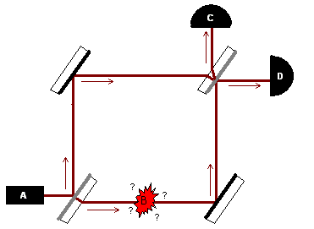
Do possibilities exist?
Elitzur-Vaidman bomb testing experiment
Source: Wikipedia
If bomb is a dud, only D detects photon
If only C detects the photon, bomb is not a dud
Destructive interference at C only because both possibilities exist

Slide 9
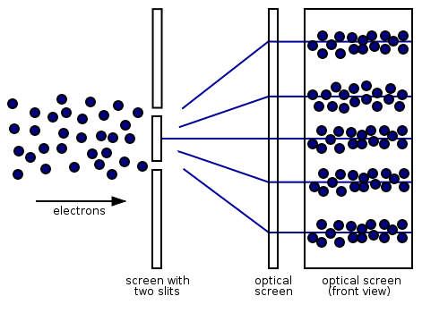
Experience and possibility
Experiences pregnant with possibilities
Ineffability of qualia
Two slit experiment: Probabilities
depend on what we choose to measure
Even though the dividing line
between the observer, whose
consciousness is being affected,
and the observed physical object
can be shifted,… it cannot be
eliminated - Wigner
Source: http://commons.wikimedia.org
Notes:
Always confused when people say that experiences show clear cut categories. My own experience is anything but clearcut. In fact it’s a big jumble, a muddle. Proof: My wife asks me how I feel about something.

Slide 10
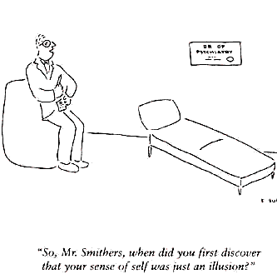
Experience and no-self
Experience as compatible with no-self
Dominant Buddhist view
Irrespective of Theravada,
Mahayana, Vajrayana, Zen
Others such as
Bernadette Roberts
Western tradition: Hume
Source: http://www.satsangnathan.com

Slide 11
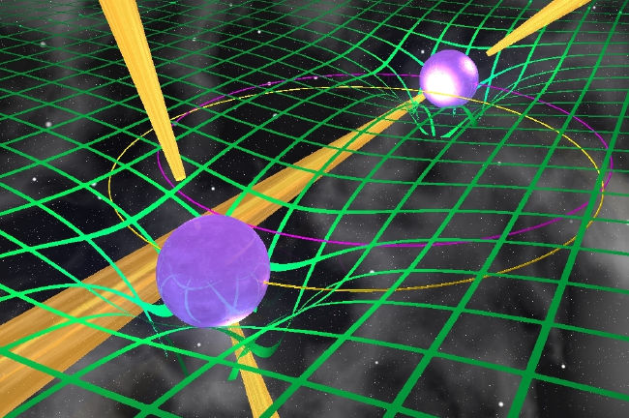
Experience and time
Indisputable that the experience did occur
But when did it occur?
Events occurring in spacetime versus
Events occurring and affecting spacetime
General relativity tells us that matter
distributions affect spacetime
Why can’t experience – also an event –
affect spacetime?
Credit: Michael Kramer, Jodrell Bank Observatory

Slide 12
Experience and awareness
Awareness of experiential content
Doubling of experience?
Awareness without a self
Awareness as movement in field of qualia
Battle over ontological nature of awareness (Advaita versus Visistadvaita Vedanta)
Notes:
Acknowledgment: Manisha K. Ranade for the picture
Audience slaps itself in the face

Slide 13
Ground assumptions
Possibilities and not trajectories – inherited from quantum theory
No fixed background spacetime – inherited from general relativity
No self – inherited from Buddhism
Awareness beyond thought – inherited from Hinduism

Slide 14
Four pillars of our approach
Quantum theory:
Possibilities and
not trajectories
Possibilities
Awareness: Underlies
content of each
experience
Awareness
No spacetime
General relativity:
No fixed background
spacetime
No self doctrine:
Experience without
an underlying self
No self
Notes:
Pillar image source: http://www.made-in-china.com

Slide 15
Base properties
Denying possibilities: Returning to classical trajectories looks difficult if not impossible
Denying awareness: Experiential content without awareness denies phenomenology
Spacetime as basic: Beginning with spacetime and consciousness as basic seems to entail panpsychism (Strawson)
Self as basic: Most approaches that assume a self end up close to a Cartesian dualism

Slide 16
Moving forward

Slide 17
Putting it together
Experience unpacked as “moments of awareness” (MoA)
MoA: final grounding of experiential event by selecting from a set of possibilities
MoA: final grounding of physical event by selecting from a set of possibilities
No self, no background spacetime

Slide 18
Measurement problem in QM
Everett’s many worlds theory unpacked: Possibilities real but no worlds and no observers.
Interactionist approach where moments of awareness (MoA) coupled with quantum measurements (Stapp)
Translated to static Schrodinger equation with constraints representing what actually happens
Experience reaffirmed in this approach

Slide 19
Putting experience into physics
Wavefunction constraint formed from physical and experiential event
Spacetime issues separate
Physical
Experiential
Constraint

Slide 20
Dissolving the QM measurement problem
Schrodinger in spacetime
Static Schrodinger
Two processes
Process 1: Eigenvalue α of operator O picked with probability
Process 2: Unitary evolution of wavefunction in time
Two sets of constraints
Constraint 1: Wavefunction constrained by operator O
Constraint 2: Wavefunction constrained by operator H
Spacetime issues separate from this framework
Notes:
Conventional physicists will hate this because we are sidestepping the problem

Slide 21
No collapse view
Qualia correspond to choices in each MoA
Choices constrain nature in terms of what is possible
Nature acts as a quantum computer and interpolates/extrapolates our choices
Interlocking choices and possibilities
If you don’t partake in awareness, you’re part of the simulation
Notes:
Do the slapping thing

Slide 22
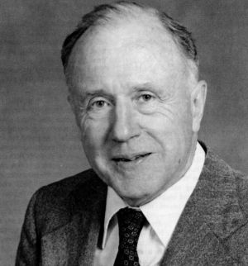
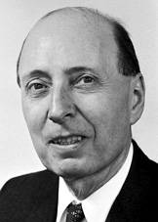
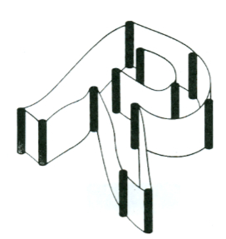
Wheeler and Wigner together
Wheeler’s four no’s
No tower of turtles
No laws
No continuum
No space, no time
“It follows that the being with a consciousness must have a different role in quantum mechanics than the inanimate measuring device” - Wigner
Many instants interpretation – Barbour
Projection operators (Stapp)
“Reality: an elaborate papier-mache construction of imagination and theory fitted in between a few iron posts of observation” - Wheeler
Source: Quantum theory and measurement
Notes:
John A. Wheeler picture source: http://www.dbtechno.com
Eugene P. Wigner picture source: http://nobelprize.org

Slide 23
The duality of duality and non-duality
Borrow from science and eastern non-dual mysticism
Take responsibility for saying something rather than nothing/everything
Fallibility leads to falsifiability
One possible approach: Possibilities (QM), awareness (Hinduism), no-self (Buddhism) and no absolute spacetime (relativity) synthesized
MoA turns physical and experiential possibilities into actualities
Other possible approaches

Slide 24
References
The End of Time: The Next Revolution in Physics, Julian Barbour, Oxford University Press, 2001.
The Conscious Mind: In Search of a Fundamental Theory, David J. Chalmers, Oxford University Press, 1996.
‘I’=Awareness, Arthur Deikman, Journal of Consciousness Studies, 3(4):350-356, 1996.
The Disinterested Witness: A Fragment of Advaita Vedanta Phenomenology, Bina Gupa, Northwestern University Press, 1998.
Programming the Universe: A Quantum Computer Scientist Takes on the Cosmos, Seth Lloyd, Alfred A. Knopf, 2006.
Ignorance and Imagination: The Epistemic Origin of the Problem of Consciousness, Daniel Stoljar, Oxford University Press, 2006.
The Embodied Mind: Cognitive Science and Human Experience, Francisco J. Varela, Evan T. Thompson and Eleanor Rosch, The MIT Press, 1991.
Quantum interactive dualism, Henry Stapp, Journal of Consciousness Studies, 12(11):43-58, 2005.
Realistic monism: Why physicalism entails panpsychism, Galen Strawson, Journal of Consciousness Studies, 13(10-11), 2006.
Quantum Theory and Measurement, John A. Wheeler and Wojciech Zurek (editors), Princeton University Press, 1984.

Slide 25
Four pillars of our approach
Quantum theory:
Possibilities and
not trajectories
Possibilities
Awareness: Underlies
content of each
experience
Awareness
No spacetime
General relativity:
No fixed background
spacetime
No self doctrine:
Experience without
an underlying self
No self
Notes:
Pillar image source: http://www.made-in-china.com

