Slide 1





Context-aware Social Discovery
& Opportunistic Trust
Ahmed Helmy
Nomads: Mobile Wireless Networks Design and Testing Group
University of Florida, Gainesville
iTrust (by Udayan Kumar): https://code.google.com/p/itrust-uf/
www.cise.ufl.edu/~helmy

Slide 2
Motivation
New ways to ‘network’ people
  Promote social interaction
  Searching the mobile society
  Forming peer-to-peer infrastructure-less networks
  Localized emergency response, safety
Hypothesis: Human interaction & communication relies on prior information (trust)
  Homophily: birds of a feather, flock together! [Social Science lit.]
    Network homophily?! [Social Networks lit.]
  People with proximity, similar interest, behavior, background likely to interact
Phones have powerful capabilities
  Sensing, storage, computation, communication
Q: How can we use phones to
  Sense users we already know/trust
  Identify similar users who we may want to interact in future
Notes:
Whether facebook friends

Slide 3
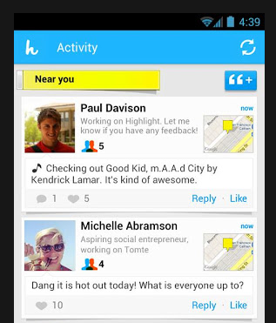
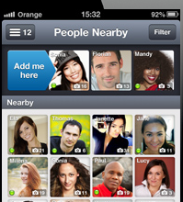
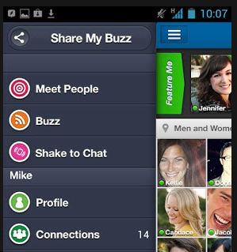
Terminology
Social Discovery: searching for other users by location and/or other criteria (interest, age, gender,…) [wikipedia]
  Match making, mainly!
  Apps: Highlight, Blendr, Skout
Behavioral similarity:
  Behavior: based on location visitation, mobility, activity (network-related, or other), social interaction
  Similarity: based on mathematical definition of distance in a multi-dimensional metric space [qualitative definition later]
Encounter:
  Radio device encounter
  Face-to-face encounter
Trust: [50 different, sometimes contradicting, definitions]
  Tendency (likelihood) to exchange encounter-based out-of-band keys

Slide 4
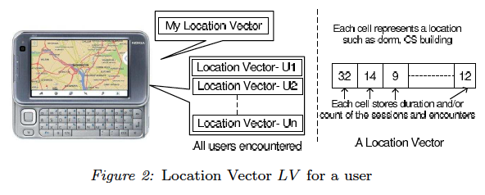
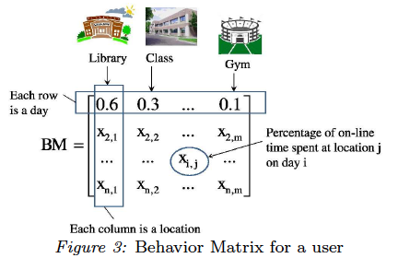
Location-based Behavioral Represenation
* W. Hsu, D. Dutta, A. Helmy, “Mining Behavioral Groups in WLANs”, ACM MobiCom 2007,
IEEE Transactions on Mobile Computing (TMC), Vol. 11, No. 11, Nov. 2012.
Summarize user association per day by a vector
  a = {a_{j} : fraction of online time user i spends at AP_{j} on day d}
Sum long-run mobility in behavior “association matrix”
Office, 10AM -12PM
Library, 3PM – 4PM
-Class, 6PM – 8PM
Association vector:
(library, office, class) =(0.2, 0.4, 0.4)

Slide 5


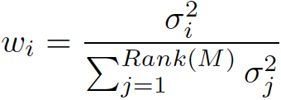
Computing Behavioral Similarity Distance
Eigen-behaviors (EB): Vectors describing maximum remaining power in assoc. matrix M (through SVD):
- Eigen-vectors:
- Eigen-values:
- Relative importance:
Eigen-behavior Distance weighted inner products of EBs
  Similarity calculation:
Assoc. patterns can be re-constructed with low rank & error
For over 99% of users, < 7 vectors capture > 90% of M’s power
Sim(U,V)
Multi-dimensional
Behavioral
Space
V
U

Slide 6
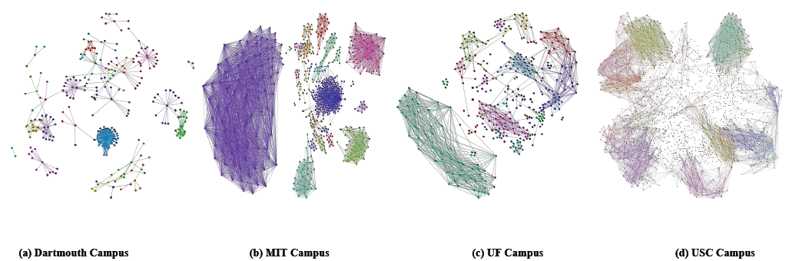
Similarity Clusters in WLANs
Hundreds of distinct similarity groups - Skewed group size distribution
  “Power-law ‘like’ distribution
  of cluster/group sizes”
Behavioral Similarity Graphs
(a) Dartmouth Campus (b) MIT Campus (c) UF Campus (d) USC Campus
Videos
Video
* G. Thakur, A. Helmy, W. Hsu, “Similarity analysis and modeling of similarity in mobile societies: The missing link”, ACM MobiCom CHANTS 2010

Slide 7
iTrust (or ConnectEnc*)
Attempts to measure strength of social connections, similarity based on mobility behavior & encounters
Inspired by social sciences principle of Homophily
Utilizes encounter-based filters⁺
Promotes face-to-face interaction
Can utilize of out-of-band encounter-based encryption key establishment [Perrig et al., Gangs, SPATE]
+ Udayan Kumar, Gautam Thakur, Ahmed Helmy, “Proximity based trust advisor using encounters for mobile societies: Analysis of four filters”, Journal on Wireless Communications and Mobile Computing (WCMC), December 2010.
* Udayan Kumar, Ahmed Helmy, “Discovering Trustworthy social spaces in mobile networks”, ACM SenSys – PhoneSense, Nov. 2012
Notes:
Face to face interactions are very easily possible in encounter based networks and can allow identity verification the way it is not possible in wired world

Slide 8
ConnectEnc: Details
An encounter, in our case, can be defined as an event when two devices can detect radio signals from each other
Currently, the application utilizes Bluetooth radio
We proposed several filters that ConnectEnc utilizes to rate encounters

Slide 9
Trust Adviser Filters
Frequency of Encounter (FE) -- Encounter count
Duration of Encounter (DE) – Encounter duration
Profile Vector (PV) – Location based similarity using vectors.
Location Vector (LV) – Location based similarity using vectors – Count and Duration (Privacy preserving)
Behavior Matrix (BM) – Location based similarity (using matrix) – Count and Duration [HSU08]
Combined Filter – function of the above filters

Slide 10
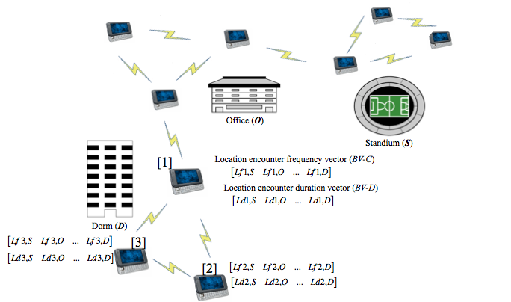
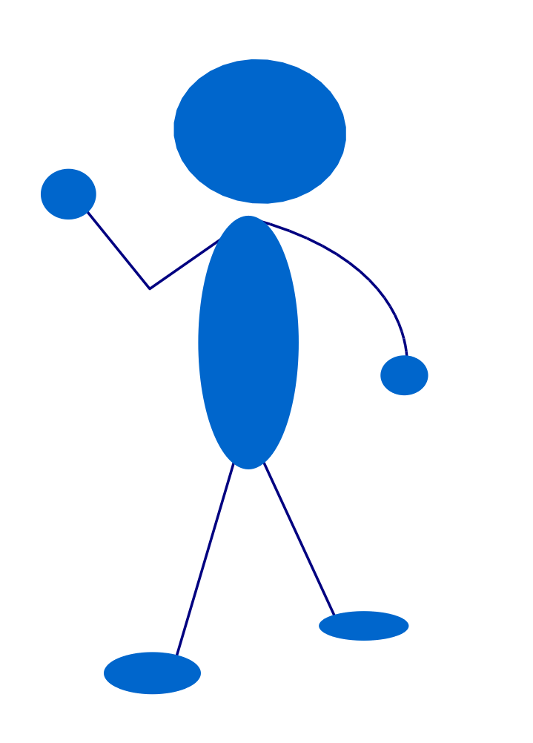
Filters
Each cell stores count/duration
at that location
Each cell represents a
Location (dorm, ofc)
4
32
15
--
--
L1 L2 L3 --
Vector
Profile Vector (PV):
Maintains a vector for itself
B’s Profile Vector
A’s Profile Vector
B
A
Profile Vector Exchange for similarity calculations
Location Vector (LV) :
Maintains a vector for itself
Creates and manages vector for every user encountered
Vector for other users are populated
with only the information B has
witnessed
B
No exchange of vectors is needed !! Privacy preserving

Slide 11
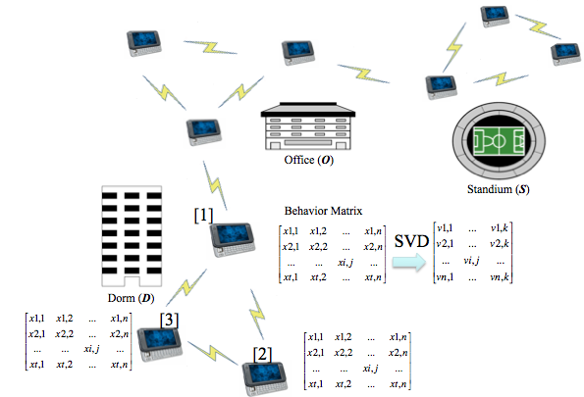
Filters
Behavior Matrix (BM):
Each cell stores count/duration
at that location
Day 1
4
32
15
--
--
This matrix is summarized using SVD. The summary is exchanged b/w the users to calculate similariy
Day 2
--
--
--
--
--
--
--
--
--
--
--
--
--
--
--
Day N
--
--
--
--
--
Maintains a Matrix for itself
B’s Matrix Summary
A’s Matrix Summary
B
A
Behavior Matrix Exchange for similarity calculations
(can remove exchange by relying on first-hand information)

Slide 12
Combined Filter (H)
In combined filter we combine trust scores from all the filters to provide a unified trust score.
H (U_{j}) = Σ α_{i}F_{i}(U_{j}), where α_{i} is the weight for
Filter F_{i,} n is the total number of filters
Different people may prefer different weights (observed from the user feedback on implementation). Eventually it can be made adaptive.
n

Slide 13
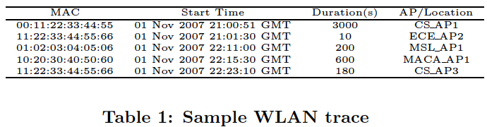
Analysis Setup: Traces Used
3 month long (Sep to Nov 2007) Wireless LAN (WLAN) traces from University of Florida, Gainesville.
More than 35,000 users
Total number of Access Points is over 730

Slide 14
Evaluation and Analysis
1- Statistical characterization of the encounter and behavior trends in the traces for the various filter parameters
2- Stability analysis: how do the advisory lists change over time for each filter
3- Effect of selfishness and trust on epidemic routing (a tool to study the dynamic trust graph)

Slide 15
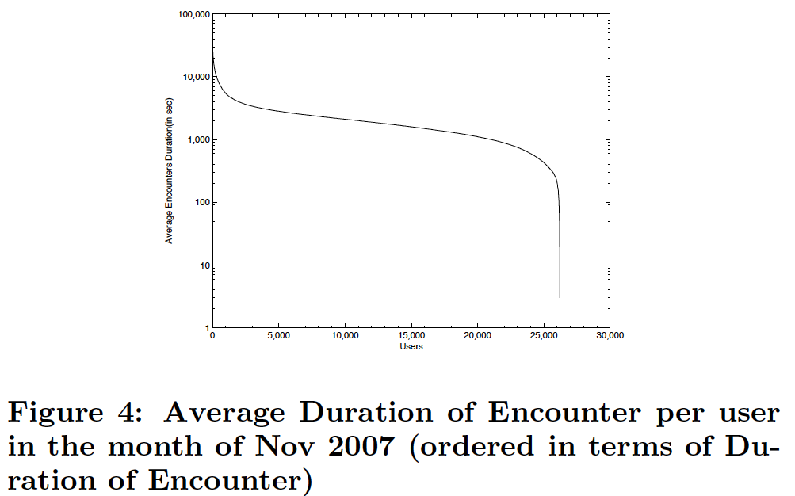
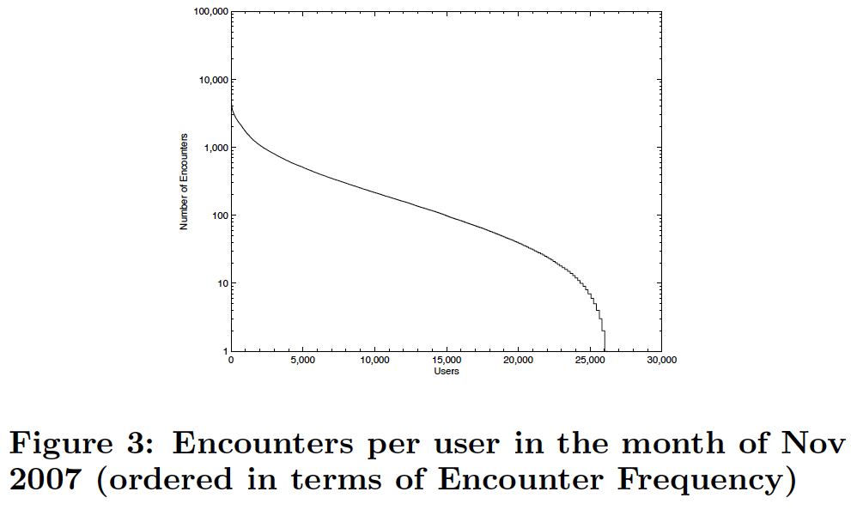
Characterization of Encounter Frequency & Duration
Richness of encounter distributions could potentially differentiate between users

Slide 16
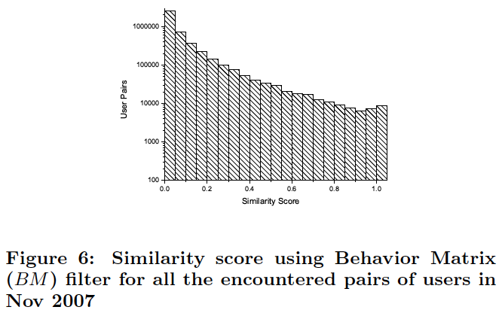
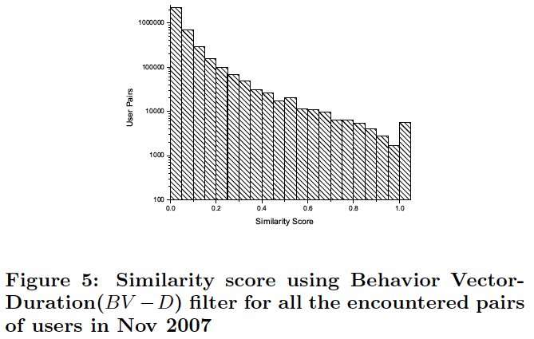
Characterization of Behavior Vectors & Matrices
Richness of behavioral profiles could potentially differentiate between users
(LV-D)

Slide 17
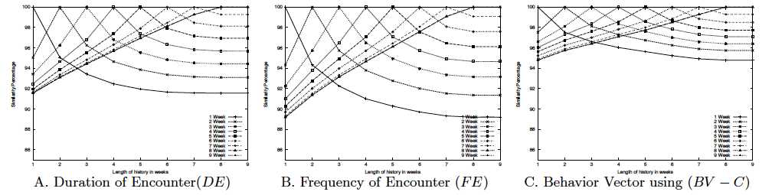
Filter Stability Analysis
Desirable to possess stability in the advisory lists over time
Behavior vector based on session count (LV-C) filter is the most stable with over 95% over 9 weeks
Freq. (FE) and duration of encounter (DE) filters have good stability with over 89% common users over 9 weeks

Slide 18
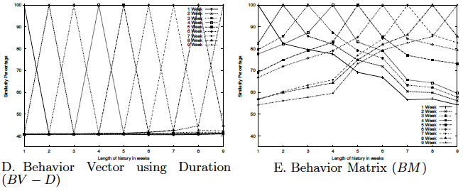
Filter Stability Analysis (contd.)
Behavior vector based on duration (LV-D) is the least stable with ~40% stability over 1-9 weeks
Behavior matrix is relatively stable (~80%) for 3 weeks. Stability degrades to ~55% for 9 wks

Slide 19
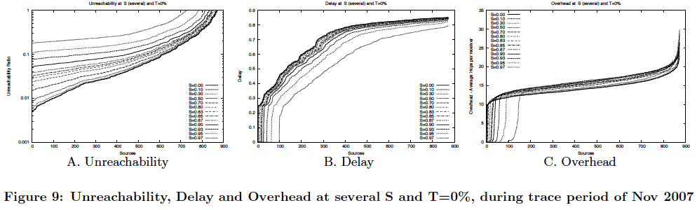
Epidemic Routing Analysis with Selfishness (no Trust)
Reachability degrades noticeably with increased selfishness
DTN routing suffers significantly with selfishness
Can trust help?

Slide 20
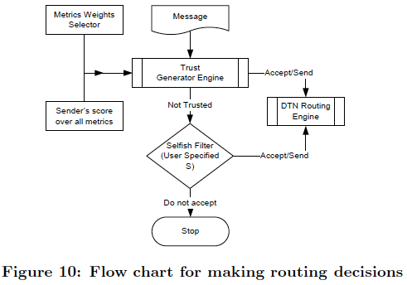
Epidemic Routing with Selfishness and Trust
Trust-augmented DTN routing engine
  If the sending node is trusted (according to a trust adviser filter) then accept and forward message
  Otherwise, do not forward if selfish to sender

Slide 21
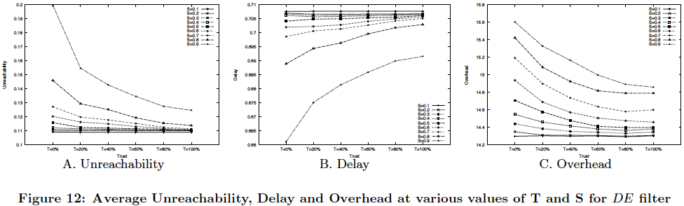
Epidemic Routing Analysis with Selfishness (with Trust)
Q: Can we use trust without much sacrifice to performance?
A: Trust can be used with selective choice of nodes without losing on performance. Enhancing performance over selfish cases dramatically

Slide 22
Proximity based Trust: iTrust
A trust framework that can unify trust inputs from various sources.
Several filters to measure similarity, including FE, DE, PV and LV
Trace driven analysis of filters
  stability (>90% 1week and 9 week) ,
  Correlation (<50% between filters)
A DTN scenario where iTrust generated trust list can improve network performance
  At T = 40% reachability increases by 50% when is S=0.8

Slide 23
Architecture Overview
Trust Scores
Energy
Efficiency
Location
Aggregator
Social Nets
Notes:
Color location and scanners or add more blocks,.. Interface to social networks. Make colors a animaition? Or separately. Do it fast. Prepare one line sentences.

Slide 24
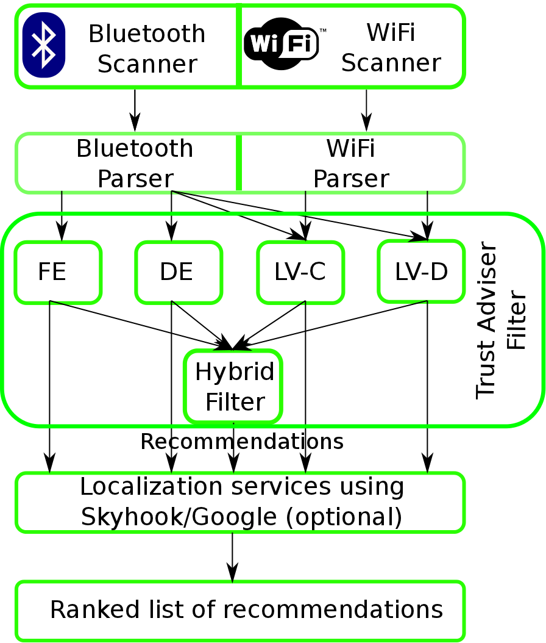
ConnectEnc: Block Diagram

Slide 25
Goals Met
Stability – Trust recommendations → Trace Analysis
Distributed Operation - Calculations → Design of Filters
Privacy-Preservation – Minimize the need of data exchange → Design of Filters
Energy Efficiency - Running iTrust → New Algos proposed
Accuracy - Recommendations → Results from User Study
Resilience – From anomalies such as artificially induced encounters → introduction of Anomaly Detection

Slide 26
A few ConnecEnc’s scenarios from user’s Perspective

Slide 27
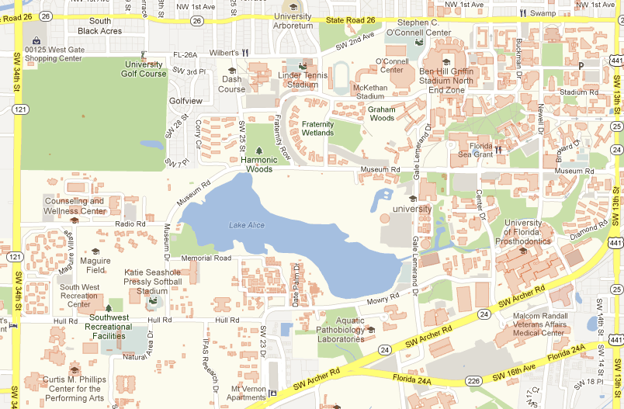
A day in life of user A :
Food Court
Home
Office
Gym

Slide 28
Scenario 1

Slide 29
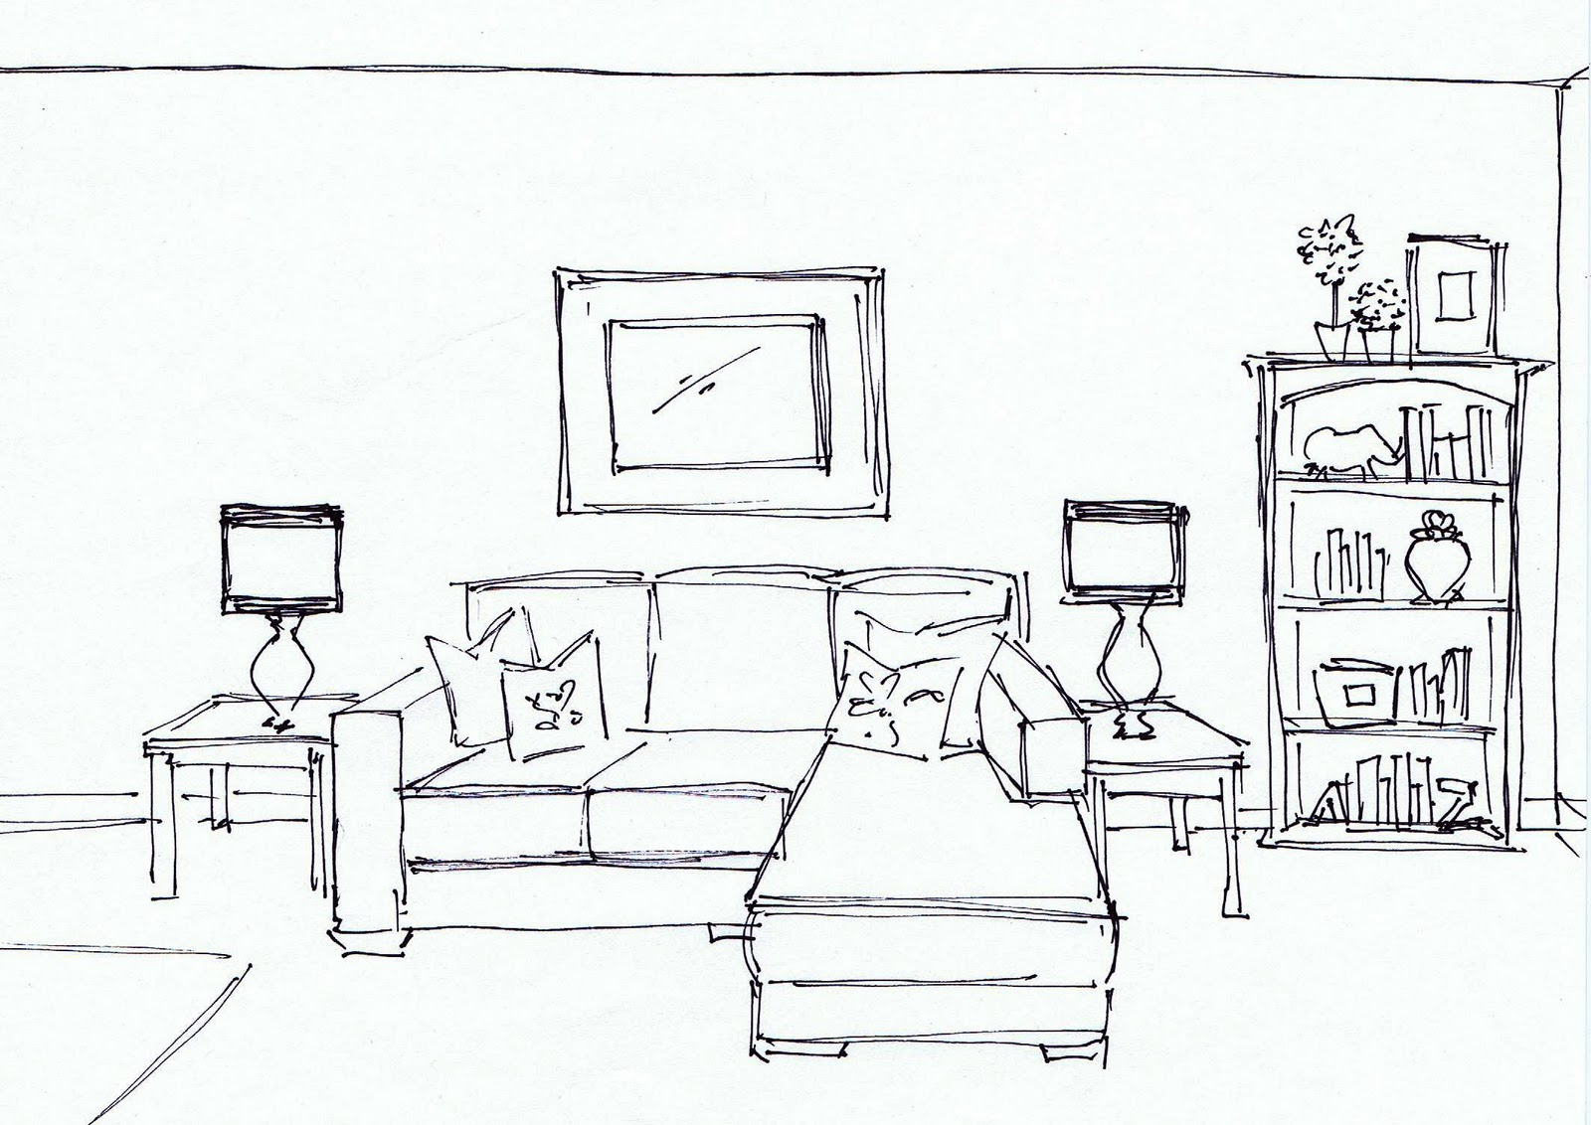
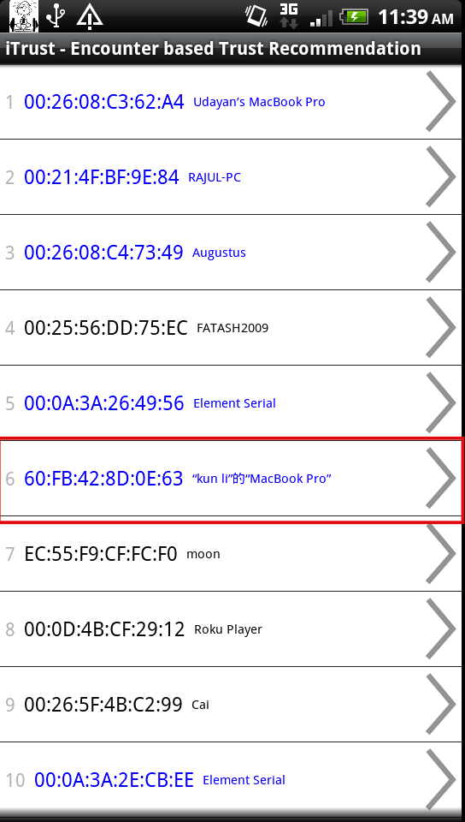

Wow I don’t know this high ranked
person. Let me check him out!
A
Scenario 1: Checking out details about an user

Slide 30
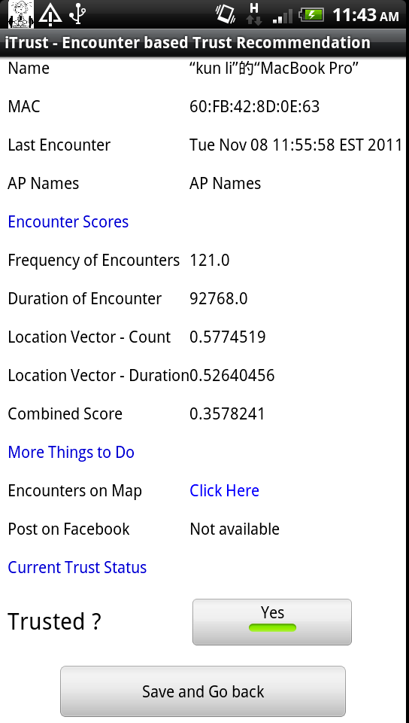

Has a pretty high Filter score..
Let me check more details
Context: Commute *
Encounter time:
10:30am 10-12-12
10:30am 10-11-12
10:30am 10-10-12
…..
A
Scenario 1: Checking out details about an user
*Only for illustration purposes, context cannot be sensed in the current app. version

Slide 31
Hmm I think I meet this guy on bus..
Not interested .. Not trusted.
A
Scenario 1: Checking out details about an user

Slide 32
Scenario 2

Slide 33
Wow I don’t know this high ranked
person. Let me check him out!
A
Scenario 2: Checking out details about an user

Slide 34
Has a pretty high Filter score..
Let me check more details
Context: Physical Activity
Encounter time:
5:30pm 10-12-12
6:12pm 10-11-12
5:46pm 9-21-12
…..
A
Scenario 2: Checking out details about an user

Slide 35
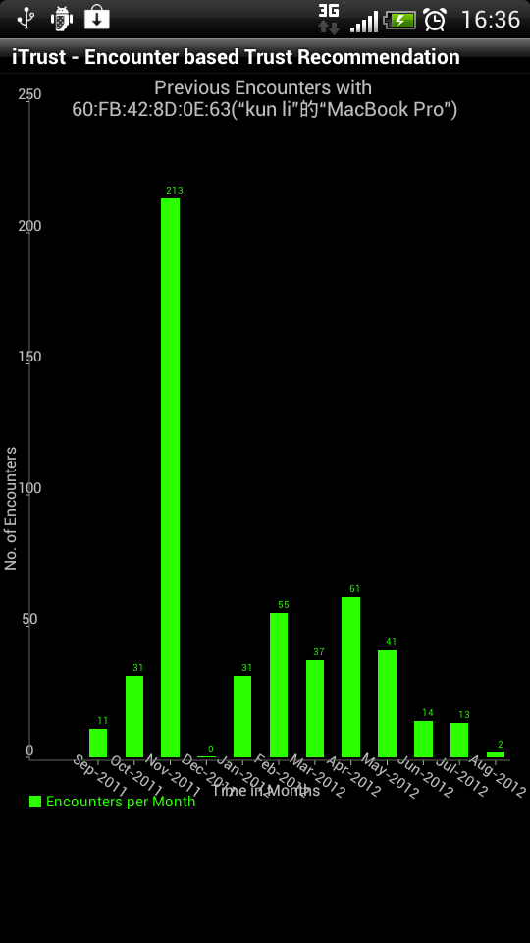
This person was encountered in my dept!
Goes to gym !! I hope this person also loves
Tennis. Let me dig more.
A
Scenario 2: Checking out details about an user

Slide 36
Very regular encounter for a couple of months..
Let me send a msg to setup face to face meetings..
A
Scenario 2: Checking out details about an user

Slide 37
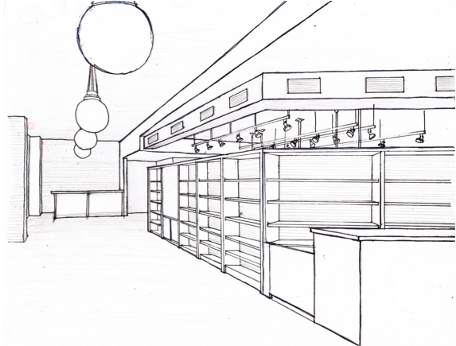
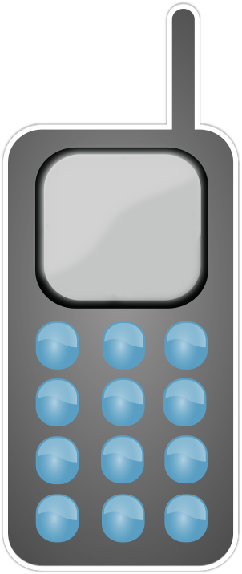
Finally they meet face to face.. Exchange personal details and …
Hey B. would you like to play Tennis today?
Hey A. Yes, why not!
Sure !!
Lets exchange keys
Out-of-band Key Exchange
B
A
Scenario 2: Checking out details about an user

Slide 38
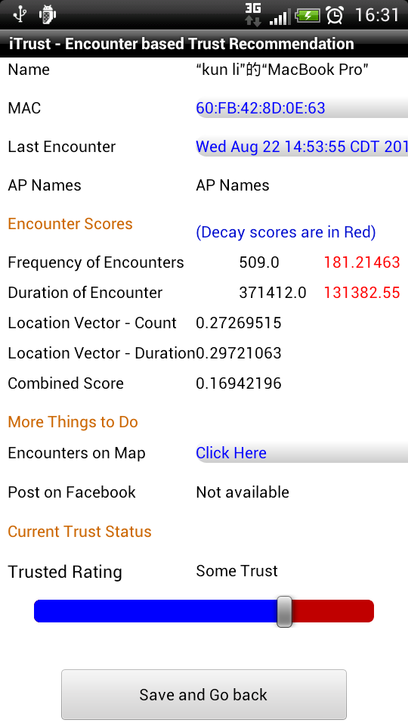
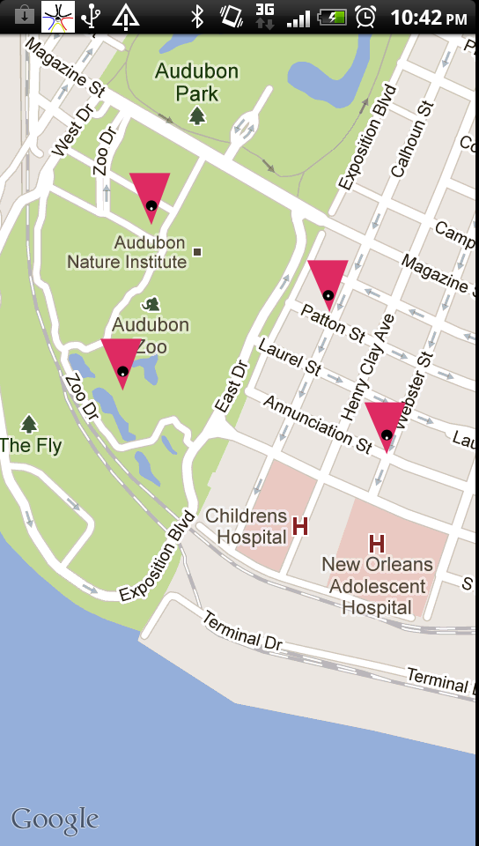
Application Screenshots

Slide 39
Application Screenshots

Slide 40

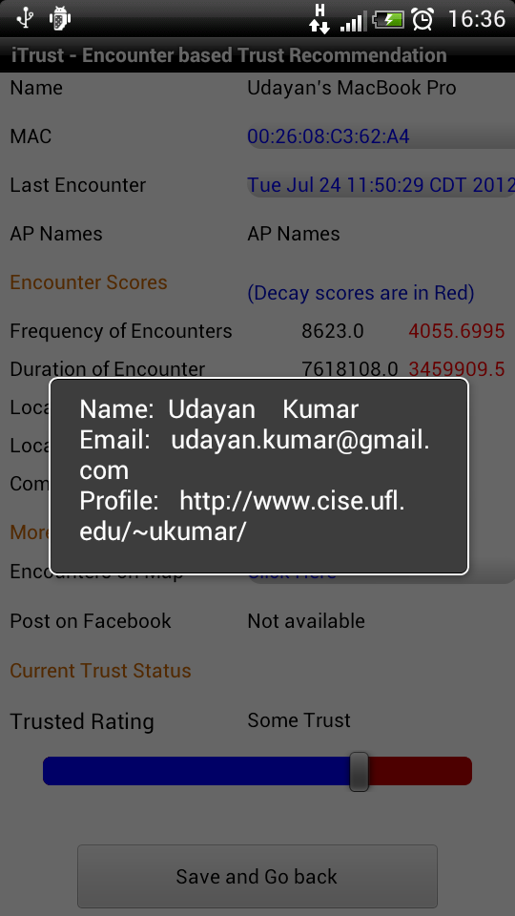
Application Screenshots

Slide 41
ConnecEnc Validation :User Study
How close are ConnectEnc recommendation to the ground truth?
Will ConnectEnc really select trustworthy users?
Notes:
TODO: correct the sentences

Slide 42
Deployment
22 Students and faculty ran ConnectEnc application for at least a month
  Total duration ~ 15K hours
  Average unique encounters per user = 175
  Average # of devices marked trusted = 15
They were asked to rate the mobile encounters as trusted/non-trusted
We collected all the data including user selections
We compare user’s selection with ConnectEnc’s recommendations.

Slide 43
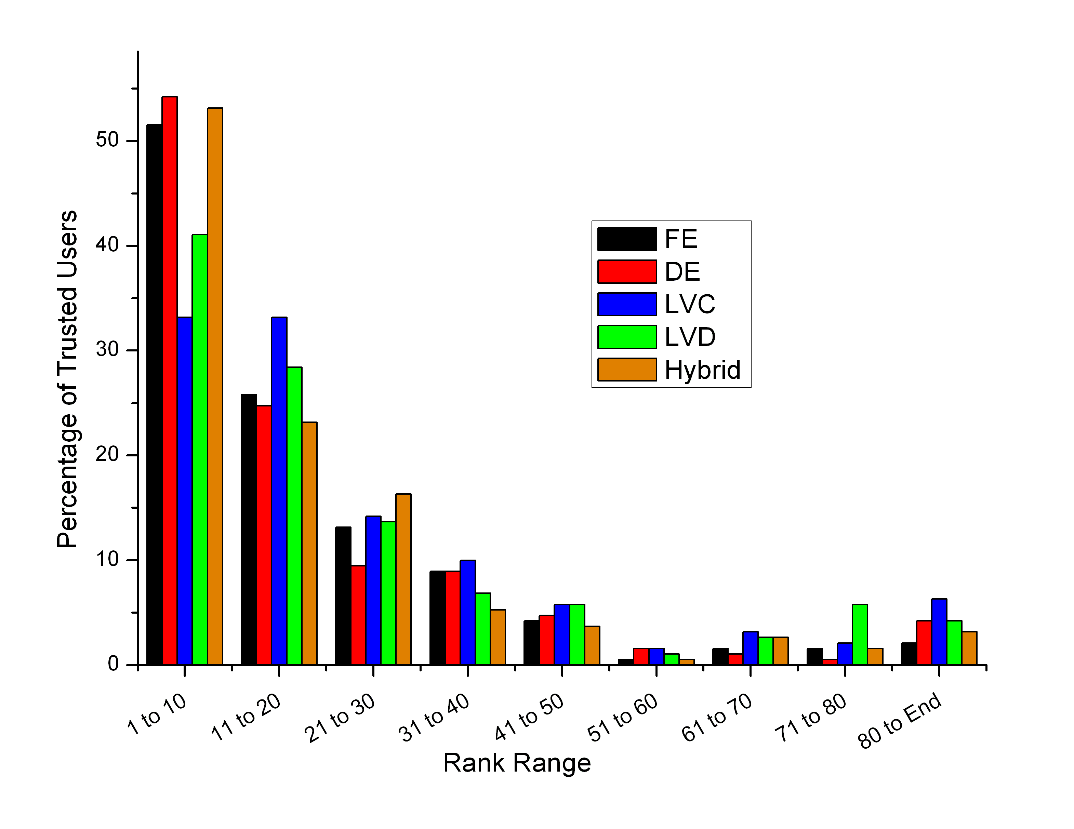
  1. % of total trusted users in Top 1 to 10, 11 to 20 … ranks
ConnectEnc is able to capture more than 50% of the trusted user in top 10 ranks
(except LVC). And more than 70% in top 20 ranks

Slide 44
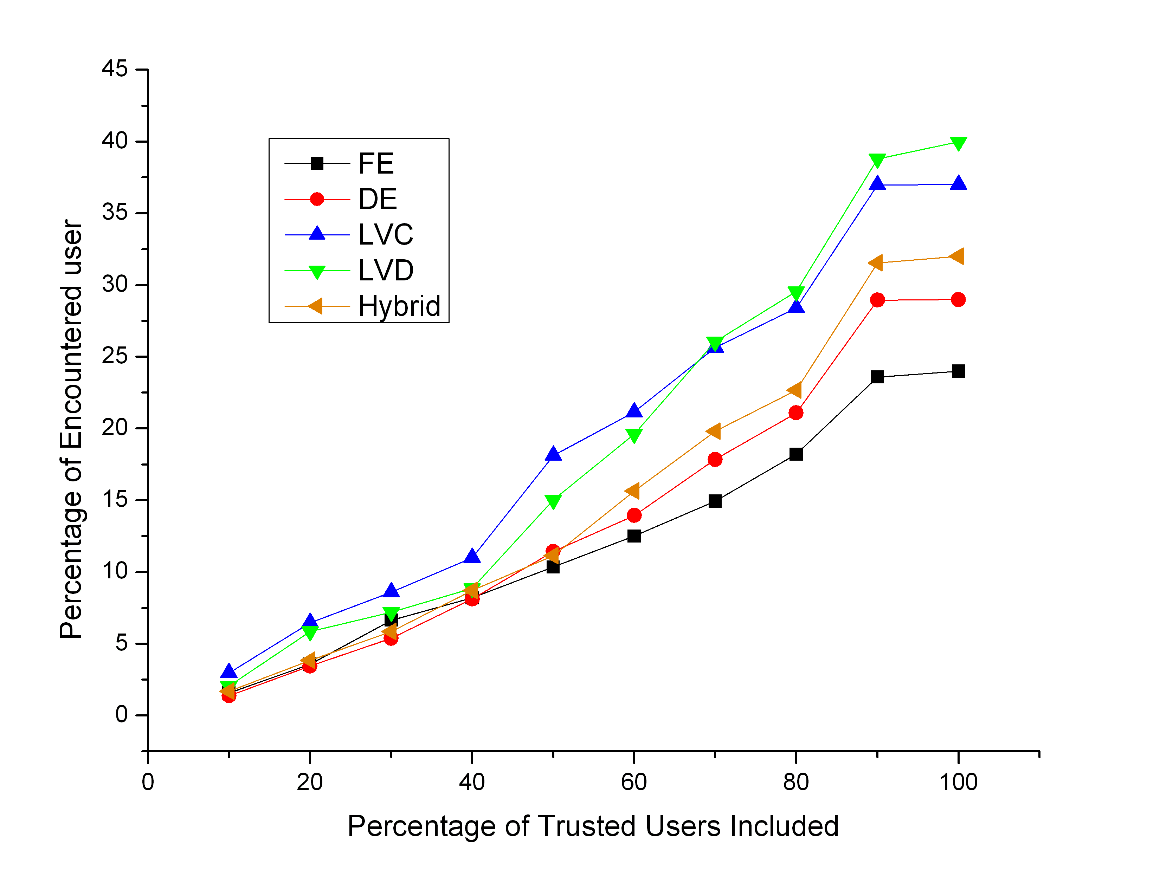
  2. % of ranked users needed to capture ‘x’% of trusted users for each filter
Percentage of Encountered users
(ranked by filter score)
ConnectEnc is able to capture 80% of the trusted user in less than 30%
of the ranked users

Slide 45
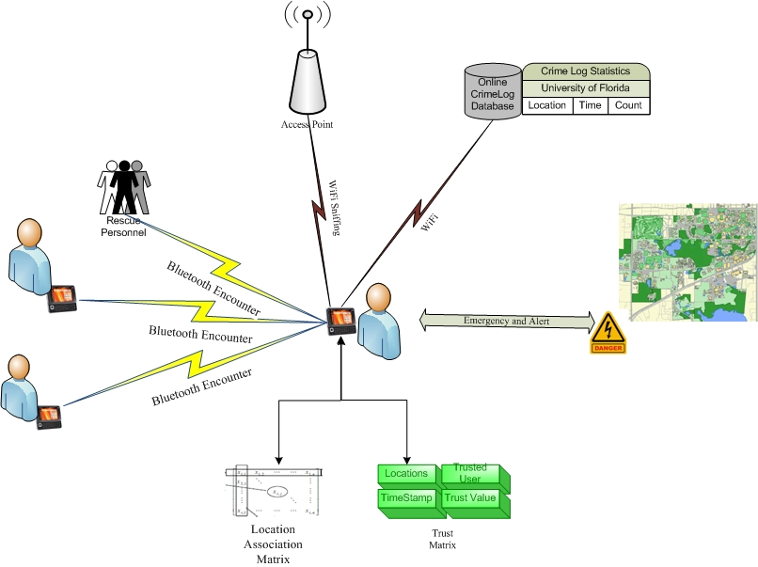
SHIELD Architecture
Locator
External Sources
Scanner
Distress Signaling
Profiler
Trust
Module
Work with G. Thakur, U. Kumar, W. Hsu, S. Moon at IEEE Globecom ‘10, ACM MobiCom SRC ‘10, IEEE ICNP ‘09

Slide 46
Crime Statistics and Mobile Users
There is a positive correlation (~55%) between the incidences and the number of active mobile users.
  Thus, these incidences can be very well averted given proper preparedness exists for the mobile users.

Slide 47
Conclusions
We propose a encounter based trust framework “ConnectEnc” which leverages homophily to recommend similar users (communication oriented trust)
ConnectEnc has potential to enable, establish and promote social interaction with socially similar users.
There is a statistically strong correlation between ConnectEnc ranking and trusted user selection, while still capturing opportunistic (new) encounters.
Potential application in safety, context-aware security*, profiling: profile-cast, participatory sensing, m-health, education, mobile ranking, among others
Future: integrate with social networks, extend behavioral representation, scale deployment
* For banking applications, studied by Udayan Kumar as intern at IBM Research – India, summer ‘11.

Slide 48
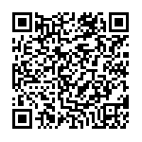
Thanks !
iTrust code is available here :
(ConnectEnc’s partial realization)
https://code.google.com/p/itrust-uf/
  www.cise.ufl.edu/~helmy
  Google itrust-uf
Android installer is available here:

Slide 49
Design of iTrust application
The challenge is to design a App that incorporates all the filters as well as all provides several features to probe into the encounters.
Easy to Use UI
Features
We went through several iteration based on the feedback we received from the users.

Slide 50
Location Fragmentation

Slide 51
One Cell here represents one cell in the Location Vector.
Mall
Tennis court
Bus
Food
How can we correctly fill in the Location Vector?
Location Grid
Notes:
How can we correctly fill in the location vector? Mall may get split into several location cells .. However a person visiting the bus station may turn out to be similar to a person visiting the restaurant
It also depends on the requirements of the users. … some may want whole mall to be treated as a single entity and others may not ..

Slide 52
Location Fragmentation
An establishment may comprise of several cells or only a partial cell.
How can we determine the area occupied by an establishment ?
How can we correctly create the Location Vector?
Incorrect location estimate may split a location into several vectors and thus dilute/increase the similarity score
What about user’s preference?

Slide 53
Energy Efficient Scanner

Slide 54
Energy Efficiency
Efficient use of energy is essential for always-on mobile applications such as iTrust. Having little effect on phone battery life is going to promote users adoption.
Directions:
  Use current scan response to determine next scanning time
  Use temporal locality: e.g. weekly patterns
  Use spatial locality
scanning process is very similar in Bluetooth and Wifi, any technique developed for Bluetooth can be used for Wifi and vice-versa

Slide 55
Energy Efficiency : Algorithms
Star Algorithm¹: Uses a method to estimate arrival rate based on the number of new devices detected in the current scan round and also increase the scan rate if the current time is greater than 8 am.
MIMD Algorithm (proposed): doubles current scan time interval if no new device is found (we have an upper bound on the time interval). On detecting a new device, the scan time interval is reduced to the minimum possible period.
Fibonacci Series based Algorithm (FIBO) (proposed): uses the Fibonacci series to decide the number of scan cycles to skip (otherwise similar to EE). The growth is 0, 1, 1, 2, 3, 5, 8, 13, 21 and so on.
¹ Wei Wang, Vikram Srinivasan, and Mehul Motani. Adaptive contact probing mechanisms for delay tolerant applications, MobiCom, 2007
Notes:
Talk about Max threshold. Give the basic intuition about the scanners and how they work

Slide 56
Energy Efficiency: Testing
For testing these methods, we used Bluetooth and Wi-Fi traces collected at min scan time interval of 100 seconds.
The energy efficient algorithms are given this trace as an input for simulation as ground truth.
We can compare the output trace from these algorithms to measure efficiency and error

Slide 57
Energy Efficiency: Results
 | Avg Error | Std. Dev. | Avg. Eff. | Std.Dev. | Eff/Err
STAR | 9.97 | 7.49 | 64.64 | 8.22 | 6.49
MIMD4 | 7.45 | 4.38 | 57.81 | 9.56 | 7.76
MIMD8 | 10.45 | 5.84 | 66.45 | 11.56 | 6.36
MIMD16 | 13.65 | 6.81 | 70.81 | 13.12 | 5.19
FIBO4 | 8.24 | 3.9 | 60.28 | 11.68 | 7.31
FIBO8 | 8.58 | 3.95 | 62.79 | 12.86 | 7.32
FIBO12 | 10.93 | 5.42 | 64.87 | 12.8 | 5.93
FIBO16 | 12.26 | 6.04 | 66.11 | 14.4 | 5.39
We note that MIMD4, FIBO4 and FIBO8 have better Eff/Err Ratio than STAR
Error and Efficiency rates using traces of 20 users at least one month long
Notes:
How star will fail if the energy budget changes.
iTrust application implements EE algos

Slide 58
Anomaly Detection

Slide 59
Anomaly Detection
Problem: An attacker/stalker may want to generate artificially high number of encounters so as to get into top recommendations made by the device
The problem becomes challenging due to the inferences are based on the behavior of users.
Notes:
This was not initially on our plan for this work but based on comments by reviewers and other researchers we have added an anomaly detection feature.
Note that in our implementation, a user has to approve each encountering user before adding to the trust list. The role of anomaly detection would then be to raise a red flag on suspicion of attack.
Being robust to potential attacks on ecnounter assimilating applications is one of the main requirements for our design. In our case, for example, the attack on the trust system includes an attempt by an untrusted user (e.g., a stranger) to gain trust of the system in a relatively short time by injecting many encounter events (e.g., via stalking). Such a growth of trust scores can be considered an anomaly, and a specialized anomaly detection system is needed to combat such attacks.

Slide 60
Requirements and Assumptions
Requirements
Detection should be distributed. No exchange of data among devices should be needed
Scalable
Assumption
There is only one attacker at a time. No collusion.
Attacker would want to get a high score quickly.
For anomaly detection, user behavior would not have sudden changes like user moving to a different city.

Slide 61
Approach
Considerably raise the level of effort needed for a successful attack
  to be no less than genuine trusted nodes and friends
  may entail weeks of consistent encounters at trusted locations by the attacker. (Attacker may have to change his/her life altogether)
Find encountering nodes having similar encounter score.
Compare growth slope of the suspicious user with all the other users with similar encounter score,
if the growth difference is high… mark as attacker
Notes:
Note that in our implementation, a user has to approve each encountering user before adding to the trust list. The role of anomaly detection would then be to raise a red flag on suspicion of attack.

Slide 62
Attacker Model
No known attacks on iTrust system. Hence, no attacker patterns available for testing anomaly detection
We have created a parameterized model for the attacker, based on number of encounter, Max days available and periodicity of encounters.

Slide 63
Attacker’s model

Slide 64
Results of Anomaly detection
For evaluations, we varied the number of days from 1 to 30
(the trace is from UF and 30 days long).
40 users were analyzed (20 users have most number of encounters and
20 have average number of encounters in the 30 day trace).
We are able to identify attackers with low false +ve and false -ve

Slide 65
Metrics
We have compared the selections and recommendations on 3 metrics
  Percentage of trusted users in Top 1 to 10, 11 to 20, etc (Also known as Precision)
  F_{k}(i) is the user U ranked at i position by Filter k
  Percentage of users needed (from top) to capture ‘x’% of trusted users for each filter
  Normalized Discount Cumulative Gain (NDCG), a metric used by search engines to measure relevance.
Notes:
ConnectEnc shows users with high encounter score on the top of the recommendation list.

Slide 66
3. Normalized Discount Cumulative Gain (NDCG)
All the ConnectEnc filters recommendations are at least 50% relevant with some as much as 80%

Slide 67
Encounter Trace Analysis
Users know each other
Strangers
- Experiments and surveys show initial evidence of high correlation between trusted
nodes and encounter statistics

