Slide 1






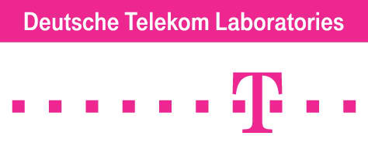
Data-Driven Design of Mobile Social Networking:
(with Application to Mobile Health & Emergency Scenarios)
[Cyber-Physical vs. Cyber-Social Systems]
Ahmed Helmy
Computer and Information Science and Engineering (CISE) Department
^{University of Florida}
helmy@ufl.edu , http://www.cise.ufl.edu/~helmy
Founder & Director: Wireless Mobile Networking Lab http://nile.cise.ufl.edu
Funded by:

Slide 2
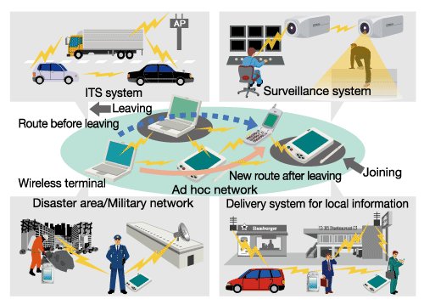
Networked Mobile Societies Anywhere, Anytime
Transportation/Vehicular Networks
Sensor Networks
Disaster & Emergency alerts
Mobile Ad hoc, Sensor and Delay Tolerant Networks

Slide 3
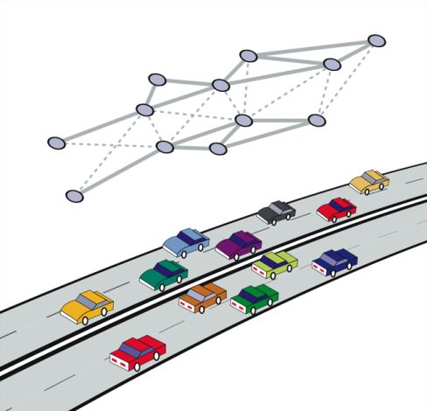
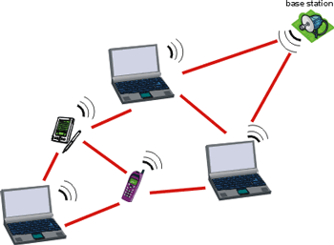
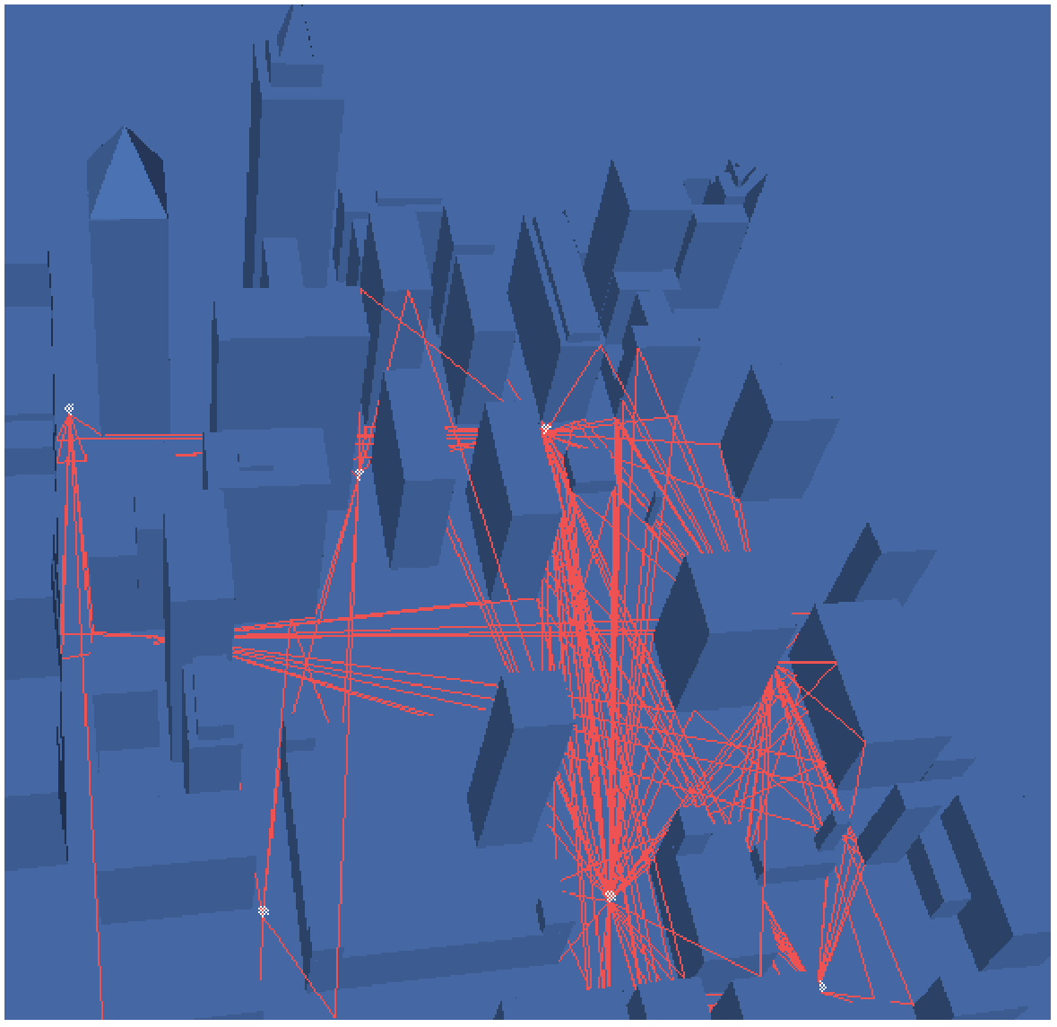
Example Ad hoc Networks
Mobile devices (laptop, PDAs)
Vehicular Networks on Highways
Hybrid urban ad hoc network (vehicular, pedestrian, hot spots,…)

Slide 4
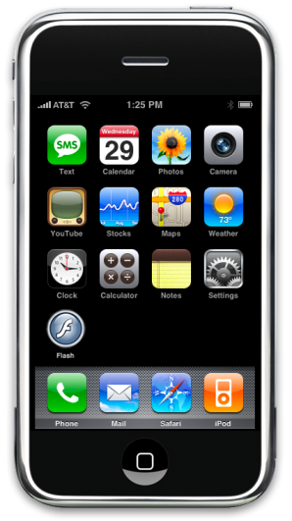
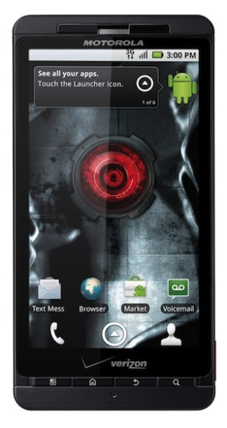
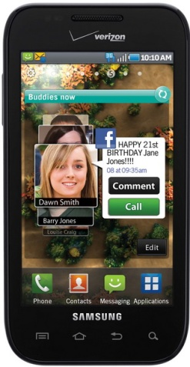
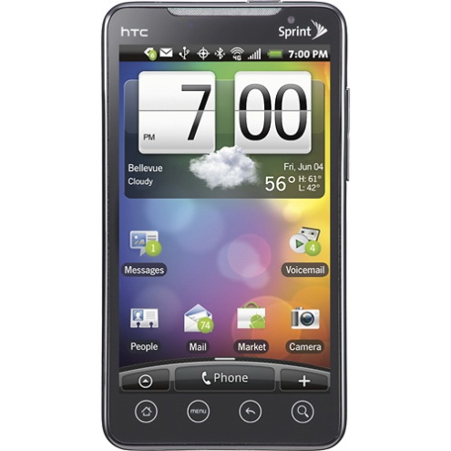
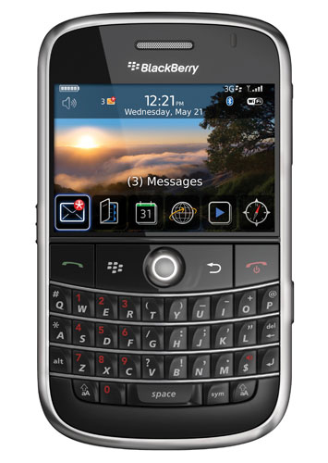
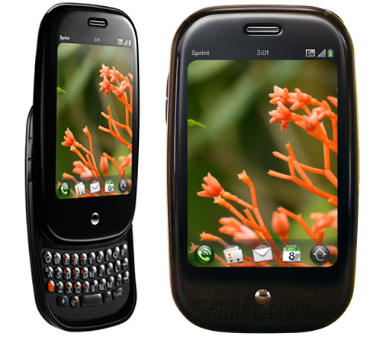
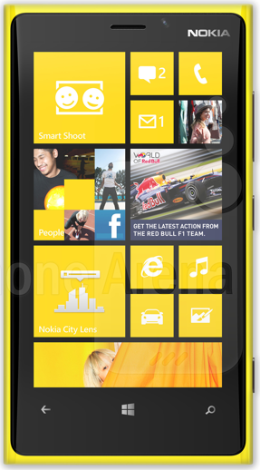
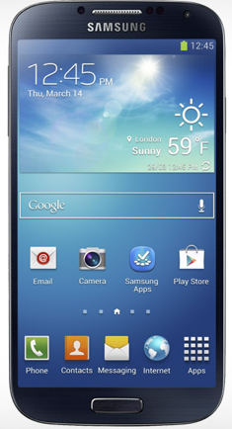
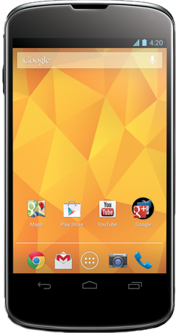
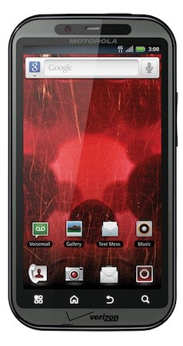
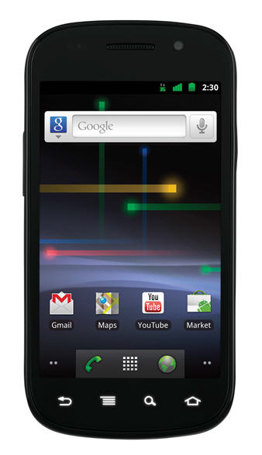
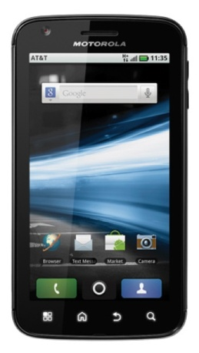
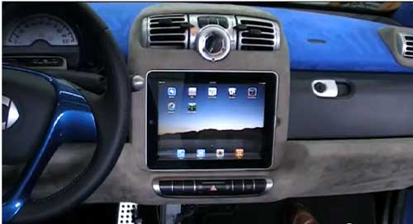
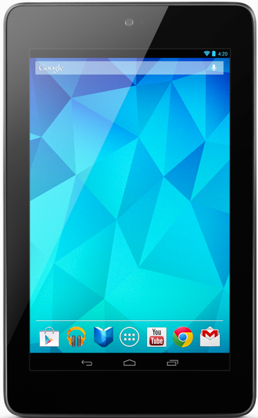
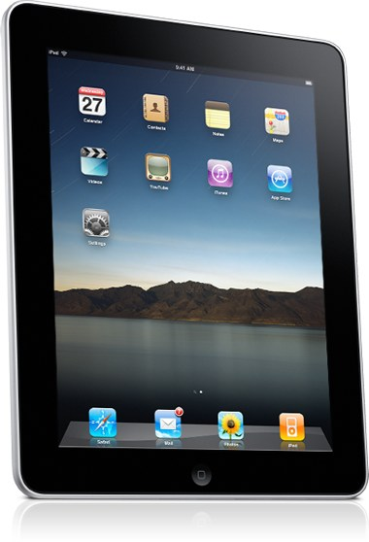
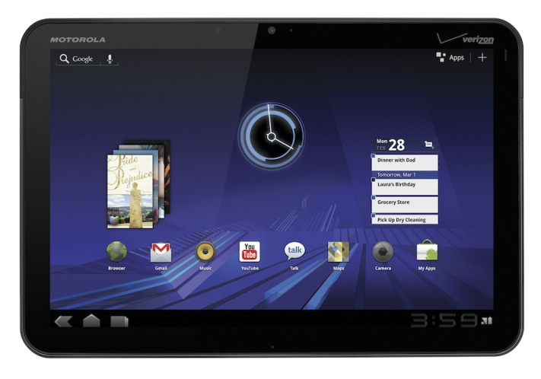
New Generations of Powerful Mobile Devices
~7 Billion mobile network subscriptions globally !! (Jan 2014, predicted)
~1.75B smartphones worldwide and growing fast (~2.5-3B by 2017, predicted)
Capabilities of smartphones:
I- Sensors: accelerometer, gyro, proximity, compass, barometer, camera(s), mic, touch, GPS, heart rate, temperature, humidity …
II- Storage:1-3 GB RAM, Internal Mem: 16-64 GB, External Mem: 32-128 GB
III- Computing: quad/octa-core 1-2.5GHz CPU, GPU
IV- Communication: cellular 3G-4G/LTE/5G, WiFi-AP/direct/adhoc, Bluetooth, NFC
iPhone
Droid X
Galaxy S
HTC EVO
Blackberry Bold
Palm Pre
?
?
Lumia 920
Galaxy S4/5
Nexus 4/5
Bionic
Nexus S
Atrix
Next iPhone
Next Droid
Motorola Xoom
Nexus 7
iPad

Slide 5
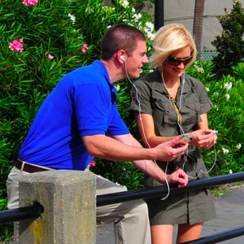
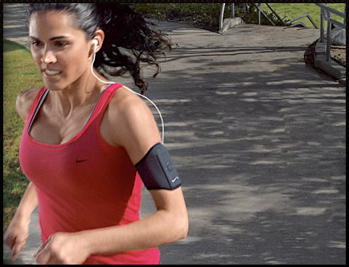
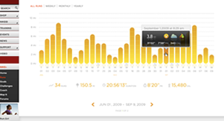
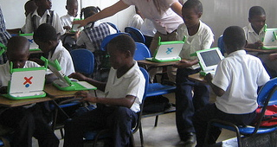
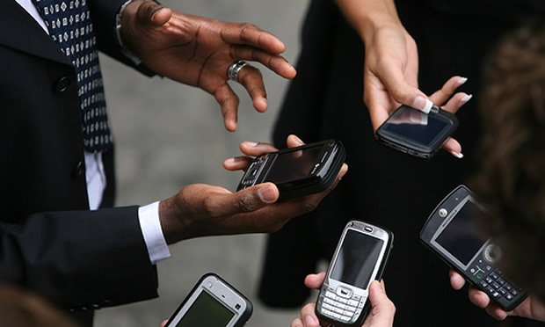
Emerging Behavior-Aware Services
Tight coupling between users, devices
  Devices can infer user preferences, behavior
  Capabilities: comm., comp., storage, sensing
New generation of behavior-aware protocols
  Behavior: mobility, interest, trust, friendship,…
  Apps: interest-cast, participatory sensing, crowd sourcing, mobile social nets, alert systems, …
New paradigms of communication,
computation, storage and sensing?!

Slide 6
Emerging Human Sensor Networks
1. Sensing the Human Society:
  Characterizing human behavior
    Mobility, location visitation, encounters, activity patterns (network-related or otherwise), health related, ...
  Mostly facilitated using smartphones
2. Humans as Sensors:
  Participatory sensing, crowd sourcing
  Utilizing sensors carried to sense environment
    Pollution, crime-watch, re-cycling, traffic/congestion…
Can we use behavioral characteristics (from 1) to recruit human sensors & adapt (in 2)?*
G. Tuncay, G. Benincasa, A. Helmy, ACM MobiCom CHANTS, Oct 2013.

Slide 7
Paradigm Shift in Protocol Design
Used to:
Design general purpose protocols
Evaluate using generic models (random mobility, exp. traffic, …)
Deployment context: Modify to improve performance and failures for specific context
  Use of unrealistic models results in suboptimal performance or failures due to lack of context in the design phase
Propose to:
Trace, analyze deployment context
Drive design of ‘application class’-specific parameterized protocols
Utilize insights from context analysis to fine-tune protocol parameters

Slide 8
Main Research Questions
Q1: How to gain insight into deployment context?
Q2: How to utilize insight to design future services?
Approach
Extensive trace-based analysis to identify dominant trends & characteristics
Analyze user behavioral patterns
  I. Individual user behavior and mobility
  II. Collective user behavior: grouping, encounters
Integrate findings in modeling and protocol design
  I. User mobility modeling – II. Behavioral grouping
  III. Information dissemination in mobile societies, profile-cast

Slide 9

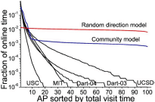
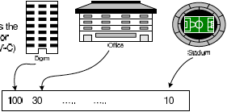
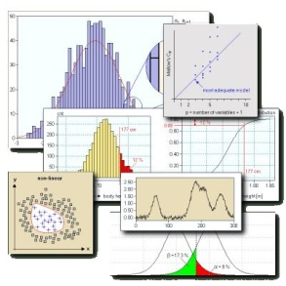
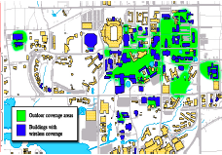
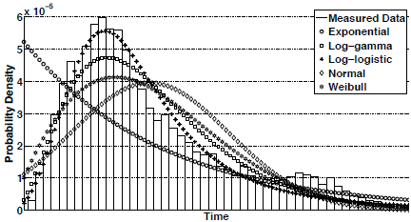
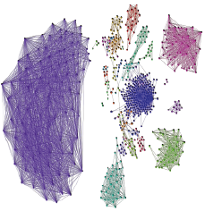
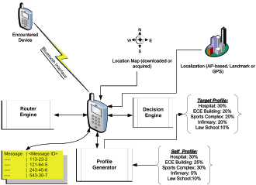
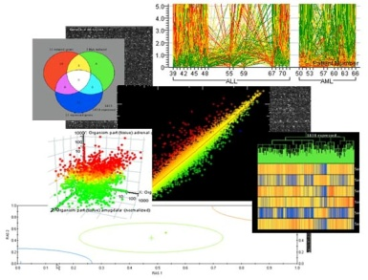

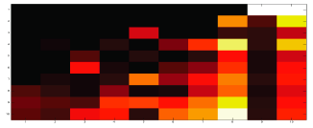
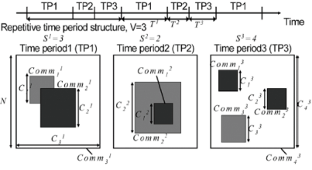
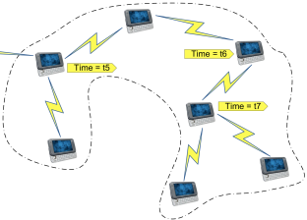



Systematic TRACE framework
Data-driven Mobile Network Mining, Modeling and Design
Billions of traces since 2004
MobiLib
Analyze
Trace
Represent
Characterize, Cluster
Employ(Model, Design)
- Mobility Modeling
- Adhoc & Sensor Network Design

Slide 10
Community-wide Wireless/Mobility Library
Vision: Library of
  Measurements: from universities, vehicular networks
  Realistic models: of behavior mobility, traffic, encounters
  Simulation benchmarks - Tools for trace data mining
Available libraries:
  CRAWDAD (Dartmouth, ‘05-) crawdad.cs.dartmouth.edu MobiLib (USC & UFL, ’04-) nile.cise.ufl.edu/MobiLib
    65+ Traces from: USC, Dartmouth, MIT, UCSD, UCSB, UNC, UMass, GATech, Cambridge, UFL, …
    Tools for mobility modeling (IMPORTANT, TVC), data mining
Types of traces:
  Campuses (WLANs), Conference AP and encounter traces
  Municipal (off-campus) wireless APs, Bus & vehicular
Trace

Slide 11
Case Study: IMPACT: Investigation of Mobile-user Patterns Across University Campuses using WLAN Trace Analysis*
- 4 major campuses – 30 day traces studied from 2+ years of traces
- Total users > 12,000 users - Total Access Points > 1,300
Trace source | Trace duration | User type | Environment | Collection method | Analyzed part
MIT | 7/20/02 – 8/17/02 | Generic | 3 corporate buildings | Polling | Whole trace
Dartmouth | 4/01/01 – 6/30/04 | Generic w/ subgroup | University campus | Event-based | July ’03 April ’04
UCSD | 9/22/02 – 12/8/02 | PDA only | University campus | Polling | 09/22/02- 10/21/02
USC | 4/20/05 – 3/31/06 | Generic | University campus | Event-based (Bldg) | 04/20/05-05/19/05
* W. Hsu, A. Helmy, “IMPACT: Investigation of Mobile-user Patterns Across University Campuses using
WLAN Trace Analysis”, two papers at IEEE Wireless Networks Measurements (WiNMee), April 2006 and
IEEE Transactions on Mobile Computing (TMC), Nov. 2010, TMC , Nov. 2012.

Slide 12
Case study I – Individual Mobility
Traces
Individual
User groups
Encounter
Observation
user mobility
in the
patterns in
population
the network
SmallWorld-
Mobility
Profile-cast
based
Application
model
protocol
message
dissemination
Microscopic
Macroscopic
behavior
behavior

Slide 13
Classification of Mobility Models
Mobility
Space
Geographic
Restriction
Spatial
Correlation
Temporal
Correlation
* F. Bai, A. Helmy, "A Survey of Mobility Modeling and Analysis in Wireles Adhoc Networks", Book Chapter in the book "Wireless Ad Hoc and Sensor Networks”, Kluwer Academic Publishers, June 2004 & Book Chapter on “Vehicular Mobility”, 2011.

Slide 14
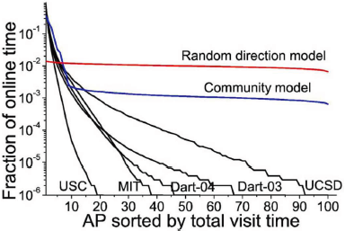
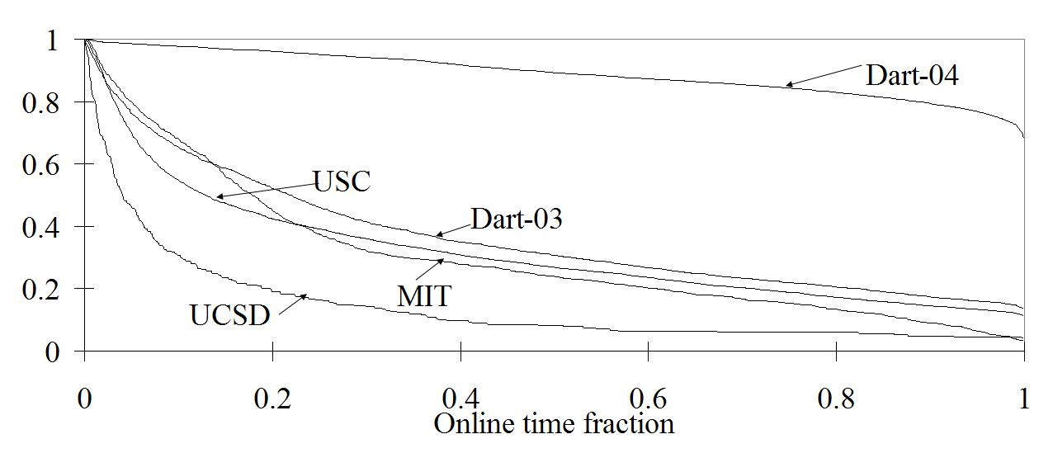
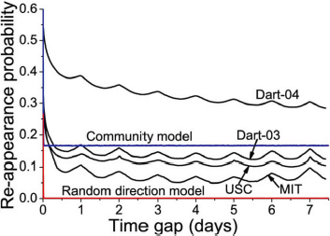
Spatio-temporal Mobility in WLANs
Skewed location preference
Simple existing models
are very different
from the spatio-temporal characteristics in WLANs
On/off activity pattern
95% on-line time at 5 most visited APs
Periodic re-appearance
Prob.(online time fraction > x)
Characterize
Periodic repetition peaks daily/weekly

Slide 15
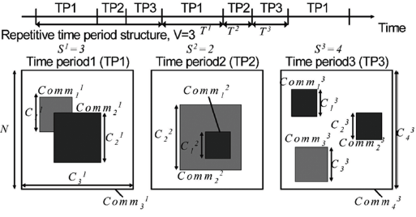
The TVC Model: Reproducing Mobility Characteristics
http://nile.cise.ufl.edu/~weijenhs/TVC_model/
Skewed location visiting preference
Time-Variant Community (TVC) Model:
1- Assigns communities (locations) to users
to re-produce location visiting preference
2- Varies temporal assignment of communities to re-produce the periodic re-appearance
CCDF
Periodic re-appearance
Hsu, Spyropoulos, Psounis, Helmy, IEEE INFOCOM 2007
IEEE/ACM Trans. on Networking 2009
* Model-simplified: single community per node. Model-complex: multiple communities
** Similar matches achieved for USC and Dartmouth traces

Slide 16
Case study III – Groups in WLAN

Slide 17
Case Study III: Goal
Identify similar users (in terms of long run mobility preferences) from the diverse WLAN user population
  Understand the constituents of the population
  Identify potential groups for group-aware service
Approach:
  Classify users based on their mobility trends and location-visiting preferences
  Utilize data mining and clustering techniques to assess quality of classification
  Extend similarity to include website access patterns (future)

Slide 18
Representation of User Association Patterns
* W. Hsu, D. Dutta, A. Helmy, “Mining Behavioral Groups in WLANs”, ACM MobiCom 2007,
IEEE Transactions on Mobile Computing (TMC), Vol. 11, No. 11, Nov. 2012.
Summarize user association per day by a vector
  a = {a_{j} : fraction of online time user i spends at AP_{j} on day d}
Sum long-run mobility in “association matrix”
Office, 10AM -12PM
Library, 3PM – 4PM
-Class, 6PM – 8PM
Association vector:
(library, office, class) =(0.2, 0.4, 0.4)
Example association matrix to describe a given user’s location visiting preference
Represent

Slide 19


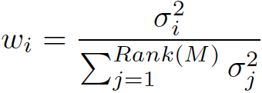
Eigen-behaviors & Behavioral Similarity Distance
Eigen-behaviors (EB): Vectors describing maximum remaining power in assoc. matrix M (through SVD):
- Eigen-vectors:
- Eigen-values:
- Relative importance:
Eigen-behavior Distance weighted inner products of EBs
  Similarity calculation:
Assoc. patterns can be re-constructed with low rank & error
For over 99% of users, < 7 vectors capture > 90% of M’s power
Sim(U,V)
Multi-dimensional
Behavioral
Space
V
U

Slide 20
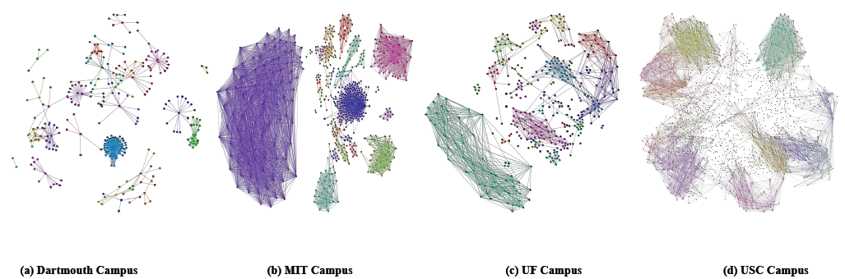
User Groups in WLANs - Observations
Hundreds of distinct similarity groups - Skewed group size distribution
  “Power-law ‘like’ distribution
  of cluster/group sizes”
Behavioral Similarity Graphs
(a) Dartmouth Campus (b) MIT Campus (c) UF Campus (d) USC Campus
Videos
* G. Thakur, A. Helmy, W. Hsu, “Similarity analysis and modeling of similarity in mobile societies: The missing link”, ACM MobiCom CHANTS 2010

Slide 21
Profile-cast: A New Communication Paradigm
W. Hsu, D. Dutta, A. Helmy, ACM Mobicom 2007, WCNC 2008, AdHoc Nets Jrnl Nov 2012
Payload
Dest Address
Payload
Target Profile
Sending messages to others with similar behavior, without knowing their identity
  Announcements to users with specific behavioral profile V
  Interest-based ads, similarity resource discovery
Case study: Delay Tolerant Networks (DTNs)
B
C
Is E similar to V?
Is B similar to V?
?
E
D
Is C/D similar to V?
A

Slide 22
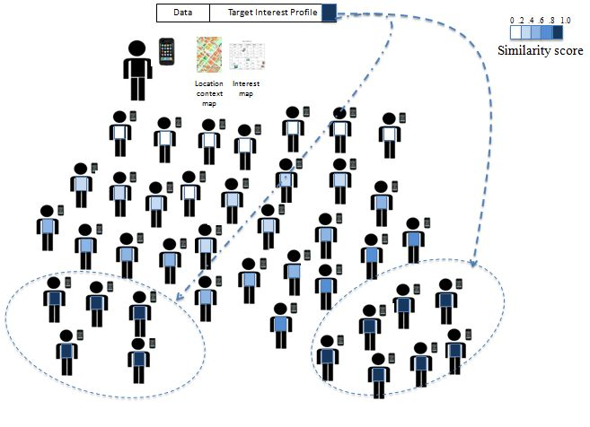
Instead of using a destination address (e.g., unicast, broadcast), destination is defined by the target interest profiles. Destination(s) match based on a similarity score, inferred based on user behavioral aspects .

Slide 23
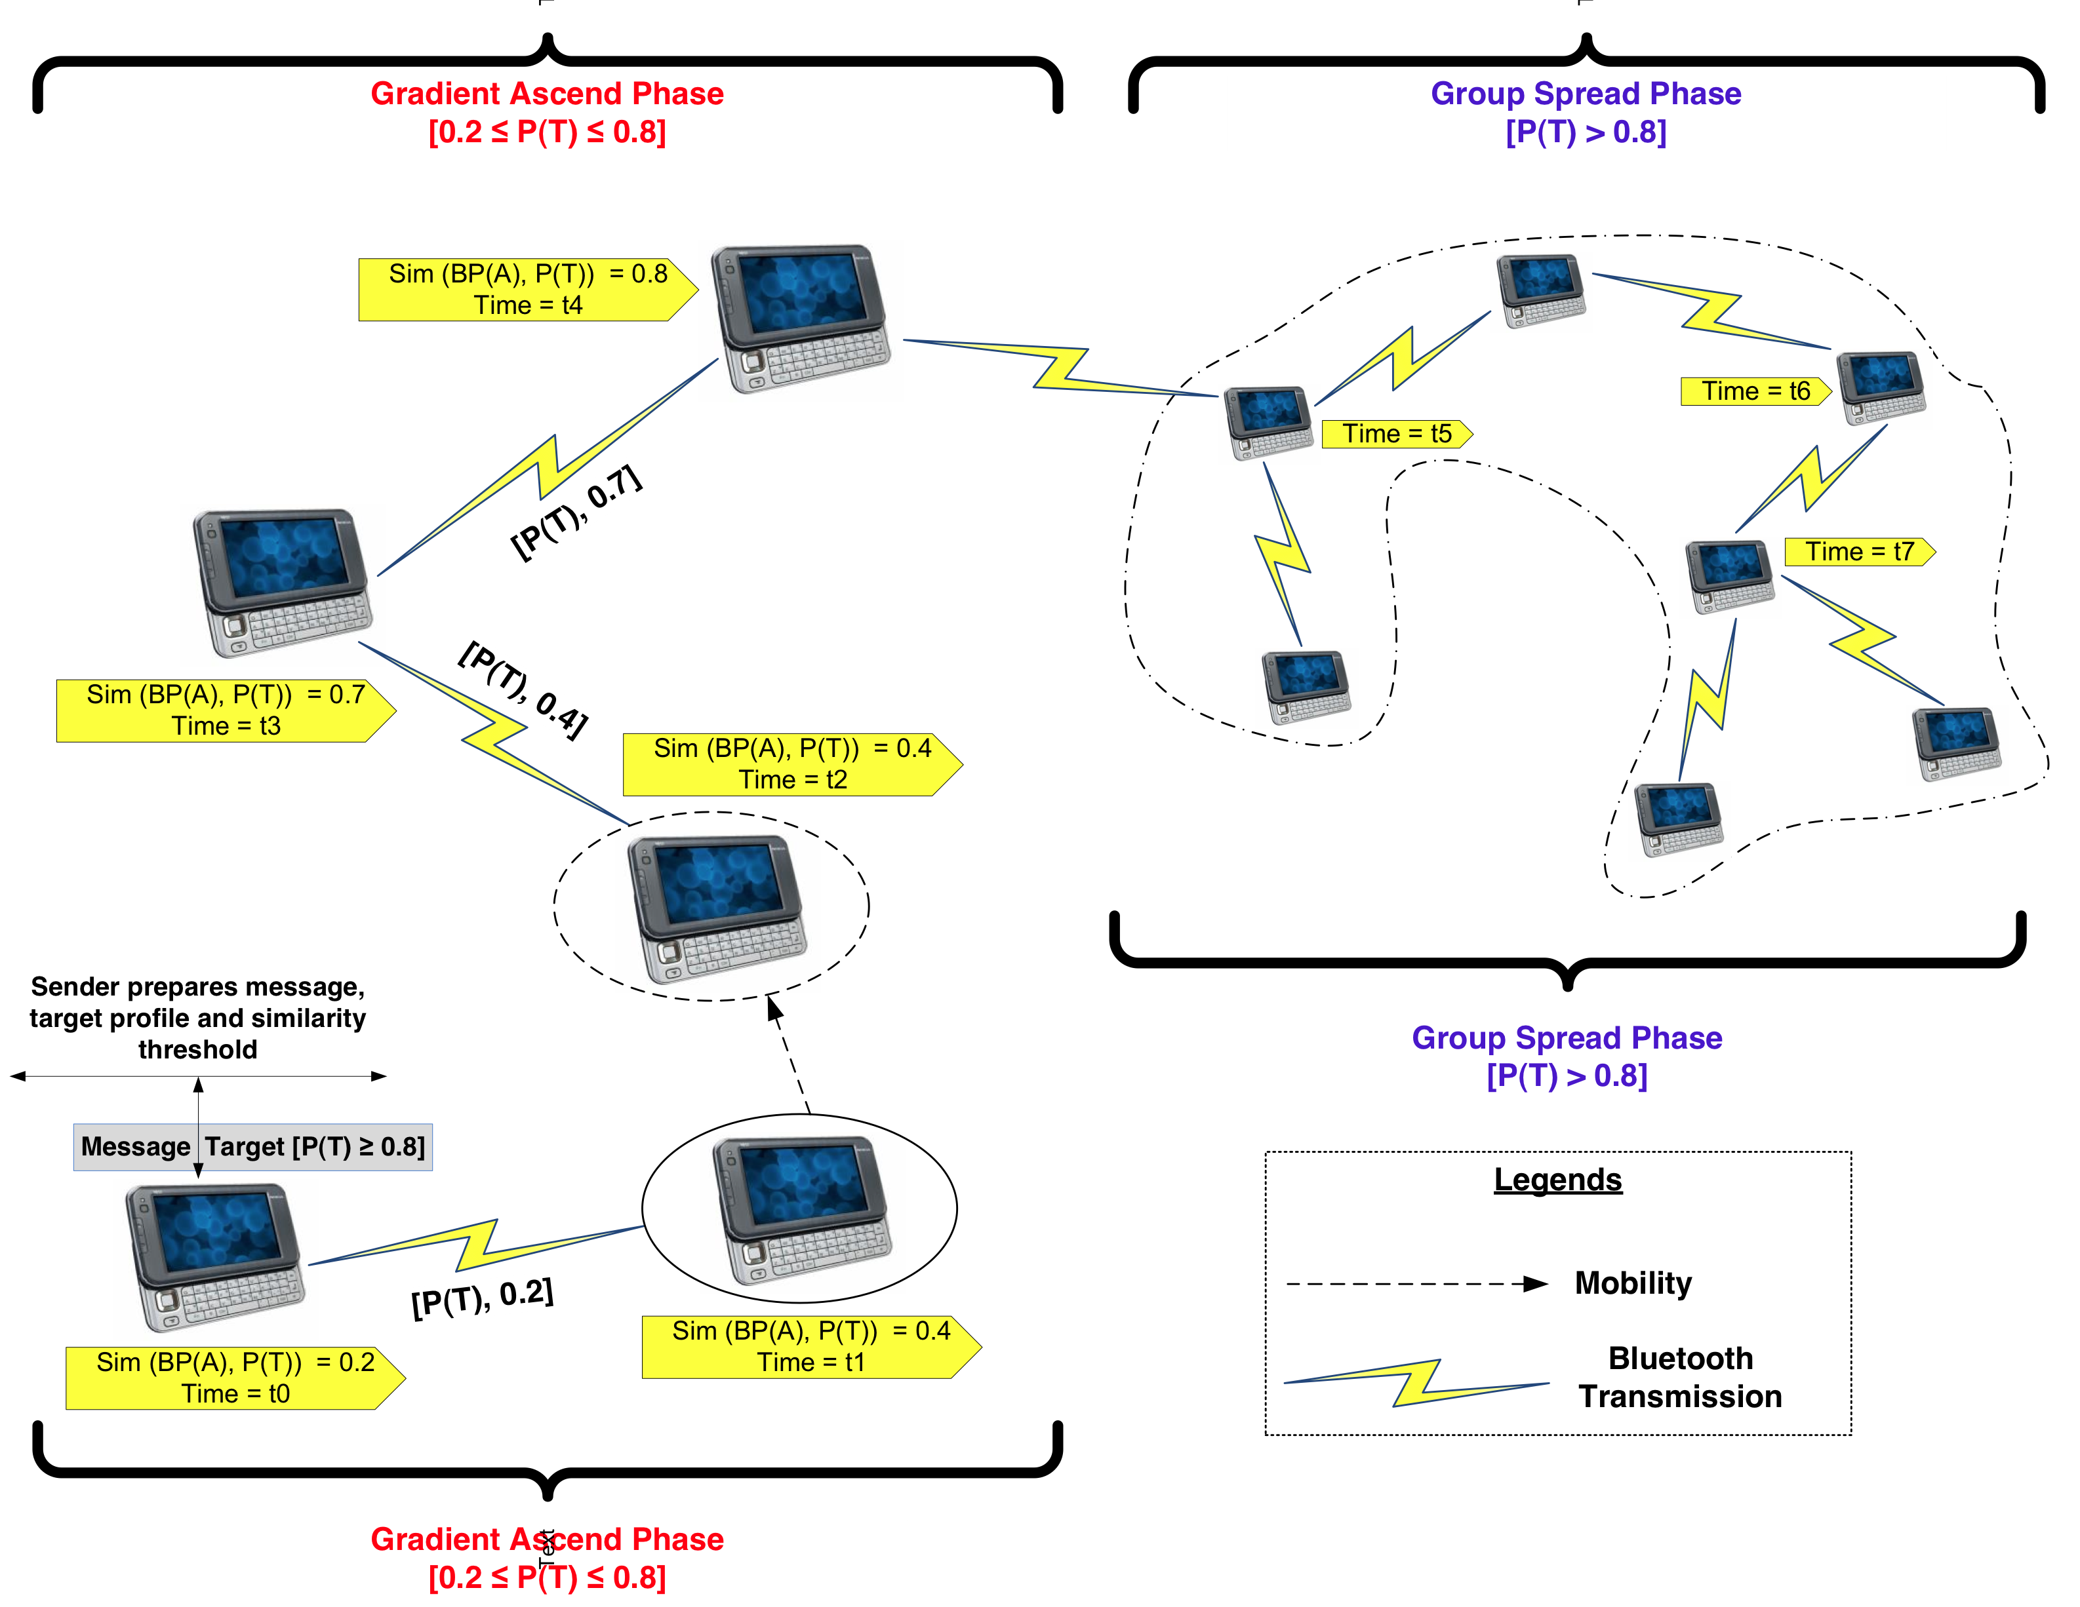
Profile-cast CSI protocol: Target-mode
S
Sim (BP(A), P(T)) = similarity of node’s behavioral profile to the target profile

Slide 24
Mobility Profile-cast (intra-group)
Goal
Flooding
Profile-cast (group-spread)
S
S
S
Single long random walk
Multiple short random walks
S
S

Slide 25
Mobility Profile-cast (inter-group)
Goal
Flooding
Profile-cast (group-spread only)
S
S
S
T.P.
T.P.
T.P.
Profile-cast (w/gradient-ascend)
Single long random walk
Multiple short random walks
S
S
S
T.P.
T.P.
T.P.

Slide 26
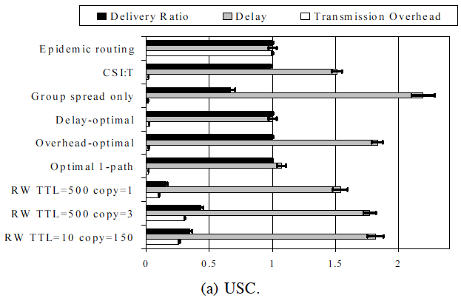
Profile-cast Evaluation
* Results presented as the ratio to epidemic routing
Over 96% delivery ratio – Over 98% reduction in overhead w.r.t. Epidemic
RW < 45% delivery
Strikes a near-optimal balance between delivery, overhead and delay
Video

Slide 27
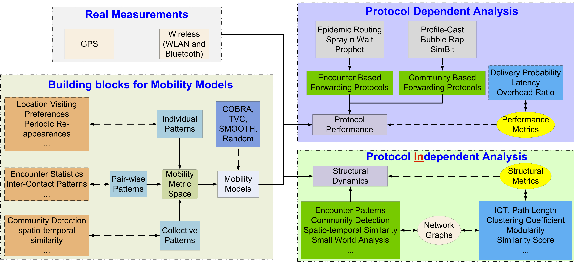
Framework for mobility analysis*
Real Measurements (WiFi, Bluetooth, GPS footprints)
Building block: Design, development of models (MIDAS)
Protocol Independent Analysis: Community, similarity, small world
Protocol Dependent Analysis: Routing performance
G. Thakur, A. Helmy, “COBRA: A Framework for the Analysis of Realistic Mobility Models”,
IEEE INFOCOM – Global Internet, April 2013.

Slide 28
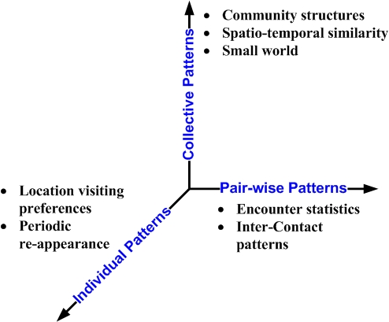
COBRA design architecture
COllective Behavior based on
Realistic Aspects of human mobility

Slide 29
Protocol Independent analysis
Trace
Models
Gap
COBRA
Gap
COBRA
RD-P, SMOOTH,
RD, TVC (Models)
Similarity gap > 95%
Clustering matches
Trace
Similarity distribution
  COBRA captures > 95% of similar user pairs.
  Other models largely deviate.
Clustering
  COBRA- Membership and cluster size are closely correlated with real traces.

Slide 30
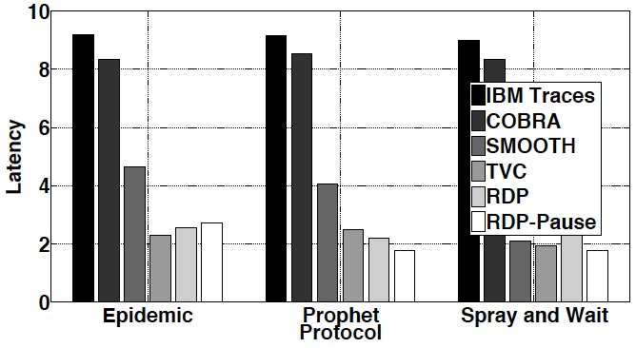
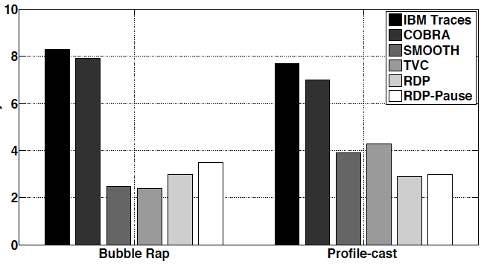
Protocol Dependent analysis
Non-community based
Deviation - Delivery
  COBRA < 5%, others > 30%
Deviation – Latency
  COBRA < 10%, others > 20%
Deviation – Overhead
  COBRA < 10%, others > 20%
Community-based (bubble rap)
Deviation – Delivery
  COBRA < 10%, others > 20%
Deviation – Latency
  COBRA < 5%, others > 50%
Deviation – Overhead
  COBRA < 25%, others > 40%

Slide 31
Aggregate gap reduction
Protocol independent
Metrics
Protocol dependent
Metrics

Slide 32

Mining for Interest: Behavior Beyond Mobility
User’s web access and traffic patterns, applications used represent other dimensions of interest and behavior
Further analysis of network measurements (e.g., Netflow) can reveal behavioral characteristics in these dimensions
Netflow traces are orders of magnitude larger than WLANs (WLANs: dozens of millions, Netflows: dozens of billions)
Challenge: from ‘big data’ to information and knowledge
starting Mar 11
Table I. Wireless Network Traces (MobiLib – UF)

Slide 33


DATA COLLECTION
Billions of netflow records
  3 billion for Feb-Apr 2008
DHCP: IP to user assignments
AP logs: Location of access
External info:
domain resolution/building map
User’s Device MAC
Web Domain

Slide 34

DATA PROCESSING
Integration
To find user, domain and building for each flow record
Aggregation
For Top 100 active domains , 22816 users, 79 buildings on:
  Total online time (per min)
  [Number of Flows]
domain 1 domain 2 … domain m
building 1 building 2 …building k
user 1
user 1
user 2
x(i,j): percentage of online time for user i at domain j
user 2
x(i,j): percentage of online time for user i at building j
.
.
.
.
.
.
user n
user n

Slide 35
GLOBAL DATA MODELING & ANALYSIS
Information Theoretic Co-clustering [1] for simultaneous clustering of mobile users and web domains and discovering behavioral groups (e.g., Mac users who frequently visit washingtonpost and cnet)
black to white: values from min to max.
Interest (Association) level matrix:
Shows how different groups of users are interested in different groups of domain.
Moghaddam, Helmy, Ranka, Somaya, ACM MSWIM 2010, MSWIM 2011, MSWIM 2012.

Slide 36

GLOBAL DATA MODELING & ANALYSIS [8]
User groups
behavioral groups
Domain groups
- Users can be modeled using few (~10) clusters with clearly disjoint and meaningful profiles. This behavior is very stable (with ~90% similarity) from month to month.

Slide 37


Location-based Clique Analysis
Graph representation of dissimilarity matrix for different buildings using the threshold of 0.06.
Most buildings in the same category form a clique in the graph

Slide 38


Scaling Computation over Big Data
Scale of analytics and data mining*:
2011: 3 days netflow data, MySQL, >$25K system, <TB, >3 months
2012: 30 days netflow data, DataPath, <$12K system, ~2TB, <72 seconds !!
Anecdotal evidence: ~40 times faster than 100 node hadoop cluster, ~$0.5M
The magic box:
16 Cores, 64GB ram and 2 SSD 1TB disks
*S. Moghaddam, Y. Parthsarathy, A. Dobra, A. Helmy, Demo: “Efficient Large-scale Data-driven Network Mining”, IEEE INFOCOM, Apr. 2012

Slide 39




Vehicular Mobility Sensing at Planet Scale
* G. Thakur, P. Hui, A. Helmy
Vehicular Tracing System
Traffic density estimates
- Imagery data from webcams
- Estimate traffic density
- Spatio-temporal analysis, modeling
* IEEE INFOCOM NetSciCom 2012, GI 2013.
* ACM MobiSys HotPlanet 2012, * ACM SIGSPATIAL IWCTS 2013 (Best Paper Award)

Slide 40
Traffic Modeling
Memory-less
Heavy-tailed distributions better at modeling empirical values of traffic densities.
Heavy-tailed distributions combined model more than 85% of all 700+ locations.
Heavy-tailed
Notes:
The table shows the 1st, 2nd and 3rd best fits and last two columns shows the models at 3 and 5% deviation.
We find that memory less models failed to capture the statistical properties of empirical distribution and heavy tailed distributions like Weibull are better at modeling the densities.
Btw, many current studies assume exponential or Poisson process.

Slide 41
Curve fitting
Heavy-tailed better at fitting empirical distribution
Log-gamma, Log-logistic, Weibull
Memory-less deviate

Slide 42

Scaling of stochastic self similar traffic
Granularity of traffic is scaled from 1 minute to 10, 100, to 1000 minutes.
Plots are invariant to the chosen time granularity.
Notes:
what does it mean to be invariant ? and why does it is have an effect ? why its important ?
Network performance degrades gradually with increasing self-similarity. The more self-similar the traffic, the longer the queue size. The queue length distribution of self-similar traffic decays more slowly than with Poisson sources.
Self-similar traffic exhibits the persistence of clustering which has a negative impact on network performance.
With Poisson traffic (found in conventional telephony networks), clustering occurs in the short term but smooths out over the long term.
With self-similar traffic, the bursty behaviour may itself be bursty, which exacerbates the clustering phenomena, and degrades network performance. [11]
Many aspects of network quality of service depend on coping with traffic peaks that might cause network failures, such as Cell/packet loss and queue overflow Violation of delay bounds e.g. in video
Worst cases in statistical multiplexing Poisson processes are well-behaved because they are stateless, and peak loading is not sustained, so queues do not fill. With long-range order, peaks last longer and have greater impact: the equilibrium shifts for a while. [12]
In general, a long range dependence is referred when the auto-correlation function decays polynomially as opposed to exponential as a function of time.

Slide 43
Percentage locations with Self-similar traffic
Shows the distribution of seven estimators of Hurst parameter
Value ranges from 0.5 – 0.9

Slide 44

Percentage locations with Self-similar traffic
Mean value > 0.65. Plots are invariant to the chosen time granularity.
The percentage of locations from every region that have self-similarity in their traffic patterns.

Slide 45



Social Discovery: iTrust/ConnectEnc*
(downloadable from www.cise.ufl.edu/~helmy , or google itrust-uf )
* U. Kumar, A. Helmy, “Discovering Trustworthy Social Spaces", ACM SenSys - PhoneSense, Nov 2012. * IEEE WCNC Apr 2014.

Slide 46

Discovering Frequently Encountered Devices

Slide 47
Putting it Together: Health Care, Emergency Mgmt, Education
Applications
Emergency management
[Customized Collaboration]
[Bullying Support Groups]
Security
Health Care
Education
[Support Group Formation for:
Depression, Frailty, Alzheimer]
Automatic Community Formation
Differential Behavioral Analysis
Behavior-based Networking
[i-cast]
Trust Advisers
Behavior-based Networking
Privacy
Information Hiding
Mobile Networks Architectural Spectrum
Data Vault
Opportunistic Networks
Participatory
Sensing
Model-informed
Design
Enabling Technologies & Data
[DataPath]
Mobile Measurements & Sensing
Behavioral Modeling
Scalable Data Mining & Computing
Big Data
[Dictate]
Multi-dimensional Analysis
Interdisciplinary Framework for Mobile Social Sensing, Computing and Networking

Slide 48


Application: Mobile Health Care
Long term, continuous, multi-modal behavioral sensing
Differential behavioral analysis
Promise:
  Early detection of risks, behavioral disorders
Targets:
  Obesity, mobility, frailty

Slide 49


Application: Mobile Health Care
Similarity-based “support group” formation
Promise:
  Disease self-management, self-efficacy
Targets:
  Diabetes, depression, social isolation, elderly care, Alzheimer care

Slide 50




Application:
Mobile Education
Similarity-aware collaborative group formation
Support groups against bullying
Next generation mobile classroom

Slide 51



The Next Generation (Boundless) Classroom
Students
sensor
sensor
sensor
sensor
sensor
sensor-adhoc
WLAN/adhoc
Embedded sensor network
WLAN/adhoc
sensor
sensor
sensor
Multi-party conference
Tele-collaboration tools
sensor
sensor
sensor-adhoc
Instructor
WLAN/adhoc
Challenges
Integration of wired Internet, WLANs, Adhoc Mobile and Sensor Networks
Will this paradigm provide better learning experience for the students?
sensor
sensor
sensor
sensor
sensor-adhoc
Real world group experiments (structural health monitoring)

Slide 52

Disaster Relief (Self-Configuring) Networks
sensor
sensor
sensor
sensor
sensor
sensor
sensor
sensor
sensor
sensor
sensor
sensor
sensor
sensor
sensor
sensor
sensor
sensor
sensor
sensor

Slide 53


Thank you!
Ahmed Helmy helmy@ufl.edu
URL: www.cise.ufl.edu/~helmy
NOMADS, MobiLib: nile.cise.ufl.edu/MobiLib
MobiCom 2010, Chicago
* Thanks to my students and collaborators

