Slide 1
Panpsychism, Emergence and Physicalism
Anand Rangarajan
Dept. of Computer and Information Science and Engineering
University of Florida

Slide 2
Realistic physicalism & panpsychism
When more radical alternatives - idealism or mysticism - are ruled out, only physicalism remains.
Emergence - most popular physicalist approach – technological circles.
Does realistic physicalism entail panpsychism? (Strawson)
Rapprochement between panpsychism and emergence?

Slide 3

Panpsychism
Primordial approach recast in modern and postmodern settings (Skrbina).
Consciousness “all the way down.”
Varieties of panpsychism (Turausky).
Combination problem of panpsychism.
JCS 10:3, 2003

Slide 4

Emergence
Default approach in technological circles.
Emergence, complexity, self-organization – standard tropes in theoretical biology.
Emergence of consciousness from life.
Emergence of qualia from brain function.
Complexity problem for emergence.
JCS 8:9-10, 2001

Slide 5

Panpsychism and Emergence
Panpsychism
  Main problem: How does phenomenology add? The combination problem of panpsychism.
Emergence
  Main problem: Is “More is different” true?
  The complexity problem of emergence.
Clue: Problems faced by both approaches related to combination of basic elements

Slide 6
Panpsychism, Emergence & Physicalism
Physicalism
Panpsychism
Emergence
Combination problem
Complexity problem
Conservative option
Emergence
Radical option
Reformulate physicalism
Conservative option
Panpsychism

Slide 7
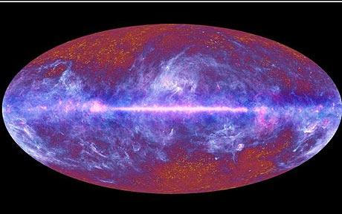
Physicalism
“Everything is physical”: explanatory gap.
Can physicalism be expanded to accommodate consciousness?
Why is it accompanied by experience? (Chalmers)
Forced into speculative ontology because of hard problem.
Source: esa.int

Slide 8

Physicalism = Physicalism + X
Add ingredient X to physicalism.
Physicalism should remain physicalism despite X.
Re-examine panpsychism and emergence in light of new physicalism.
It is accompanied by experience because X is always accompanied by experience.

Slide 9
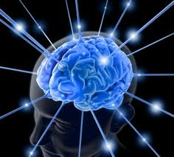
Orienting Intuition
Experience implies subject of experience – the experiencer (Frege).
Avoid doubling of problems:
  the problem of experience.
  the problem of subjects.
Subjects cannot be Cartesian – controversial.
Both panpsychism and emergence have difficulties related to combination of basic elements.

Slide 10

Clues: Problems in panpsychism and emergence
Panpsychism: Combination problem. How does phenomenology add up?
Emergence: Is there a level of complexity at which consciousness “pops out”?
Common problem: The many somehow become one.
Could compositionality be the missing ingredient X?

Slide 11
A fundamental compositionality
A counter-intuitive proposal.
Assertion: Physicalism + fundamental compositionality accompanied by experience.
Letter but not the spirit of panpsychism: fundamental but not pan.
Spirit but not the letter of emergence: non-reductive but fundamental.
New ingredient
X
Physicalism
Experience
Subjects
Compositionality

Slide 12
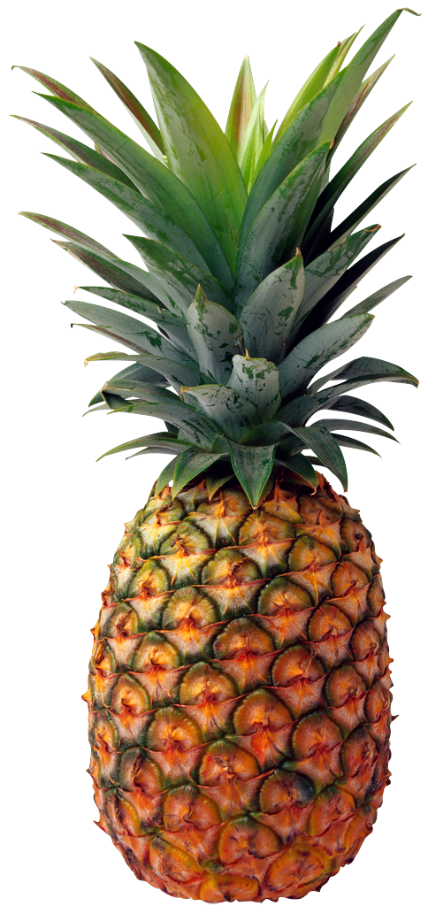



Compositionality and Experience
A composition is always accompanied by experience.
Structural counterpart to phenomenology.
Combinations not accompanied by experience.
Uniqueness of compositions related to ineffability of qualia?

Slide 13
Compositions versus Combinations
Fundamental composition of basic elements contrasted with combinations of basic elements.
Phenomenology
Chemistry
Combination
Fundamental Composition
Physics
Basic Elements
Basic Elements
Physics

Slide 14
Recap of new physicalism
Panpsychism >> combination problem.
Emergence >> complexity problem.
New physicalism with compositions.
Experience implies subjects of experience.
Subjects are
  (possibly unique) fundamental physical compositions.
  always accompanied by experience.
Compositions contrasted with combinations.
  the former is necessary for experience.

Slide 15
Summary
Everything is physical.
There is experience.
Experience cannot exist without subjects of experience.
Subjects are physical (compositions).
Denied by idealists.
Denied by eliminativists.
Denied by materialists?
Denied by dualists.

Slide 16
Related ideas and background
Chalmers: addition of experience to physicalist base.
Van Gulick: Varieties of emergence.
Rosenberg: receptivity, ingressions and causation.
Stoljar: Ignorance and physicalism.
Strawson: Realistic physicalism entails panpsychism.
Montero: Inscrutables and Russelian physicalism.

Slide 17
Discussion
Panpsychism with emergence used to solve the combination problem – conservative option.
Radical option: a fundamental compositionality contrasted with standard physical combinations.
Compositions always accompanied by experience: motivated by subjects of experience and inscrutables.
Spirit of emergence and the letter of panpsychism.

Slide 18
Thank You

Slide 19
Objections
New ingredient merely motivated by subjects of experience.
Freedom for adding compositions to physicalism not fleshed out.
Experience epiphenomenal due to causal closure?
What actually distinguishes compositions from combinations?

Slide 20
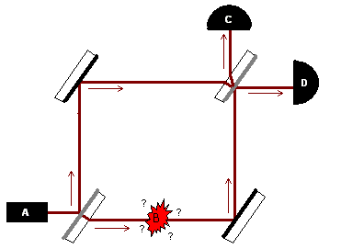
Do possibilities exist?
Elitzur-Vaidman bomb testing experiment
If bomb is a dud, only D detects photon
If only C detects the photon, bomb is not a dud
Destructive interference at C only because both possibilities exist

Slide 21
Physicalism: Trajectories vs. Possibilities
Trajectories
Possibilities
Evolution of particles and fields from the big bang
Phase space
No room for top down causation.
Natural laws constrain the set of possibilities in spacetime.
Configuration space
New “entities” can further reduce set of possibilities.

Slide 22
Compositions acting on possibilities
Current quantum field theories: evolution of scalar and vector fields in time.
Instead we envisage a basic physicalism with a restriction operator on set of possibilities.
Compositionality: further restriction on possibilities accompanied by experience.
Qualia: What it’s like to choose? Interior counterpart to choice.
Ontologically bold, hence almost surely wrong.

Slide 23
William James on combination problem
“Where the elemental units are supposed to be feelings, the case is in no wise altered. Take a hundred of them, shuffle them and pack them as close together as you can (whatever that might mean); still each remains the same feeling it always was, shut in its own skin, windowless, ignorant of what the other feelings are and mean. There would be a hundred-and-first feeling there, if, when a group or series of such feeling were set up, a consciousness belonging to the group as such should emerge” (James, 1890)

Slide 24
The Combination Problem
How does phenomenology add up?
  What about awareness of “mid-level subjects” [James 1890, Seager - JCS 2:3]?
  Intersubjective phenomenal content at mid-level?
Quantum coherence etc. suggested as objective criteria.
Ontology of subjects as a way out?
Notes:
Where the elemental units are supposed to be feelings, the case is in no wise altered. Take a hundred of them, shuffle them and pack them as close together as you can (whatever that might mean); still each remains the same feeling it always was, shut in its own skin, windowless, ignorant of what the other feelings are and mean. There would be a hundred-and-first feeling there, if, when a group or series of such feeling were set up, a consciousness belonging to the group as such should emerge

Slide 25
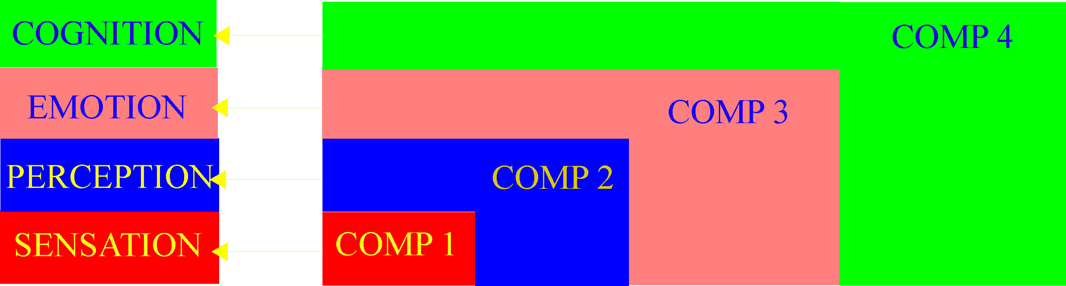
Nested Compositions
Fundamental compositions formulated from intuition regarding subjects.
Qualia correlate with compositions.
Nested compositions provide structure for qualia.

